Slide 1
CS406: Compilers
Spring 2020
Week 3: Scanners

Slide 2
Scanner
Also called lexers, lexical analyzers
Recall: scanners break input stream up into a set of tokens
  Identiﬁers, reserved words, literals, etc.
\tif (a<4) {\n\t\tb=5\n\t}
if
(
ID(a)
OP(<)
LIT(4)
)
{
ID(b)
=
LIT(5)
}

Slide 3
Scanner - overview
Divide the program text into substrings or lexemes
  place dividers
Identify the class of the substring identified
  Examples: Identiﬁers, keywords, operators, etc.
    Identifier – strings of letters or digits starting with a letter
    Integer – non-empty string of digits
    Keyword – “if”, “else”, “for” etc.
    Blankspace - \t, \n, ‘ ‘
    Operator – (, ), <, =, etc.
Substrings follow some pattern

Slide 4
Exercise
What is the English language analogy for class?
How many tokens of class identifier exist in the code below?
for(int i=0;i<10;i++){\n\tprintf(“hello”);\n}

Slide 5
Scanner Output
A token corresponding to each lexeme
  Token is a pair: <class, value>
A string / lexeme / substring of program text
Program
Scanner
tokens
Parser

Slide 6
Scanners – interesting examples
Fortran (white spaces are ignored)
DO 5 I = 1,25
DO 5 I = 1.25
PL/1
  DECLARE (ARG1, ARG2, . . .
C++
  Nested template: Quad<Square<Box>> b;
  Stream input: std::cin >> bx;
We always need to look ahead to identify tokens

Slide 7
Scanners – what do we need to know?
How do we define tokens?
  Regular expressions
How do we recognize tokens?
  build code to find a lexeme that is a prefix and that belongs to one of the patterns.
How do we write lexers?
  E.g. use a lexer generator tool such as Flex

Slide 8
Regular Expressions
Regular sets:
  Formal: a language that can be defined by regular expressions
  Informal: a set of strings deﬁned by regular expressions
  Strings are regular sets (with one element): pi 3.14159
    So is the empty string: λ (ɛ instead)
  Concatenations of regular sets are regular: pi3.14159
    To avoid ambiguity, can use ( ) to group regexps together
  A choice between two regular sets is regular, using |: (pi|3.14159)
  0 or more of a regular set is regular, using *: (pi)*
  Some other notation used for convenience:
    Use Not to accept all strings except those in a regular set
    Use ? to make a string optional: x? equivalent to (x|λ)
    Use + to mean 1 or more strings from a set: x+ equivalent to xx*
    Use [ ] to present a range of choices: [1-3] equivalent to (1|2|3)

Slide 9
Examples of Regular Expressions
Digit: D = [0-9]
Letter: L = [A-Za-z]
Literals (integers or ﬂoats): -?D+(.D*)?
Identiﬁers: (_|L)(_|L|D)*
Comments (as in Micro): -- Not(\n)*\n
More complex comments (delimited by ##, can use # inside comment): ##((#|λ)Not(#))*##

Slide 10
Scanner Generators
Essentially, tools for converting regular expressions into scanners
Lex (Flex) generates C/C++ scanners

Slide 11
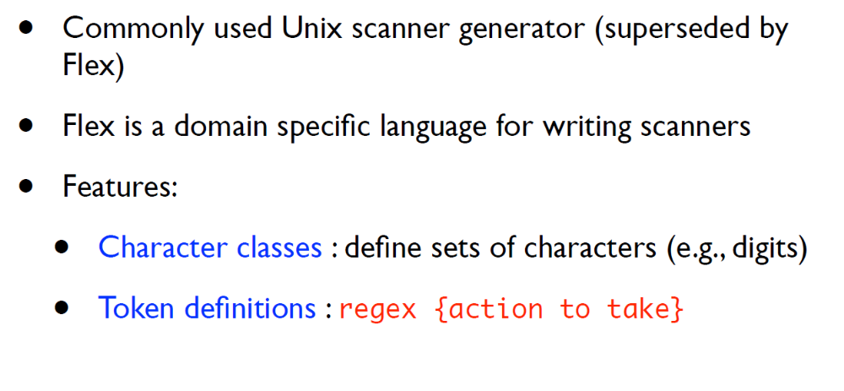
Lex (Flex)

Slide 12
Lex (Flex)
lex.l
Lexer Compiler
lex.yy.c
lex.yy.c
C Compiler
a.out
input stream
a.out
tokens

Slide 13
Lex (Flex)
Format of lex.l
      Declarations
      %%
      Translation rules
      %%
      Auxiliary functions

Slide 14
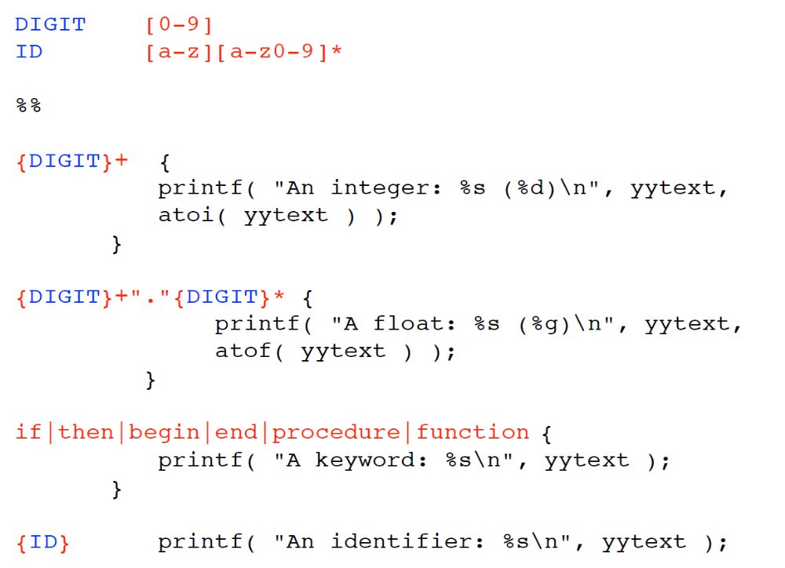
Lex (Flex)

Slide 15
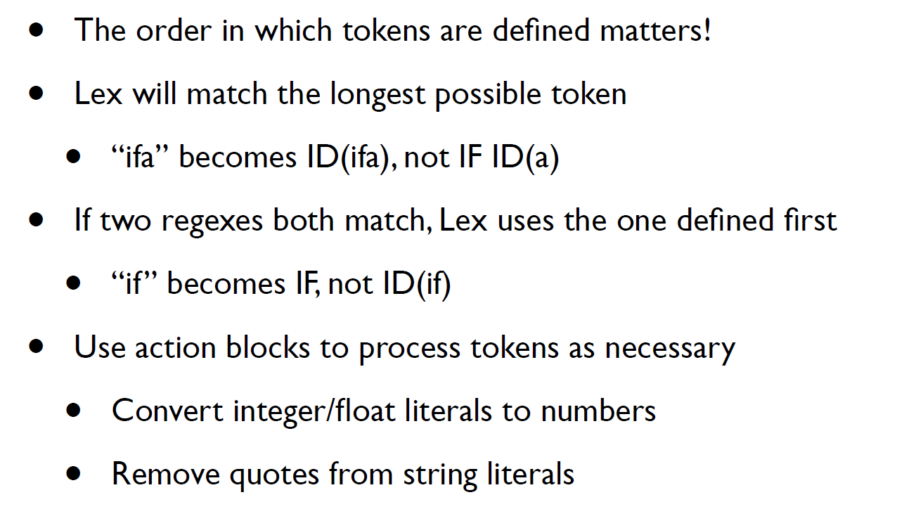
Lex (Flex)

