Slide 1
CS406: Compilers
Spring 2020
Week1: Overview, Structure of a compiler

Slide 2
Intro to Compilers
Way to implement programming languages
    Programming languages are notations for specifying computations to machines
    Target can be an assembly code, executable, another source program etc.
Compiler
Compiler
Program
Program
Target
Target

Slide 3
What is a Compiler?
Traditionally: Program that analyzes and translates from a high level language (e.g. C++) to low-level assembly language that can be executed by the hardware
var a
var b
mov 3 a
mov 4 r1
cmpi a r1
jge l_e
mov 2 b
jmp l_d
l_e:mov 3 b
l_d:;done
var a
var b
mov 3 a
mov 4 r1
cmpi a r1
jge l_e
mov 2 b
jmp l_d
l_e:mov 3 b
l_d:;done
var a
var b
mov 3 a
mov 4 r1
cmpi a r1
jge l_e
mov 2 b
jmp l_d
l_e:mov 3 b
l_d:;done
var a
var b
mov 3 a
mov 4 r1
cmpi a r1
jge l_e
mov 2 b
jmp l_d
l_e:mov 3 b
l_d:;done
int a, b;
a = 3;
if (a < 4) {
b = 2;
} else {
b = 3;
}
int a, b;
a = 3;
if (a < 4) {
b = 2;
} else {
b = 3;
}
int a, b;
a = 3;
if (a < 4) {
b = 2;
} else {
b = 3;
}
int a, b;
a = 3;
if (a < 4) {
b = 2;
} else {
b = 3;
}
int a, b;
a = 3;
if (a < 4) {
b = 2;
} else {
b = 3;
}

Slide 4
Compilers are translators
Fortran
C
C++
Java
Text processing language
HTML/XML
Command & Scripting Languages
Natural Language
Domain Specific Language
Machine code
Virtual machine code
Transformed source code
Augmented source code
Low-level commands
Semantic components
Another language
translate

Slide 5
Compilers are optimizers
Can perform optimizations to make a program more efficient
var a
var b
var c
mov a r1
addi 3 r1
mov r1 b
mov a r2
addi 3 r2
mov r2 c
var a
var b
var c
mov a r1
addi 3 r1
mov r1 b
mov r1 c
int a, b, c;
b = a + 3;
c = a + 3;

Slide 6
Why do we need compilers?
Compilers provide portability
Old days: whenever a new machine was built, programs had to be rewritten to support new instruction sets
IBM System/360 (1964): Common Instruction Set Architecture (ISA) --- programs could be run on any machine which supported ISA
  Common ISA is a huge deal (note continued existence of x86)
But still a problem: when new ISA is introduced (EPIC) or new extensions added (x86-64), programs would have to be rewritten
Compilers bridge this gap: write new compiler for an ISA, and then simply recompile programs!

Slide 7
Why do we need compilers?
Compilers enable high-performance and productivity
Old: programmers wrote in assembly language, architectures were simple (no pipelines, caches, etc.)
  Close match between programs and machines --- easier to achieve performance
New: programmers write in high level languages (Ruby, Python), architectures are complex (superscalar, out-of-order execution, multicore)
Compilers are needed to bridge this semantic gap
  Compilers let programmers write in high level languages and still get good performance on complex architectures

Slide 8
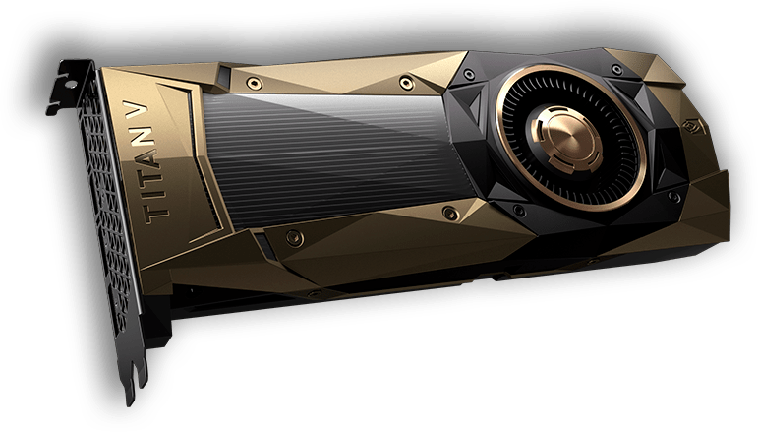
Semantic Gap
Python code that actually runs on GPU
import pycuda
import pycuda.autoinit from pycuda.tools import make_default_context
c = make_default_context()
d = c.get_device()
……
Impossible without Compilers
source: nvidia.com

Slide 9


Some common compiler types
High level language assembly language (e.g. gcc)
High level language machine independent bytecode (e.g. javac)
Bytecode native machine code (e.g. java’s JIT compiler)
High level language High level language (e.g. domain specific languages, many research languages)

Slide 10
HLL to Assembly
Program
Compiler
Assembly
Assembler
Machine code
Compiler converts program to assembly
Assembler is machine-specific translator which converts assembly to machine code
  add $7 $8 $9 ($7 = $8 + $9 ) => 000000 00111 01000 01001 00000 100000
Conversion is usually one-to-one with some exceptions
  Program locations
  Variable names

Slide 11
HLL to Bytecode to Assembly
Program
Compiler
Bytecode
JIT Compiler
Machine code
Compiler converts program into machine independent bytecode
  e.g. javac generates Java bytecode, C# compiler generates CIL
Just-in-time compiler compiles code while program executes to produce machine code
  Is this better or worse than a compiler which generates machine code directly from the program?

Slide 12
HLL to Bytecode
Program
Compiler
Bytecode
Interpreter
Execute!
Compiler converts program into machine independent bytecode
  e.g. javac generates Java bytecode, C# compiler generates CIL
Interpreter then executes bytecode “on-the-fly”
Bytecode instructions are “executed” by invoking methods of the interpreter, rather than directly executing on the machine
Aside: what are the pros and cons of this approach?

Slide 13
Quick Detour: Interpreters
Alternate way to implement programming languages
Interpreter
Program
Output
Data
Data

Slide 14
Data
Compiler
Program
Target
Offline
Output
Interpreter
Program
Output
Data
Data
Online
these are the two types of language processing systems

Slide 15
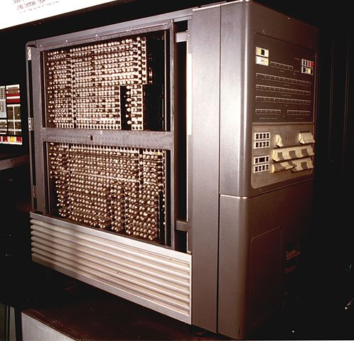
History
1954: IBM 704
  Huge success
  Could do complex math
  Software cost > Hardware cost
Source: IBM Italy, https://commons.wikimedia.org/w/index.php?curid=48929471
How can we improve the efficiency of creating software?

Slide 16
1953: Speedcoding
  High-level programming language by John Backus
  Early form of interpreters
  Greatly reduced programming effort
  About 10x-20x slower
  Consumed lot of memory (~300 bytes = about 30% RAM)
Notes:
Weather prediction, finite element analysis, computational chemistry, computational physics, computational fluid dynamics etc.
Benchmarking fastest supercomputers

Slide 17
Fortran I
1957: Fortran released
  Building the compiler took 3 years
  Very successful: by 1958, 50% of all software created was written in Fortran
Influenced the design of:
  high-level programming languages e.g. BASIC
  practical compilers
Today’s compilers still preserve the structure of Fortran I

Slide 18
Structure of a Compiler
Scanner / Lexical Analysis
Parser / Syntax Analysis
Semantic Actions
Optimizer
Code Generator

Slide 19
Scanner
A compiler starts by seeing only program text
Analogy: Humans processing English text
  Rama is a neighbor.
if ( a < 4) {
b = 5
}

Slide 20
Scanner
A compiler starts by seeing only program text
‘i’ ‘f’ ‘ ’ ‘(’ ‘a’ ‘<’ ‘4’ ‘)’
‘ ’ ‘{’ ‘\n’ ‘\t’ ‘b’ ‘=’ ‘5’
‘\n’ ‘}’

Slide 21
Scanner
A compiler starts by seeing only program text
Scanner converts program text into string of tokens
Analogy: Humans processing English text
  recognize words
    Rama, is, a, neighbor
    Additional details such as punctuations, capitalizations, blankspaces etc.
‘i’ ‘f’ ‘ ’ ‘(’ ‘a’ ‘<’ ‘4’ ‘)’
‘ ’ ‘{’ ‘\n’ ‘\t’ ‘b’ ‘=’ ‘5’
‘\n’ ‘}’

Slide 22
Scanner
A compiler starts by seeing only program text
Scanner converts program text into string of tokens
But we still don’t know what the syntactic structure of the program is
if
(
ID(a)
OP(<)
LIT(4)
)
{
ID(b)
=
LIT(5)
}

Slide 23
Exercise
Convert the following program text into tokens:
  pos = initPos + speed * 60

Slide 24
Parser
Converts a string of tokens into parse tree or abstract syntax tree
Captures syntactic structure of the code (i.e. “this is an if statement, with a then-block”
Analogy: understand the English sentence structure
  Rama is a good neighbor
if
(
ID(a)
OP(<)
LIT(4)
)
{
ID(b)
=
LIT(5)
}

Slide 25
Parser
Converts a string of tokens into parse tree or abstract syntax tree
Captures syntactic structure of the code (i.e. “this is an if statement, with a then-block”
a
lhs
<
cond-expr
rhs
4
if-stmt
b
b
then-clause
lhs
stmt_list
assign_stmt
rhs
5
5

Slide 26
Parser - Analogy
Diagramming English sentences
Rama is a good neighbor
Noun Verb Article Adjective Noun
Subject
Object
Sentence

Slide 27
Exercise
Draw the syntax tree for the following program stmt:
pos = initPos + speed * 60

Slide 28
Semantic Actions
Interpret the semantics of syntactic constructs
Refer to actions taken by the compiler based on the semantics of program statements.
Up until now, we have looked at syntax of a program
  what is the difference?

Slide 29
Syntax vs. Semantics
Syntax: “grammatical” structure of language
  What symbols, in what order, is a legal part of the language?
    But something that is syntactically correct may mean nothing!
    “colorless green ideas sleep furiously”
Semantics: meaning of language
  What does a particular set of symbols, in a particular order mean?
    What does it mean to be an if statement?
    “evaluate the conditional, if the conditional is true, execute the then clause, otherwise execute the else clause”

Slide 30
Semantic Actions - What
What actions are taken by compiler based on the semantics of program statements ?
    Examples:
    - bind variables to their scopes
    - check for type inconsistencies
Analogy:
  - Raj said Raj has a big heart
  - Raj left her home in the evening

Slide 31
Semantic Actions - How
What actions are taken by compiler based on the semantics of program statements ?
  Building a symbol table
  Generating intermediate representations

Slide 32
Symbol Tables
A list of every declaration in the program, along with other information
  Variable declarations: types, scope
  Function declarations: return types, # and type of arguments
Program Example
Integer ii;
…
ii = 3.5;
…
print ii;
Symbol Table
Name Type Scope
ii int global
…

Slide 33
Intermediate Representation
Also called IR
A (relatively) low level representation of the program
  But not machine-specific!
One example: three address code
bge a, 4, done
mov 5, b
done: //done!
Each instruction can take at most three operands (variables, literals, or labels)
  Note: no registers!

Slide 34
Exercise
Explain the semantics of the following program stmt:
pos = initPos + speed * 60

Slide 35
A Note on Semantics
How do you define semantics?
  Static semantics: properties of programs
    All variables must have type
    Expressions must use consistent types
    Can define using attribute grammars
  Execution semantics: how does a program execute?
    Defined through operational or denotational semantics
    Beyond the scope of this course!
  For many languages, “the compiler is the specification”

Slide 36
Optimizer
Transforms code to make it more efficient
Different kinds, operating at different levels
  High-level optimizations
    Loop interchange, parallelization
    Operates at level of AST, or even source code
  Scalar optimizations
    Dead code elimination, common sub-expression elimination
    Operates on IR
  Local optimizations
    Strength reduction, constant folding
    Operates on small sequences of instructions

Slide 37
Optimizer - Analogy
Analogy: reducing word usage
Sunny felt a sense of having experienced it before when his bike broke down.
Exercise: is this rule correct?
X = Y * 0 is the same as X = 0
Dejavu

Slide 38
Code Generation
Generate assembly from intermediate representation
  Select which instruction to use
  Select which register to use
  Schedule instructions
ld a, r1
mov 4, r2
cmp r1, r2
bge done
mov 5, r3
st r3, b
done:
bge a, 4 done
mov 5, b
done: //done

Slide 39
Code Generation
Generate assembly from intermediate representation
  Select which instruction to use
  Select which register to use
  Schedule instructions
mov 4, r1
ld a, r2
cmp r1, r2
blt done
mov 5, r1
st r1, b
done:
bge a, 4 done
mov 5, b
done: //done

Slide 40
Structure of a Compiler
Source code
Scanner / Lexical Analysis
Use regular expressions to define tokens. Can then use scanner generators such as lex or flex.
Tokens
Parser / Syntax Analysis
Define language using context free grammars. Can then use parser generators such as yacc or bison.
Syntax Tree
Semantic routines done by hand. But can be formalized.
Semantic Actions
IR
Optimizer
Written manually. Automation is an active research area (e.g. dataflow analysis frameworks)
IR
Code Generator
Written manually.
Executable
Notes:
Is this organization of compiler’s passes/steps/phases correct? What do you think?

Slide 41
Structure of a Compiler
Source code
Scanner / Lexical Analysis
Use regular expressions to define tokens. Can then use scanner generators such as lex or flex.
Tokens
Many of these passes can be combined
Parser / Syntax Analysis
Define language using context free grammars. Can then use parser generators such as yacc or bison.
Syntax Tree
Semantic routines done by hand. But can be formalized.
Semantic Actions
IR
Optimizer
Written manually. Automation is an active research area (e.g. dataflow analysis frameworks)
IR
Code Generator
Written manually.
Executable

Slide 42
Front-end vs. Back-end
Source code
Scanner + Parser + Semantic actions + (high level) optimizations called the front-end of a compiler
Scanner / Lexical Analysis
Tokens
IR level optimizations and code generation (instruction selection, scheduling, register allocation) called the back-end of a compiler
front-end /
analysis
Parser / Syntax Analysis
Syntax Tree
Can build multiple front-ends for a particular back-end
  e.g. gcc or g++ or many front-ends which generate CIL
Semantic Actions
IR
Optimizer
back-end /
synthesis
Can build multiple back-ends for a particular front-end
  gcc allows targeting different architectures
IR
Code Generator
Executable

Slide 43
Programming Language Design Considerations
Why are there so many programming languages?
Why are there new languages?
What is a good programming language?

Slide 44
Compiler and language designs influence each other
  Higher level languages are harder to compile
    More work to bridge the gap between language and assembly
  Flexible languages are often harder to compile
    Dynamic typing (Ruby, Python) makes a language very flexible, but it is hard for a compiler to catch errors (in fact, many simply won’t)
  Influenced by architectures
    RISC vs. CISC

Slide 45
Suggested Reading
Alfred V. Aho, Monica S. Lam, Ravi Sethi and Jeﬀrey D.Ullman: Compilers: Principles, Techniques, and Tools, 2/E, AddisonWesley 2007
  Chapter 1 (Sections: 1.1 to 1.3, 1.5)
Fisher and LeBlanc: Crafting a Compiler with C
  Chapter 1 (Sections 1.1 to 1.3, 1.5)

