Slide 1
CS406: Compilers
Spring 2020
Week 3: Scanners

Slide 2
Scanner - Overview
Also called lexers, lexical analyzers
Recall: scanners break input stream up into a set of tokens
  Identiﬁers, reserved words, literals, etc.
\tif (a<4) {\n\t\tb=5\n\t}
if
(
ID(a)
OP(<)
LIT(4)
)
{
ID(b)
=
LIT(5)
}

Slide 3
Scanner - Overview
Divide the program text into substrings or lexemes
  place dividers
Identify the class of the substring identified
  Examples: Identiﬁers, keywords, operators, etc.
    Identifier – strings of letters or digits starting with a letter
    Integer – non-empty string of digits
    Keyword – “if”, “else”, “for” etc.
    Blankspace - \t, \n, ‘ ‘
    Operator – (, ), <, =, etc.
Substrings follow some pattern

Slide 4
Exercise
What is the English language analogy for class?
How many tokens of class identifier exist in the code below?
for(int i=0;i<10;i++){\n\tprintf(“hello”);\n}

Slide 5
Scanner Output
A token corresponding to each lexeme
  Token is a pair: <class, value>
A string / lexeme / substring of program text
Program
Scanner
tokens
Parser

Slide 6
Scanners – interesting examples
Fortran (white spaces are ignored)
DO 5 I = 1,25
DO 5 I = 1.25
PL/1
  DECLARE (ARG1, ARG2, . . .
C++
  Nested template: Quad<Square<Box>> b;
  Stream input: std::cin >> bx;
We always need to look ahead to identify tokens

Slide 7
Scanners – what do we need to know?
How do we define tokens?
  Regular expressions
How do we recognize tokens?
  build code to find a lexeme that is a prefix and that belongs to one of the patterns.
How do we write lexers?
  E.g. use a lexer generator tool such as Flex

Slide 8
Regular Expressions
Regular sets:
  Formal: a language that can be defined by regular expressions
  Informal: a set of strings deﬁned by regular expressions
  Strings are regular sets (with one element): pi 3.14159
    So is the empty string: λ (ɛ instead)
  Concatenations of regular sets are regular: pi3.14159
    To avoid ambiguity, can use ( ) to group regexps together
  A choice between two regular sets is regular, using |: (pi|3.14159)
  0 or more of a regular set is regular, using *: (pi)*
  Some other notation used for convenience:
    Use Not to accept all strings except those in a regular set
    Use ? to make a string optional: x? equivalent to (x|λ)
    Use + to mean 1 or more strings from a set: x+ equivalent to xx*
    Use [ ] to present a range of choices: [1-3] equivalent to (1|2|3)

Slide 9
Examples of Regular Expressions
Digit: D = [0-9]
Letter: L = [A-Za-z]
Literals (integers or ﬂoats): -?D+(.D*)?
Identiﬁers: (_|L)(_|L|D)*
Comments (as in Micro): -- Not(\n)*\n
More complex comments (delimited by ##, can use # inside comment): ##((#|λ)Not(#))*##

Slide 10
Scanner Generators
Essentially, tools for converting regular expressions into scanners
Lex (Flex) generates C/C++ scanners

Slide 11
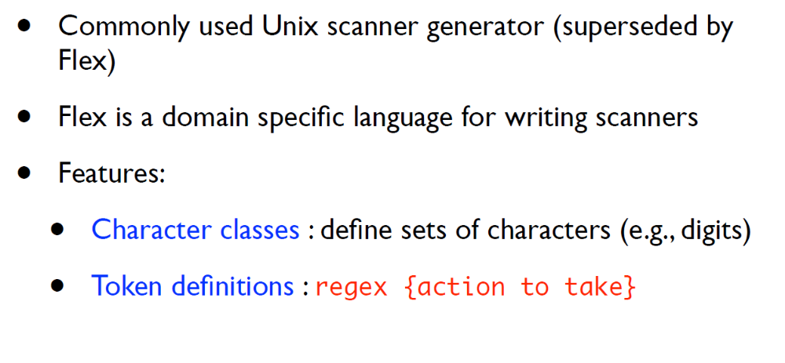
Lex (Flex)

Slide 12
Lex (Flex)
lex.l
Lexer Compiler
lex.yy.c
lex.yy.c
C Compiler
a.out
input stream
a.out
tokens

Slide 13
Lex (Flex)
Format of lex.l
      Declarations
      %%
      Translation rules
      %%
      Auxiliary functions

Slide 14
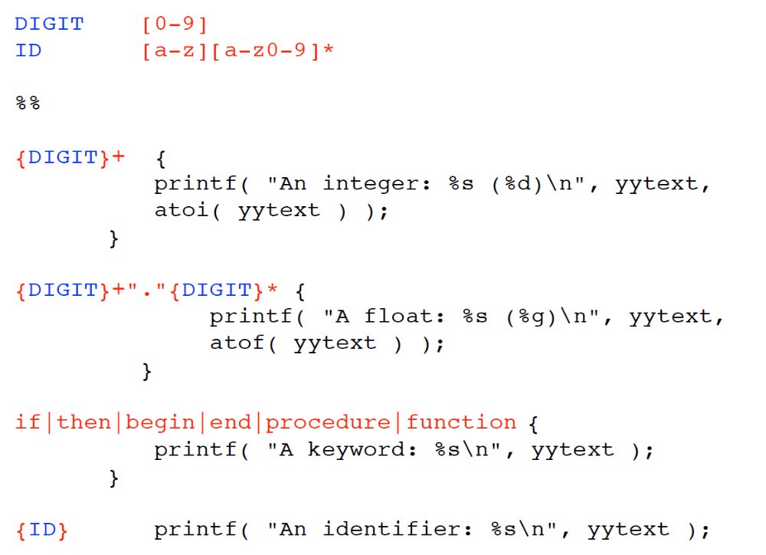
Lex (Flex)

Slide 15
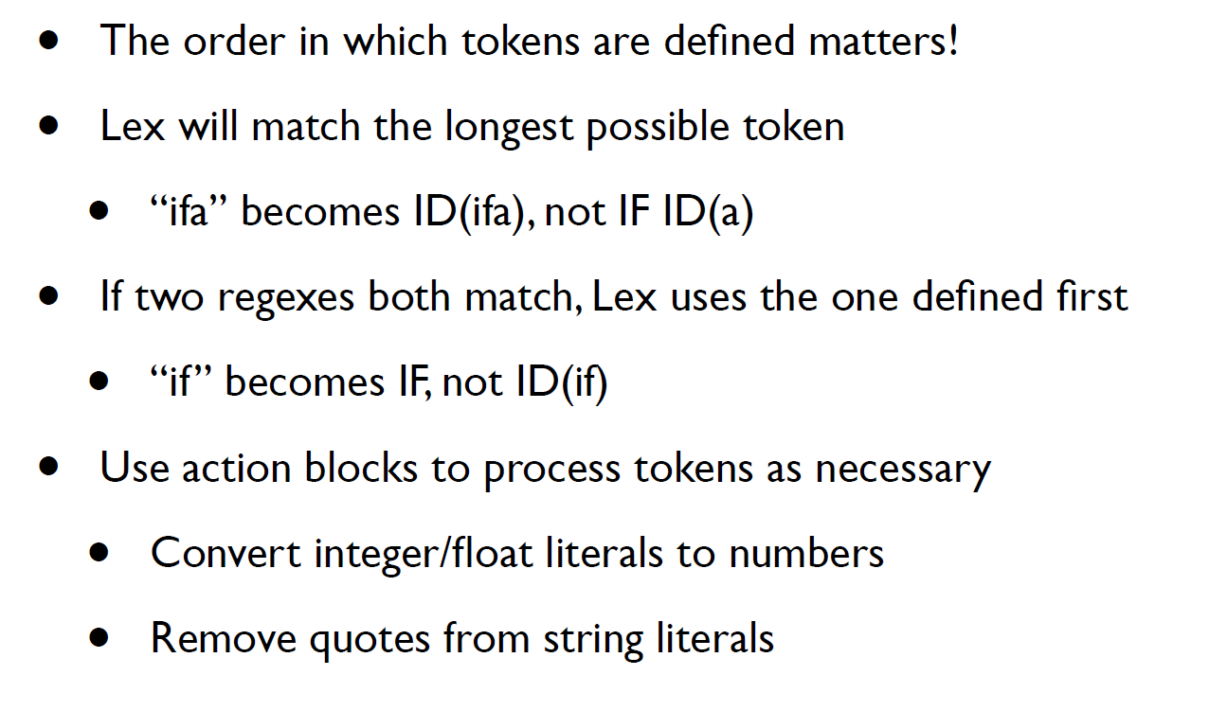
Lex (Flex)

Slide 16
Recap…
We saw what it takes to write a scanner:
  Specify how to identify token classes (using regexps)
  Convert the regexps to code that identifies a prefix of the input string as a lexeme matching one of the token classes
    Using tools for automatic code generation (e.g. Lex / Flex / ANTLR)
How do these tools convert regexps to code?
Enabling concept: Finite Automata

Slide 17
Finite Automata
Another way to describe sets of strings (just like regular expressions)
Also known as finite state machines / automata
Reads a string, either recognizes it or not
Features:
  State: initial, matching / final / accepting, non-matching
  Transition: a move from one state to another

Slide 18
Finite Automata
Regular expressions and FA are equivalent*
a
a
b
a
b
a
initial state
initial state
state
state
matching state
matching state
Exercise: what is the equivalent regular expression for this FA?
* Ignoring the empty regular language

Slide 19
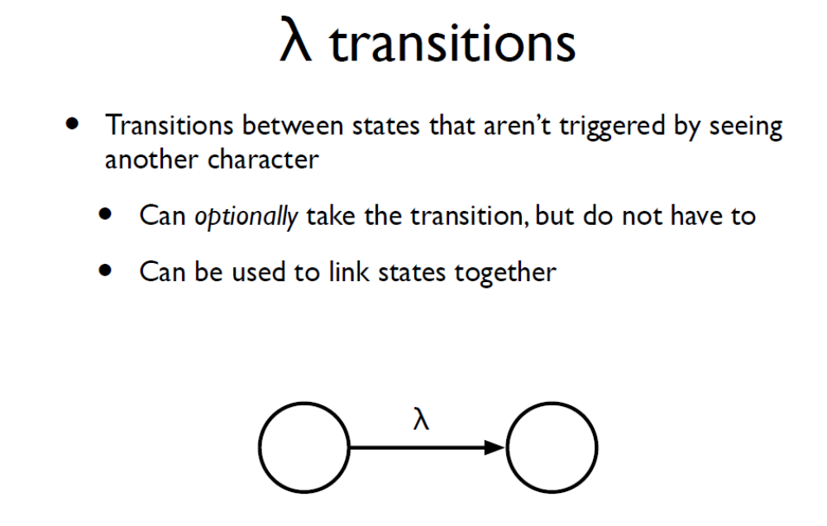
Think of this as an arrow to a state without a label

Slide 20
Non-deterministic Finite Automata
A FA is non-deterministic if, from one state reading a single character could result in transition to multiple states (or has λ transitions)
Sometimes regular expressions and NFAs have a close correspondence
a
b
b
a
≡
a(bb)+a

Slide 21
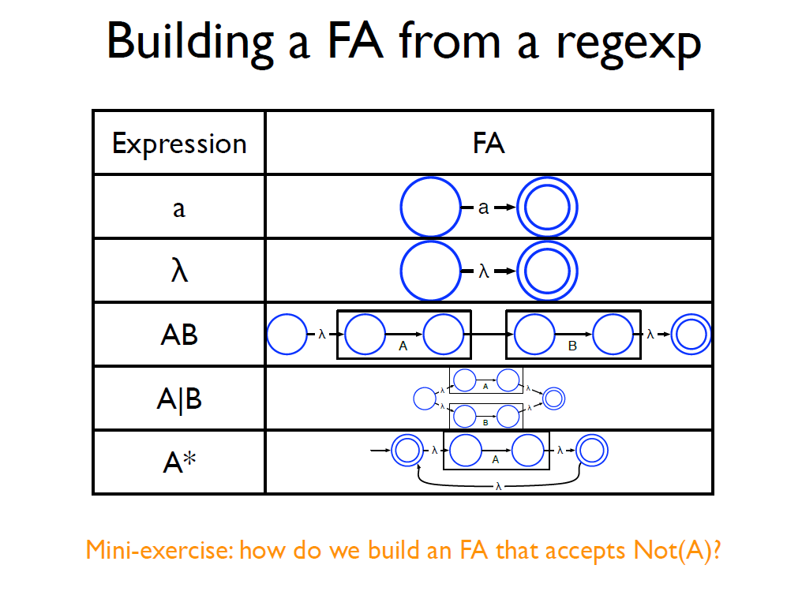
What about A? (? as in optional)

Slide 22

Non-deterministic Finite Automata
NFAs are concise but slow
Example:
  Running the NFA for input string abbb requires exploring all execution paths
* picture example taken from https://swtch.com/~rsc/regexp/regexp1.html

Slide 23
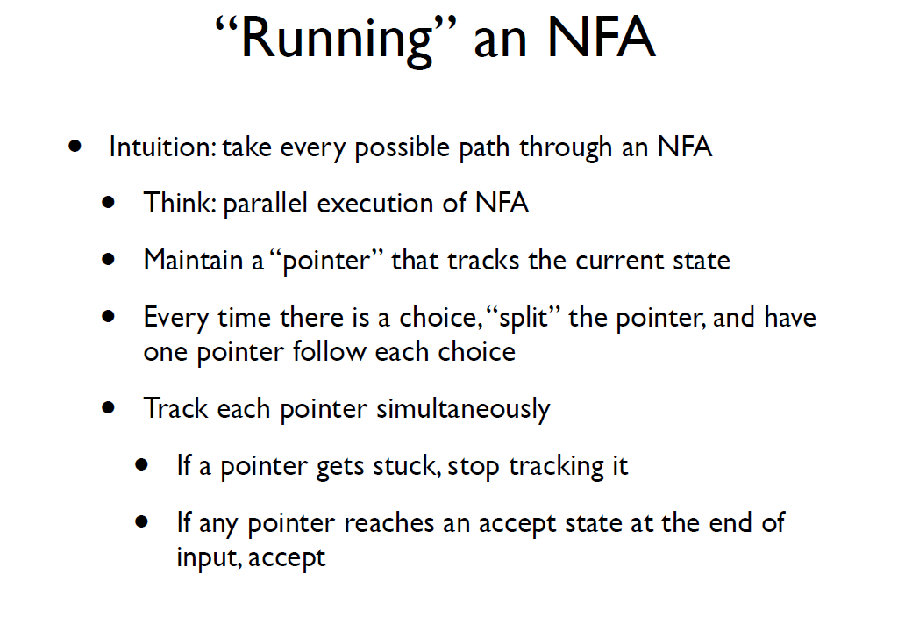

Slide 24
Non-deterministic Finite Automata
NFAs are concise but slow
Example:
  Running the NFA for input string abbb requires exploring all execution paths
  Optimization: run through the execution paths in parallel
    Complicated. Can we do better?
* picture example taken from https://swtch.com/~rsc/regexp/regexp1.html

Slide 25
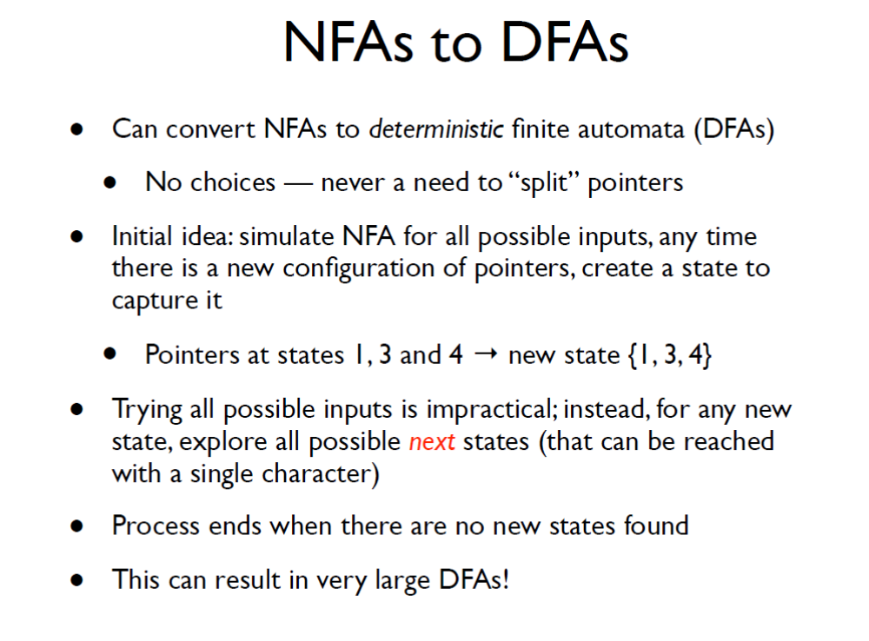
Each possible input character read leads to at most one new state

Slide 26
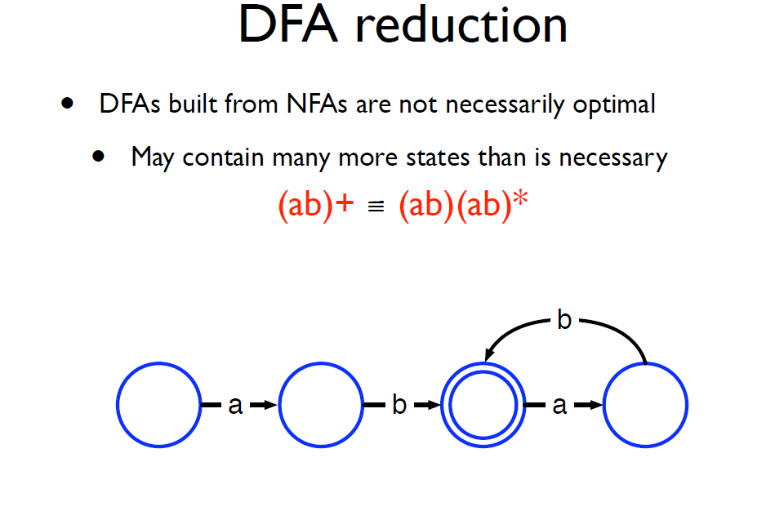

Slide 29
Example

Slide 30
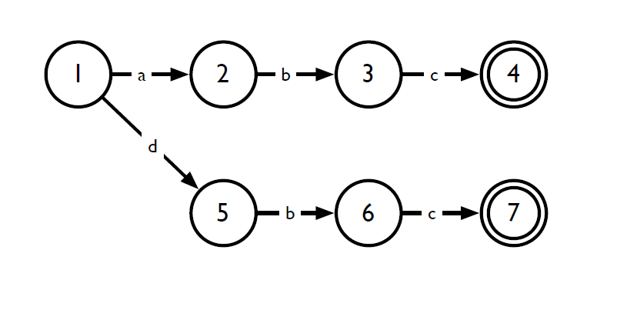
Exercise
Reduce the DFA

Slide 31
Scanner - flowchart
Lexical specification
Regular expressions
NFA
e.g. Identifiers are letter followed by any sequence of digits or letters
Implementation
Reduced DFA
DFA

Slide 32
Implementation: Transition Tables

Slide 33
DFA Program

Slide 37
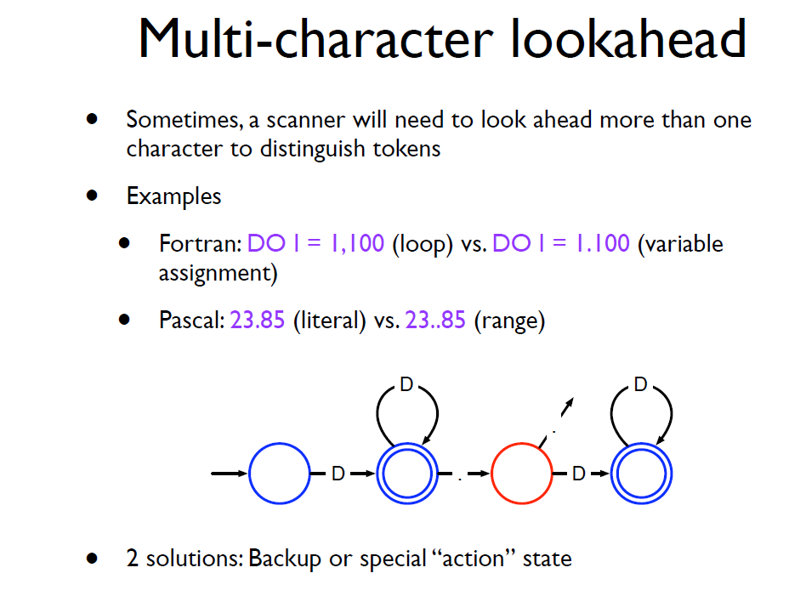

Slide 38
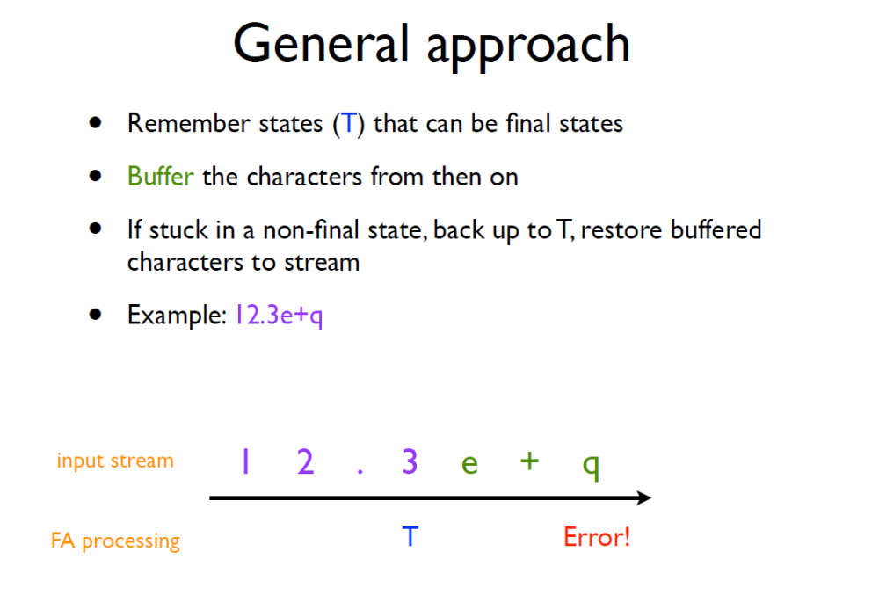

Slide 39
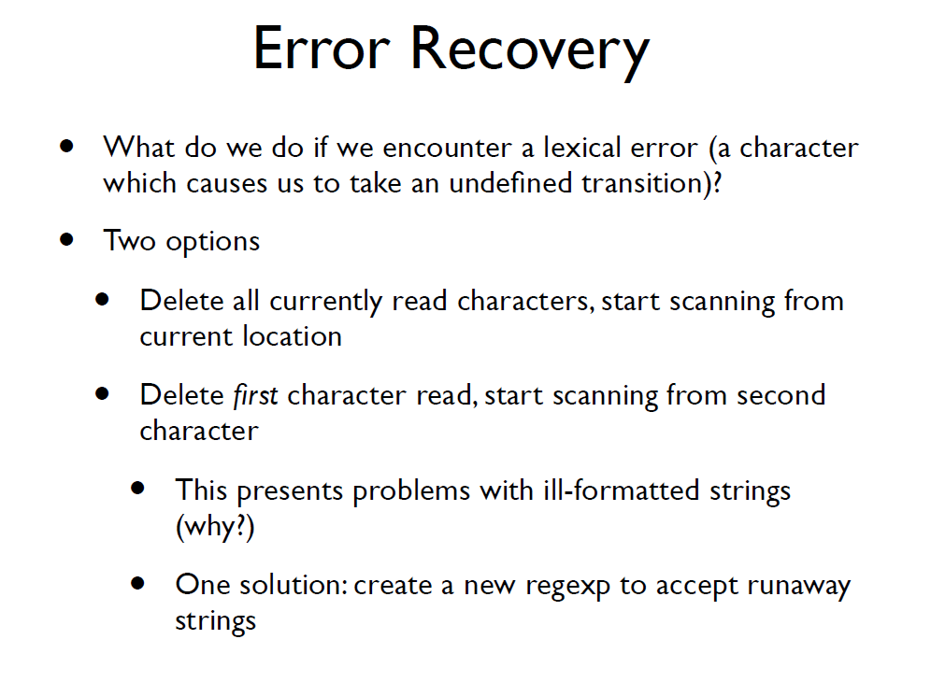

Slide 40
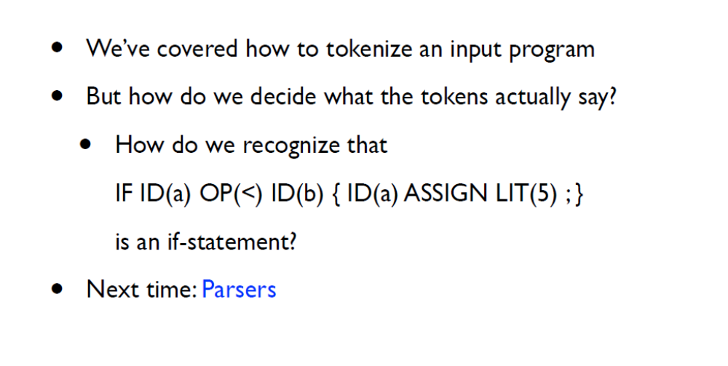
Next time

Slide 41
Suggested Reading
Alfred V. Aho, Monica S. Lam, Ravi Sethi and Jeﬀrey D.Ullman: Compilers: Principles, Techniques, and Tools, 2/E, AddisonWesley 2007
  Chapter 3 (Sections: 3.1, 3,3, 3.6 to 3.9)
Fisher and LeBlanc: Crafting a Compiler with C
  Chapter 3 (Sections 3.1 to 3.4, 3.6, 3.7)

