Slide 1
CS406: Compilers
Spring 2020
Week 4: Parsers

Slide 2
Parsers - Overview
Also called syntax analyzers
Determine two things:
  1. If a program is valid syntactically
  - Is an English sentence grammatically correct?
  2. Structure of programming language constructs
  - E.g. the sequence IF, ID(a), OP(<), ID(b), {, ID(a), ASSIGN, LIT(5), }, ;, } refers to if-statement ?
  - Diagramming English sentences

Slide 3
Parsers - Overview
Input: stream of tokens
Output: Parse tree
  sometimes implicit
if
(
ID(a)
OP(<)
LIT(4)
)
Stream of tokens:
{
ID(b)
=
LIT(5)
}
If-stmt
expr
{
stmt-list
}
Parse tree:
(
expr
)
assign-stmt
a
<
4
b
=
5

Slide 4
Parsers – what do we need to know?
How do we define language constructs?
  Context-free grammars
How do we determine: 1) valid strings in the language? 2) structure of program?
  LL Parsers, LR Parsers
How do we write Parsers?
  E.g. use a parser generator tool such as Bison

Slide 5
Languages
A language is (possibly infinite) set of strings
Regular expressions describe regular languages
weakness: can’t describe a string of the form:
{ (^{i} )^{i} | i>=1}
Parenthesized expressions:
((( int x; )))
IF
IF
IF
FI
IF
FI
Programming language syntax is i.e. recursive
Nested structures:

Slide 6
Trivia
Regular expressions can describe strings: { mod k | k = # states in FA}
1
1
“accept all strings having odd number of 1s”

Slide 7
Context Free Grammar (CFG)
Natural notation for describing recursive structure definitions. Hence, suitable for specifying language constructs.
Consist of:
  A set of Terminals
  A set of Non-terminals
  A Start Symbol
  A set of Productions

Slide 8
Context Free Grammar (CFG)
Terminology:
Terminals – T
Non-terminals – N
Start Symbol – S∈N
Productions – P (also called rules sometimes)
X Y₁Y₂Y₃..Y_{N} | X∈N, Y_{i}∈ N ⋃ T ⋃ ϵ/λ
Grammar G = (T, N, S, P)
E.g. G = ({a,b}, {S, A, B}, S, {S AB, A Aa
A a, B Bb, B b})
G is context free. Why?

Slide 9
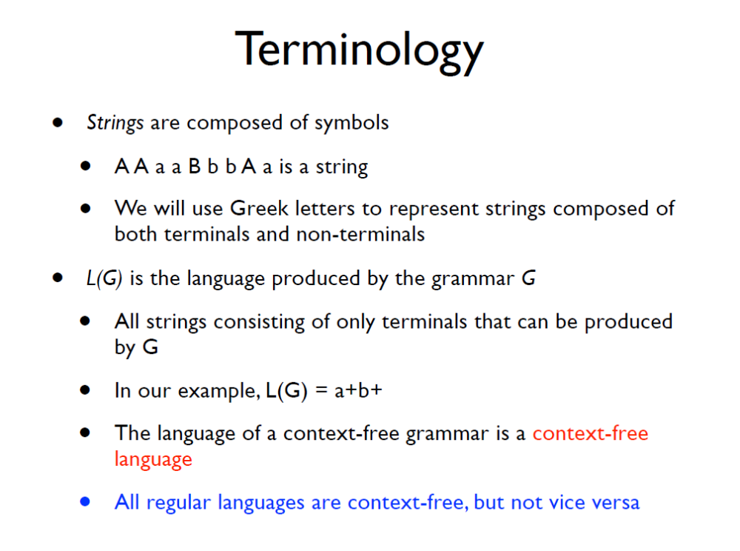

Slide 10
String Derivations
How do we apply the grammar rules repeatedly to determine the validity of a string? (i.e. string belongs to the language specified by the grammar)
  Always start with the Start Symbol
  Replace any Non-terminal X in the string by the right-hand side of the production
  Repeat Step 2 until there are no more non-terminals

Slide 12
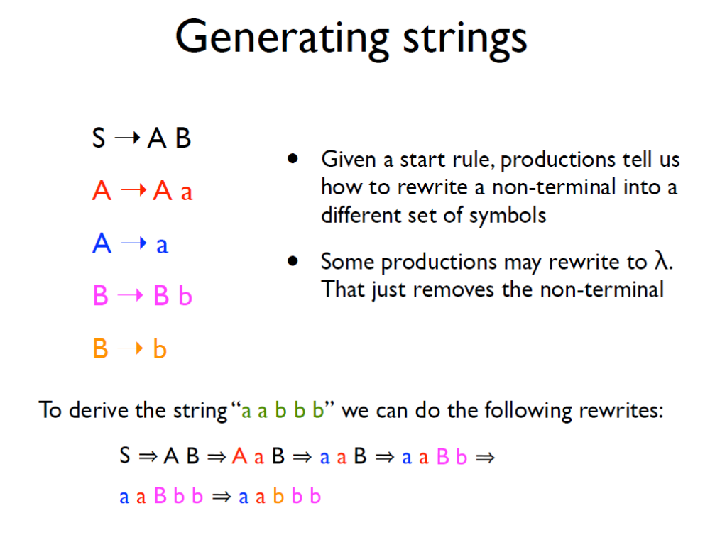

Slide 13
Exercise
Which of the below strings are accepted by the grammar:
A aAa
A bBb
A λ
B cA
B λ
abcba
abcbca
abba
abca

Slide 14
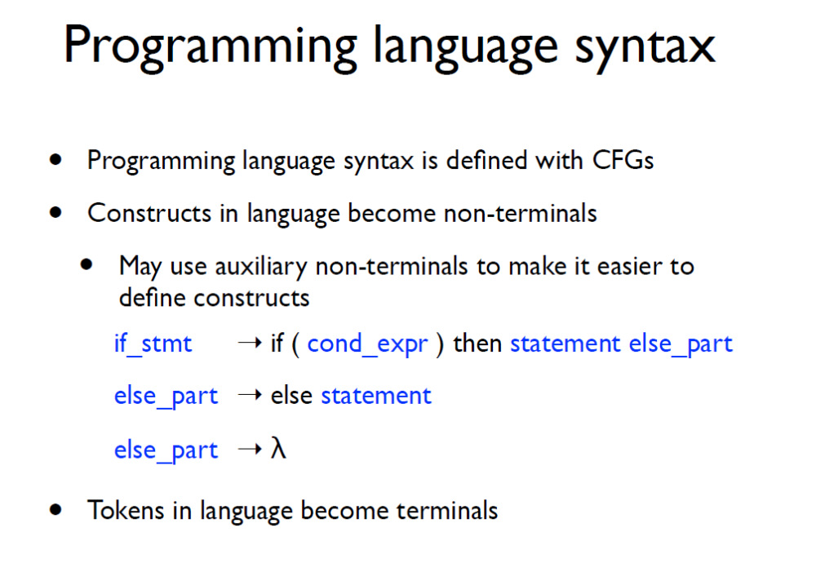

Slide 15
CFG Contd..
Is it enough if parsers answer “yes” or “no” to check if a string belongs to context-free language?
  Also need a parse tree
What if the answer is a “no”?
  Handle errors
How do we implement CFGs?
  E.g. Bison

Slide 16
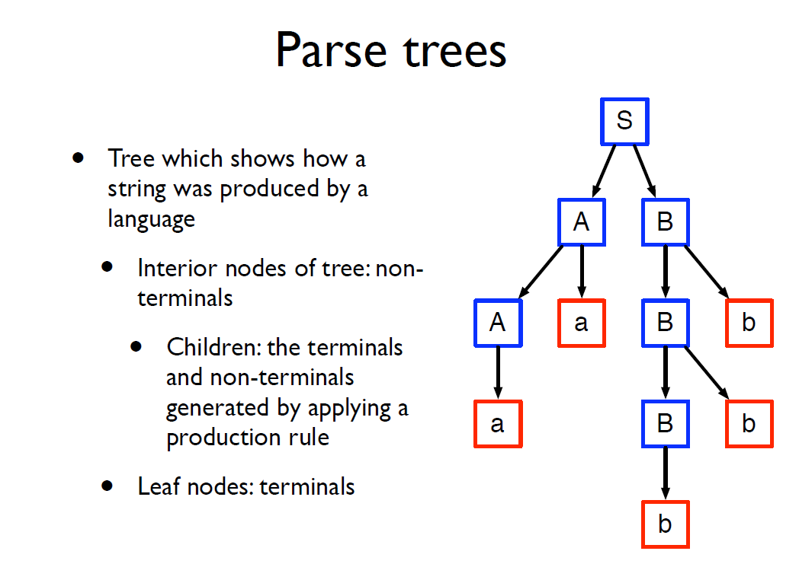

Slide 17
Parse Trees and String Derivations
Recall: sequence of rules applied to produce a string is a derivation
A derivation defines a parse tree
  A parse tree may have many derivations

Slide 18
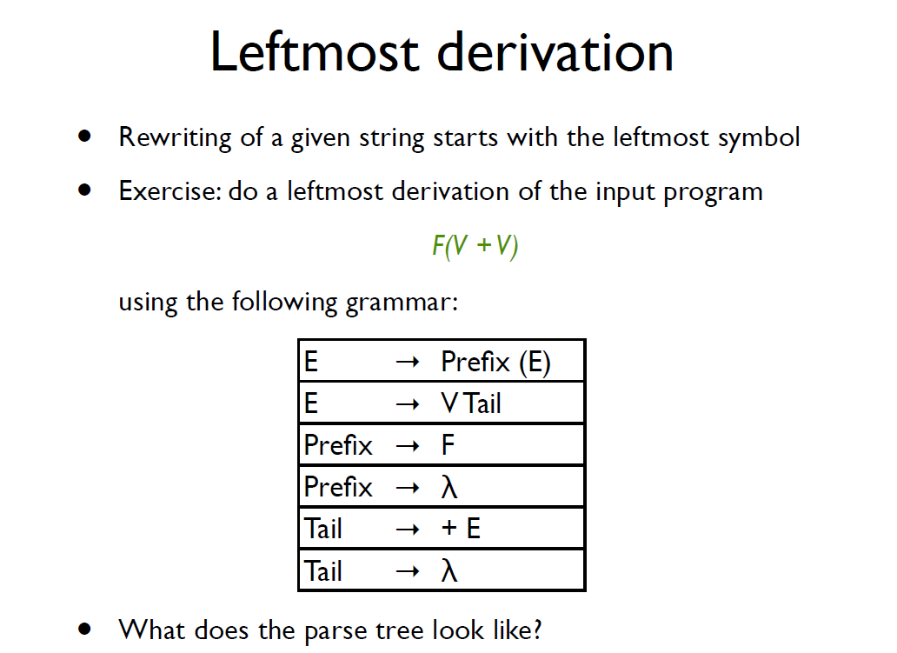

Slide 19
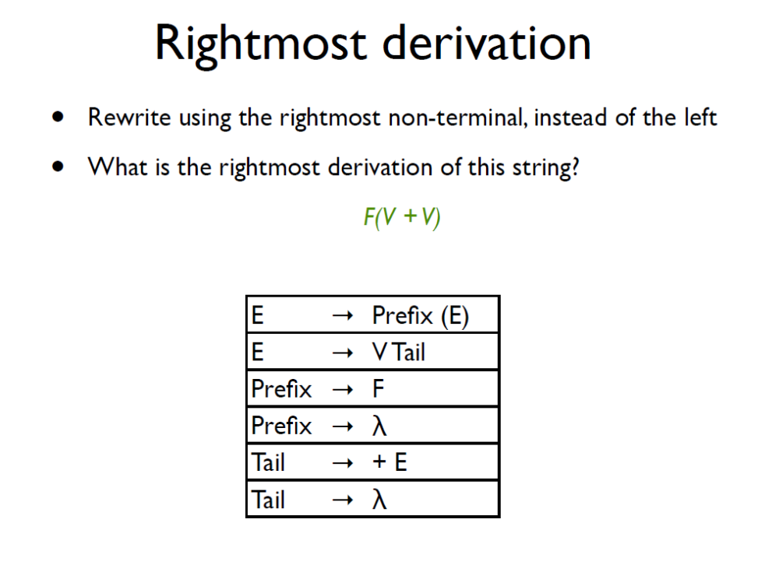

Slide 20
Ambiguity
Grammar that produces more than one parse tree for some string
E.g. E -> E + E | E * E | id
String: id+id*id
E
E
E->E*E
E->E+E*E
E->id+E*E
E->id+id*E
E->id+id*id
E->E+E
E->id+E
E->id+E*E
E->id+id*E
E->id+id*id
+
E
*
E
E
E
id
id
E
*
E
E
+
E
id
id
id
id

Slide 21
Ambiguity – what to do?
Ignore it
  Give hints to other components of the compiler on how to resolve it
Fix it
  Manually
  May make the grammar complicated and difficult to maintain

Slide 22
Ambiguity – ignore
E -> E + E | id
Associativity declaration in Bison:
  %left +
  Picks the parse tree on the right
E->E+E
E->id+E
E->id+E+E
E->id+id+E
E->id+id+id
Produces: id+(id+id)
E
E->E+E
E->E+E+E
E->id+E+E
E->id+id+E
E->id+id+id
Produces:
(id+id)+id
E
+
E
+
E
E
E
id
id
E
+
E
E
+
E
id
id
id
id

Slide 23
Ambiguity - ignore
E -> E + E | E * E | id
%left +
%left *
Tells that * has higher precedence over + and both are left associative. So we get the tree on left.
E
E
E->E*E
E->E+E*E
E->id+E*E
E->id+id*E
E->id+id*id
E->E+E
E->id+E
E->id+E*E
E->id+id*E
E->id+id*id
+
E
*
E
E
E
id
id
E
*
E
E
+
E
id
id
id
id

Slide 24
Ambiguity – fixing
Rewrite E -> E + E | E * E | id as
E -> E’ + E | E’
E’ -> id * E’ | id | (E) * E’ | (E)
E controls generation of +
E’ controls generation of *. *’s are nested deeper in the parse tree.
E
E->E’+E
E->id+E
E->id+E’
E->id+id*E’
E->id+id*id
E’
+
E
id
E’
id
*
E’
id

Slide 25
Ambiguity - fixing
stmt -> if expr then stmt |
if expr then stmt else stmt |
other
String: if E1 then if E2 then S1 else S2
Exercise: verify if the above grammar is ambiguous. If so, rewrite the grammar to make it unambiguous.
stmt -> matched | open
matched -> if expr then matched else matched |
other
open -> if expr then stmt |
if expr then matched else open

Slide 26
Error Handling
Objective: detect invalid programs and provide meaningful feedback to programmer
  Report errors accurately
  Recover from errors quickly
  Don’t slow down compilation

Slide 27
Error Types
Many types of errors:
  Lexical – use Size instead of size
  Syntactic – extra brace
  Semantic – float sqr; sqr(2);
  Logical – use = instead of ==

Slide 28
Error Handling - Types
Panic mode
Error production
Automatic local or global correction

Slide 29
Panic Mode Error Handling
Simplest, most popular
Discards tokens until one from a set of synchronizing tokens is found
Synchronizing tokens have a clear role
  e.g. semicolons, braces
E.g. i=i++j
policy: while parsing an expression, discard all tokens until an integer is found. This policy skips the additional +
Specifying policy in bison: error keyword
E -> E + E | (E) | id | error int | error

Slide 30
Error Productions
Anticipate common errors
  2x instead of 2 *
Augment the grammar
  E -> EE | …
Disadvantages:
  Complicates the grammar

Slide 31
Error Corrections
Rewrite the program – find a “nearby” correct program
  Local corrections – insert a semicolon, replace a comma with semicolon etc.
  Global corrections – modify the parse tree with “edit distance” metric in mind
Disadvantages?
  Implementation difficulty
  Slows down compilation
  Not sure if “nearby” program is intended

Slide 32
Top-down Parsing
Also called recursive-descent parsing
Equivalent to finding the left-derivation for an input string
  Recall: expand the leftmost non-terminal in a parse tree
  Expand the parse tree in pre-order i.e. identify parent nodes before children

Slide 33
Top-down Parsing
Step | Input string | Parse tree
1 | cad | s
2 | cad
3 | cad
4 | cad
Step | Input string | Parse tree
1 | cad | s
2 | cad
3 | cad
4 | cad
Step | Input string | Parse tree
1 | cad | s
2 | cad
3 | cad
4 | cad
S -> cAd
A -> ab | a
String: cad
We need to backtrack
after step 3 and reset
input pointer
S
S
S
c
c
c
d
d
: next symbol to be read
A
d
A
A
S
S
S
c
c
c
d
d
A
d
A
A
a
a
a
b
b
b
S
S
S
Can we do better ?
c
c
c
A
A
A
d
d
d
a
a
a

Slide 34
Top-down Parsing
 | ( | ) | a | + | $
S | 2 | - | 1 | - | -
F | - | - | 3 | - | -
  1) S -> F
  2) S -> (S + F)
  3) F -> a
  Table-driven (Parse Table) approach doesn’t require backtracking
string: (a+a)
string’: (a+a)$
Assume that the table is given.
But how do we construct such a table?

Slide 35
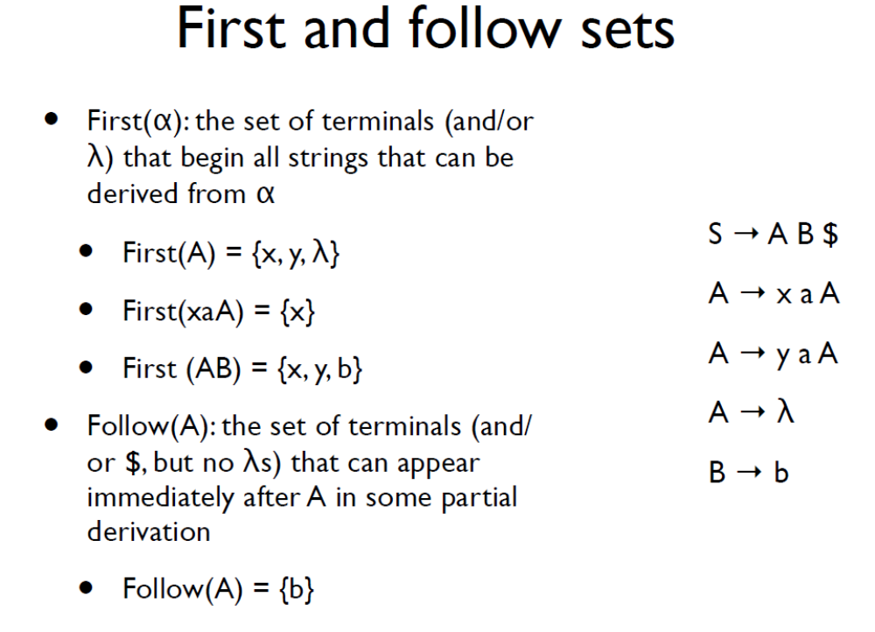

Slide 36
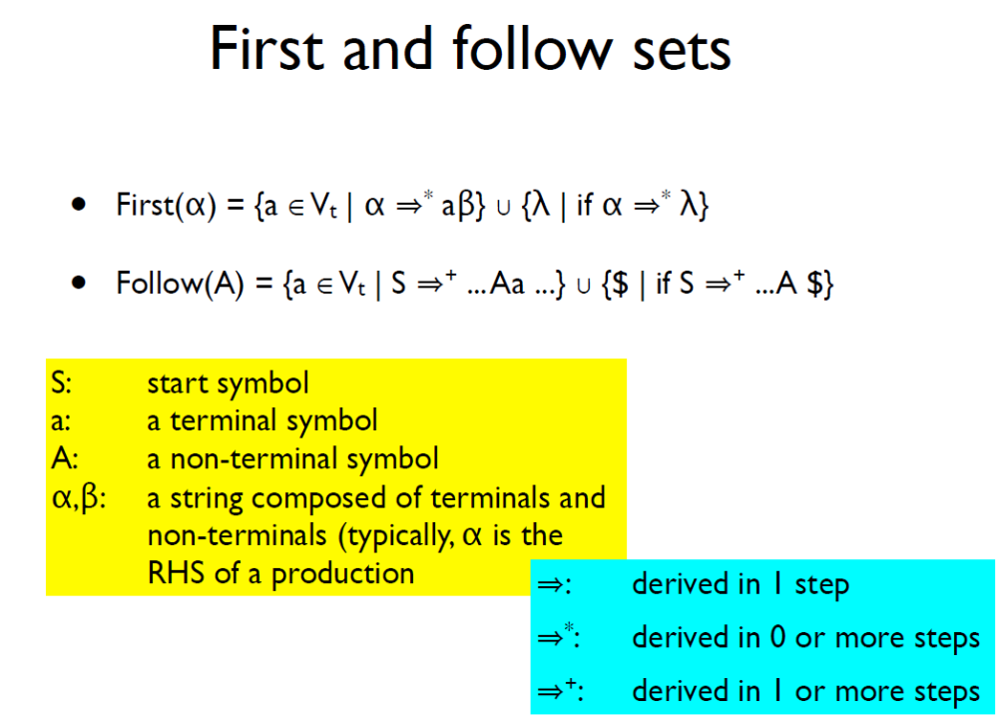

Slide 37
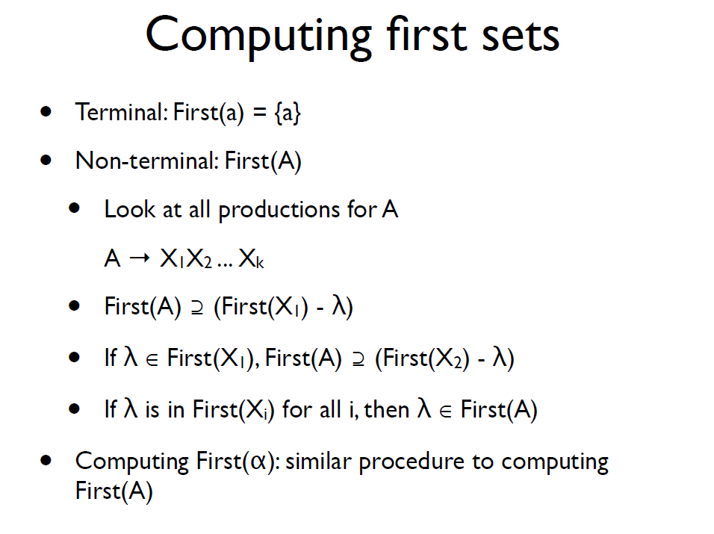

Slide 38
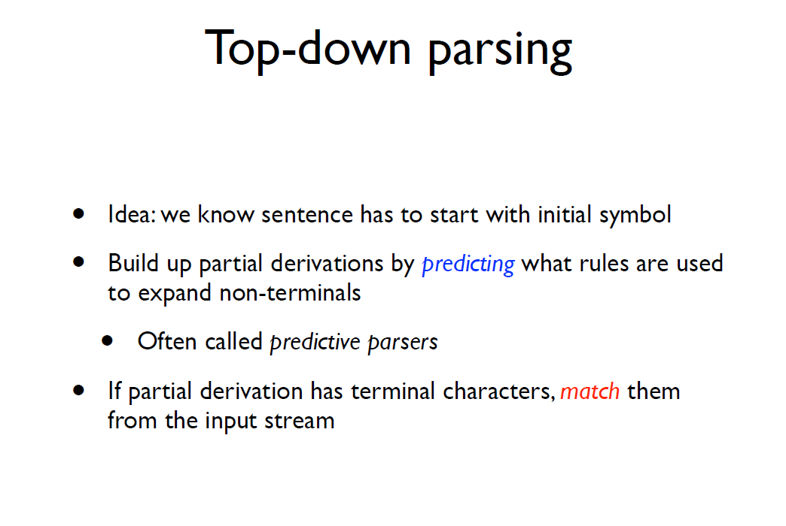
Top-down Parsing – predictive parsers
Suggested reading: https://en.wikipedia.org/wiki/LL_parser

Slide 39
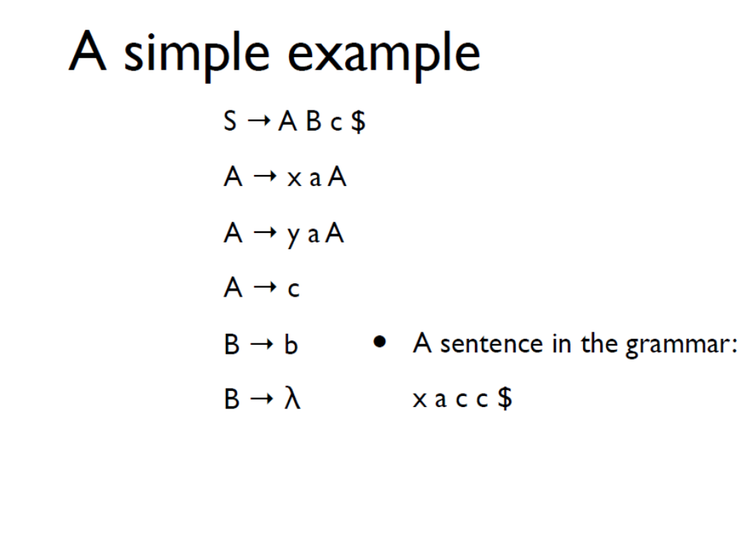

Slide 40
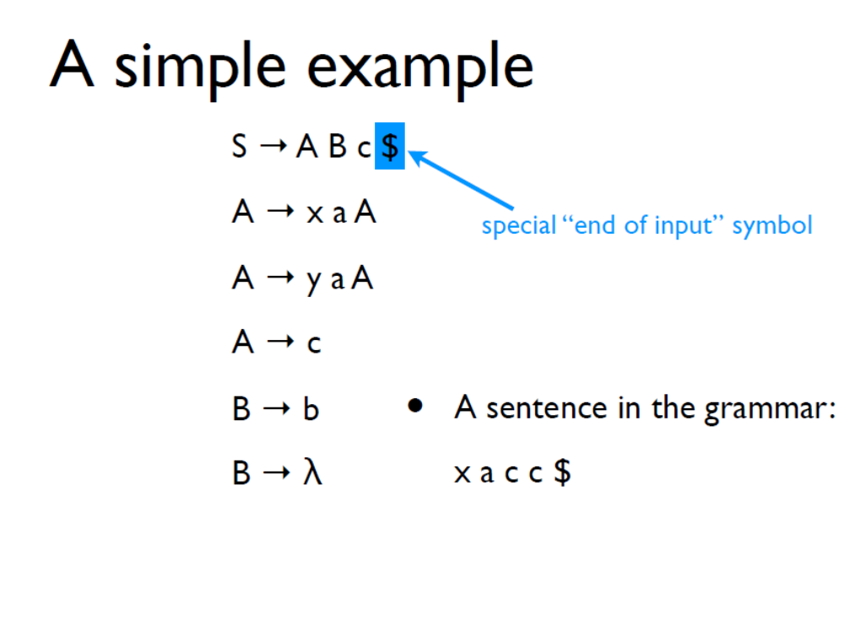

Slide 41
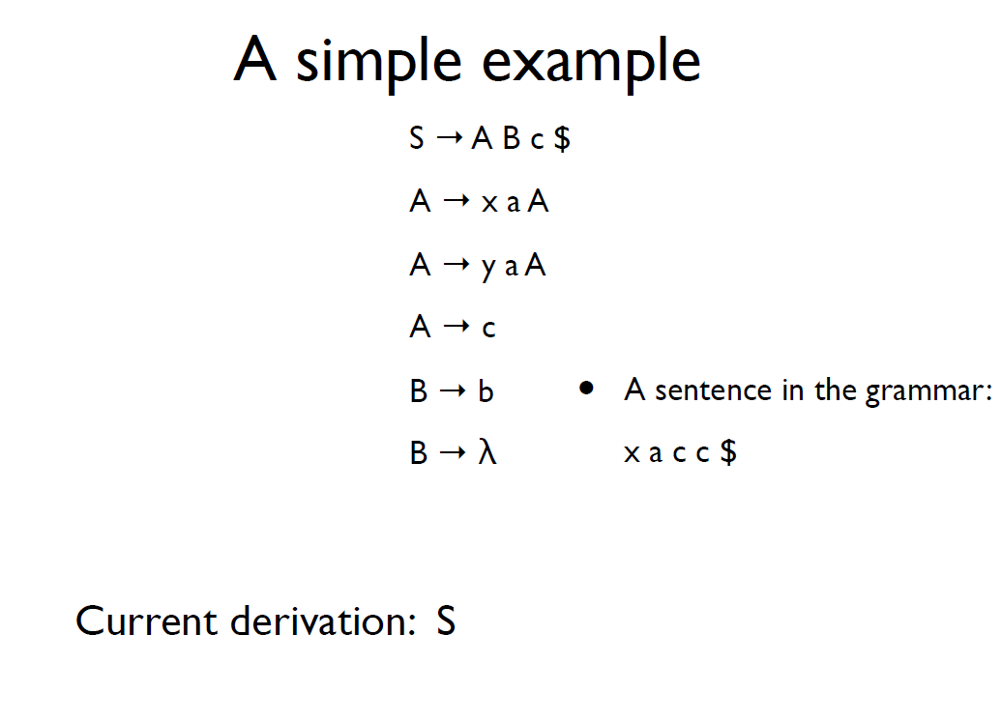

Slide 42
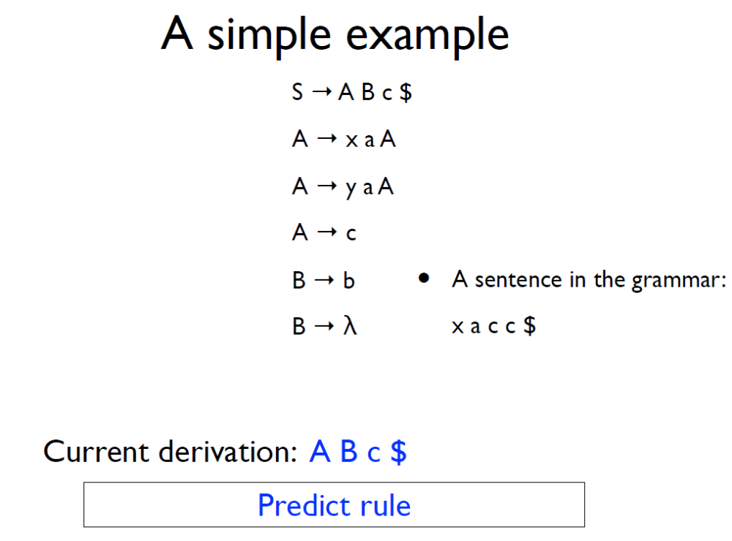

Slide 43
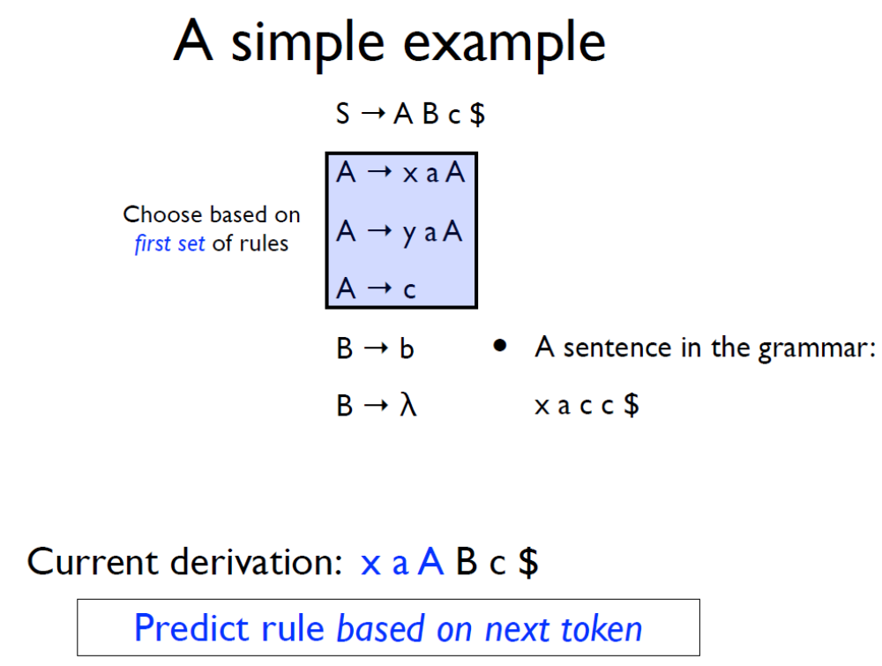

Slide 44
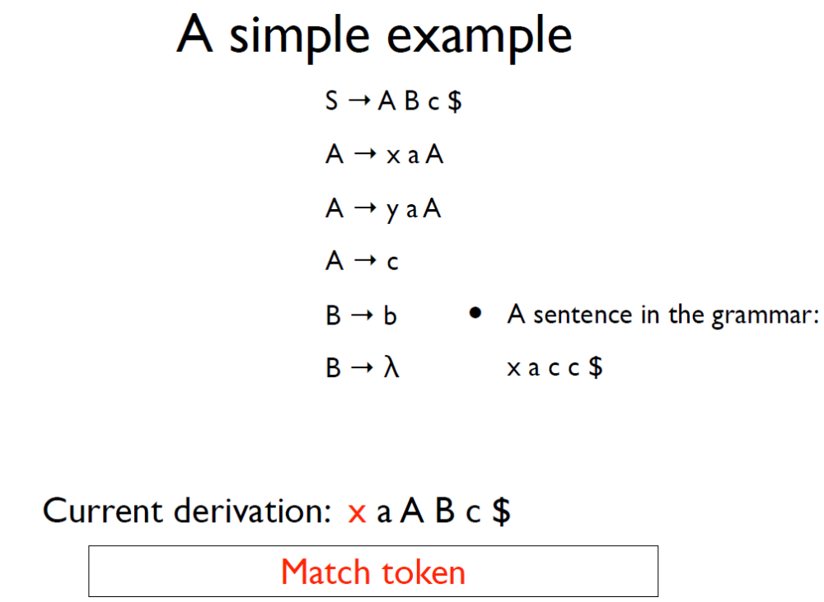

Slide 45
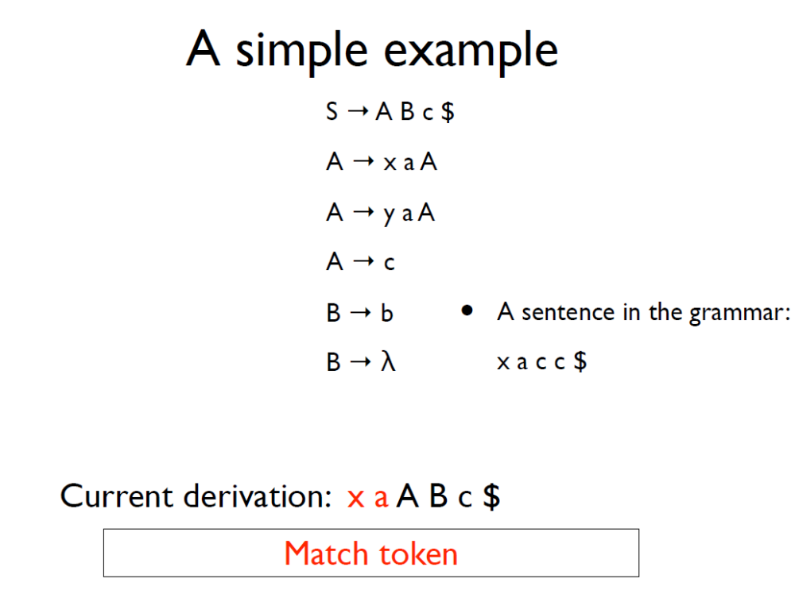

Slide 46
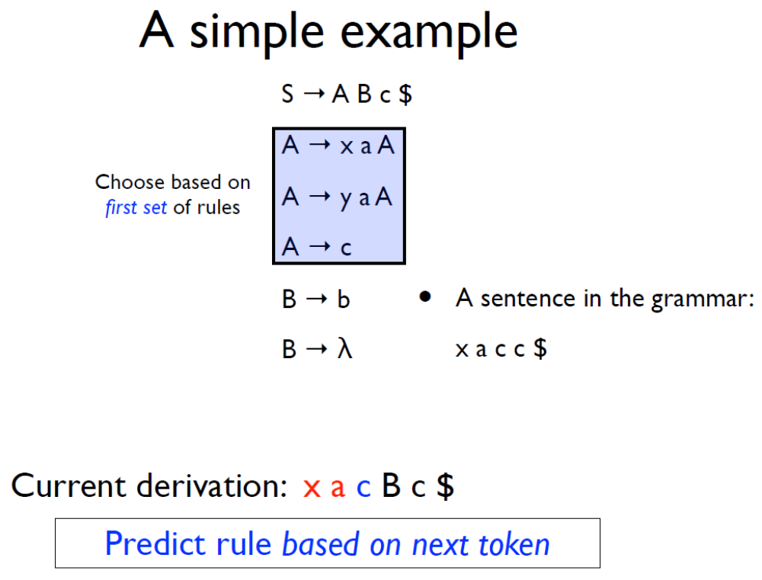

Slide 47
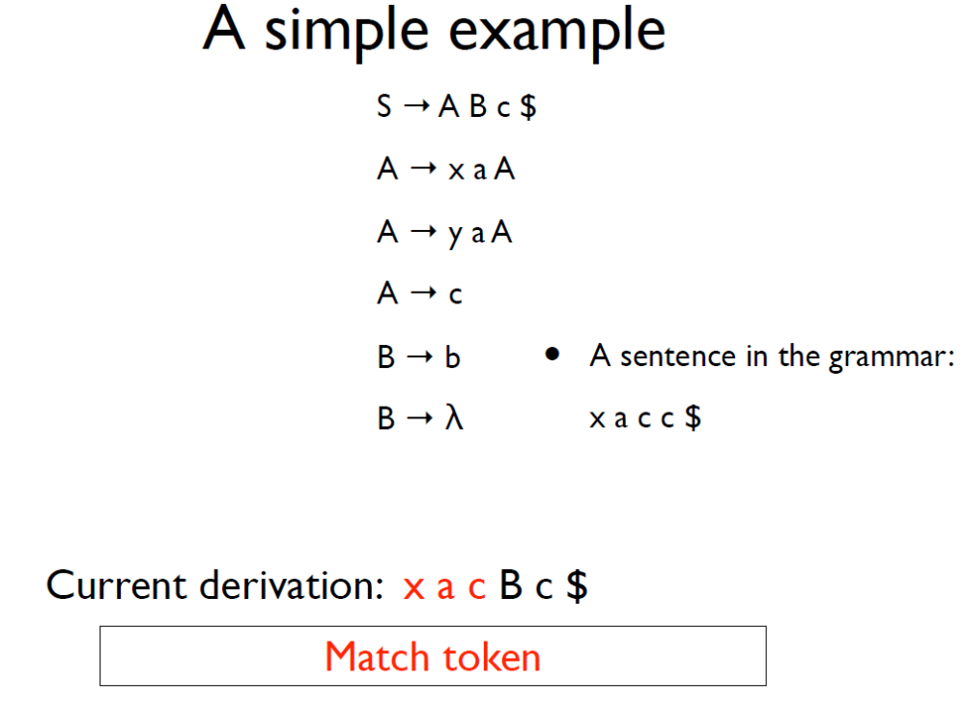

Slide 48
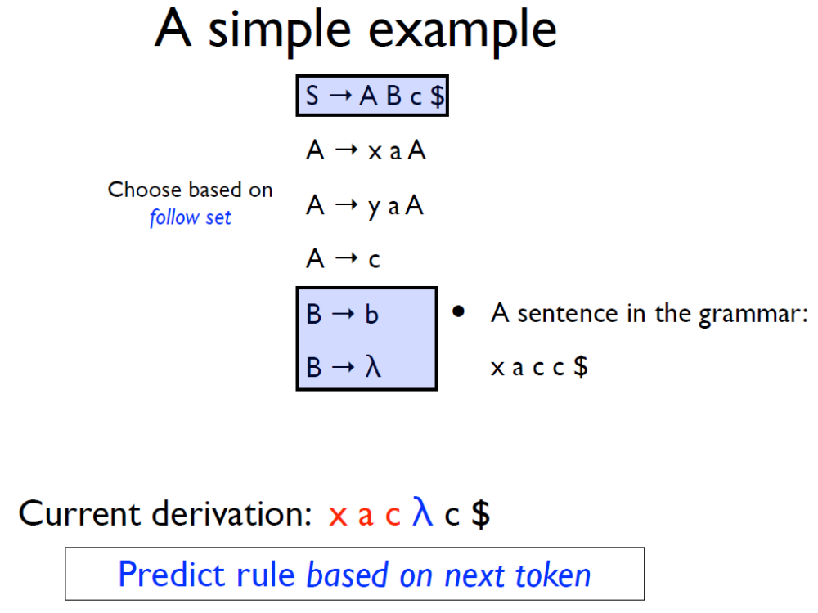

Slide 49
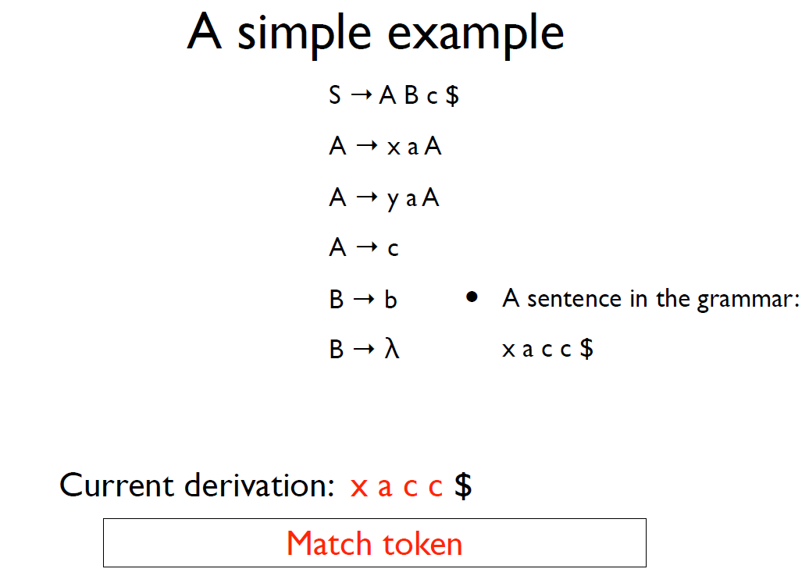

Slide 50
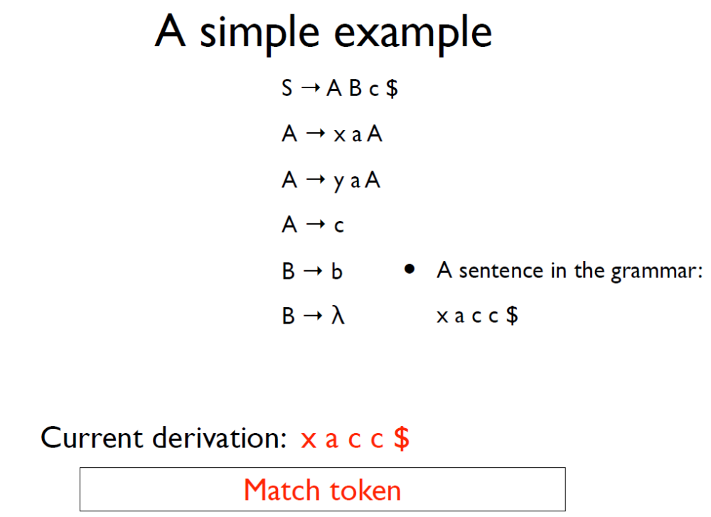

Slide 51
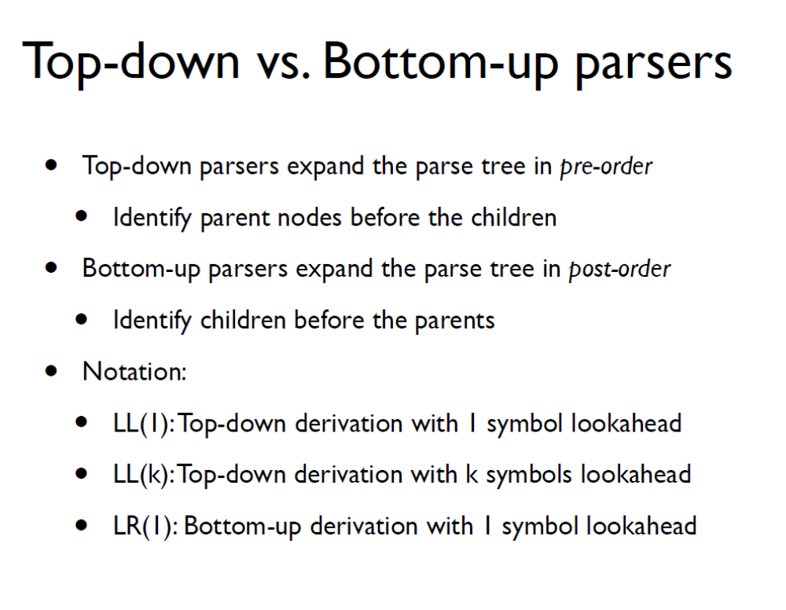

Slide 52
Suggested Reading
Alfred V. Aho, Monica S. Lam, Ravi Sethi and Jeﬀrey D.Ullman: Compilers: Principles, Techniques, and Tools, 2/E, AddisonWesley 2007
  Chapter 4 (Sections: 4.1 to 4.4)
Fisher and LeBlanc: Crafting a Compiler with C
  Chapter 4, Chapter 5(Sections 5.1 to 5.5, 5.9)

