Slide 1
CS406: Compilers
Spring 2020
Week1: Overview, Structure of a compiler

Slide 2
Intro to Compilers
Way to implement programming languages
    Programming languages are notations for specifying computations to machines
    Target can be an assembly code, executable, another source program etc.
Compiler
Compiler
Program
Program
Target
Target

Slide 3
What is a Compiler?
Traditionally: Program that analyzes and translates from a high level language (e.g. C++) to low-level assembly language that can be executed by the hardware
var a
var b
mov 3 a
mov 4 r1
cmpi a r1
jge l_e
mov 2 b
jmp l_d
l_e:mov 3 b
l_d:;done
var a
var b
mov 3 a
mov 4 r1
cmpi a r1
jge l_e
mov 2 b
jmp l_d
l_e:mov 3 b
l_d:;done
int a, b;
a = 3;
if (a < 4) {
b = 2;
} else {
b = 3;
}
int a, b;
a = 3;
if (a < 4) {
b = 2;
} else {
b = 3;
}
int a, b;
a = 3;
if (a < 4) {
b = 2;
} else {
b = 3;
}

Slide 4
Compilers are translators
Fortran
C
C++
Java
Text processing language
HTML/XML
Command & Scripting Languages
Natural Language
Domain Specific Language
Machine code
Virtual machine code
Transformed source code
Augmented source code
Low-level commands
Semantic components
Another language
translate

Slide 5
Compilers are optimizers
Can perform optimizations to make a program more efficient
var a
var b
var c
mov a r1
addi 3 r1
mov r1 b
mov a r2
addi 3 r2
mov r2 c
var a
var b
var c
mov a r1
addi 3 r1
mov r1 b
mov r1 c
int a, b, c;
b = a + 3;
c = a + 3;

Slide 6
Why do we need compilers?
Compilers provide portability
Old days: whenever a new machine was built, programs had to be rewritten to support new instruction sets
IBM System/360 (1964): Common Instruction Set Architecture (ISA) --- programs could be run on any machine which supported ISA
  Common ISA is a huge deal (note continued existence of x86)
But still a problem: when new ISA is introduced (EPIC) or new extensions added (x86-64), programs would have to be rewritten
Compilers bridge this gap: write new compiler for an ISA, and then simply recompile programs!

Slide 7
Why do we need compilers?
Compilers enable high-performance and productivity
Old: programmers wrote in assembly language, architectures were simple (no pipelines, caches, etc.)
  Close match between programs and machines --- easier to achieve performance
New: programmers write in high level languages (Ruby, Python), architectures are complex (superscalar, out-of-order execution, multicore)
Compilers are needed to bridge this semantic gap
  Compilers let programmers write in high level languages and still get good performance on complex architectures

Slide 8
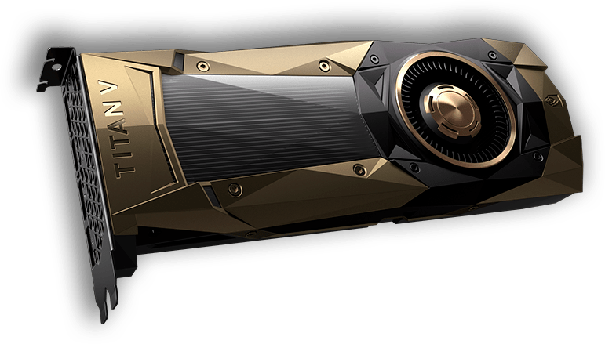
Semantic Gap
Python code that actually runs on GPU
import pycuda
import pycuda.autoinit from pycuda.tools import make_default_context
c = make_default_context()
d = c.get_device()
……
Impossible without Compilers
source: nvidia.com

Slide 9

Some common compiler types
High level language assembly language (e.g. gcc)
High level language machine independent bytecode (e.g. javac)
Bytecode native machine code (e.g. java’s JIT compiler)
High level language High level language (e.g. domain specific languages, many research languages)

Slide 10
HLL to Assembly
Program
Compiler
Assembly
Assembler
Machine code
Compiler converts program to assembly
Assembler is machine-specific translator which converts assembly to machine code
  add $7 $8 $9 ($7 = $8 + $9 ) => 000000 00111 01000 01001 00000 100000
Conversion is usually one-to-one with some exceptions
  Program locations
  Variable names

Slide 11
HLL to Bytecode to Assembly
Program
Compiler
Bytecode
JIT Compiler
Machine code
Compiler converts program into machine independent bytecode
  e.g. javac generates Java bytecode, C# compiler generates CIL
Just-in-time compiler compiles code while program executes to produce machine code
  Is this better or worse than a compiler which generates machine code directly from the program?

Slide 12
HLL to Bytecode
Program
Compiler
Bytecode
Interpreter
Execute!
Compiler converts program into machine independent bytecode
  e.g. javac generates Java bytecode, C# compiler generates CIL
Interpreter then executes bytecode “on-the-fly”
Bytecode instructions are “executed” by invoking methods of the interpreter, rather than directly executing on the machine
Aside: what are the pros and cons of this approach?

Slide 13
Quick Detour: Interpreters
Alternate way to implement programming languages
Interpreter
Program
Output
Data
Data

Slide 14
Data
Compiler
Program
Target
Offline
Output
Interpreter
Program
Output
Data
Data
Online
these are the two types of language processing systems

Slide 15
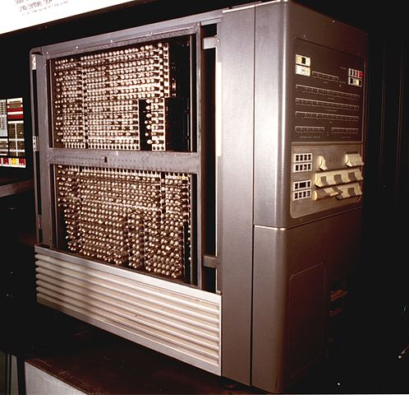
History
1954: IBM 704
  Huge success
  Could do complex math
  Software cost > Hardware cost
Source: IBM Italy, https://commons.wikimedia.org/w/index.php?curid=48929471
How can we improve the efficiency of creating software?

Slide 16
1953: Speedcoding
  High-level programming language by John Backus
  Early form of interpreters
  Greatly reduced programming effort
  About 10x-20x slower
  Consumed lot of memory (~300 bytes = about 30% RAM)
Notes:
Weather prediction, finite element analysis, computational chemistry, computational physics, computational fluid dynamics etc.
Benchmarking fastest supercomputers

Slide 17
Fortran I
1957: Fortran released
  Building the compiler took 3 years
  Very successful: by 1958, 50% of all software created was written in Fortran
Influenced the design of:
  high-level programming languages e.g. BASIC
  practical compilers
Today’s compilers still preserve the structure of Fortran I

Slide 18
Structure of a Compiler

