Slide 1
Architektur und Implementierung von Datenbanksystemen
Task 5
Team 3 - Gründlinger Diana, Huber Marcel, Klotz Thomas, Targa Aaron, Thalmann Matthias

Slide 2
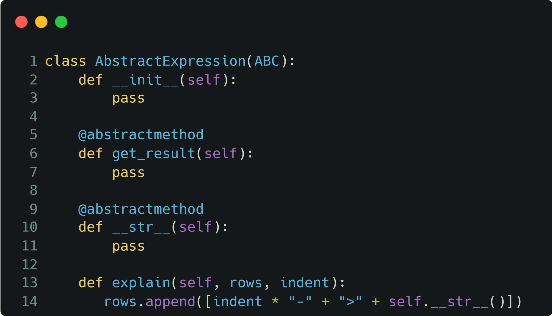
Expression representation Abstract Expression
For each expression in the AST a class is created
Abstract expression is super class for all expressions
Expression classes for binary expressions have right, left
Operator expressions have unique attributes like conditions for join and selection and columns for projection

Slide 3
Expression representation Expression classes
Arithmetic Operation Expression
Column Expression
Comparative Expression
Conjunctive Expression
Disjunctive Expression
Explain
Hash Distinct
Literal Expression
Nested Loops Join
Ordering Expression
Projection
Selection
Set Expression
Table Scan

Slide 4
Plan operators interface
Operators implementation
There is no explicit plan operators interface
The operators inherit from the abstract expression class
The get_schema()method gets implemented in the get_result()methods of the operators
All operator classes return a new table object with the corresponding relational algebra operation applied

Slide 5
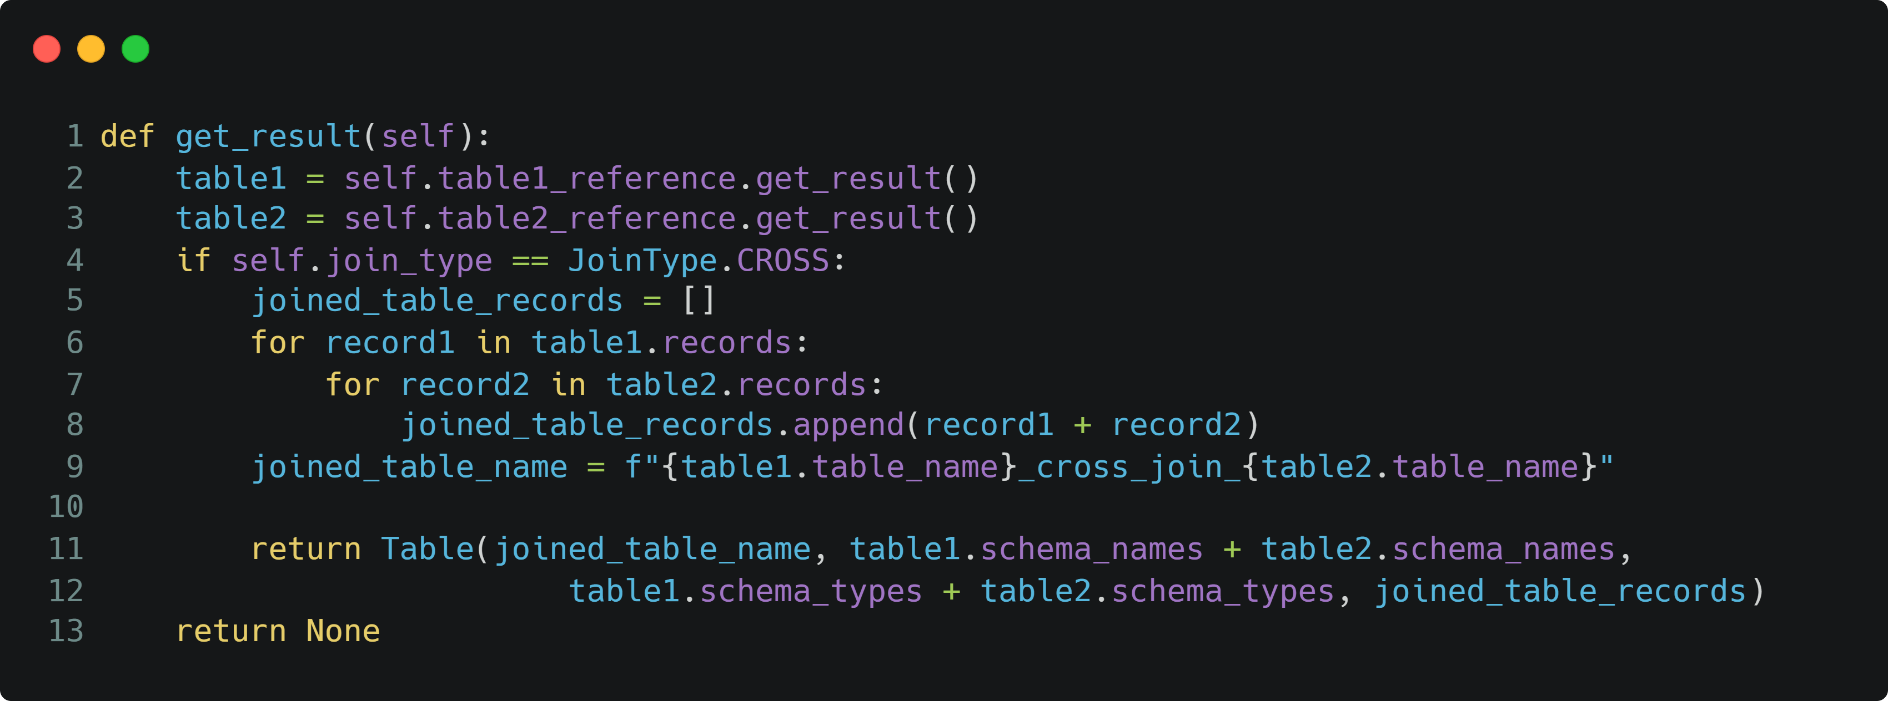
Plan operators interface Join operator example

Slide 6
Plan execution
explain pi PersNr, Name professoren cross join pi PersNr, Name, Boss assistenten;
Materialization is used to execute the plan
We don‘t use a initialize method
Only the get_result()method from the root of the execution plan gets called recursively and returns the resulting table
NestedLoopsJoin(cross, natural=True, condition=None)
TableScan(professoren)
Projection(columns=[PersNr=PersNr, Name=Name, Boss=Boss])
TableScan(assistenten)
Projection(columns=[PersNr=PersNr, Name=Name])

Slide 7
Execution plan mapping
Query
Parser
AstVisitor
AST
Execution plan
Query gets parsed by the parser with the defined grammar
Parser returns AST
AstVisitor visits nodes from the AST bottom up and builds execution plan
When using the explain query instead of get_result()the explain() method gets called recursively and builds a visual representation of the execution plan.

Slide 8


