Slide 1
Architektur und Implementierung von Datenbanksystemen
Task 9
Team 3 - Gründlinger Diana, Huber Marcel, Klotz Thomas, Targa Aaron, Thalmann Matthias

Slide 2
Legacy Query Planner
Joins are represented in a graph
Nearest Neighbors
find the cheapest path to node
find cheapest path to another node
repeat until all nodes visited
may find very inefficient execution plans

Slide 3
Next-Generation Query Planner
Joins are represented in a weighted, directed graph
N Nearest Neighbors (N3)
looks for N shortest paths (in each step)
choosing N
N = 1; for simple queries
N = 5; for two-way joins
N = 10; for joins with three or more tables

Slide 4
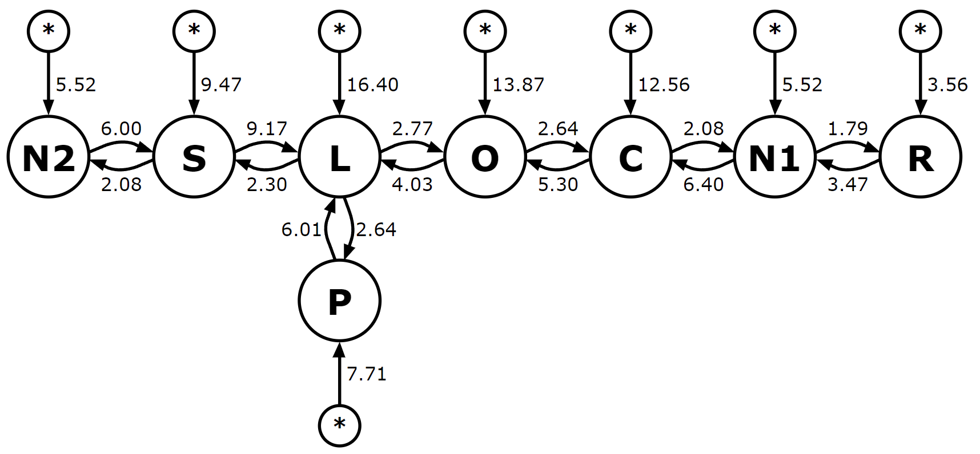
Example (N = 4), first step
Path | Cost
R | 3.56
N1 | 5.52
N2 | 5.52
P | 7.71

Slide 5
Example (N = 4), second step
Path | Cost
R-N1 | 7.03
R-N2 | 9.08
N2-N1 | 11.04
R-P | 11.27

Slide 6
Example (N = 4), second step
Path | Cost
R-N1 | 7.03
R-N2 | 9.08
N2-N1 | 11.04
R-P | 11.27

Slide 7
Example (N = 4), second step
Path | Cost
R-N1 | 7.03
R-N2 | 9.08
N2-N1 | 11.04
R-P | 11.27

Slide 8
Example (N = 4), second step
Path | Cost
R-N1 | 7.03
R-N2 | 9.08
N2-N1 | 11.04
R-P | 11.27

Slide 9
Example (N = 4), third step
Path | Cost
R-N1-N2 | 12.55
R-N1-C | 13.43
R-N1-P | 14.74
R-N2-S | 15.08

Slide 10
Next-Generation Query Planner
algorithm continues until all nodes were visited in one path
-> 8 iterations
path cost found with different Planners:
LQP: 36.92
NGQP: 29.78

Slide 11
Advantages & Disadvantages
Pro:
finds better optimizations than legacy planner
especially for complex queries
Contra
plans are still not optimal
cost guesses rely on accurate ANALYZE data

Slide 12
References
https://sqlite.org/queryplanner-ng.html

Slide 13


