Slide 1
Architektur und Implementierung von Datenbanksystemen
Task 6 – recursive query execution in PostgreSQL
Team 3 - Gründlinger Diana, Huber Marcel, Klotz Thomas, Targa Aaron, Thalmann Matthias

Slide 2
Content
Syntax of a recursive query
Execution plan
Operators used and execution control flow
Team 3 Gründlinger Diana, Huber Marcel, Klotz Thomas, Targa Aaron, Thalmann Matthias
Seite 2

Slide 3
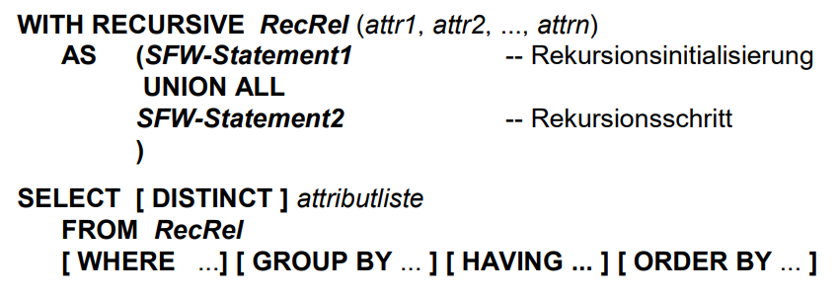
Syntax of a recursive query
(2)
Team 3 Gründlinger Diana, Huber Marcel, Klotz Thomas, Targa Aaron, Thalmann Matthias
Seite 3

Slide 4
Syntax of a recursive query
WITH → common table expression (CTE), basically defining a temporary table that just exists for one query
Optional RECURSIVE modifier → WITH query can refer to its own output
General Form of a recursive WITH query:
A non-recursive term
UNION or UNION ALL
A recursive term
Only the recursive term can reference the query’s own output.
(1,2)
Team 3 Gründlinger Diana, Huber Marcel, Klotz Thomas, Targa Aaron, Thalmann Matthias
Seite 4

Slide 5
Execution plan - example
Query:
WITH RECURSIVE recursive_query(id, child_id) AS (
SELECT id, child_id
FROM my_tree
WHERE id = 0
UNION
SELECT t.id, t.child_id
FROM my_tree t, recursive_query
WHERE recursive_query.child_id = t.id
)
SELECT * FROM recursive_query
Explain output:
CTE Scan on recursive_query (cost=113.31..115.33 rows=101 width=8) (actual time=0.686..1257.405 rows=500 loops=1)
CTE recursive_query
-> Recursive Union (cost=0.27..113.31 rows=101 width=8) (actual time=0.680..1254.706 rows=500 loops=1)
-> Index Scan using idx on my_tree (cost=0.27..8.29 rows=1 width=8) (actual time=0.664..0.670 rows=1 loops=1)
Index Cond: (id = 0)
-> Hash Join (cost=0.33..10.30 rows=10 width=8) (actual time=1.301..2.487 rows=1 loops=500)
Hash Cond: (t.id = recursive_query_1.child_id)
-> Seq Scan on my_tree t (cost=0.00..8.00 rows=500 width=8) (actual time=0.009..1.225 rows=500 loops=500)
-> Hash (cost=0.20..0.20 rows=10 width=4) (actual time=0.013..0.013 rows=1 loops=500)
Buckets: 1024 Batches: 1 Memory Usage: 9kB
-> WorkTable Scan on recursive_query recursive_query_1 (cost=0.00..0.20 rows=10 width=4) (actual time=0.003..0.005 rows=1 loops=500)
Planning time: 0.688 ms
Execution time: 1259.438 ms
(3)
Team 3 Gründlinger Diana, Huber Marcel, Klotz Thomas, Targa Aaron, Thalmann Matthias
Seite 5

Slide 6
Execution plan - example
Query:
WITH RECURSIVE recursive_query(id, child_id) AS (
SELECT id, child_id
FROM my_tree
WHERE id = 0
UNION
SELECT t.id, t.child_id
FROM my_tree t, recursive_query
WHERE recursive_query.child_id = t.id
)
SELECT * FROM recursive_query
Explain output:
CTE Scan on recursive_query (cost=113.31..115.33 rows=101 width=8) (actual time=0.686..1257.405 rows=500 loops=1)
CTE recursive_query
-> Recursive Union (cost=0.27..113.31 rows=101 width=8) (actual time=0.680..1254.706 rows=500 loops=1)
-> Index Scan using idx on my_tree (cost=0.27..8.29 rows=1 width=8) (actual time=0.664..0.670 rows=1 loops=1)
Index Cond: (id = 0)
-> Hash Join (cost=0.33..10.30 rows=10 width=8) (actual time=1.301..2.487 rows=1 loops=500)
Hash Cond: (t.id = recursive_query_1.child_id)
-> Seq Scan on my_tree t (cost=0.00..8.00 rows=500 width=8) (actual time=0.009..1.225 rows=500 loops=500)
-> Hash (cost=0.20..0.20 rows=10 width=4) (actual time=0.013..0.013 rows=1 loops=500)
Buckets: 1024 Batches: 1 Memory Usage: 9kB
-> WorkTable Scan on recursive_query recursive_query_1 (cost=0.00..0.20 rows=10 width=4) (actual time=0.003..0.005 rows=1 loops=500)
Planning time: 0.688 ms
Execution time: 1259.438 ms
(3)
Team 3 Gründlinger Diana, Huber Marcel, Klotz Thomas, Targa Aaron, Thalmann Matthias
Seite 5

Slide 7
Execution plan - example
Query:
WITH RECURSIVE recursive_query(id, child_id) AS (
SELECT id, child_id
FROM my_tree
WHERE id = 0
UNION
SELECT t.id, t.child_id
FROM my_tree t, recursive_query
WHERE recursive_query.child_id = t.id
)
SELECT * FROM recursive_query
Explain output:
CTE Scan on recursive_query (cost=113.31..115.33 rows=101 width=8) (actual time=0.686..1257.405 rows=500 loops=1)
CTE recursive_query
-> Recursive Union (cost=0.27..113.31 rows=101 width=8) (actual time=0.680..1254.706 rows=500 loops=1)
-> Index Scan using idx on my_tree (cost=0.27..8.29 rows=1 width=8) (actual time=0.664..0.670 rows=1 loops=1)
Index Cond: (id = 0)
-> Hash Join (cost=0.33..10.30 rows=10 width=8) (actual time=1.301..2.487 rows=1 loops=500)
Hash Cond: (t.id = recursive_query_1.child_id)
-> Seq Scan on my_tree t (cost=0.00..8.00 rows=500 width=8) (actual time=0.009..1.225 rows=500 loops=500)
-> Hash (cost=0.20..0.20 rows=10 width=4) (actual time=0.013..0.013 rows=1 loops=500)
Buckets: 1024 Batches: 1 Memory Usage: 9kB
-> WorkTable Scan on recursive_query recursive_query_1 (cost=0.00..0.20 rows=10 width=4) (actual time=0.003..0.005 rows=1 loops=500)
Planning time: 0.688 ms
Execution time: 1259.438 ms
(3)
Team 3 Gründlinger Diana, Huber Marcel, Klotz Thomas, Targa Aaron, Thalmann Matthias
Seite 5

Slide 8
Execution plan - example
Query:
WITH RECURSIVE recursive_query(id, child_id) AS (
SELECT id, child_id
FROM my_tree
WHERE id = 0
UNION
SELECT t.id, t.child_id
FROM my_tree t, recursive_query
WHERE recursive_query.child_id = t.id
)
SELECT * FROM recursive_query
Explain output:
CTE Scan on recursive_query (cost=113.31..115.33 rows=101 width=8) (actual time=0.686..1257.405 rows=500 loops=1)
CTE recursive_query
-> Recursive Union (cost=0.27..113.31 rows=101 width=8) (actual time=0.680..1254.706 rows=500 loops=1)
-> Index Scan using idx on my_tree (cost=0.27..8.29 rows=1 width=8) (actual time=0.664..0.670 rows=1 loops=1)
Index Cond: (id = 0)
-> Hash Join (cost=0.33..10.30 rows=10 width=8) (actual time=1.301..2.487 rows=1 loops=500)
Hash Cond: (t.id = recursive_query_1.child_id)
-> Seq Scan on my_tree t (cost=0.00..8.00 rows=500 width=8) (actual time=0.009..1.225 rows=500 loops=500)
-> Hash (cost=0.20..0.20 rows=10 width=4) (actual time=0.013..0.013 rows=1 loops=500)
Buckets: 1024 Batches: 1 Memory Usage: 9kB
-> WorkTable Scan on recursive_query recursive_query_1 (cost=0.00..0.20 rows=10 width=4) (actual time=0.003..0.005 rows=1 loops=500)
Planning time: 0.688 ms
Execution time: 1259.438 ms
(3)
Team 3 Gründlinger Diana, Huber Marcel, Klotz Thomas, Targa Aaron, Thalmann Matthias
Seite 5

Slide 9
Operators used
CTE Scan
Recursive Union
WorkTable Scan
Team 3 Gründlinger Diana, Huber Marcel, Klotz Thomas, Targa Aaron, Thalmann Matthias
Seite 6

Slide 10
Operators used and execution control flow
CTE Scan – Scans results of a CTE as temporary table
WorkTable Scan - Scans the work table used in evaluating a recursive CTE
Recursive Union - Returns the union of the recursive and non recursive subplan
(4)
Team 3 Gründlinger Diana, Huber Marcel, Klotz Thomas, Targa Aaron, Thalmann Matthias
Seite 7

Slide 11
Operators used and execution control flow
evaluate non-recursive term for UNION discard duplicate rows include remaining rows in result of recursive query, and also place them in a temporary working table
while working table not empty, repeat:
Evaluate recursive term, substituting current contents of working table for recursive self-reference. For UNION (but not UNION ALL), discard duplicate rows and rows that duplicate any previous result row. Include all remaining rows in result of the recursive query, and also place them in temporary intermediate table.
Replace contents of working table with contents of intermediate table, then empty intermediate table.
Execution terminates when no further tuples are added in a recursive step.
Note: It’s called RECURSIVE but the process is really iterative.
(5)
Team 3 Gründlinger Diana, Huber Marcel, Klotz Thomas, Targa Aaron, Thalmann Matthias
Seite 8

Slide 12
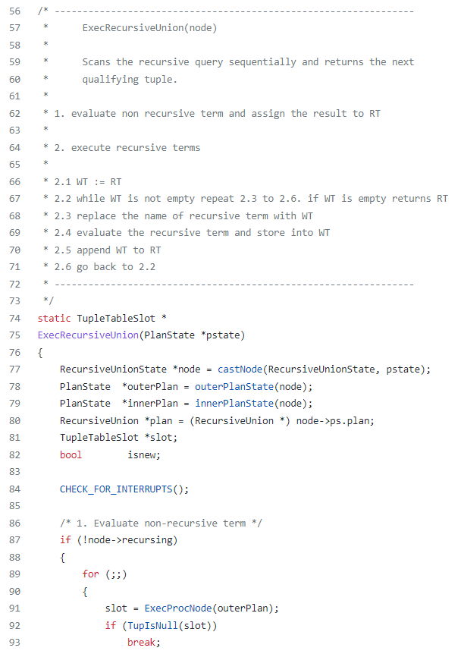
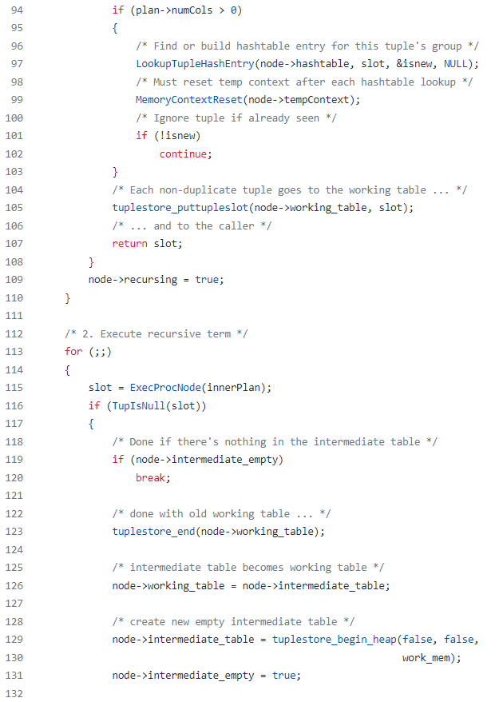
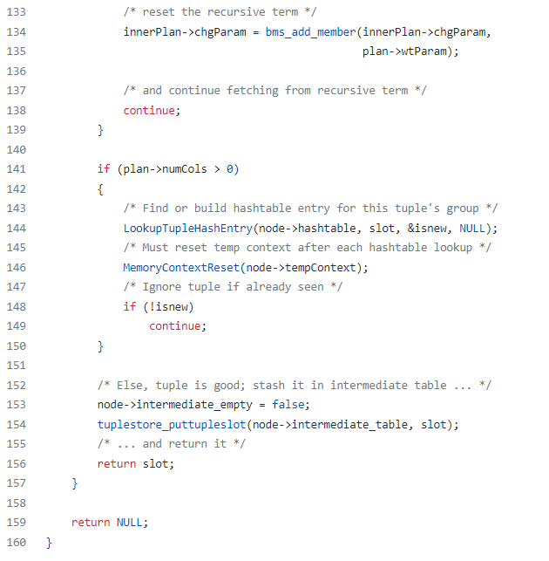
(5)
Team 3 Gründlinger Diana, Huber Marcel, Klotz Thomas, Targa Aaron, Thalmann Matthias
Seite 9

Slide 13
References
https://www.postgresql.org/docs/current/queries-with.html
Lecture slides from course “Database Systems”
https://medium.com/swlh/postgres-recursive-query-cte-or-recursive-function-3ea1ea22c57c
https://pganalyze.com/docs/explain#postgres-plan-nodes
https://github.com/postgres/postgres/tree/master/src/backend/executor
https://gitlab.com/postgres/postgres/blob/master/src/include/nodes/plannodes.h
Team 3 Gründlinger Diana, Huber Marcel, Klotz Thomas, Targa Aaron, Thalmann Matthias
Seite 10

Slide 14


