Slide 1
Architektur und Implementierung von Datenbanksystemen
Task 8
Team 3 - Gründlinger Diana, Huber Marcel, Klotz Thomas, Targa Aaron, Thalmann Matthias

Slide 2
PostgreSQL cost estimation
Each parameter can be customized
ANALYZE collects statistics about contents of tables → pg_statistic → statistics used by query planner (as partially seen in lecture 08: Optimization 2)
ANALYZE is automatically done by the autovacuum deamon
pg_statistic: - entry for each column - fraction of null values, avg. stored bytes, amount of distinct values, …

Slide 3
Cost estimation parameters (1)
Arbitrary scale
Relative values
Default: relative to seq_page_cost
Parameter | Default value | Description
seq_page_cost | 1.0 | Cost of a disk page fetch (sequentially)
random_page_cost | 4.0 | Cost of a disk page fetch (non-sequentially)
cpu_tuple_cost | 0.01 | Cost of processing each row during a query
cpu_index_tuple_cost | 0.005 | Cost of processing each index entry during an index scan
cpu_operator_cost | 0.0025 | Cost of processing each operator executed during a query

Slide 4
Cost estimation parameters (2)
Parameter | Default value | Description
parallel_setup_cost | 1000 | Cost of launching parallel worker processes
parallel_tuple_cost | 0.1 | Cost of transferring a tuple from one process to another one
min_parallel_table_scan_size | 8MB | Min. amount of table data needed to be scanned for a parallel scan to be considered
min_parallel_index_scan_size | 512KB | Min. amount of index data needed to be scanned for a parallel scan to be considered
effective_cache_size | 4GB | Assumed amount of disk cache avail. to a single query
jit_above_cost | 100,000 | Cost, above which JIT compilation is activated
jit_inline_above_cost | 500,000 | Cost, above which JIT comp. attempts inlining
jit_optimize_above_cost | 500,000 | Cost, above which JIT comp. applies expensive optimization

Slide 5
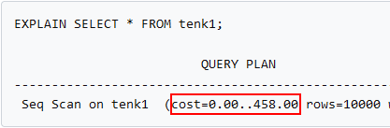
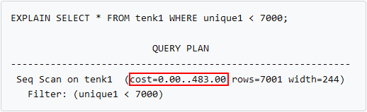
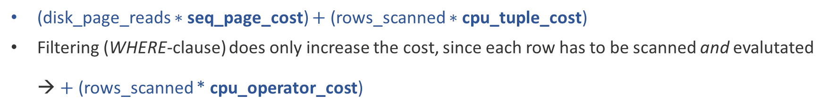
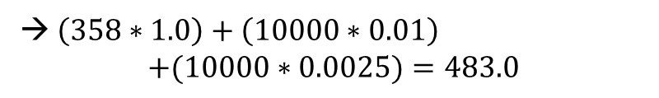

Cost estimation – Sequential scan
(disk_page_reads $∗$ seq_page_cost) $+$ (rows_scanned $∗$ cpu_tuple_cost)
Filtering (WHERE-clause) does only increase the cost, since each row has to be scanned and evalutated → $+$ (rows_scanned * cpu_operator_cost)
Example 1:
tenk1 has 358 disk pages and 10,000 rows
Example 2:
tenk1 has 358 disk pages and 10,000 rows
→ $\left(358∗1.0\right)+\left(10000∗0.01\right)=458.0$
→ $\left(358∗1.0\right)+\left(10000∗0.01\right)$ $$+(10000∗0.0025)=483.0$$

Slide 6
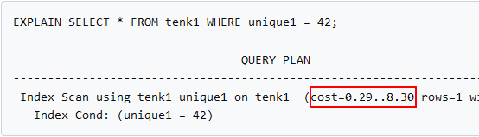
Cost estimation – Index scan (1)
Very complex method in costsize.c
Heavily dependent on the implementation of the index (e.g. B-Tree index)
amcostestimate – function-interface; implementation specific for each type of index
Estimates the total cost of the index (and other costs) → depending on type of index and index statistics → uses the genericcostestimate function (takes for example caching into account)

Slide 7
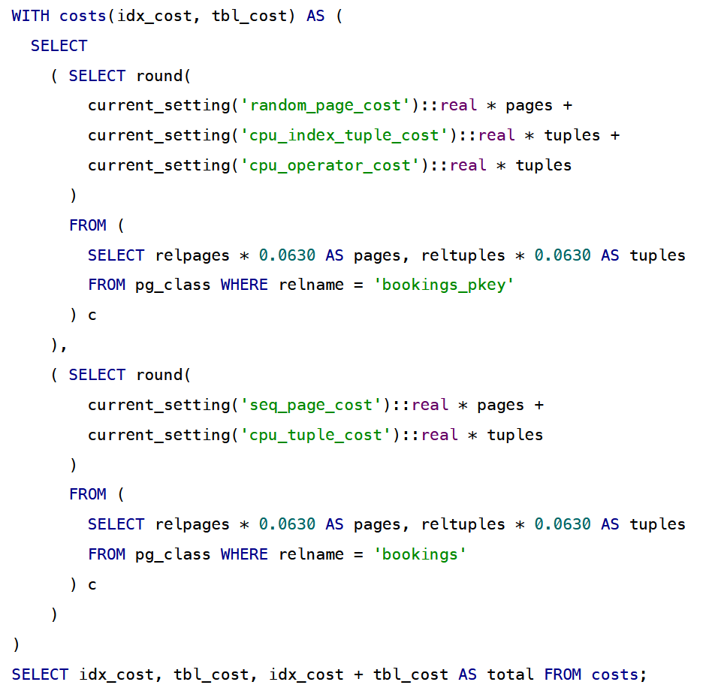
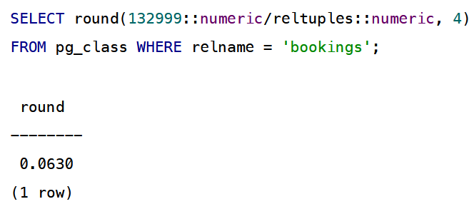
Cost estimation – Index scan (2) – Example for a B-Tree index
Amount of rows
Source: https://postgrespro.com/blog/pgsql/5969493

Slide 8
References
https://github.com/postgres/postgres/blob/master/src/backend/optimizer/path/costsize.c
http://morningcoffee.io/the-postgresql-query-cost-model.html
https://www.postgresql.org/docs/current/runtime-config-query.html
https://www.postgresql.org/docs/current/using-explain.html
https://www.postgresql.org/docs/current/index-cost-estimation.html
https://www.postgresql.org/docs/current/sql-analyze.html
https://www.postgresql.org/docs/current/routine-vacuuming.html
https://git.uibk.ac.at/informatik/dbis/dbis-teaching/archimpl-course-material-2022/-/blob/main/slides/08_optimization2.pdf
https://postgrespro.com/blog/pgsql/5969493
https://stackoverflow.com/a/57279653/11028838

Slide 9


