Slide 1
Architektur und Implementierung von Datenbanksystemen
Task 9
Team 3 - Gründlinger Diana, Huber Marcel, Klotz Thomas, Targa Aaron, Thalmann Matthias

Slide 2
Legacy Query Planner
Joins are represented in a weighted, directed graph
Nearest Neighbors
find the cheapest path to node
find cheapest path to another node
repeat until all nodes visited
may find very inefficient execution plans

Slide 3
Next-Generation Query Planner
Joins are represented in a weighted, directed graph
N Nearest Neighbors (N3)
looks for N shortest paths (in each step)
choosing N
N = 1; for simple queries
N = 5; for two-way joins
N = 10; for joins with three or more tables

Slide 4
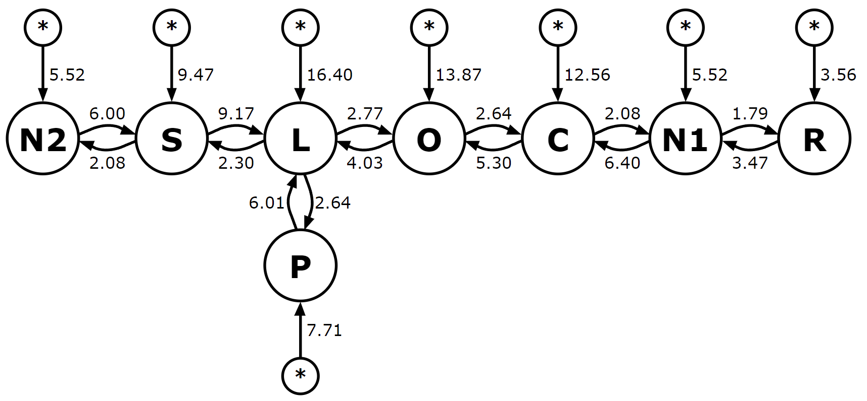
Example (N = 4), first step
Path | Cost
R | 3.56
N1 | 5.52
N2 | 5.52
P | 7.71

Slide 5
Example (N = 4), second step
Path | Cost
R-N1 | 7.03
R-N2 | 9.08
N2-N1 | 11.04
R-P | 11.27

Slide 6
Example (N = 4), second step
Path | Cost
R-N1 | 7.03
R-N2 | 9.08
N2-N1 | 11.04
R-P | 11.27

Slide 7
Example (N = 4), second step
Path | Cost
R-N1 | 7.03
R-N2 | 9.08
N2-N1 | 11.04
R-P | 11.27

Slide 8
Example (N = 4), second step
Path | Cost
R-N1 | 7.03
R-N2 | 9.08
N2-N1 | 11.04
R-P | 11.27

Slide 9
Example (N = 4), third step
Path | Cost
R-N1-N2 | 12.55
R-N1-C | 13.43
R-N1-P | 14.74
R-N2-S | 15.08

Slide 10
Next-Generation Query Planner
algorithm continues until all nodes were visited in one path
-> 8 iterations
path cost found with different Planners:
LQP: 36.92
NGQP: 29.78

Slide 11
Advantages & Disadvantages
Pro:
finds better optimizations than legacy planner
especially for complex queries
Contra
plans are still not optimal
cost guesses rely on accurate ANALYZE data
problems when schema contains indices that have more than about 10 or 20 rows with the same value in the left-most column of index

Slide 12
References
https://sqlite.org/queryplanner-ng.html

Slide 13


