Slide 1
Architektur und Implementierung von Datenbanksystemen
<Task 3>
Team 3 - Gründlinger Diana, Huber Marcel, Klotz Thomas, Targa Aaron, Thalmann Matthias

Slide 2
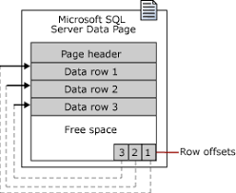
SQL Server Data Page
Page size is 8kb
96-byte header containing:
Number of rows, page type, free space, …
Rows follow serially after header
Row offset at end in reverse sequence from rows

Slide 3
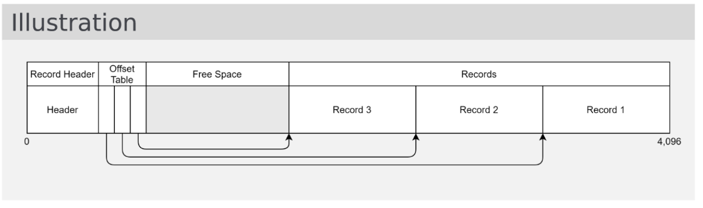
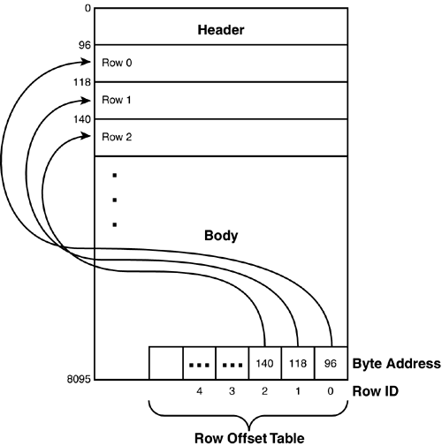
Comparison with block from lecture
Records start at the end, grow towards start
Offset Table starts after header, grows towards end
Size is 4kb

Slide 4
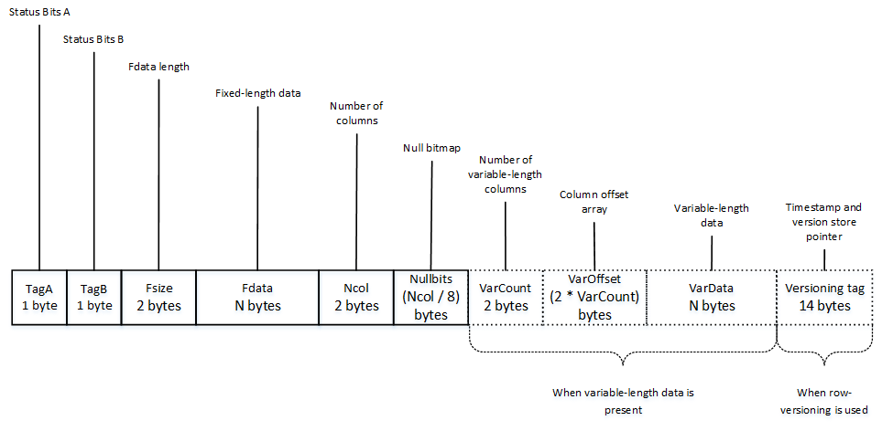
Record Format SQL Server
SQL Server uses fixedvar format
Fixed length:
Status bits (bitmap) for row data
Pointer to end of fixed data (ncol)
Fixed length data
Number of columns total
Null bitmap array (for all columns)
Variable length:
Number of columns n
Offset array with n offset values
Variable data at the end

Slide 5
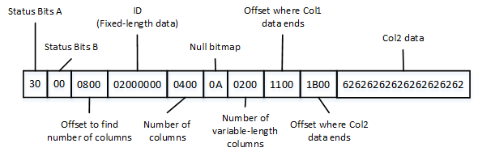
Record Example

Slide 6
Row overflow
Maximum size of row is 8060 Bytes (except text/image pages)
Columns of rows can be moved off the page
Upon overflow SQL server moves variable length columns to ROW_OVERFLOW_DATA page
Overflow = update or insert operation that increases row size over 8060 Bytes
Upon reduction of row size under 8060 Bytes moved columns get moved back from ROW_OVERFLOW_Data

Slide 7
Sources
https://etutorials.org/SQL/microsoft+sql+server+2000/Part+V+SQL+Server+Internals+and+Performance+Tuning/Chapter+33.+SQL+Server+Internals/Database+Pages/
https://docs.microsoft.com/en-us/sql/relational-databases/pages-and-extents-architecture-guide?view=sql-server-ver15
https://www.red-gate.com/simple-talk/databases/sql-server/database-administration-sql-server/sql-server-storage-internals-101/
https://aboutsqlserver.com/2013/10/15/sql-server-storage-engine-data-pages-and-data-rows/

Slide 8


