Slide 1
Architektur und Implementierung von Datenbanksystemen
Task 3
Team 3 - Gründlinger Diana, Huber Marcel, Klotz Thomas, Targa Aaron, Thalmann Matthias

Slide 2
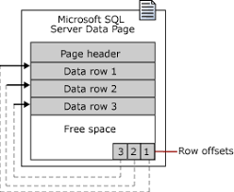
SQL Server Data Page
Page size: 8kb
96-byte header containing:
Number of rows
page type
free space
…
Rows follow serially after header
Row offset at end, reverse from rows

Slide 3
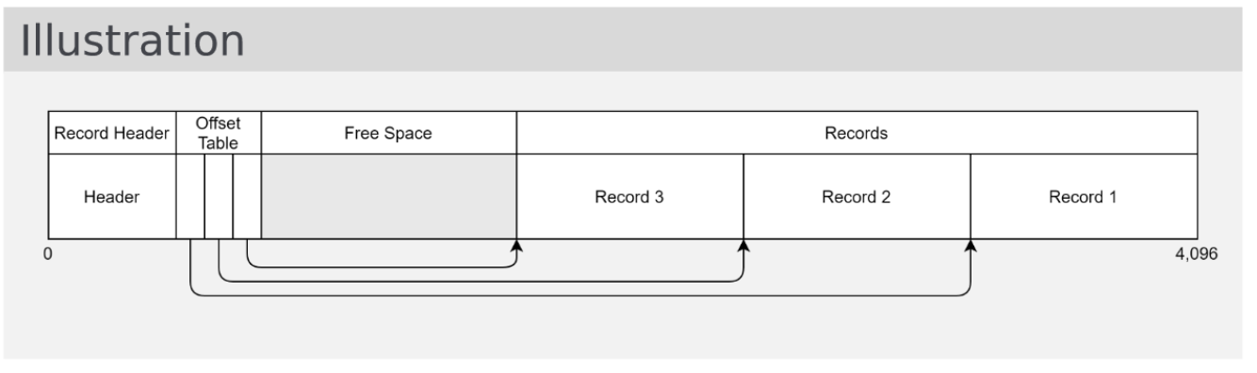
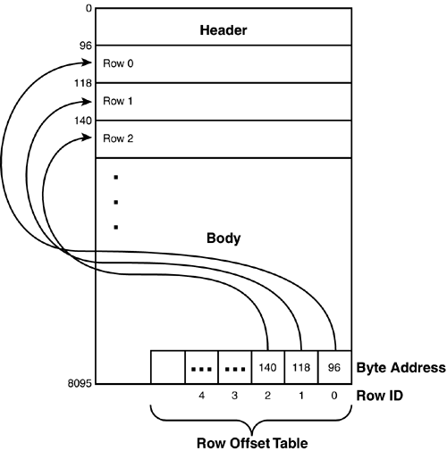
Comparison with block from lecture
Records start at the end, grow towards start
Offset Table starts after header, grows towards end
Size: 4kb

Slide 4
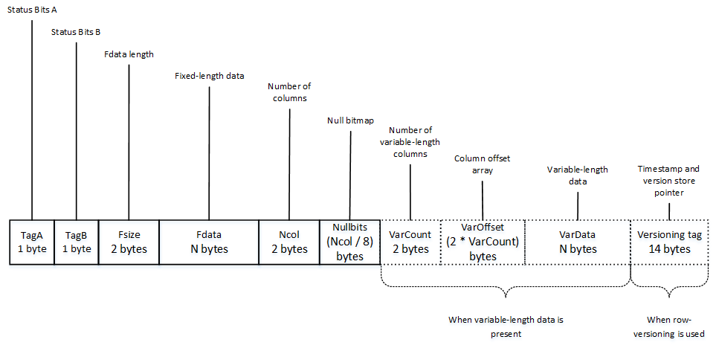
Record Format SQL Server
SQL Server uses fixedvar format
Fixed length:
Tag A, Tag B: Status bits for row data
Fsize: Pointer to end of fixed data (ncol)
Ncol: Number of columns total
Nullbits: Null bitmap array (for all columns)
Variable length:
VarCount: Number of columns n
VarOffset: Offset array with n offset values

Slide 5
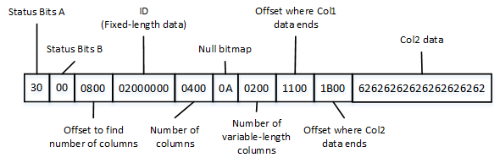
Record Example

Slide 6
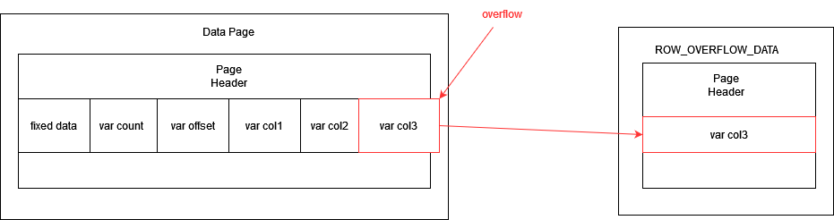
Row overflow
Maximum row size: 8060 Bytes (except text/image pages)
Columns of rows can be moved off the page
Upon overflow SQL server moves variable length columns to ROW_OVERFLOW_DATA page
Overflow = update or insert operation that increases row size over 8060 Bytes
Upon reduction of row size under 8060 Bytes moved columns get moved back from ROW_OVERFLOW_DATA

Slide 7
Sources
https://etutorials.org/SQL/microsoft+sql+server+2000/Part+V+SQL+Server+Internals+and+Performance+Tuning/Chapter+33.+SQL+Server+Internals/Database+Pages/
https://docs.microsoft.com/en-us/sql/relational-databases/pages-and-extents-architecture-guide?view=sql-server-ver15
https://www.red-gate.com/simple-talk/databases/sql-server/database-administration-sql-server/sql-server-storage-internals-101/
https://aboutsqlserver.com/2013/10/15/sql-server-storage-engine-data-pages-and-data-rows/
https://git.uibk.ac.at/informatik/dbis/dbis-teaching/archimpl-course-material-2022/-/blob/main/slides/02_records.pdf

Slide 8


