Slide 1
Operating Systems and
Systems Programming
Lecture 11
Cooperating Processes and Deadlock
Ing. Etson Guerrero

Slide 2
Goals for Today
Tips for Programming in a Project Team
Language Support for Synchronization
Discussion of Deadlocks
  Conditions for its occurrence
  Solutions for breaking and avoiding deadlock
Note: Some slides and/or pictures in the following are
adapted from slides ©2005 Silberschatz, Galvin, and Gagne
Note: Some slides and/or pictures in the following are
adapted from slides ©2005 Silberschatz, Galvin, and Gagne. Many slides generated from Kubiatowicz lecture notes.

Slide 3



Resources
Resources – passive entities needed by threads to do their work
  CPU time, disk space, memory
Two types of resources:
  Preemptable – can take it away
    CPU, Embedded security chip
  Non-preemptable – must leave it with the thread
    Disk space, plotter, chunk of virtual address space
    Mutual exclusion – the right to enter a critical section

Slide 4
Starvation vs Deadlock
Starvation vs. Deadlock
  Starvation: thread waits indefinitely
  Deadlock: circular waiting for resources
    Thread A owns Res 1 and is waiting for Res 2
    Thread B owns Res 2 and is waiting for Res 1
  Deadlock ⇒ Starvation but not vice versa
    Starvation can end (but doesn’t have to)
    Deadlock can’t end without external intervention

Slide 5



Bridge Crossing Example
Honk!

Slide 6


Train Example (Wormhole-Routed Network)
Disallowed
By Rule

Slide 7
Conditions for Deadlock
Deadlock not always deterministic – Example 2 mutexes:
Thread A Thread B
x.P(); y.P();
y.P(); x.P();
y.V(); x.V();
x.V(); y.V();
  Deadlock won’t always happen with this code
    Have to have exactly the right timing (“wrong” timing?)
    So you release a piece of software, and you tested it, and there it is, controlling a nuclear power plant…
Deadlocks occur with multiple resources
  Means you can’t decompose the problem
  Can’t solve deadlock for each resource independently

Slide 8

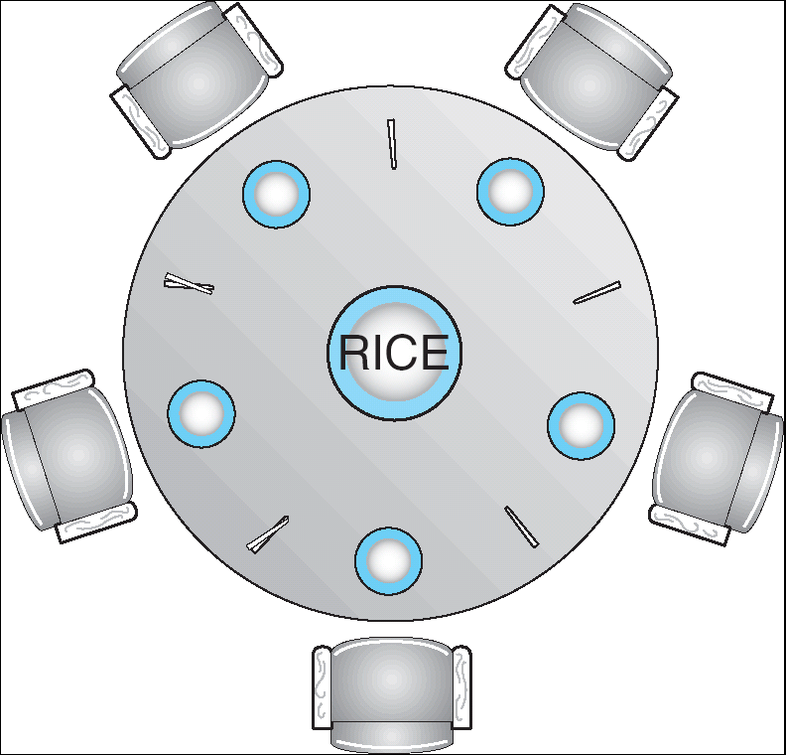

Dining Lawyers Problem

Slide 9
Four requirements for Deadlock

Slide 10
Methods for Handling Deadlocks

Slide 11
Resource-Allocation Graph
Symbols
System Model
  A set of Threads T₁, T₂, . . ., T_{n}
  Resource types R₁, R₂, . . ., R_{m}
    CPU cycles, memory space, I/O devices
  Each resource type R_{i} has W_{i} instances.
  Each thread utilizes a resource as follows:
    Request() / Use() / Release()
Resource-Allocation Graph:
  V is partitioned into two types:
    T = {T₁, T₂, …, T_{n}}, the set threads in the system.
    R = {R₁, R₂, …, R_{m}}, the set of resource types in system
  request edge – directed edge T₁ → R_{j}
  assignment edge – directed edge R_{j} → T_{i}
T₁
T₂
R₁
R₂

Slide 12
Deadlock Detection Algorithm
Only one of each type of resource ⇒ look for loops
More General Deadlock Detection Algorithm
  Let [X] represent an m-ary vector of non-negative
  integers (quantities of resources of each type):
  [FreeResources]: Current free resources each type
  [Request_{X}]: Current requests from thread X
  [Alloc_{X}]: Current resources held by thread X
  See if tasks can eventually terminate on their own
[Avail] = [FreeResources]
Add all nodes to UNFINISHED
do {
done = true
Foreach node in UNFINISHED {
if ([Request_{node}] <= [Avail]) {
remove node from UNFINISHED
[Avail] = [Avail] + [Alloc_{node}]
done = false
}
}
} until(done)
  Nodes left in UNFINISHED ⇒ deadlocked
R₁
T₂
T₁
T₃
T₄
R₂

Slide 13
Resource Allocation Graph Examples
Recall:
  request edge – directed edge T₁ → R_{j}
  assignment edge – directed edge R_{j} → T_{i}
R₁
R₂
R₁
R₂
R₁
T₂
T₁
T₂
T₃
T₁
T₂
T₃
T₁
T₃
R₃
T₄
R₄
R₃
R₂
R₄
¿Deadlock?
¿Deadlock?
¿Deadlock?

Slide 14
What to do when detect deadlock?
Terminate thread, force it to give up resources
Preempt resources without killing off thread
Roll back actions of deadlocked threads

Slide 15
Techniques for Preventing Deadlock

Slide 16
Summary
Suggestions for dealing with Project Partners
  Start Early, Meet Often
  Develop Good Organizational Plan, Document Everything,
  Use the right tools, Develop Comprehensive Testing Plan
  (Oh, and add 2 years to every deadline!)
Starvation vs. Deadlock
  Starvation: thread waits indefinitely
  Deadlock: circular waiting for resources
Four conditions for deadlocks
  Mutual exclusion
    Only one thread at a time can use a resource
  Hold and wait
    Thread holding at least one resource is waiting to acquire additional resources held by other threads
  No preemption
    Resources are released only voluntarily by the threads
  Circular wait
    ∃ set {T₁, …, T_{n}} of threads with a cyclic waiting pattern

Slide 17
Summary (2)
Techniques for addressing Deadlock
  Allow system to enter deadlock and then recover
  Ensure that system will never enter a deadlock
  Ignore the problem and pretend that deadlocks never occur in the system
Deadlock detection
  Attempts to assess whether waiting graph can ever make progress
Next Time: Deadlock prevention
  Assess, for each allocation, whether it has the potential to lead to deadlock
  Banker’s algorithm gives one way to assess this

