Slide 1
Operating Systems and
Systems Programming
Thread Scheduling (con’t)
Protection: Address Spaces
Ing. Etson Guerrero

Slide 2
Multi-Level Feedback Scheduling

Slide 3
Scheduling Details
Result approximates SRTF:
  CPU bound jobs drop like a rock
  Short-running I/O bound jobs stay near top
Scheduling must be done between the queues
  Fixed priority scheduling:
    serve all from highest priority, then next priority, etc.
  Time slice:
    each queue gets a certain amount of CPU time
    e.g., 70% to highest, 20% next, 10% lowest
Countermeasure: user action that can foil intent of the OS designer
  For multilevel feedback, put in a bunch of meaningless I/O to keep job’s priority high
  Of course, if everyone did this, wouldn’t work!

Slide 4
Scheduling Fairness
What about fairness?
  Strict fixed-priority scheduling between queues is unfair (run highest, then next, etc):
    long running jobs may never get CPU
    In Multics, shut down machine, found 10-year-old job
  Must give long-running jobs a fraction of the CPU even when there are shorter jobs to run
  Tradeoff: fairness gained by hurting avg response time!
How to implement fairness?
  Could give each queue some fraction of the CPU
    What if one long-running job and 100 short-running ones?
    Like express lanes in a supermarket—sometimes express lanes get so long, get better service by going into one of the other lines
  Could increase priority of jobs that don’t get service
    What is done in UNIX
    This is ad hoc—what rate should you increase priorities?
    And, as system gets overloaded, no job gets CPU time, so everyone increases in priority⇒Interactive jobs suffer

Slide 5

Lottery Scheduling
Yet another alternative: Lottery Scheduling
  Give each job some number of lottery tickets
  On each time slice, randomly pick a winning ticket
  On average, CPU time is proportional to number of tickets given to each job
How to assign tickets?
  To approximate SRTF, short running jobs get more, long running jobs get fewer
  To avoid starvation, every job gets at least one ticket (everyone makes progress)
Advantage over strict priority scheduling: behaves gracefully as load changes
  Adding or deleting a job affects all jobs proportionally, independent of how many tickets each job possesses

Slide 6
Lottery Scheduling Example
Lottery Scheduling Example
  Assume short jobs get 10 tickets, long jobs get 1 ticket
  What if too many short jobs to give reasonable
  response time?
    In UNIX, if load average is 100, hard to make progress
    One approach: log some user out
# short jobs/ # long jobs | % of CPU each short jobs gets | % of CPU each long jobs gets
1/1 | 91% | 9%
0/2 | N/A | 50%
2/0 | 50% | N/A
10/1 | 9.9% | 0.99%
1/10 | 50% | 5%

Slide 7

How to Evaluate a Scheduling algorithm?
Deterministic modeling
  takes a predetermined workload and compute the performance of each algorithm for that workload
Queueing models
  Mathematical approach for handling stochastic workloads
Implementation/Simulation:
  Build system which allows actual algorithms to be run against actual data. Most flexible/general.

Slide 8
Goals for Today
Kernel vs User Mode
What is an Address Space?
How is it Implemented?
Note: Some slides and/or pictures in the following are
adapted from slides ©2005 Silberschatz, Galvin, and Gagne

Slide 9
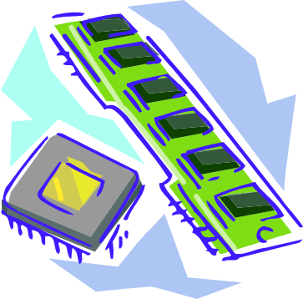
Virtualizing Resources
Physical Reality:
Different Processes/Threads share the same hardware
  Need to multiplex CPU (Just finished: scheduling)
  Need to multiplex use of Memory (Today)
  Need to multiplex disk and devices (later in term)
Why worry about memory sharing?
  The complete working state of a process and/or kernel is defined by its data in memory (and registers)
  Consequently, cannot just let different threads of control use the same memory
    Physics: two different pieces of data cannot occupy the same locations in memory
  Probably don’t want different threads to even have access to each other’s memory (protection)

Slide 10
Important Aspects of Memory Multiplexing
Controlled overlap:
Translation:
Protection:

Slide 11
Dual-Mode Operation
To Assist with Protection, Hardware provides at least two modes (Dual-Mode Operation):
  “Kernel” mode (or “supervisor” or “protected”)
  “User” mode (Normal program mode)
  Mode set with bits in special control register only accessible in kernel-mode
Intel processor actually has four “rings” of protection:
  PL (Priviledge Level) from 0 – 3
    PL0 has full access, PL3 has least
  Privilege Level set in code segment descriptor (CS)
  Mirrored “IOPL” bits in condition register gives permission to programs to use the I/O instructions
  Typical OS kernels on Intel processors only use PL0 (“user”) and PL3 (“kernel”)

Slide 12
How to get from Kernel→User
What does the kernel do to create a new user process?
  Allocate and initialize address-space control block
  Read program off disk and store in memory
  Allocate and initialize translation table
    Point at code in memory so program can execute
    Possibly point at statically initialized data
  Run Program:
    Set machine registers
    Set hardware pointer to translation table
    Set processor status word for user mode
    Jump to start of program
How does kernel switch between processes?
  Same saving/restoring of registers as before
  Save/restore PSL (hardware pointer to translation table)

Slide 13

User→Kernel (System Call)
Can’t let inmate (user) get out of padded cell on own
  Would defeat purpose of protection!
  So, how does the user program get back into kernel?
System call: Voluntary procedure call into kernel
  Hardware for controlled User→Kernel transition
  Can any kernel routine be called?
    No! Only specific ones.
  System call ID encoded into system call instruction
    Index forces well-defined interface with kernel

Slide 14
System Call Continued
What are some system calls?
  I/O: open, close, read, write, lseek
  Files: delete, mkdir, rmdir, truncate, chown, chgrp, ..
  Process: fork, exit, wait (like join)
  Network: socket create, set options
Are system calls constant across operating systems?
What happens at beginning of system call?
System Call argument passing:

Slide 15
User→Kernel (Exceptions: Traps and Interrupts)
A system call instruction causes a synchronous exception (or “trap”)
  In fact, often called a software “trap” instruction
Other sources of Synchronous Exceptions:
  Divide by zero, Illegal instruction, Bus error (bad address, e.g. unaligned access)
  Segmentation Fault (address out of range)
  Page Fault (for illusion of infinite-sized memory)

Slide 16
User→Kernel (Exceptions: Traps and Interrupts)
Interrupts are Asynchronous Exceptions
  Examples: timer, disk ready, network, etc….
  Interrupts can be disabled, traps cannot!
On system call, exception, or interrupt:
  Hardware enters kernel mode with interrupts disabled
  Saves PC, then jumps to appropriate handler in kernel
  For some processors (x86), processor also saves registers, changes stack, etc.
Actual handler typically saves registers, other CPU state, and switches to kernel stack

Slide 17
Additions to MIPS ISA to support Exceptions?
Exception state is kept in “Coprocessor 0”
  Use mfc0 read contents of these registers:
    BadVAddr (register 8): contains memory address at which memory reference error occurred
    Status (register 12): interrupt mask and enable bits
    Cause (register 13): the cause of the exception
    EPC (register 14): address of the affected instruction
Status Register fields:
  Mask: Interrupt enable
    1 bit for each of 5 hardware and 3 software interrupts
  k = kernel/user: 0⇒kernel mode
  e = interrupt enable: 0⇒interrupts disabled
  Exception⇒6 LSB shifted left 2 bits, setting 2 LSB to 0:
    run in kernel mode with interrupts disabled
15
8
5
4
3
2
1
0
Status
Mask
k
e
k
e
k
e
old
prev
cur

Slide 18
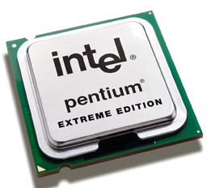
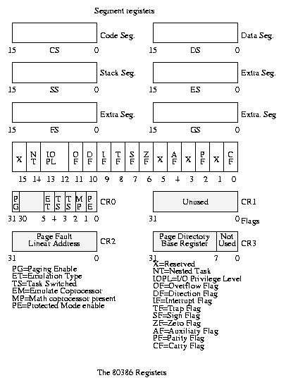
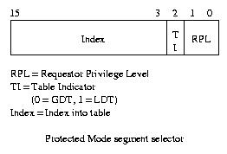
Intel x86 Special Registers
80386 Special Registers
Typical Segment Register
Current Priority is RPL
Of Code Segment (CS)

Slide 19
Controlled Overlap
Translation

Slide 20
Binding of Instructions and Data to Memory
Binding of instructions and data to addresses:
  Choose addresses for instructions and data from the standpoint of the processor
  Could we place data1, start, and/or checkit at different addresses?
    Yes
    When?
  data1: dw 32
  …
  start: lw r1,0(data1)
  jal checkit
  loop: addi r1, r1, -1
  bnz r1, r0, loop …
  checkit: …
  0x300 00000020
  … …
  0x900 8C2000C0
  0x904 0C000340
  0x908 2021FFFF
  0x90C 1420FFFF
  …
  0xD00 …

Slide 21

Multi-step Processing of a Program for Execution

Slide 22
Recall: Uniprogramming
Uniprogramming (no Translation or Protection)
  Application always runs at same place in physical memory since only one application at a time
  Application can access any physical address
  Application given illusion of dedicated machine by giving it reality of a dedicated machine
Of course, this doesn’t help us with multithreading

Slide 23
Multiprogramming (First Version)
Multiprogramming without Translation or Protection
  Must somehow prevent address overlap between threads
  Trick: Use Loader/Linker: Adjust addresses while program loaded into memory (loads, stores, jumps)
    Everything adjusted to memory location of program
    Translation done by a linker-loader
    Was pretty common in early days
With this solution, no protection: bugs in any program can cause other programs to crash or even the OS

Slide 24
Multiprogramming (Version with Protection)
Can we protect programs from each other without translation?
  Yes: use two special registers Base and Limit to prevent user from straying outside designated area
    If user tries to access an illegal address, cause an error
  During switch, kernel loads new base/limit from TCB
    User not allowed to change base/limit registers

Slide 25
Segmentation with Base and Limit registers
Could use base/limit for dynamic address translation (often called “segmentation”):
  Alter address of every load/store by adding “base”
  User allowed to read/write within segment
    Accesses are relative to segment so don’t have to be relocated when program moved to different segment
  User may have multiple segments available (e.g x86)
    Loads and stores include segment ID in opcode:
    x86 Example: mov [es:bx],ax.
    Operating system moves around segment base pointers as necessary

Slide 26
Issues with simple segmentation method
Fragmentation problem
  Not every process is the same size
  Over time, memory space becomes fragmented
Hard to do inter-process sharing
  Want to share code segments when possible
  Want to share memory between processes
  Helped by by providing multiple segments per process
Need enough physical memory for every process

Slide 27
Multiprogramming (Translation and Protection version 2)
Problem: Run multiple applications in such a way that they are protected from one another
Goals:
  Isolate processes and kernel from one another
  Allow flexible translation that:
    Doesn’t lead to fragmentation
    Allows easy sharing between processes
    Allows only part of process to be resident in physical memory

Slide 28
Example of General Address Translation
Code
Data
Heap
Stack
Data 2
Code
Data
Heap
Stack
Stack 1
Heap 1
Code 1
Stack 2
Prog 1
Virtual
Address
Space 1
Data 1
Prog 2
Virtual
Address
Space 2
Heap 2
Code 2
OS code
Translation Map 1
OS data
Translation Map 2
OS heap &
Stacks
Physical Address Space

Slide 29
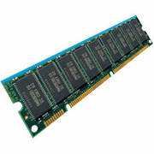
Two Views of Memory
CPU
Virtual
Addresses
Physical
Addresses
MMU
Untranslated read or write
Recall: Address Space:
  All the addresses and state a process can touch
  Each process and kernel has different address space
Consequently: two views of memory:
  View from the CPU (what program sees, virtual memory)
  View fom memory (physical memory)
  Translation box converts between the two views
Translation helps to implement protection
  If task A cannot even gain access to task B’s data, no way for A to adversely affect B
With translation, every program can be linked/loaded into same region of user address space
  Overlap avoided through translation, not relocation

Slide 30
Example of Translation Table Format
1K
PTEs
Two-level Page Tables
4KB
32-bit address:
10
10
12
P1 index
P2 index
page offset
4 bytes
4 bytes

Slide 31

Communication
Now that we have isolated processes, how
can they communicate?

Slide 32
Closing thought: Protection without Hardware
Does protection require hardware support for translation and dual-mode behavior?
  No: Normally use hardware, but anything you can do in hardware can also do in software (possibly expensive)
Protection via Strong Typing
  Restrict programming language so that you can’t express program that would trash another program
  Loader needs to make sure that program produced by valid compiler or all bets are off
  Example languages: LISP, Ada, Modula-3 and Java
Protection via software fault isolation:
  Language independent approach: have compiler generate object code that provably can’t step out of bounds
    Compiler puts in checks for every “dangerous” operation (loads, stores, etc). Again, need special loader.
    Alternative, compiler generates “proof” that code cannot do certain things (Proof Carrying Code)
  Or: use virtual machine to guarantee safe behavior (loads and stores recompiled on fly to check bounds)

