Slide 1
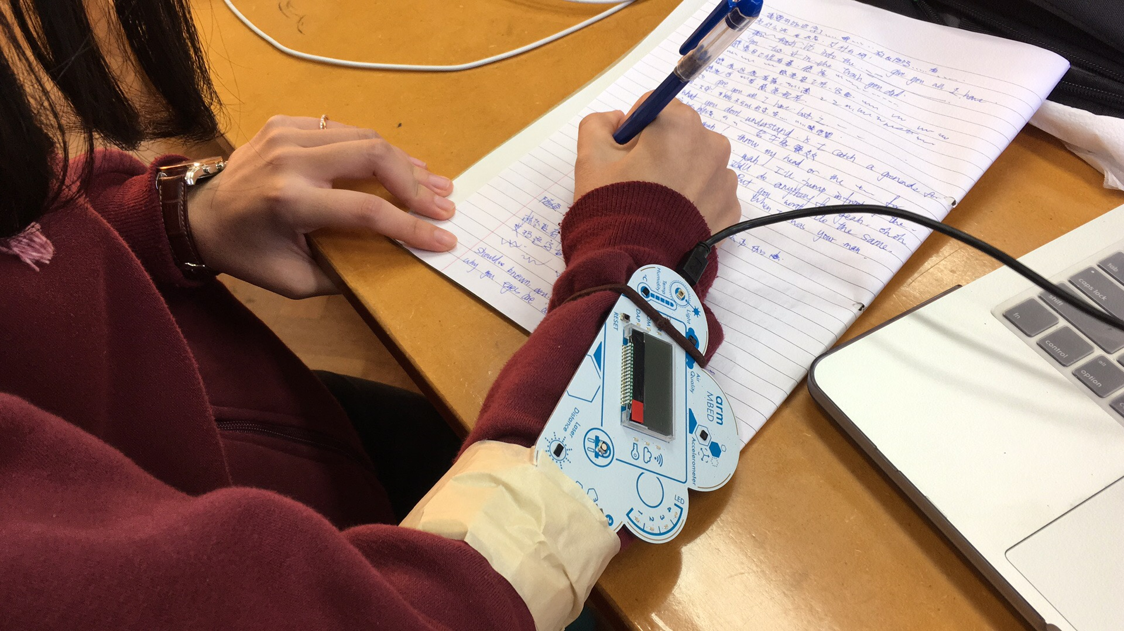
Wearable Mbed
--keep track of your life
Group member:
Xiaodong Wu
Weizhe Lin
Hehui Zheng
Yi Wang

Slide 2
Application of our device
Help people keep track of their time allocation in a day, and keep an eye on their surrondings
Major Activities Monitored:
Browsing the Internet and writing
Walking
Idle
With the help of it : make your time better allocated !

Slide 3
Special features of our device
Mbed directly upload data to the server through MQTT
Automatically recignize movement patterns of user with neural network
Sending warning message to user’s mailbox when abnormality is detected in environment (Air quality and Ambient light)
Rise to wake: show all the readings including time on Mbed’s display only when user raise the device towards his/her face.

Slide 4
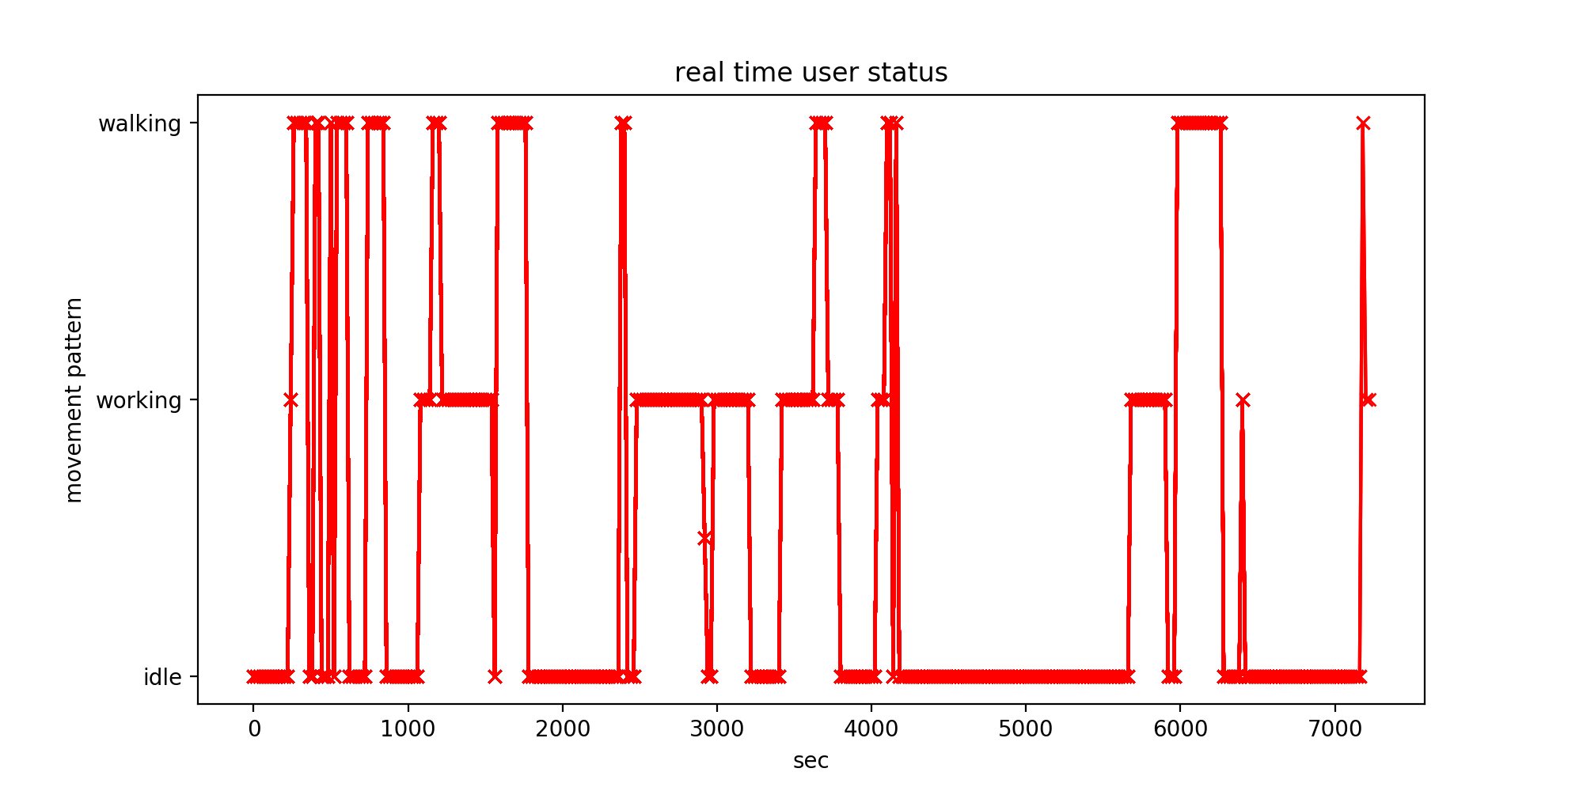
Sample Outcome of the recognition

Slide 5
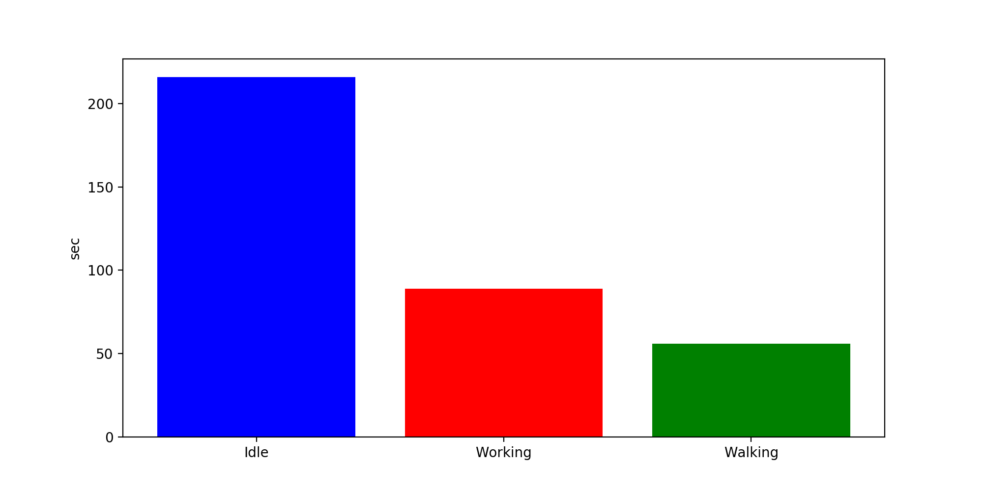
Time ratio between activities

Slide 6
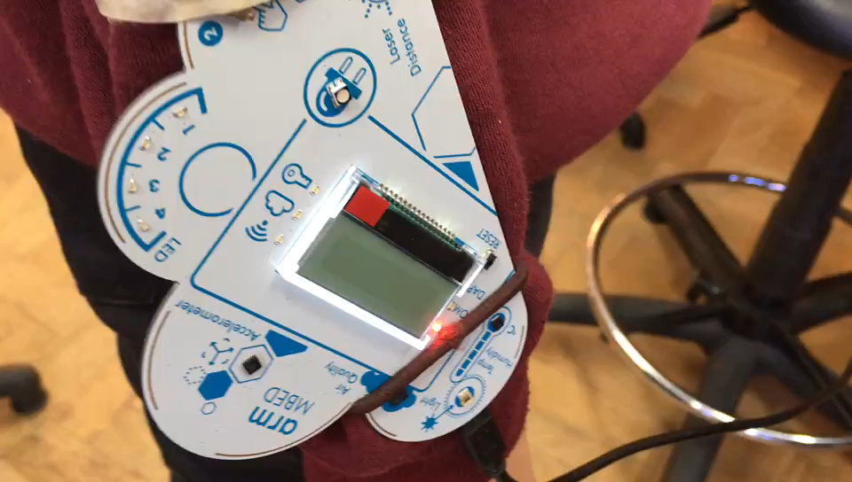
Raise to Wake

Slide 7
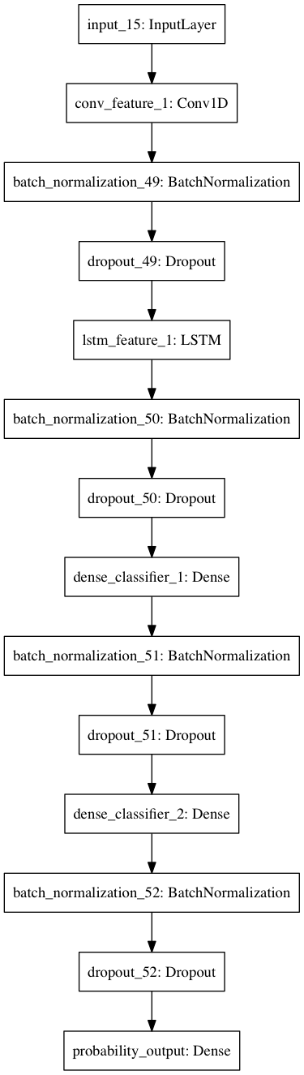
How
we achieve
It:
Neural network

Slide 8
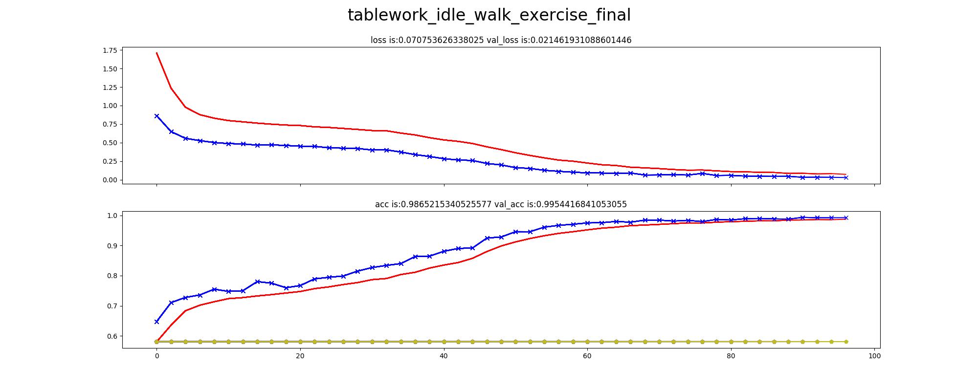
Accuracy of classification
Loss (tend to 0)
Validation Set
Training Set
Accuracy rate (tend to 1)

