Slide 1
8 bit CPU + eFPGA/sorter
Members
  Philippos, Deepak, Moritz, Malte, Enrica
Components
  SAP-3 processor (stand-alone slot)
  Sorter accelerator (stand-alone slot)
  eFPGA part

Slide 2
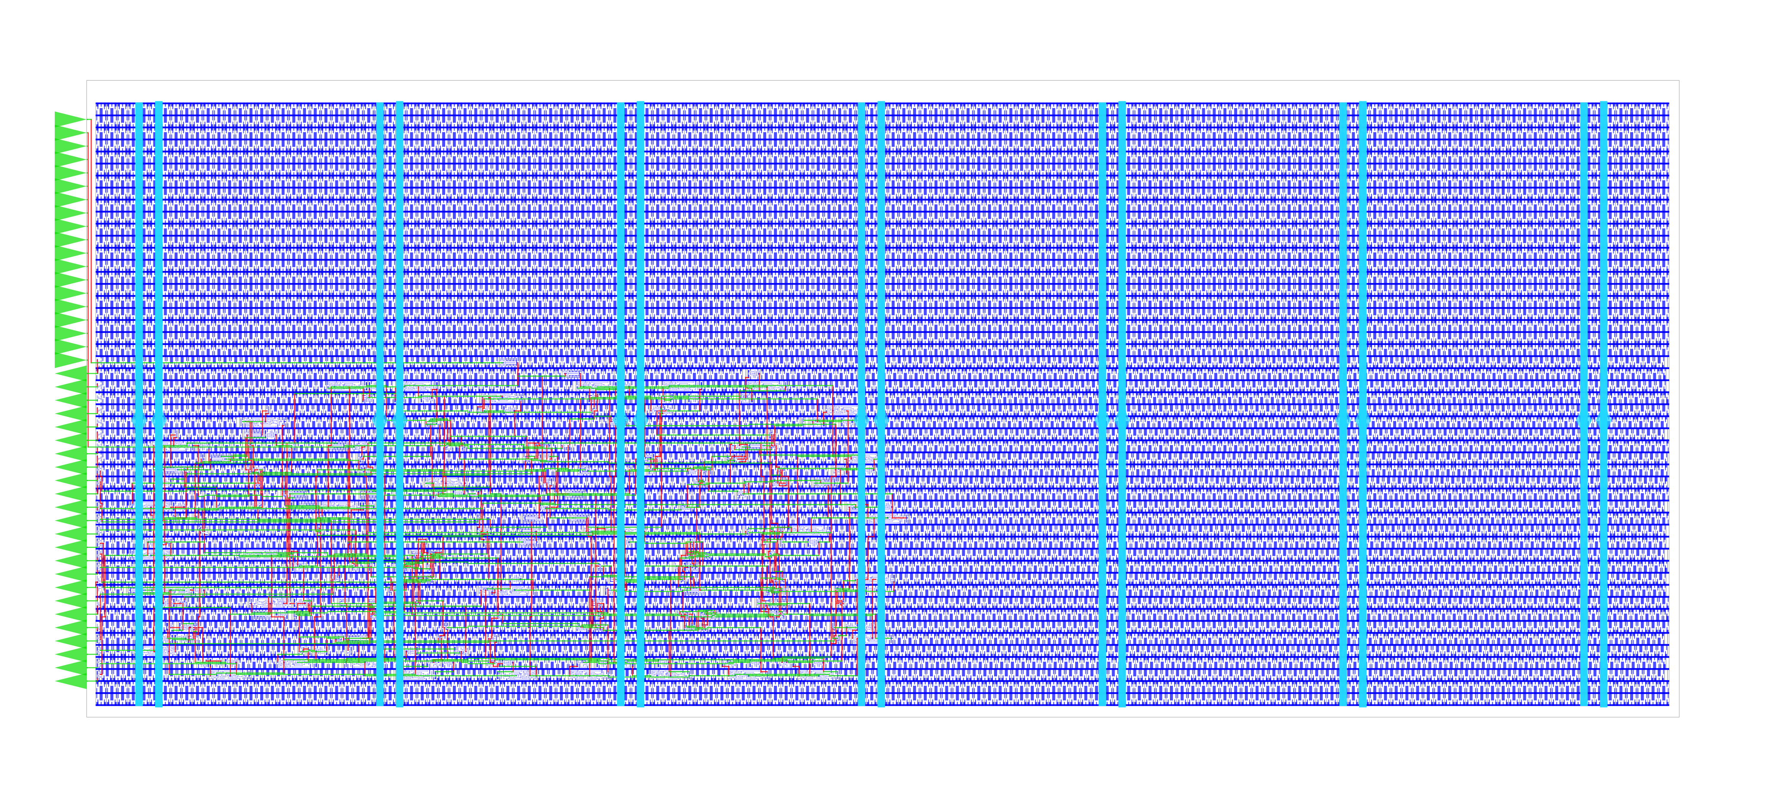
Physical implementation SAP-1

Slide 3
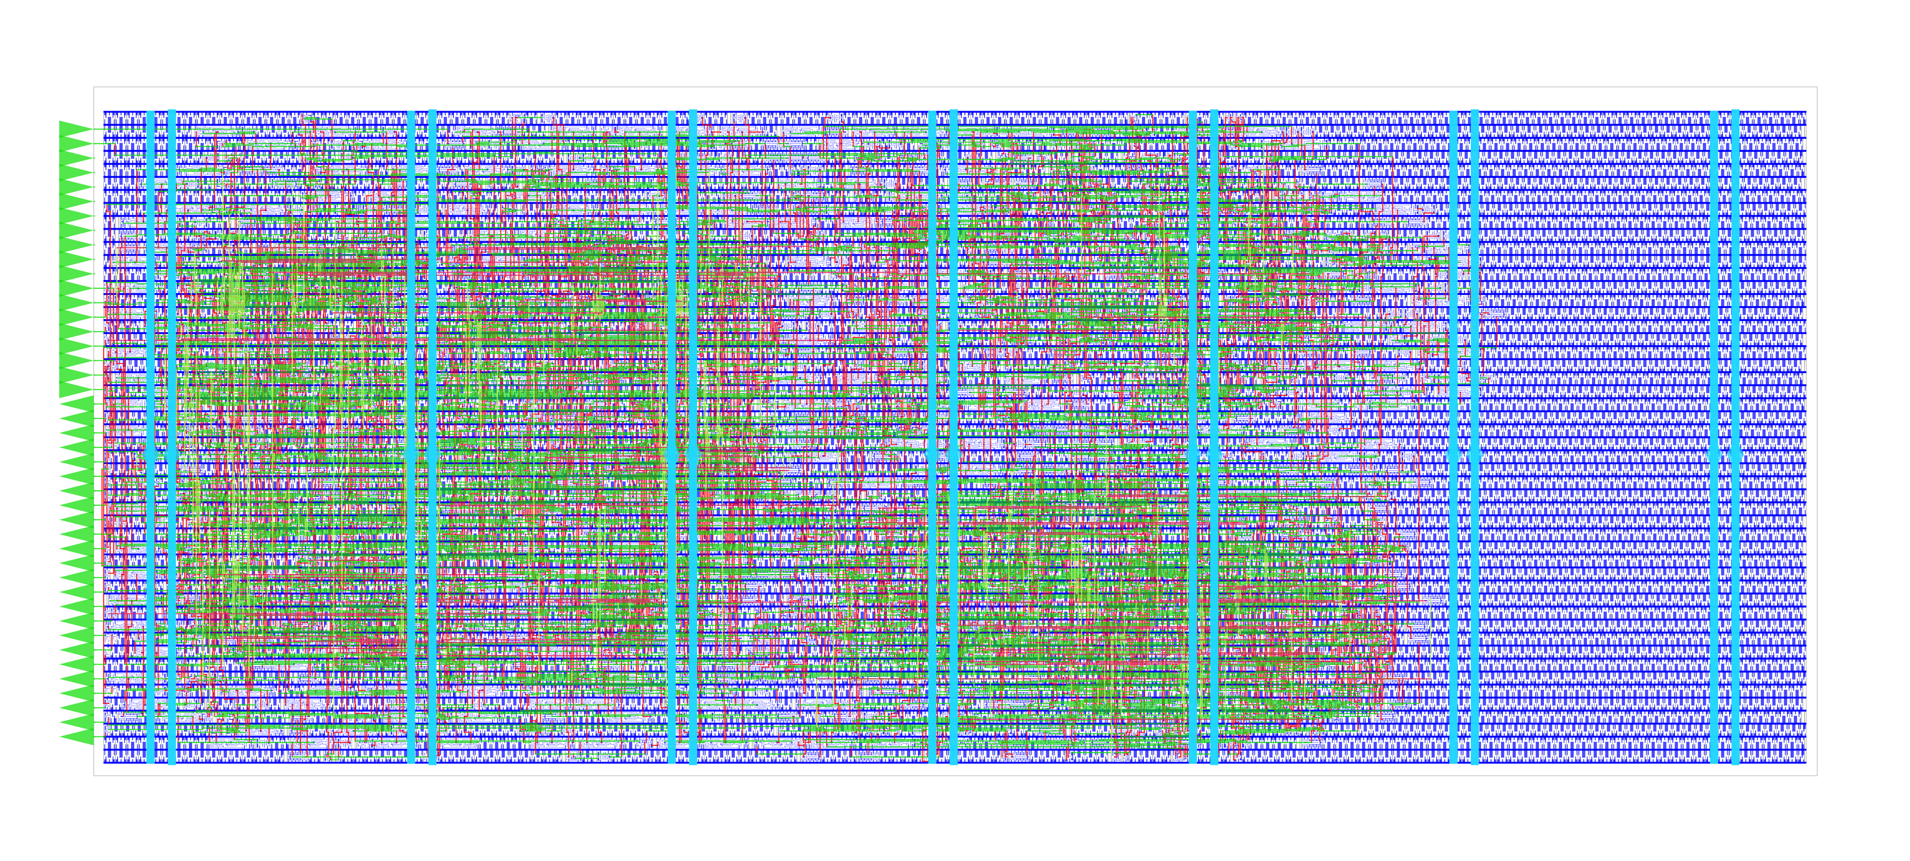
Physical implementation SAP-3

Slide 4
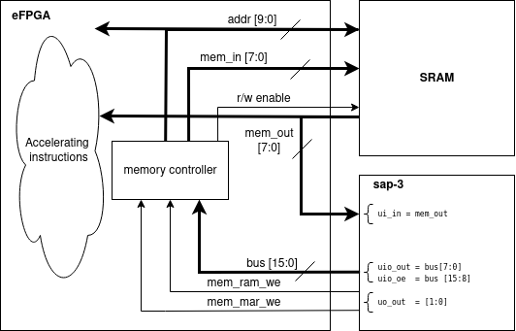
SAP-3

Slide 5
“Top Sorter”
Initially a backup project for “8-bit CPU + custom acc.”
  Works stand-alone
  Extension of “8-bit CPU + custom acc.”

Slide 6
The task
Linear sorter
  “Parallel” version of insertion sort

Slide 7
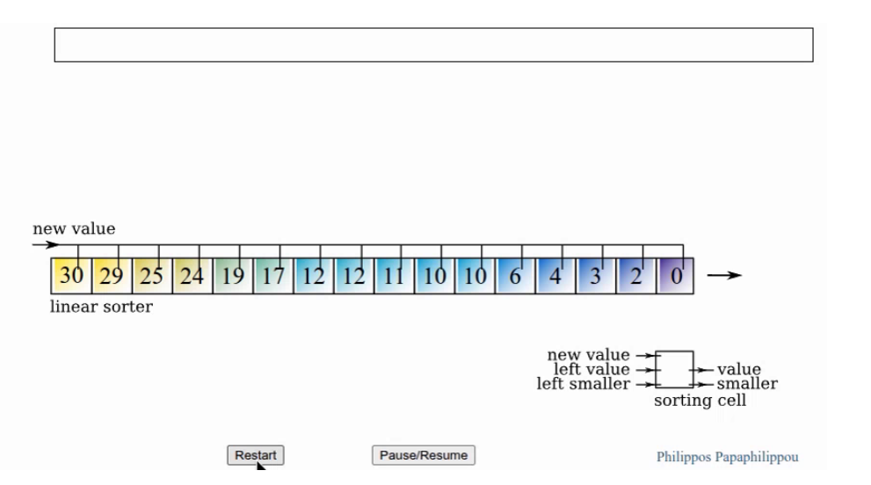
Animation from philippos.info
Click here for the animation: https://philippos.info/sort_visual/linsort.html

Slide 8
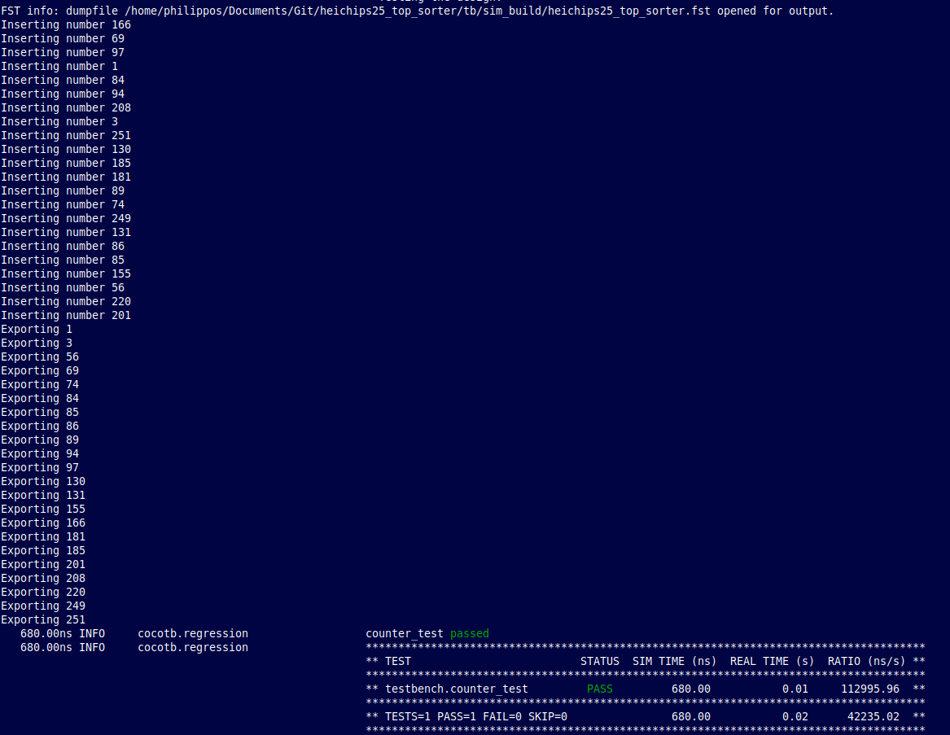
Testbench

Slide 9
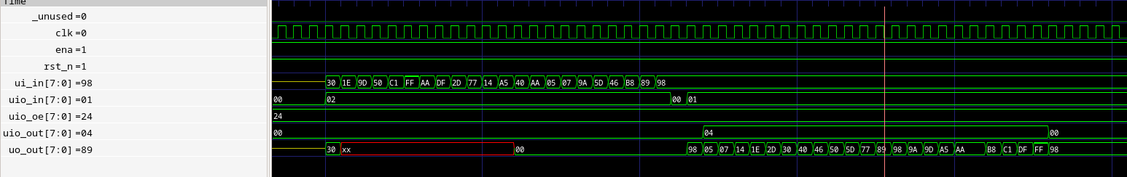
Testbench waveform

Slide 10
Final design specs
N = 22 (sorted list size/ top N)
Data width = 8 bits
100 MHz
  → Throughput: 100 MB/s

Slide 11
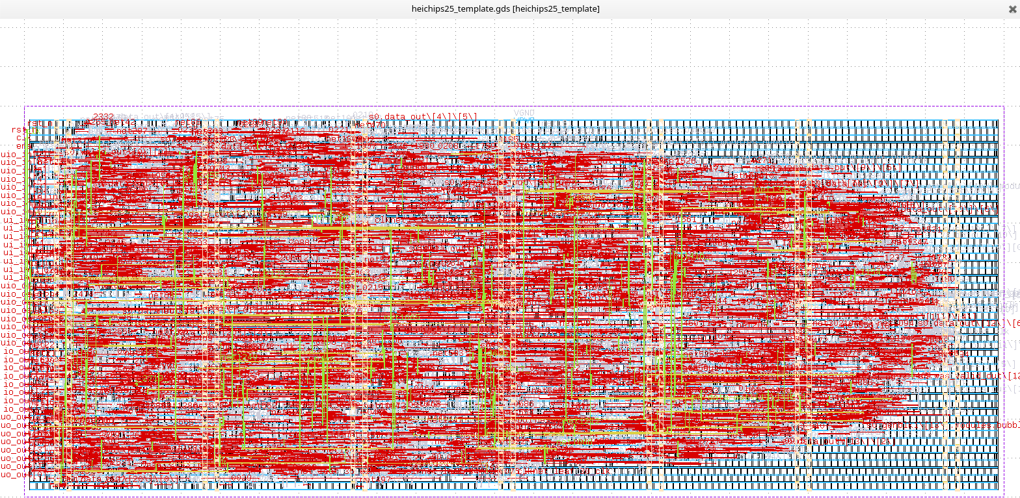
Klayout

Slide 12
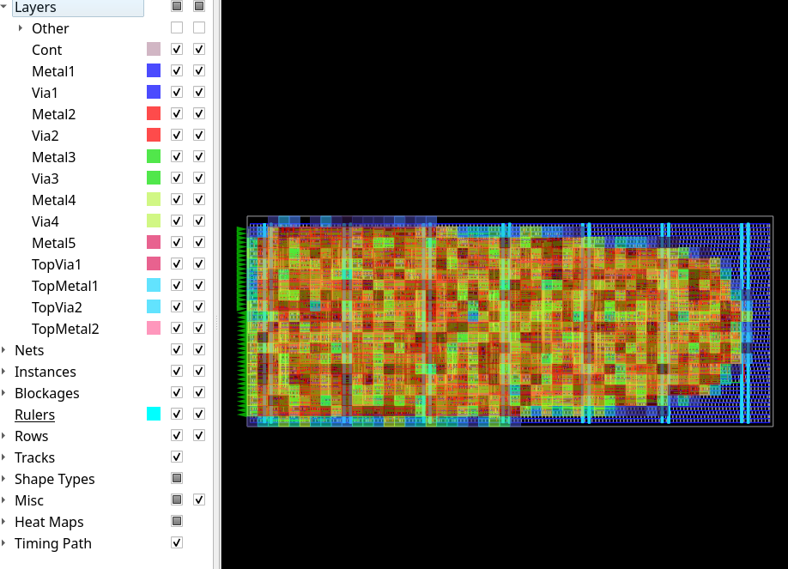
OpenRoad

Slide 13
Ongoing work
SAP-3
  eFPGA custom instr. verification
Sort
  Optimisation (increase N at 100 MHz+)
    Systolic version
    No need to have the entire list sorted on next cycle
  More functionality
    Top N
    Merge-version for sorting the entire SRAM with CPU

Slide 14
Thanks

