Slide 1
DATA 300
Topic 5: Resampling methods

Slide 2
Agenda
Cross-validation
Leave-one-out (LOOCV)
K-fold
Bootstrapping
Imbalanced classification
Oversampling
Undersampling
Synthetic Minority Oversampling Technique (SMOTE)

Slide 3

Recall that in bias-variance trade-off..
MSE can be decomposed to
In other words, there are three components in MSE:
The variance of the model
The amount of change in the model when we change the training set.
Tend to be low if the model is simple and less flexible.
The bias of the model
The error introduced by using a model to approximate a real-life problem.
Tend to be low if the model is flexible and complicated.
Irreducible variance that cannot be controlled by the model.

Slide 4
Recall that in bias-variance trade-off..
MSE can be decomposed to
In other words, there are three components in MSE:
The variance of the model
The amount of change in the model when we change the training set.
Tend to be low if the model is simple and less flexible.
The bias of the model
The error introduced by using a model to approximate a real-life problem.
Tend to be low if the model is flexible and complicated.
Irreducible variance that cannot be controlled by the model.
Therefore, for prediction purposes, a good model needs to
Have a smaller error on training set
Does not change that much when there are different sample units (from the same population, of course) in the training set

Slide 5
Brainstorming
We train the model with a trainingset, and apply the trained model to a testset. Comparing to a simple model, a more complex model makes
the training error increase, decrease, or remain the same?
What about the testing error?

Slide 6
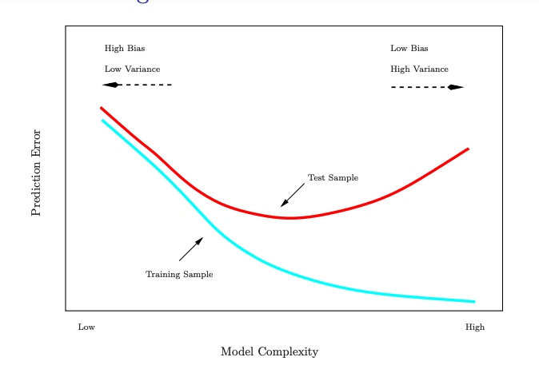
Training-testing performance comparison

Slide 7
Training-testing performance comparison
Generally speaking, training error always underestimate the test error, regardless of model complexity.
Then how do we know if a model is good for prediction?

Slide 8
Validation set approach
The best solution to deal with the underestimation is to have a large designated test set, which is often unavailable.
This is why we have been using a holdout validation set to approximate the testing error.
Is this approximation smaller or larger than test error?

Slide 9
Validation set approach
The best solution to deal with the underestimation is to have a large designated test set, which is often unavailable.
This is why we have been using a holdout validation set to approximate the testing error.
Is this a good approximation?
Validation error tends to overestimate the test error.
The reason is we obtained a validation set by reducing the training set. With fewer sample units in the training set, the model tends to perform worse.

Slide 10
Validation set approach
The best solution to deal with the underestimation is to have a large designated test set, which is often unavailable.
This is why we have been using a holdout validation set to approximate the testing error.
Is this a good approximation?
Validation error tends to overestimate the test error.
The reason is we obtained a validation set by reducing the training set. With fewer sample units in the training set, the model tends to perform worse.
What is the immediate solution?

Slide 11
Agenda
Cross-validation
Leave-one-out (LOOCV)
K-fold
Bootstrapping
Imbalanced classification
Oversampling
Undersampling

Slide 12
Cross-validation approach
Leave-one-out cross validation (LOOCV):
Leave only one unit in the validation set, so the size of the training set is guaranteed.
Repeat this step n times, so that each time it is a different unit in the validation set, to get rid of the randomness in the train-validation split.

Slide 13
Cross-validation approach
Leave-one-out cross validation (LOOCV):
Leave only one unit in the validation set, so the size of the training set is guaranteed.
Repeat this step n times, so that each time it is a different unit in the validation set, to get rid of the randomness in the train-validation split.
What is the disadvantage of this approach?

Slide 14
Cross-validation approach
Leave-one-out cross validation (LOOCV):
Leave only one unit in the validation set, so the size of the training set is guaranteed.
Repeat this step n times, so that each time it is a different unit in the validation set, to get rid of the randomness in the train-validation split.
What is the disadvantage of this approach?
High computation cost.

Slide 15
Agenda
Cross-validation
Leave-one-out (LOOCV)
K-fold
Bootstrapping
Imbalanced classification
Oversampling
Undersampling

Slide 16
Cross-validation approach
K-fold validation:
Use one fold as the validation set, and use the rest of the k-1 folds for training.
Repeat this k times, so that each fold is used as validation once
Common ones:
5-fold validation: randomly divide the training set to 5 folds.
10-fold validation.
A n-fold validation is equivalent to _____________.

Slide 17
Cross-validation approach
K-fold validation:
Use one fold as the validation set, and use the rest of the k-1 folds for training.
Repeat this k times, so that each fold is used as validation once
Common ones:
5-fold validation: randomly divide the training set to 5 folds.
10-fold validation.
A n-fold validation is equivalent to LOOCV.
As k increases, the cross-validation error gets a smaller/larger bias to the test error, and a smaller/larger variance.

Slide 18
Cross-validation approach
K-fold validation:
Use one fold as the validation set, and use the rest of the k-1 folds for training.
Repeat this k times, so that each fold is used as validation once
Common ones:
5-fold validation: randomly divide the training set to 5 folds.
10-fold validation.
A n-fold validation is equivalent to LOOCV.
As k increases, the cross-validation error gets a smaller/larger bias to the test error, and a smaller/larger variance.

Slide 19
Brainstorming
Suppose that we wish to invest a fixed sum of money in two financial assets that yield random returns of X and Y respectively.
We will invest a fraction α of our money in X, and will invest the remaining 1 − α in Y.
What is your investment goal here?

Slide 20
Brainstorming
Suppose that we wish to invest a fixed sum of money in two financial assets that yield random returns of X and Y respectively.
We will invest a fraction α of our money in X, and will invest the remaining 1 − α in Y.
What is your investment goal here?
Minimizing the total risk/variance Var(αX + (1 − α)Y).

Slide 21
Brainstorming
Suppose that we wish to invest a fixed sum of money in two financial assets that yield random returns of X and Y respectively.
We will invest a fraction α of our money in X, and will invest the remaining 1 − α in Y.
What is your investment goal here?
Minimizing the total risk/variance Var(αX + (1 − α)Y).
But how do we estimate the variance/covariance for the investments?

Slide 22
Brainstorming
Suppose that we wish to invest a fixed sum of money in two financial assets that yield random returns of X and Y respectively.
We will invest a fraction α of our money in X, and will invest the remaining 1 − α in Y.
What is your investment goal here?
Minimizing the total risk/variance Var(αX + (1 − α)Y).
But how do we estimate the variance/covariance for the investments?
In an ideal world, we could use a lot of subsets from the original population to compute. However, such datasets are often not available.

Slide 23
Agenda
Cross-validation
Leave-one-out (LOOCV)
K-fold
Bootstrapping
Imbalanced classification
Oversampling
Undersampling

Slide 24
Bootstrapping
The Bootstrapping method refers to the procedure of repeatedly sampling (with replacement) from the dataset.
As a result, we could obtain multiple datasets from the initial dataset, and would be able to measure variation among datasets.

Slide 25
Design a bootstrapping process
Assume we want to measure the variation of average income in the US. We collected a dataset of a sample 10:
$40k, $50k, $45k, $80k, $100k, $110k, $90k, $85k, $120k, $1 million
What happens next?

Slide 26
Agenda
Cross-validation
Leave-one-out (LOOCV)
K-fold
Bootstrapping
Imbalanced classification
Oversampling
Undersampling

Slide 27
Sampling for imbalanced datasets
An imbalanced classification refers to classification problems where one class has way more sample units than the other.
What are the common imbalanced classification problems?

Slide 28
Sampling for imbalanced datasets
An imbalanced classification refers to classification problems where one class has way more sample units than the other.
What are the common imbalanced classification problems?
Classifying patients with cancer (we can only obtain a small sample for diagnosed patients, relative to the healthy population)
Churn prediction for carriers (only a small percentage of customers will switch carrier)
…

Slide 29
Sampling for imbalanced datasets
Oversampling refers to sample (with replacement) from the underrepresented group, until we obtain a group of a similar size.

Slide 30
Sampling for imbalanced datasets
Oversampling refers to sample (with replacement) from the underrepresented group, until the two groups are of similar size.
Undersampling refers to sample from the overrepresented group, until the two groups are of similar size.

Slide 31
Sampling for imbalanced datasets
Oversampling refers to sample (with replacement) from the underrepresented group, until the two groups are of similar size.
Undersampling refers to sample from the overrepresented group, until the two groups are of similar size.
Hybrid sampling refers to a mix of the above two.

Slide 32
The applicability of the sampling methods
Assume we have a dataset with one class having 100 sample units, and the other class having 20 sample units, which method is more applicable?

Slide 33
The applicability of the sampling methods
Assume we have a dataset with one class having 100 sample units, and the other class having 20 sample units, which method is more applicable?
Undersampling, because the majority class is still a small sample.

Slide 34
The applicability of the sampling methods
How about one class having 100,000 sample units, and the other class having 20,000 sample units, which method is more applicable?

Slide 35
The applicability of the sampling methods
How about one class having 100,000 sample units, and the other class having 20,000 sample units, which method is more applicable?
Oversampling, because the underrepresented class is already considerable sample size.

