Slide 1
DATA 300
Topic 8: Support Vector Machines (SVM)

Slide 2
Agenda
Maximal marginal classifier
Support Vector Classifier
The Loss+penalty form
Non-linear separating hyperplanes

Slide 3
Hyperplane
 | # of bedrooms | Price | Living space | # of bathrooms
House 1 | 5 | $150k | 3000 sq.ft. | 3
House 2 | 3 | $150k | 1200 | 1
House 3 | 2 | $200k | 800 | 1

Slide 4
Hyperplane
 | # of bedrooms | Price | Living space | # of bathrooms
House 1 | 5 | $150k | 3000 sq.ft. | 3
House 2 | 3 | $150k | 1200 | 1
House 3 | 2 | $200k | 800 | 1
I also (somehow) know the multiplier for each of the variables is 3, -0.5, 20, 1 , respectively, with an intercept of 20,000.

Slide 5
Hyperplane
 | # of bedrooms | Price | Living space | # of bathrooms | Sold or not | f(x)
House 1 | 5 | $150k | 3000 sq.ft. | 3 | Yes | 5018
House 2 | 3 | $150k | 1200 | 1 | No | -30990
House 3 | 2 | $200k | 800 | 1 | No | -63993
I also (somehow) know the multiplier for each of the variables is 3, -0.5, 20, 1 , respectively, with an intercept of 20,000.
If I multiply each multiplier with the corresponding variable and add the intercept, we get a column, say, f(x).

Slide 6
Hyperplane
 | # of bedrooms | Price | Living space | # of bathrooms | Sold or not | f(x)
House 1 | 5 | $150k | 3000 sq.ft. | 3 | Yes | 5018
House 2 | 3 | $150k | 1200 | 1 | No | -30990
House 3 | 2 | $200k | 800 | 1 | No | -63993
I also (somehow) know the multiplier for each of the variables is 3, -0.5, 20, 1 , respectively, with an intercept of 20,000.
If I multiply each multiplier with the corresponding variable and add the intercept, we get a column, say, f(x).
How do I use this f(x) to predict for whether a house is sold or not?

Slide 7
Hyperplane
 | # of bedrooms | Price | Living space | # of bathrooms | f(x) | Sold or not
House 1 | 5 | $150k | 3000 sq.ft. | 3 | 5018 | Yes
House 2 | 3 | $150k | 1200 | 1 | -30990 | No
House 3 | 2 | $200k | 800 | 1 | -63993 | No
I also (somehow) know the multiplier for each of the variables is 3, -0.5, 20, 1 , respectively, with an intercept of 20,000.
If I multiply each multiplier with the corresponding variable and add the intercept, we get a column, say, f(x).
How do I use this f(x) to predict for whether a house is sold or not?
Predict as sold if f(x) > 0, otherwise it is NOT.

Slide 8
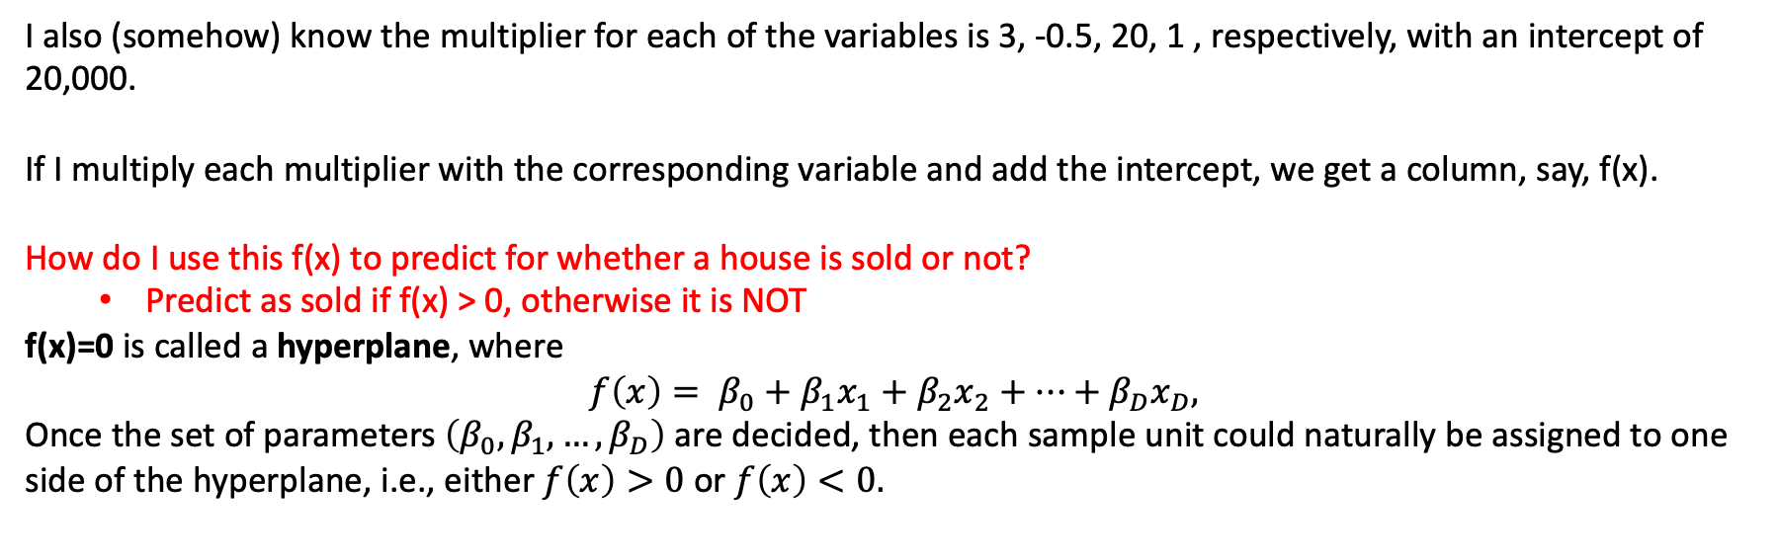
Hyperplane
 | # of bedrooms | Price | Living space | # of bathrooms | f(x) | Sold or not
House 1 | 5 | $150k | 3000 sq.ft. | 3 | 5018 | Yes
House 2 | 3 | $150k | 1200 | 1 | -30990 | No
House 3 | 2 | $200k | 800 | 1 | -63993 | No
I also (somehow) know the multiplier for each of the variables is 3, -0.5, 20, 1 , respectively, with an intercept of 20,000.
If I multiply each multiplier with the corresponding variable and add the intercept, we get a column, say, f(x).
How do I use this f(x) to predict for whether a house is sold or not?
Predict as sold if f(x) > 0, otherwise it is NOT
f(x)=0 is called a hyperplane, where
$$f\left(x\right)= β_{0}+β_{1}x_{1}+β_{2}x_{2}+…+β_{D}x_{D},$$
Once the set of parameters $\left(β_{0},β_{1},…,β_{D}\right)$ are decided, then each sample unit could naturally be assigned to one side of the hyperplane, i.e., either $f\left(x\right)>0$ or $f\left(x\right)<0.$

Slide 9
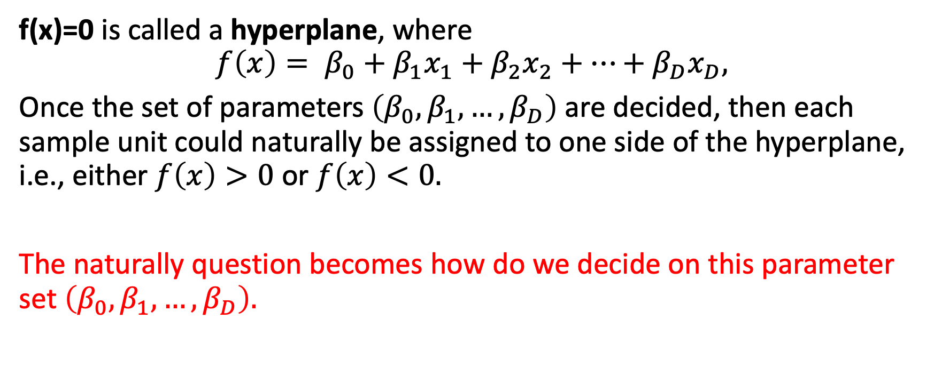
Maximal marginal classifier
f(x)=0 is called a hyperplane, where
$$f\left(x\right)= β_{0}+β_{1}x_{1}+β_{2}x_{2}+…+β_{D}x_{D},$$
Once the set of parameters $\left(β_{0},β_{1},…,β_{D}\right)$ are decided, then each sample unit could naturally be assigned to one side of the hyperplane, i.e., either $f\left(x\right)>0$ or $f\left(x\right)<0.$
The naturally question becomes how do we decide on this parameter set $\left(β_{0},β_{1},…,β_{D}\right).$

Slide 10
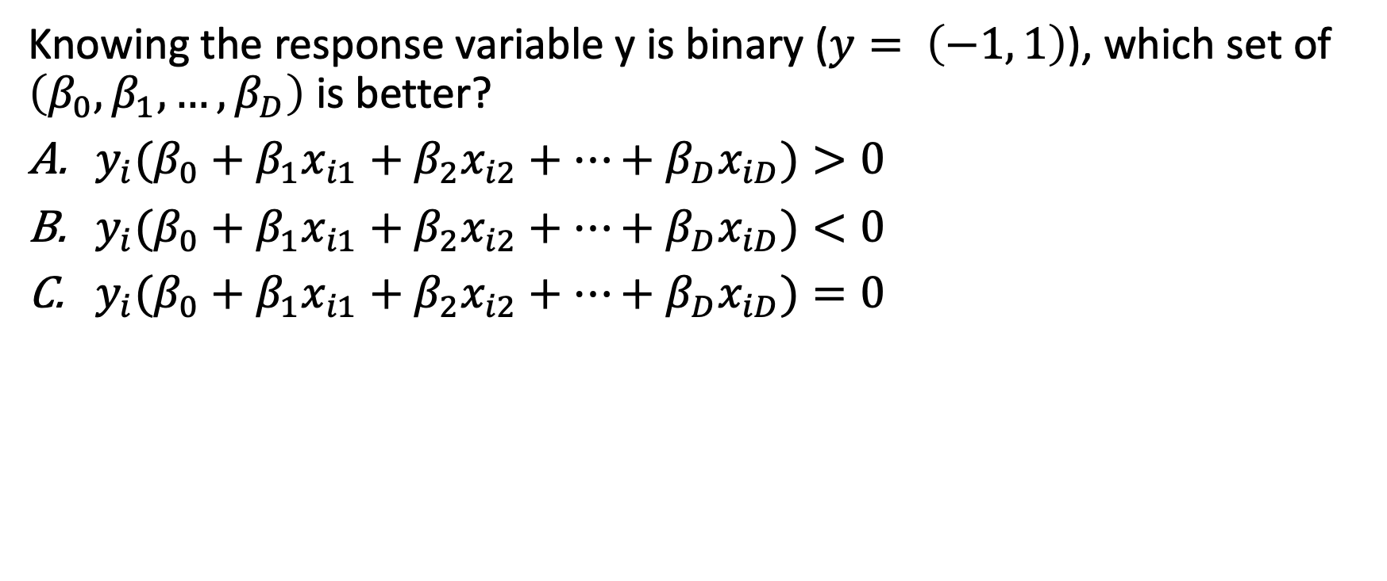
Question
Knowing the response variable y is binary ($y= \left(−1, 1\right)$), which set of $\left(β_{0},β_{1},…,β_{D}\right)$ is better?
${y_{i}(β}_{0}+β_{1}x_{i1}+β_{2}x_{i2}+…+β_{D}x_{iD})>0$
${y_{i}(β}_{0}+β_{1}x_{i1}+β_{2}x_{i2}+…+β_{D}x_{iD})<0$
${y_{i}(β}_{0}+β_{1}x_{i1}+β_{2}x_{i2}+…+β_{D}x_{iD})=0$

Slide 11
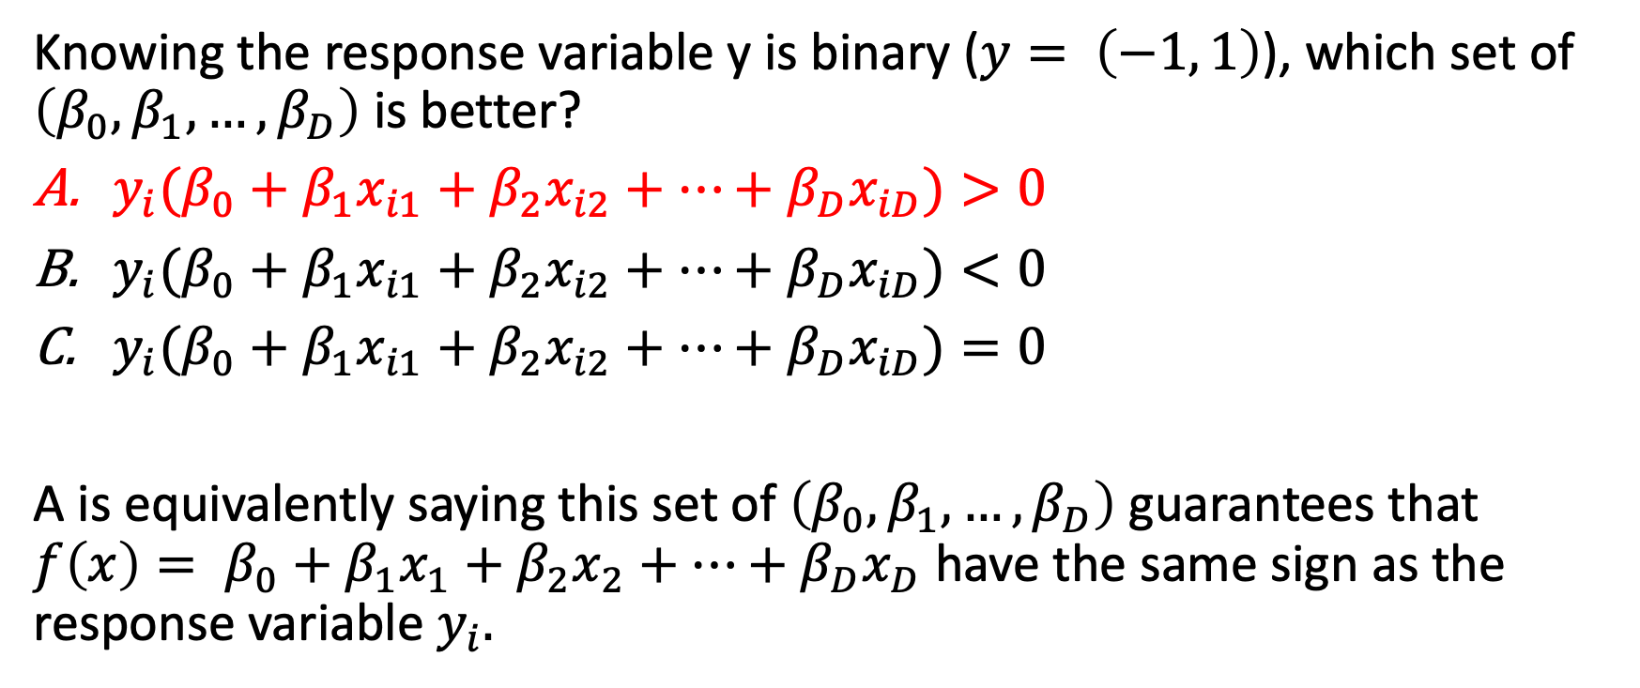
Question
Knowing the response variable y is binary ($y= \left(−1, 1\right)$), which set of $\left(β_{0},β_{1},…,β_{D}\right)$ is better?
${y_{i}(β}_{0}+β_{1}x_{i1}+β_{2}x_{i2}+…+β_{D}x_{iD})>0$
${y_{i}(β}_{0}+β_{1}x_{i1}+β_{2}x_{i2}+…+β_{D}x_{iD})<0$
${y_{i}(β}_{0}+β_{1}x_{i1}+β_{2}x_{i2}+…+β_{D}x_{iD})=0$
A is equivalently saying this set of $\left(β_{0},β_{1},…,β_{D}\right)$ guarantees that $f\left(x\right)= β_{0}+β_{1}x_{1}+β_{2}x_{2}+…+β_{D}x_{D}$ have the same sign as the response variable $y_{i}.$

Slide 12
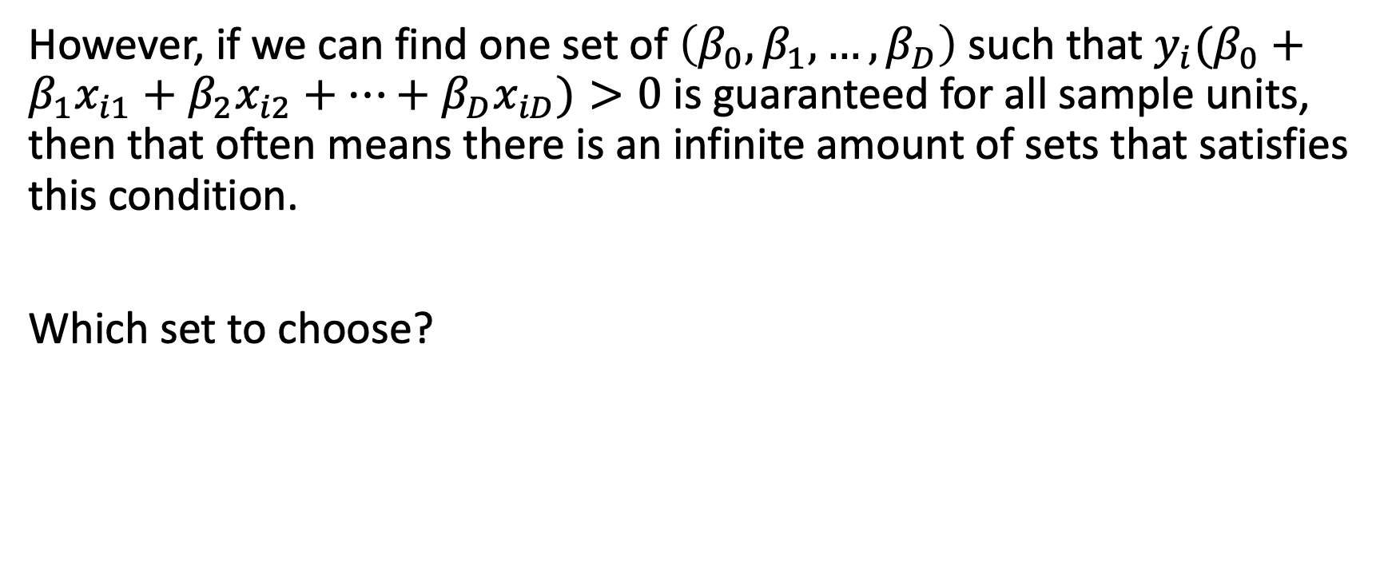
Maximal marginal classifier
However, if we can find one set of $\left(β_{0},β_{1},…,β_{D}\right)$ such that ${y_{i}(β}_{0}+β_{1}x_{i1}+β_{2}x_{i2}+…+β_{D}x_{iD})>0$ is guaranteed for all sample units, then that often means there is an infinite amount of sets that satisfies this condition.
Which set to choose?

Slide 13
Maximal marginal classifier
However, if we can find one set of $\left(β_{0},β_{1},…,β_{D}\right)$ such that ${y_{i}(β}_{0}+β_{1}x_{i1}+β_{2}x_{i2}+…+β_{D}x_{iD})>0$ is guaranteed for all sample units, then that often means there is an infinite amount of sets that satisfies this condition.
Which set to choose?

Slide 14
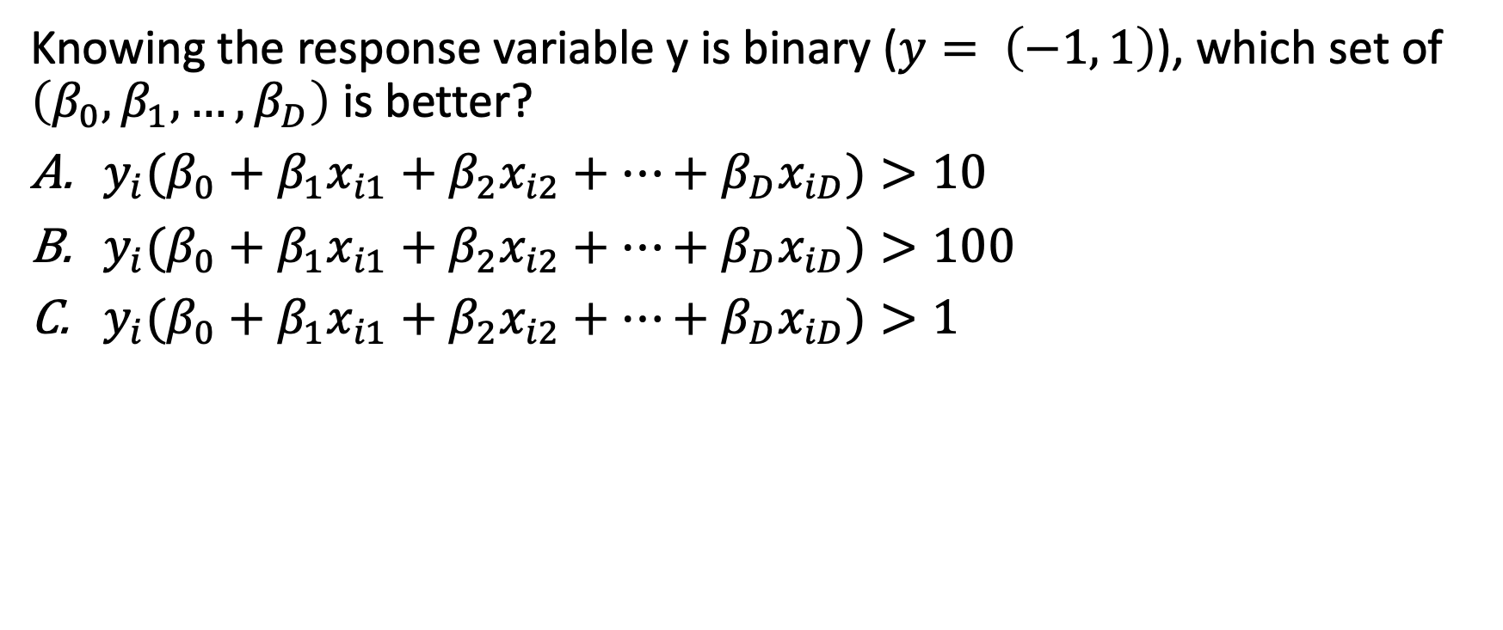
Another Question
Knowing the response variable y is binary ($y= \left(−1, 1\right)$), which set of $\left(β_{0},β_{1},…,β_{D}\right)$ is better?
${y_{i}(β}_{0}+β_{1}x_{i1}+β_{2}x_{i2}+…+β_{D}x_{iD})>10$
${y_{i}(β}_{0}+β_{1}x_{i1}+β_{2}x_{i2}+…+β_{D}x_{iD})>100$
${y_{i}(β}_{0}+β_{1}x_{i1}+β_{2}x_{i2}+…+β_{D}x_{iD})>1$

Slide 15
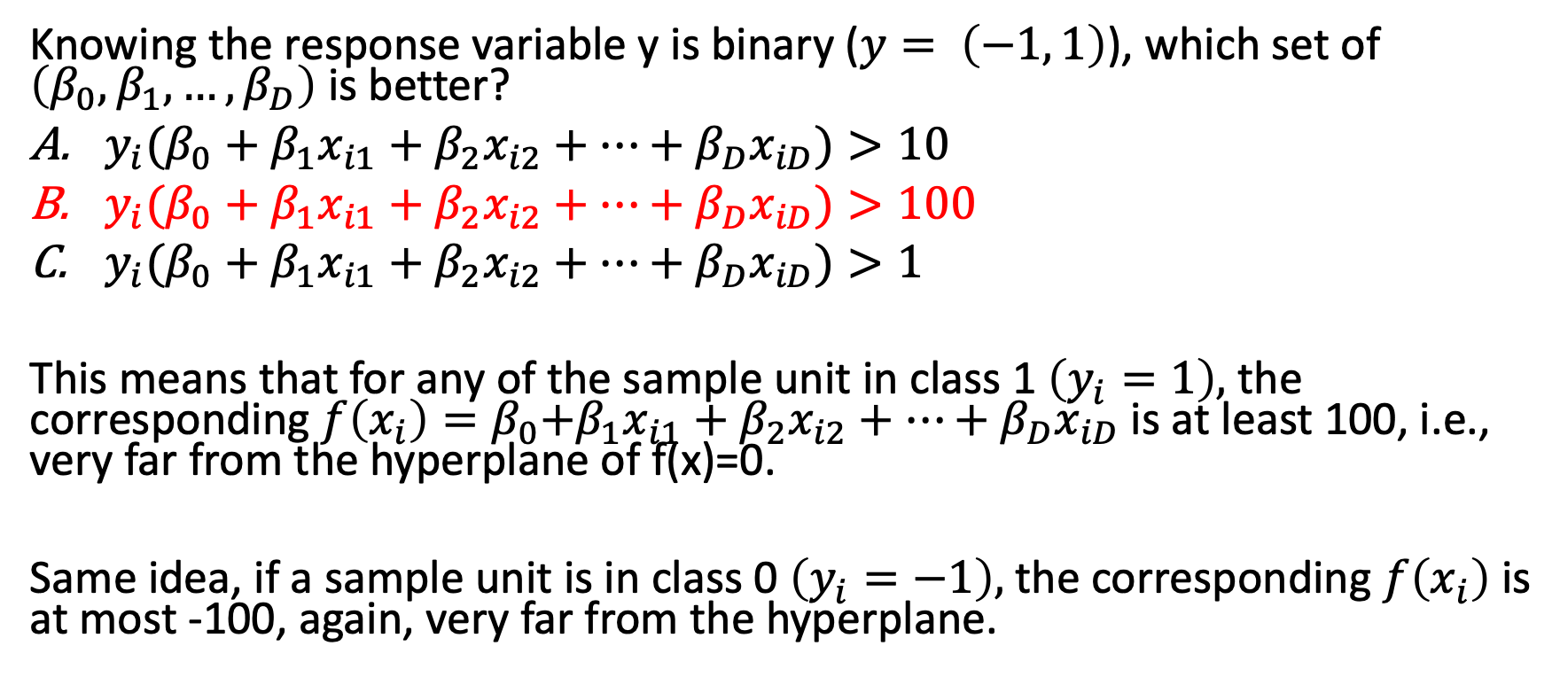
Another Question
Knowing the response variable y is binary ($y= \left(−1, 1\right)$), which set of $\left(β_{0},β_{1},…,β_{D}\right)$ is better?
${y_{i}(β}_{0}+β_{1}x_{i1}+β_{2}x_{i2}+…+β_{D}x_{iD})>10$
${y_{i}(β}_{0}+β_{1}x_{i1}+β_{2}x_{i2}+…+β_{D}x_{iD})>100$
${y_{i}(β}_{0}+β_{1}x_{i1}+β_{2}x_{i2}+…+β_{D}x_{iD})>1$
This means that for any of the sample unit in class 1 $\left(y_{i}=1\right),$ the corresponding${ f\left(x_{i}\right)=β}_{0}+β_{1}x_{i1}+β_{2}x_{i2}+…+β_{D}x_{iD}$ is at least 100, i.e., very far from the hyperplane of f(x)=0.
Same idea, if a sample unit is in class 0 $\left(y_{i}=−1\right),$ the corresponding $f\left(x_{i}\right)$ is at most -100, again, very far from the hyperplane.

Slide 16
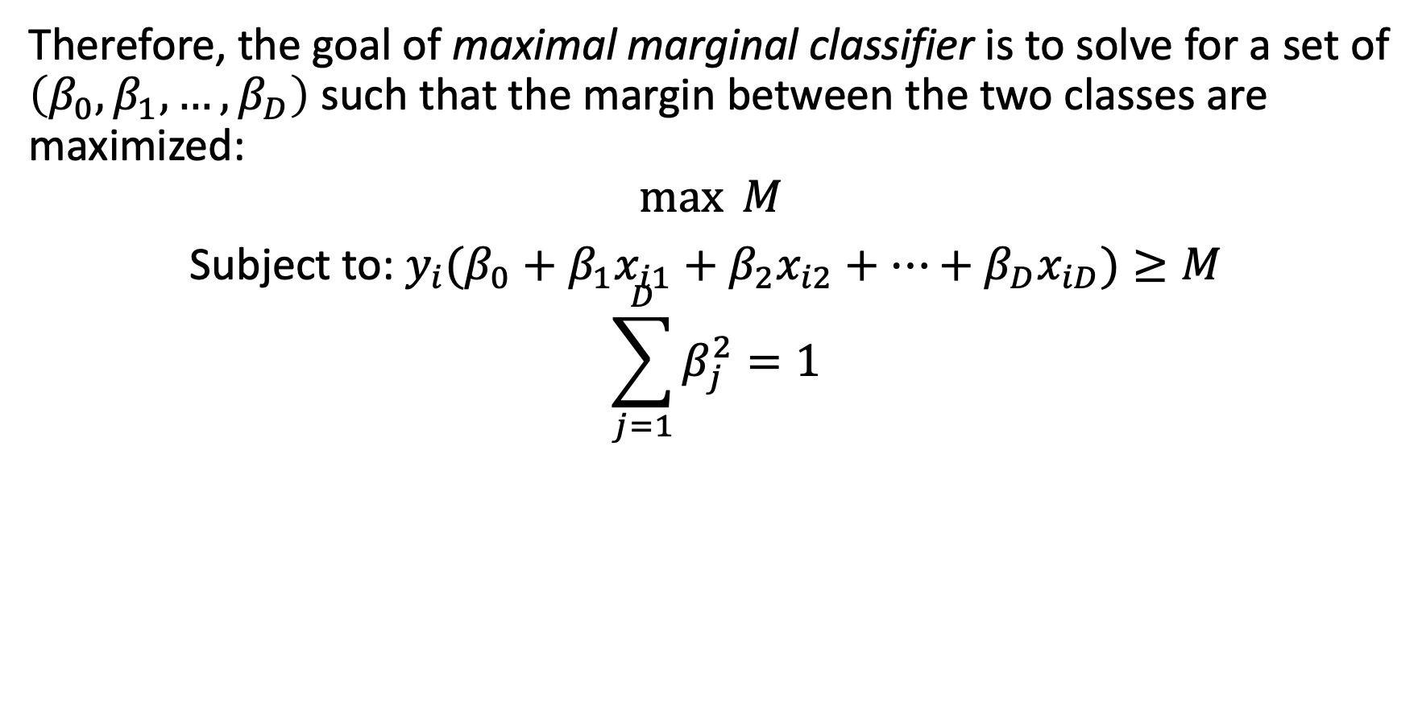
Maximal marginal classifier
Therefore, the goal of maximal marginal classifier is to solve for a set of $\left(β_{0},β_{1},…,β_{D}\right)$ such that the margin between the two classes are maximized:
$$\max{M}$$
Subject to: ${y_{i}(β}_{0}+β_{1}x_{i1}+β_{2}x_{i2}+…+β_{D}x_{iD})≥M$
$$\sum_{j=1}^{D}{β_{j}^{2}=1}$$

Slide 17
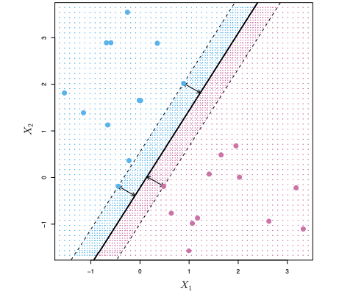
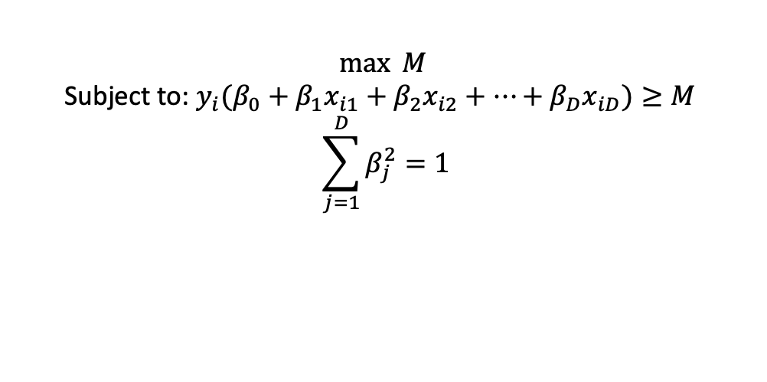
Maximal marginal classifier
$$\max{M}$$
Subject to: ${y_{i}(β}_{0}+β_{1}x_{i1}+β_{2}x_{i2}+…+β_{D}x_{iD})≥M$
$$\sum_{j=1}^{D}{β_{j}^{2}=1}$$

Slide 18
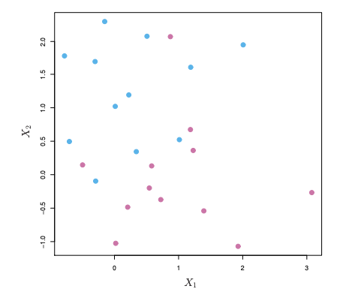
How about..
Can you get maximal marginal classifier to work here?

Slide 19
How about..
Can you get maximal marginal classifier to work here?
Nope, because there is no way to completely separate the two classes using a straight line.
Thoughts on how to revise maximal marginal classifier such that it could still work? (and as accurate as possible)

Slide 20
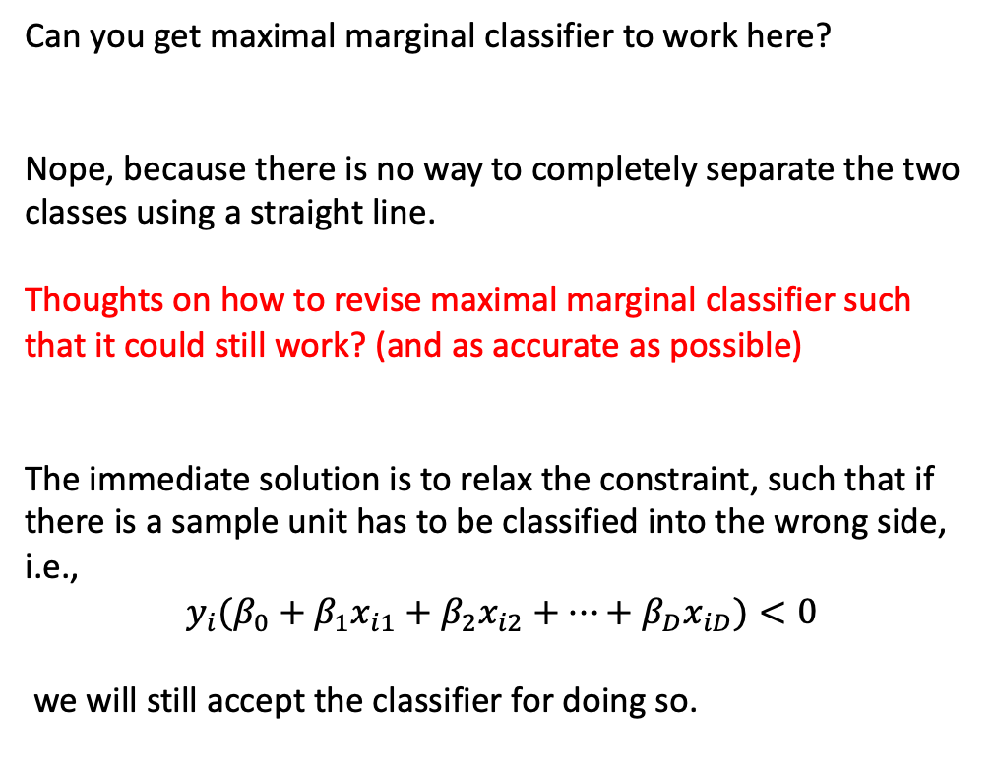
How about..
Can you get maximal marginal classifier to work here?
Nope, because there is no way to completely separate the two classes using a straight line.
Thoughts on how to revise maximal marginal classifier such that it could still work? (and as accurate as possible)
The immediate solution is to relax the constraint, such that if there is a sample unit has to be classified into the wrong side, i.e.,
$${y_{i}(β}_{0}+β_{1}x_{i1}+β_{2}x_{i2}+…+β_{D}x_{iD})<0$$
we will still accept the classifier for doing so.

Slide 21
Agenda
Maximal marginal classifier
Support Vector Classifier
The Loss+penalty form
Non-linear separating hyperplanes

Slide 22
Definition: Support vectors
Knowing support vector means data points, which of the points on the graph below looks like a support vector to you?

Slide 23
Definition: Support vectors
Knowing support vector means data points, which of the points on the graph below looks like a support vector to you?
A support vector is a data point that are within/on the margin of a separating hyperplane.

Slide 24
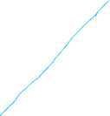
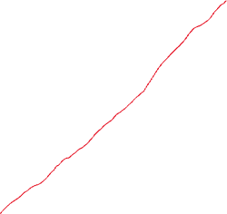
Support vector machine
A support vector machine is the same idea as a maximal margin classifier, except the margin is now a soft-margin.

Slide 25
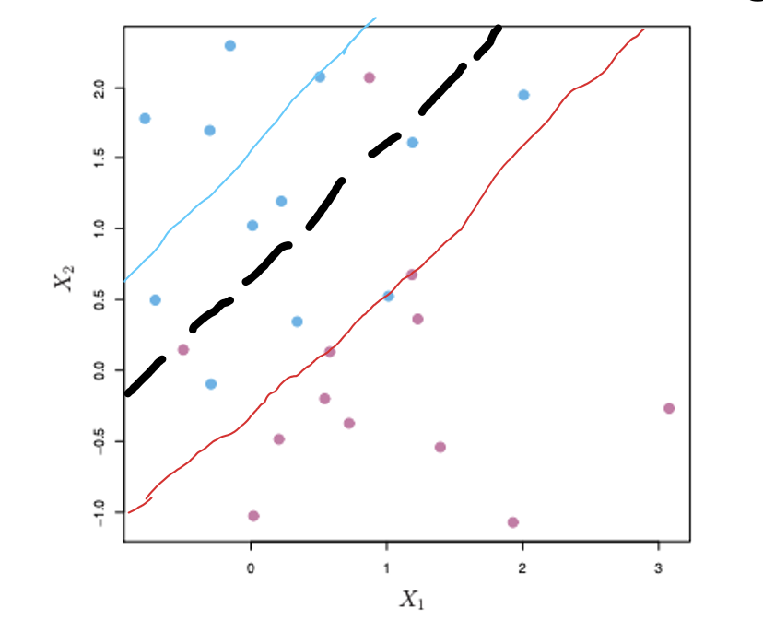
Support vector machine
A support vector machine is the same idea as a maximal margin classifier, except the margin is now a soft-margin.
Here in SVM:
It is still trying to construct a hyperplane, such that one side is class 1 (red), the other side is class 0 (blue)
It is still trying to find support vectors such that the margin to the hyperplane is maximized.
It does, however, allow misclassifications.

Slide 26
Support vector machine
A support vector machine is the same idea as a maximal margin classifier, except the margin is now a soft-margin.
Here in SVM:
It is still trying to construct a hyperplane, such that one side is class 1 (red), the other side is class 0 (blue)
It is still trying to find support vectors such that the margin to the hyperplane is maximized.
It does, however, allow misclassifications (the circled data points).
This margin is thus called a soft-margin exactly because it allows misclassifications.

Slide 27
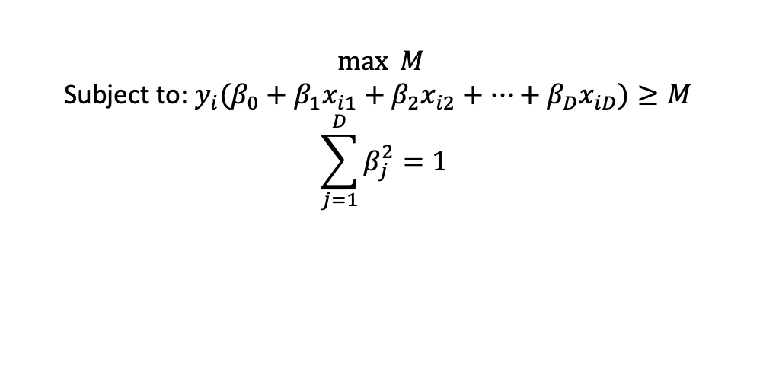
From Maximal Marginal Classifier to SVM
To accommodate for such misclassifications, which part needs to change in the following optimization problem?
$$\max{M}$$
Subject to: ${y_{i}(β}_{0}+β_{1}x_{i1}+β_{2}x_{i2}+…+β_{D}x_{iD})≥M$
$$\sum_{j=1}^{D}{β_{j}^{2}=1}$$

Slide 28
From Maximal Marginal Classifier to SVM
To accommodate for such misclassifications, which part needs to change in the following optimization problem?
$$\max{M}$$
Subject to: ${y_{i}(β}_{0}+β_{1}x_{i1}+β_{2}x_{i2}+…+β_{D}x_{iD})≥M$
$$\sum_{j=1}^{D}{β_{j}^{2}=1}$$
Here in SVM:
It is still trying to construct a hyperplane, such that one side is class 1 (red), the other side is class 0 (blue)
It is still trying to find support vectors such that the margin to the hyperplane is maximized.
It does, however, allow misclassifications.

Slide 29

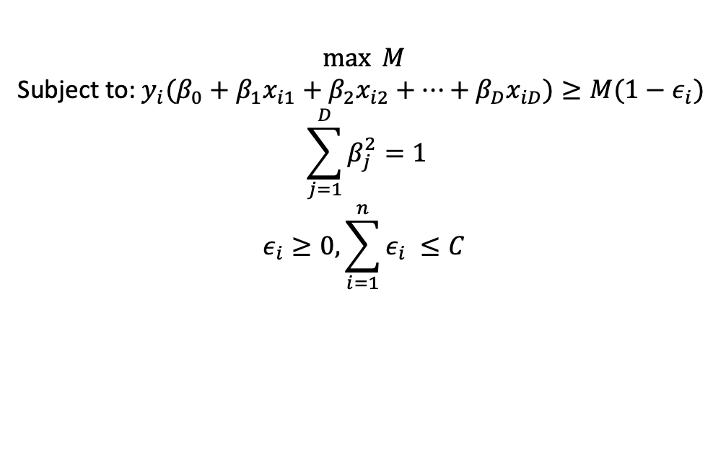
From Maximal Marginal Classifier to SVM
A support vector machine (classification) tries to solve the following problem:
where while we are focusing on maximizing the margin, we also allow “slacks” by having $∈_{i}$ such that some sample units can be on the wrong side.
C is the total budget of “slacking”, and it is a tuning parameter.
$$\max{M}$$
Subject to: ${y_{i}(β}_{0}+β_{1}x_{i1}+β_{2}x_{i2}+…+β_{D}x_{iD})≥M(1−ε_{i})$
$$\sum_{j=1}^{D}{β_{j}^{2}=1}$$
$$ε_{i}≥0, \sum_{i=1}^{n}{ε_{i} ≤C}$$

Slide 30
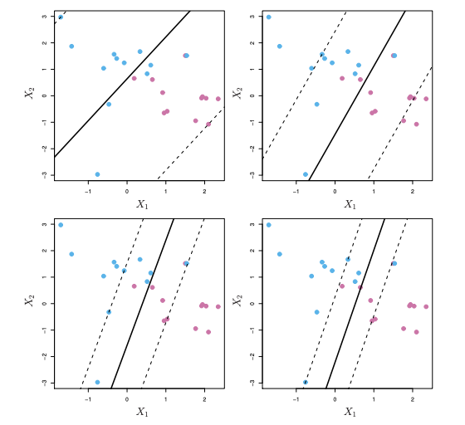
The effect of C in Support Vector Machine
Which of the graph has larger C, and which one has the smallest C?

Slide 31
The effect of C in Support Vector Machine
Which of the graph has larger C, and which one has the smallest C?
Top left is the largest C, in other words, we allow more misclassification in order to obtain a high margin.
C decreases as we move to top right, bottom left, and bottom right, where our tolerance for C decreases, and our margin decreases.

Slide 32
Agenda
Maximal marginal classifier
Support Vector Classifier
The Loss+penalty form
Non-linear separating hyperplanes

Slide 33

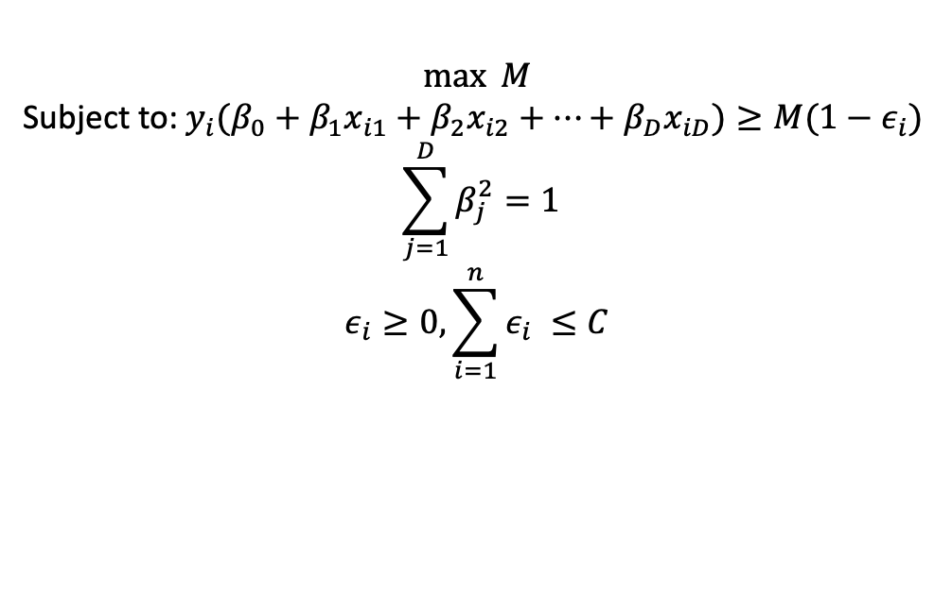


Support Vector Machine in the form of loss+penalty
Initial form:
Loss+penalty form:
$$\max{M}$$
Subject to: ${y_{i}(β}_{0}+β_{1}x_{i1}+β_{2}x_{i2}+…+β_{D}x_{iD})≥M(1−ε_{i})$
$$\sum_{j=1}^{D}{β_{j}^{2}=1}$$
$$ε_{i}≥0, \sum_{i=1}^{n}{ε_{i} ≤C}$$

Slide 34
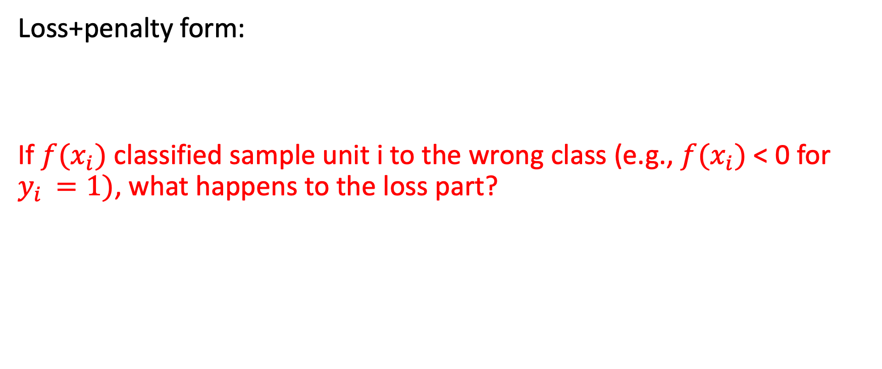


Support Vector Machine in the form of loss+penalty
Loss+penalty form:
If $f(x_{i})$ classified sample unit i to the wrong class (e.g., $f(x_{i})$ < 0 for $y_{i }=1)$, what happens to the loss part?

Slide 35
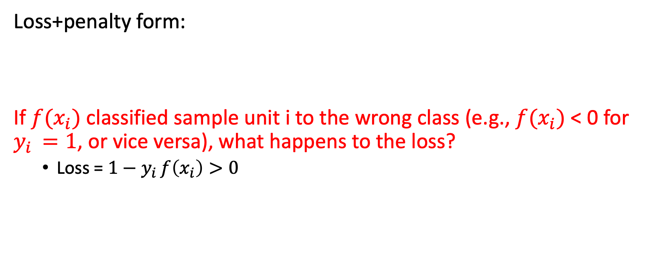
Support Vector Machine in the form of loss+penalty
Loss+penalty form:
If $f(x_{i})$ classified sample unit i to the wrong class (e.g., $f(x_{i})$ < 0 for $y_{i }=1$, or vice versa), what happens to the loss?
Loss = $1−y_{i }f\left(x_{i}\right)>0$

Slide 36
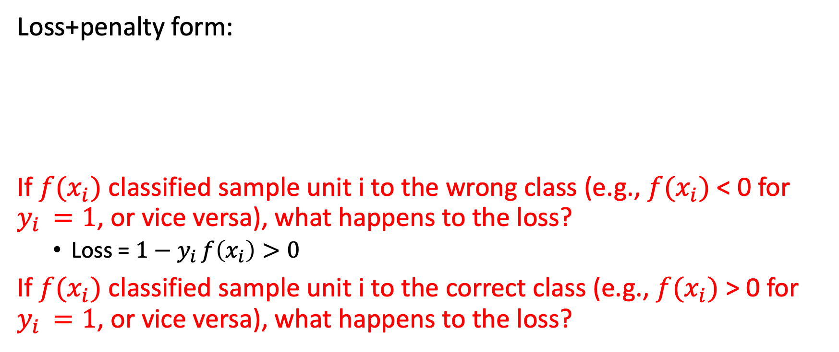


Support Vector Machine in the form of loss+penalty
Loss+penalty form:
If $f(x_{i})$ classified sample unit i to the wrong class (e.g., $f(x_{i})$ < 0 for $y_{i }=1$, or vice versa), what happens to the loss?
Loss = $1−y_{i }f\left(x_{i}\right)>0$
If $f(x_{i})$ classified sample unit i to the correct class (e.g., $f(x_{i})$ > 0 for $y_{i }=1$, or vice versa), what happens to the loss?

Slide 37
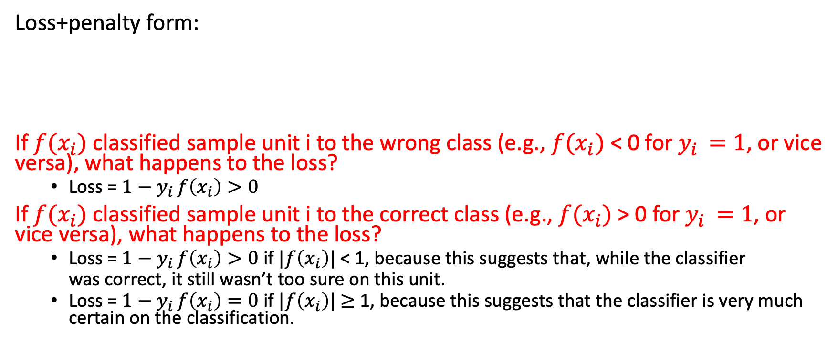
Support Vector Machine in the form of loss+penalty
Loss+penalty form:
If $f(x_{i})$ classified sample unit i to the wrong class (e.g., $f(x_{i})$ < 0 for $y_{i }=1$, or vice versa), what happens to the loss?
Loss = $1−y_{i }f\left(x_{i}\right)>0$
If $f(x_{i})$ classified sample unit i to the correct class (e.g., $f(x_{i})$ > 0 for $y_{i }=1$, or vice versa), what happens to the loss?
Loss = $1−y_{i }f\left(x_{i}\right)>0$ if $|f\left(x_{i}\right)|$ < 1, because this suggests that, while the classifier
was correct, it still wasn’t too sure on this unit.
Loss = $1−y_{i }f\left(x_{i}\right)=0$ if $|f\left(x_{i}\right)|$ $≥$ 1, because this suggests that the classifier is very much certain on the classification.

Slide 38
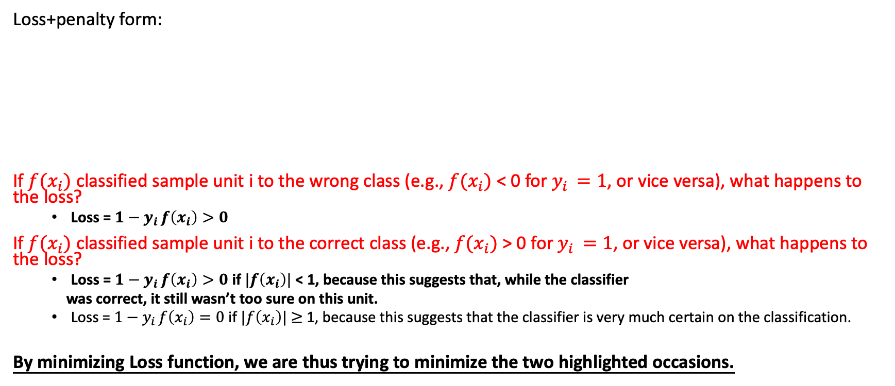
Support Vector Machine in the form of loss+penalty
Loss+penalty form:
If $f(x_{i})$ classified sample unit i to the wrong class (e.g., $f(x_{i})$ < 0 for $y_{i }=1$, or vice versa), what happens to the loss?
Loss = $1−y_{i }f\left(x_{i}\right)>0$
If $f(x_{i})$ classified sample unit i to the correct class (e.g., $f(x_{i})$ > 0 for $y_{i }=1$, or vice versa), what happens to the loss?
Loss = $1−y_{i }f\left(x_{i}\right)>0$ if $|f\left(x_{i}\right)|$ < 1, because this suggests that, while the classifier
was correct, it still wasn’t too sure on this unit.
Loss = $1−y_{i }f\left(x_{i}\right)=0$ if $|f\left(x_{i}\right)|$ $≥$ 1, because this suggests that the classifier is very much certain on the classification.
By minimizing Loss function, we are thus trying to minimize the two highlighted occasions.

Slide 39
Support Vector Machine in the form of loss+penalty
Loss+penalty form:
This type of Loss function is called a Hinge Loss, and support vector machine is thus also approached as a Hinge Loss+L2-penalty problem.

Slide 40
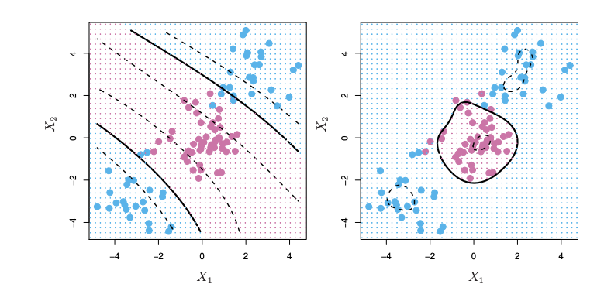
How about..
Can a SVM classifier separate the classes in these two scenarios? Why or why not?

Slide 41
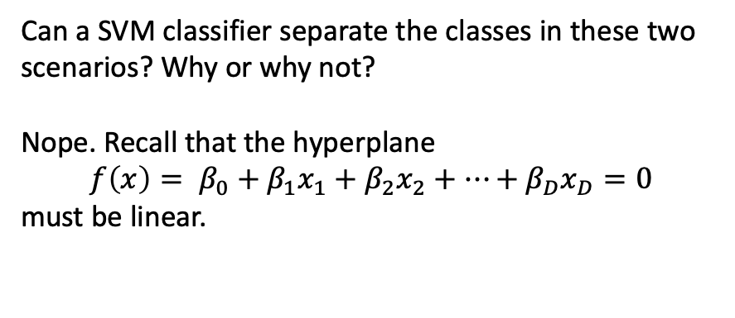
How about..
Can a SVM classifier separate the classes in these two scenarios? Why or why not?
Nope. Recall that the hyperplane
$$f\left(x\right)= β_{0}+β_{1}x_{1}+β_{2}x_{2}+…+β_{D}x_{D}=0$$
must be linear.

Slide 42
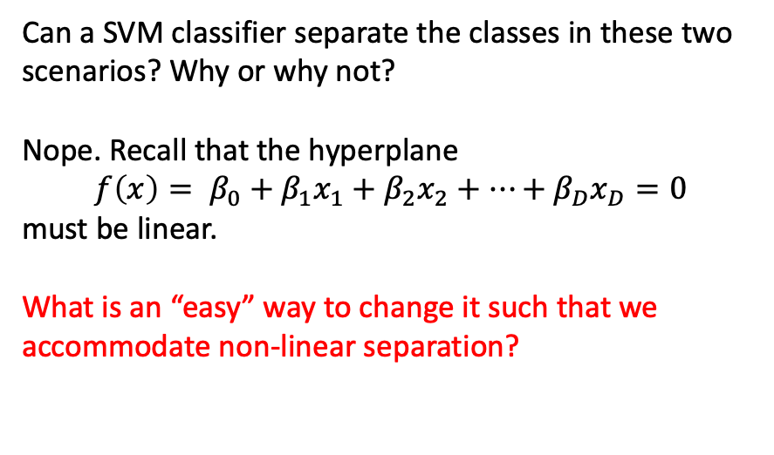
How about..
Can a SVM classifier separate the classes in these two scenarios? Why or why not?
Nope. Recall that the hyperplane
$$f\left(x\right)= β_{0}+β_{1}x_{1}+β_{2}x_{2}+…+β_{D}x_{D}=0$$
must be linear.
What is an “easy” way to change it such that we accommodate non-linear separation?

Slide 43
Agenda
Maximal marginal classifier
Support Vector Classifier
The Loss+penalty form
Non-linear separating hyperplanes

Slide 44
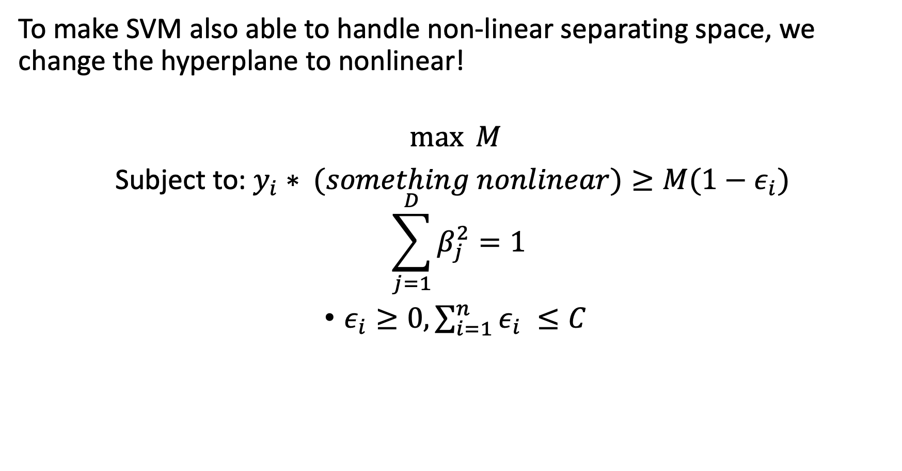
Support Vector Machine with non-linear kernel
To make SVM also able to handle non-linear separating space, we change the hyperplane to nonlinear!
$$\max{M}$$
Subject to: $y_{i}∗ (something nonlinear)≥M(1−ε_{i})$
$$\sum_{j=1}^{D}{β_{j}^{2}=1}$$
$ε_{i}≥0, \sum_{i=1}^{n}{ε_{i} ≤C}$

Slide 45
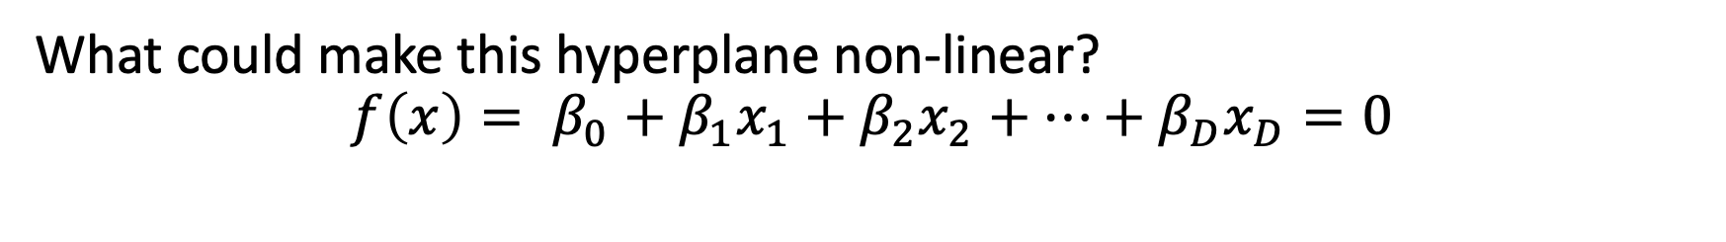
Question
What could make this hyperplane non-linear?
$$f\left(x\right)= β_{0}+β_{1}x_{1}+β_{2}x_{2}+…+β_{D}x_{D}=0$$

Slide 46
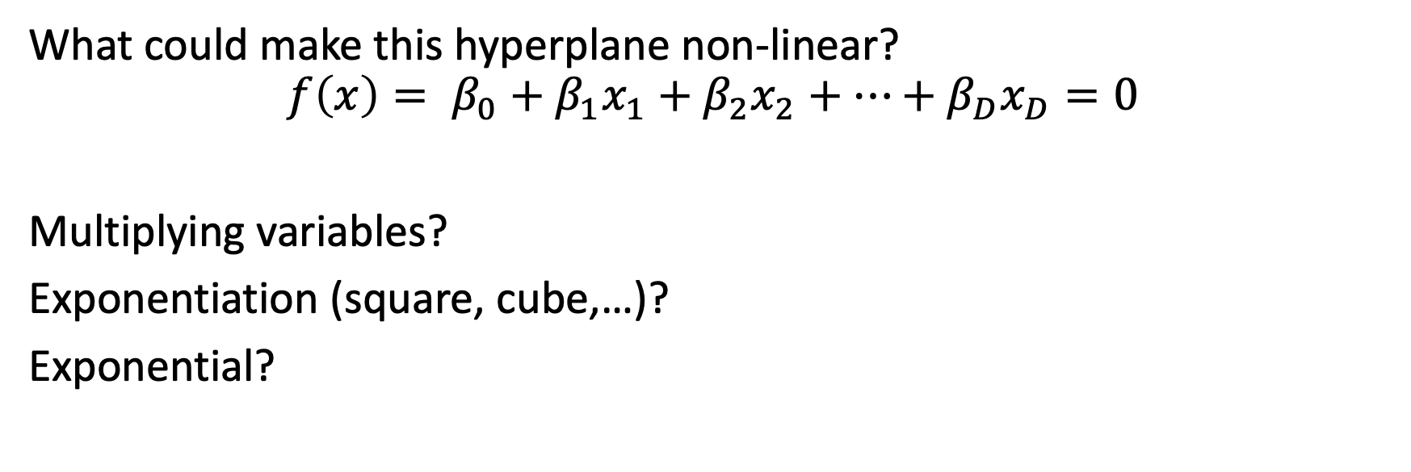
Question
What could make this hyperplane non-linear?
$$f\left(x\right)= β_{0}+β_{1}x_{1}+β_{2}x_{2}+…+β_{D}x_{D}=0$$
Multiplying variables?
Exponentiation (square, cube,…)?
Exponential?

Slide 47
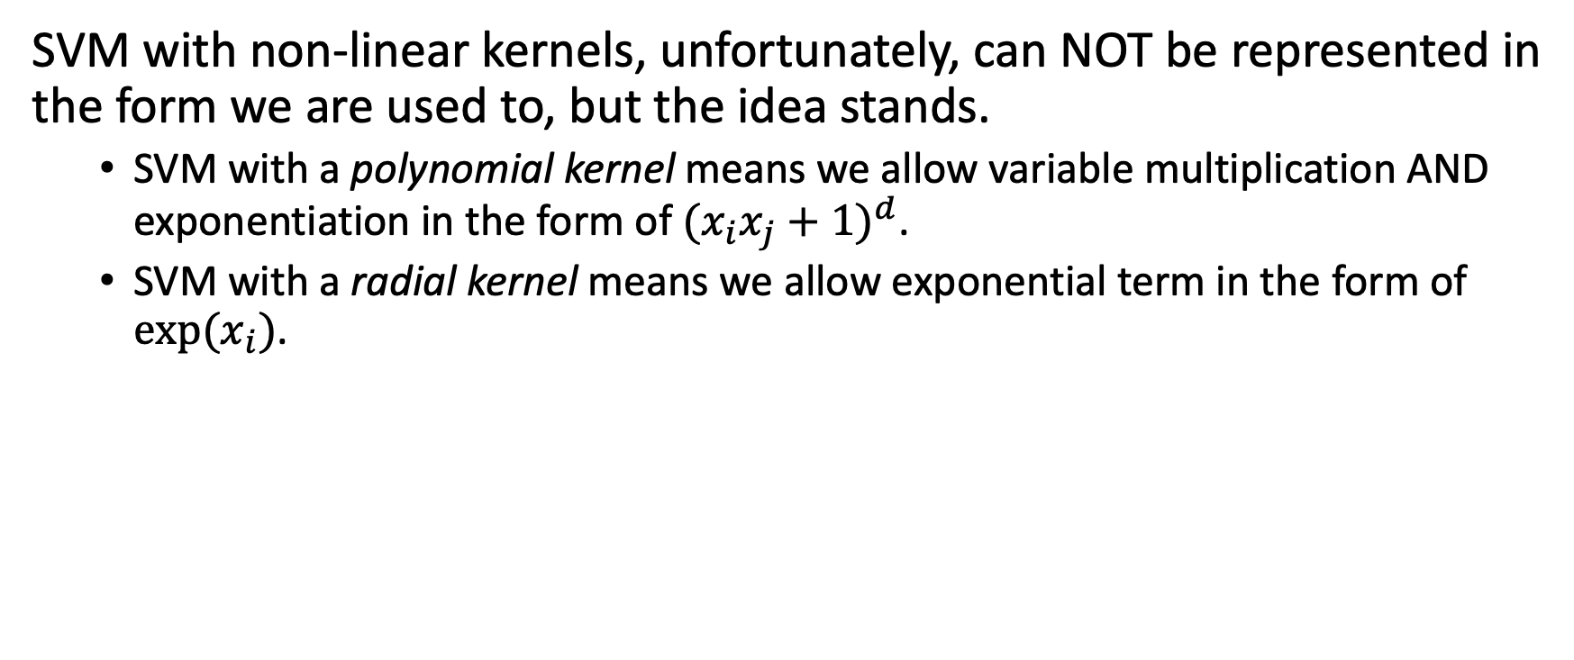
SVM with non-linear kernels
SVM with non-linear kernels, unfortunately, can NOT be represented in the form we are used to, but the idea stands.
SVM with a polynomial kernel means we allow variable multiplication AND exponentiation in the form of ${(x_{i}x_{j}+1)}^{d}$.
SVM with a radial kernel means we allow exponential term in the form of $exp⁡(x_{i})$.

Slide 48
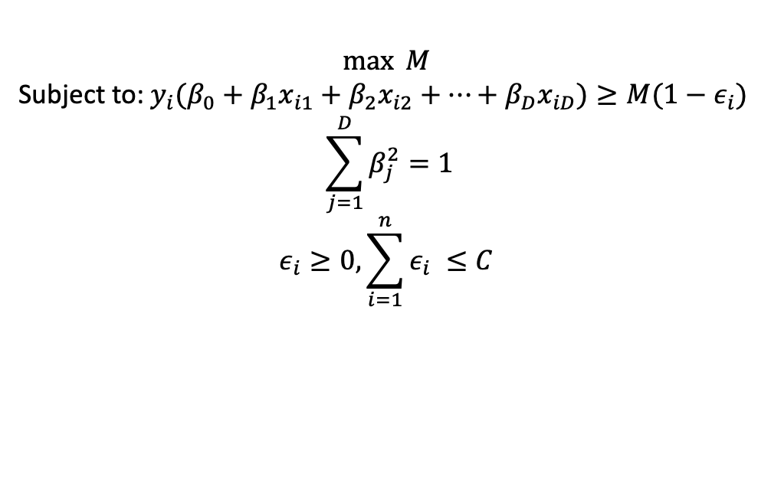
The interpretability of SVM
SVM with linear kernel (the initial form):
SVM with linear kernel (the LOSS+PENALTY form):
$$\max{M}$$
Subject to: ${y_{i}(β}_{0}+β_{1}x_{i1}+β_{2}x_{i2}+…+β_{D}x_{iD})≥M(1−ε_{i})$
$$\sum_{j=1}^{D}{β_{j}^{2}=1}$$
$$ε_{i}≥0, \sum_{i=1}^{n}{ε_{i} ≤C}$$

Slide 49
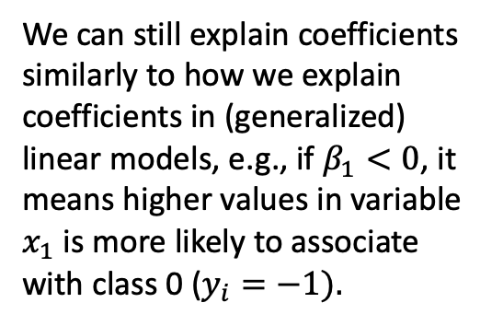


The interpretability of SVM
SVM with linear kernel (the initial form):
SVM with linear kernel (the LOSS+PENALTY form):
$$\max{M}$$
Subject to: ${y_{i}(β}_{0}+β_{1}x_{i1}+β_{2}x_{i2}+…+β_{D}x_{iD})≥M(1−ε_{i})$
$$\sum_{j=1}^{D}{β_{j}^{2}=1}$$
$$ε_{i}≥0, \sum_{i=1}^{n}{ε_{i} ≤C}$$
We can still explain coefficients similarly to how we explain coefficients in (generalized) linear models, e.g., if $β_{1}<0$, it means higher values in variable $x_{1}$ is more likely to associate with class 0 ($y_{i}=−1).$

Slide 50
The interpretability of SVM
However, SVM with nonlinear kernel naturally loses that interpretability..

