Slide 1
Information System of Research-Oriented University
Grigoriy Kovrizhnykh
Kenesbek Asylmurat
Myrzakhanov Zhanibek
Arslan Koshimov

Slide 2
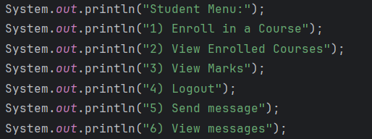
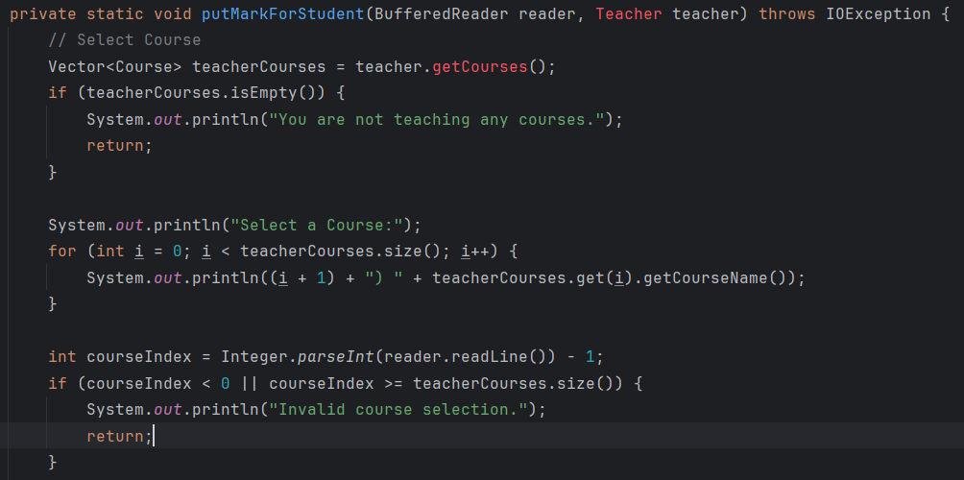
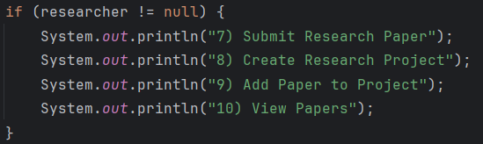
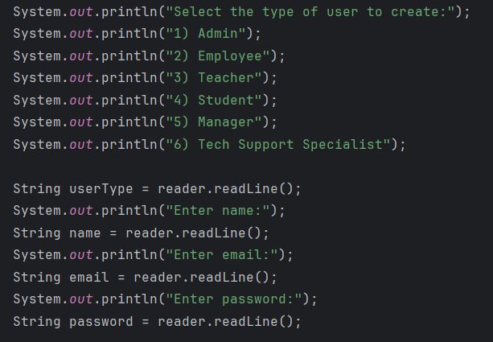
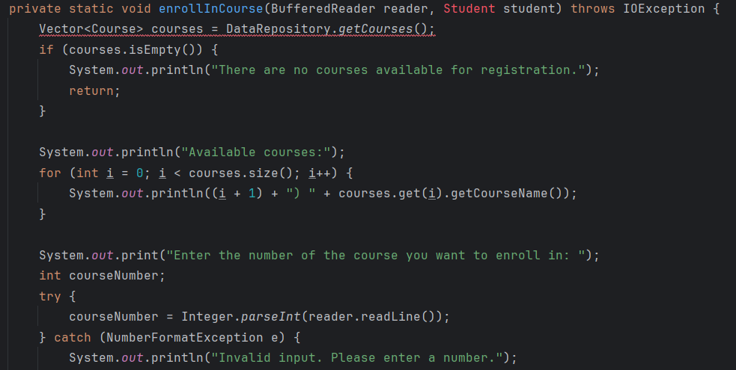
What Works
Messages
Grading a student
Basic researcher functionality
Creating User
Registration for courses

Slide 3
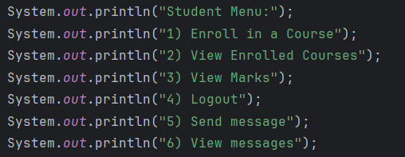
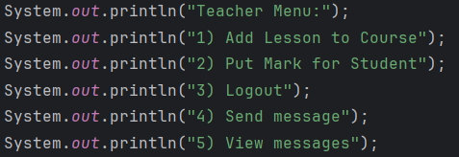
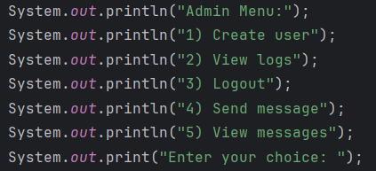
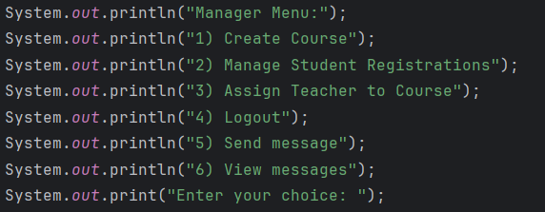
University system can do

Slide 4

What Does Not Work
Created, but not enabled:
- See news
- Teacher evaluation
- Tech support system
Student organizations
Journals
There is no:
- Librarian system
Schedule

Slide 5
Conclusion
The completion of our project reflects a meticulous and thoughtful process, with the team engaging in in-depth discussions to strategically plan and execute each step. Assigning specific responsibilities ensured that everyone contributed meaningfully to the project's success. Through this collaborative effort, our team experienced significant growth in both hard and soft skills, learning to communicate effectively and work cohesively. The utilization of various tools and services streamlined our workflow, enabling efficient validation and study of essential project materials. Despite encountering challenges, the collective dedication of the team, coupled with the invaluable guidance of our teacher Shamoi Pakita, led to a successful outcome, highlighting the power of collaboration and continuous learning.

