Slide 1
Optimizing Data Compression Techniques: Enhancing Efficiency and Scalability for Diverse Applications by implementing AI
Author: Grigoriy Kovrizhnykh, Arslan Koshimov

Slide 2
Agenda
4. Codebase
5. Dataset and Tools
6. Numerical experiments
7. Further…
Introduction
Background
3. Research Goal

Slide 3
Introduction
Problem:
The world is generating data at an unprecedented rate, creating challenges for storage and transmission.
Solution:
Data compression reduces file sizes, enabling efficient storage and faster data transfer.

Slide 4
Background
Lossless Compression
Preserves all original data, ideal for text and databases.
Lossy Compression
Removes less noticeable data, suitable for images, videos, and audio.
AI-Powered Compression
Machine learning models enhance compression efficiency by recognizing patterns in data.

Slide 5

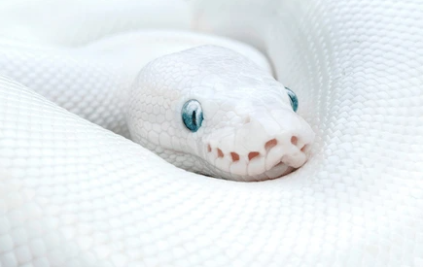




Research Goal
Develop Efficient and Adaptable Compression Techniques
1
2
Python Implementation
3
Performance Evaluation

Slide 6



Codebase
/examples
Ready-to-run examples demonstrating compression of images.
/src
Python scripts for the algorithms, methods.
/docs
Documentation including installation instructions, tutorials, and integration guides.

Slide 7
Dataset & Tools
Flickr Faces Dataset Resized
(OpenSource faces image dataset)

Slide 8
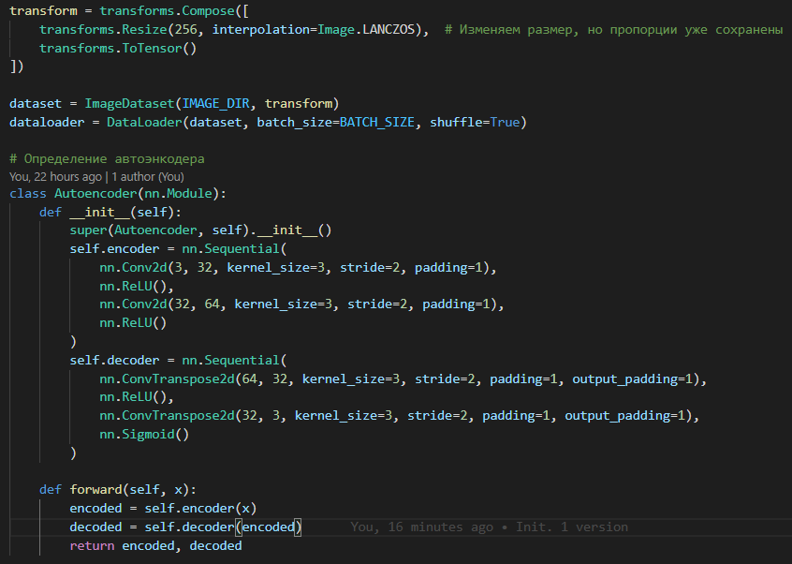
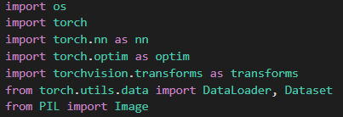
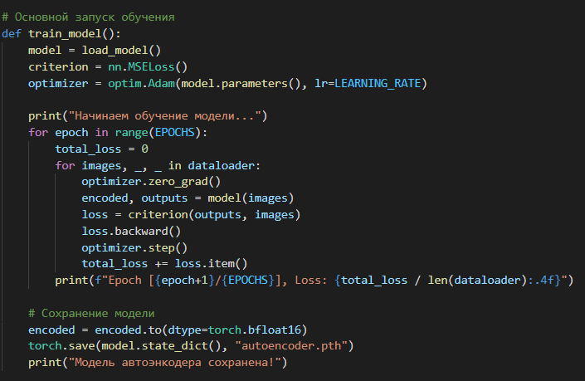

Code
V1

Slide 9
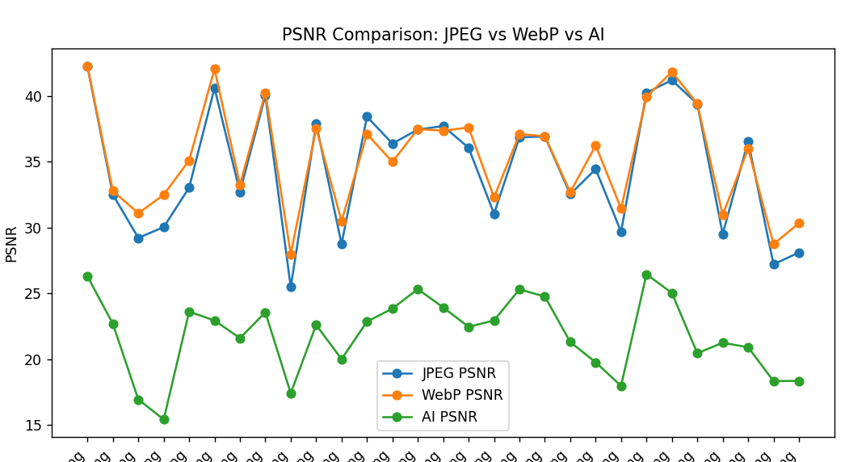
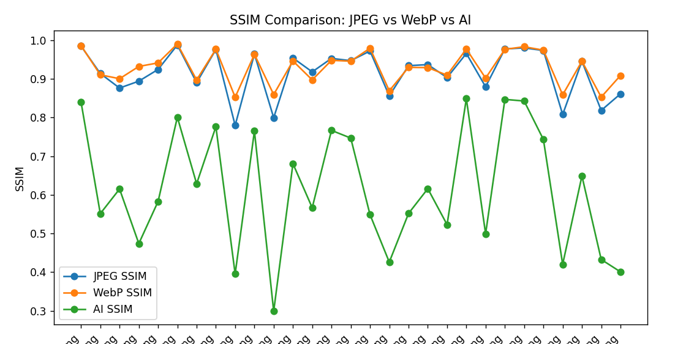
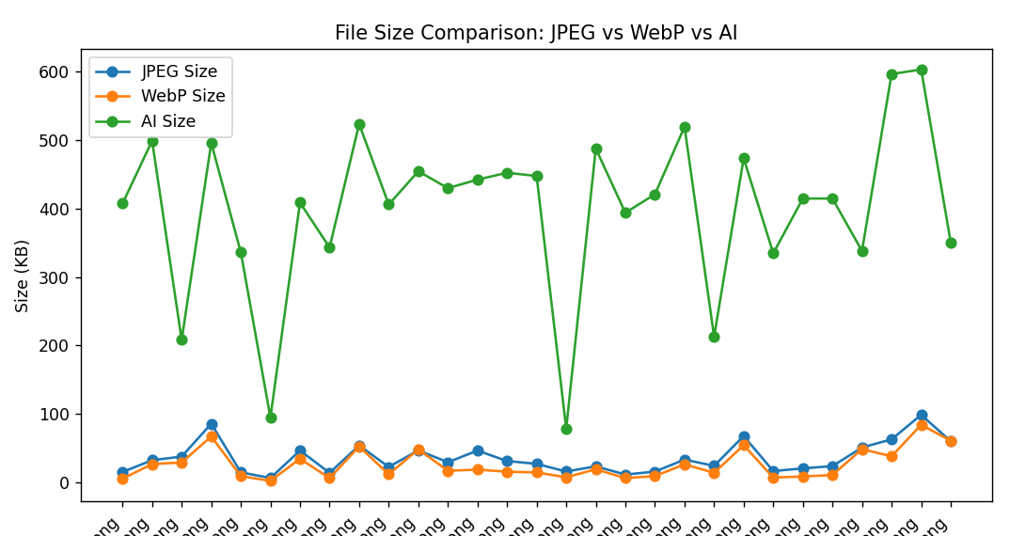
Numerical experiments on our own neural network(30 photos dataset)

Slide 10
Further…
Model Development
development of the ai encoder learning methods, implementation of the information theory concepts
Training and Validation
training the different kind of models on a big open source photo datasets
Working on less file size and high quality
1) decreasing encoded images size to compete with jpeg 2) working on decoded image quality to be higher than jpeg

Slide 11



Code explanation
Learning Type: supervised Learning – model learns by minimizing reconstruction error using MSE loss.
Loss Function: Mean Squared Error (MSE)
Activation Functions(Introduce non-linearity → Enable the model to learn complex patterns):
1) ReLU 2) Sigmoid
Architecture(2 layers):
Encoder, Decoder – 2 layers(AI model size – 0.1MB)
V1

Slide 12


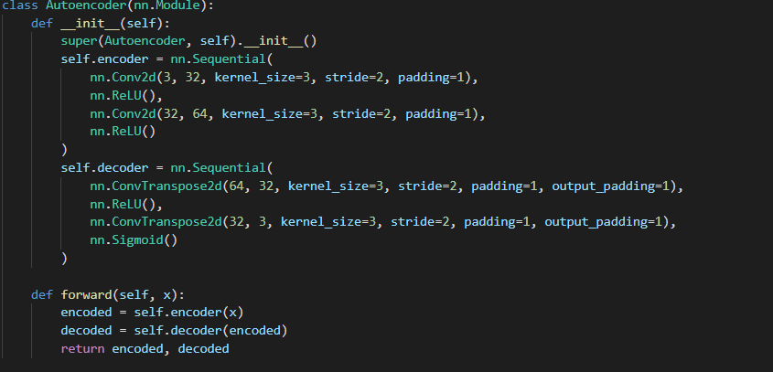

34KB
30 photos dataset(128x128px)
100 kb encoded
26.4KB decoded
Training time – 1 min
V1

Slide 13


34KB
52000 photos dataset(128x128px)
100kb encoded
30KB decoded
Training time – 170 minutes
V1

Slide 14
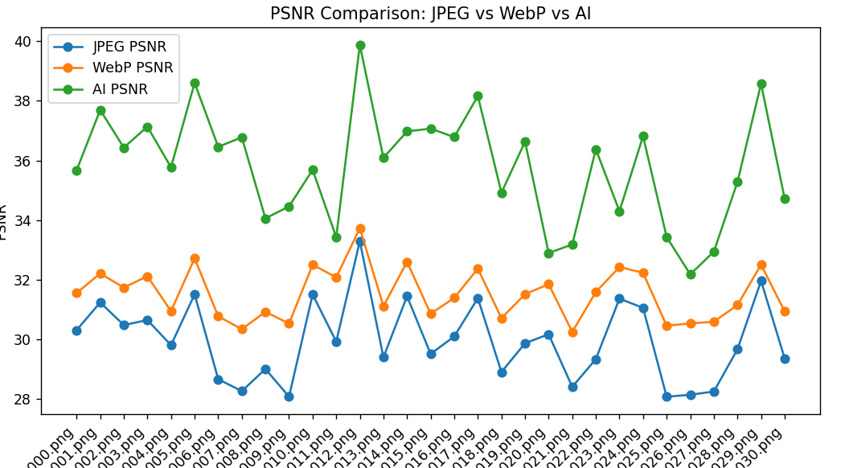
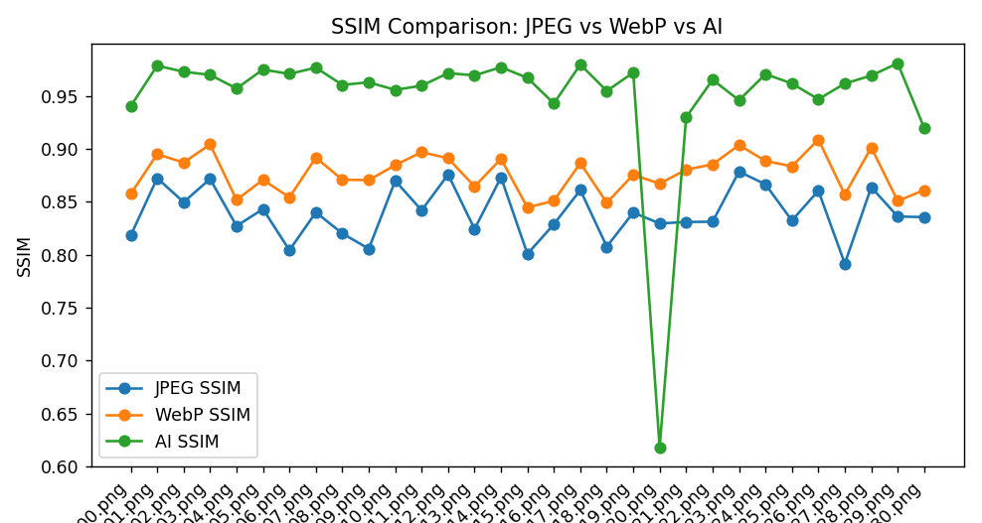
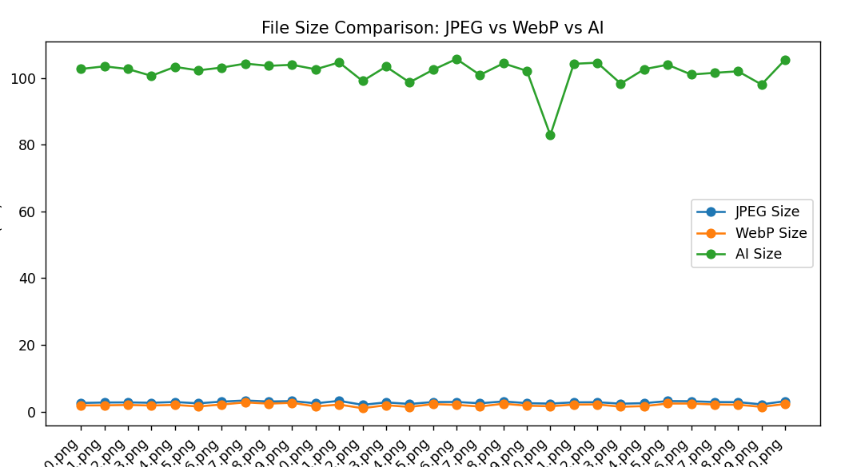
Results(52000 photos trained model)
V1

Slide 15
Conclusion and next step
We see that quality of decoded image is better, than JPEG, but the encoded size of image is enormous, so we need to work on the size and make sure that quality stays high. The quality doesn’t matter, if the decoded size is bigger than the original, there is no reason to use it.
The next step(V2) is to work on the neural network, implement new features, play with neural layers to reduce the size and increase the quality
V1

Slide 16
Code explanation
Learning Type: supervised Learning – model learns by minimizing reconstruction error using MSE loss.
Loss Function: Mean Squared Error (MSE)
Activation Functions(Introduce non-linearity → Enable the model to learn complex patterns):
1) ReLU 2) Sigmoid
Architecture(3 layers):
Encoder, Decoder – 3 layers(AI model size – 0.4MB)
V2

Slide 17
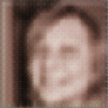
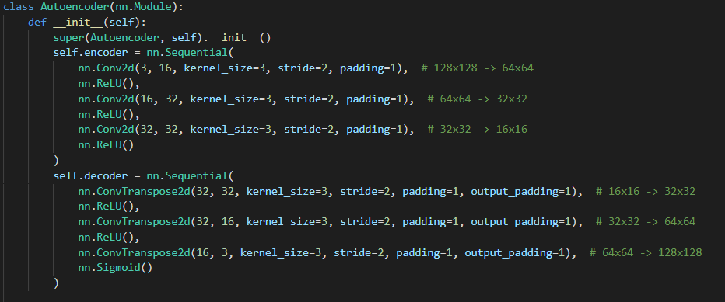
34KB
30 photos dataset(128x128px)
12.6 kb encoded
31.6KB decoded
Training time – 30 seconds
V2

Slide 18


34KB
52000 photos dataset(128x128px)
13.1KB encoded
26,9KB Decoded
Training time – 121 minutes
V2

Slide 19
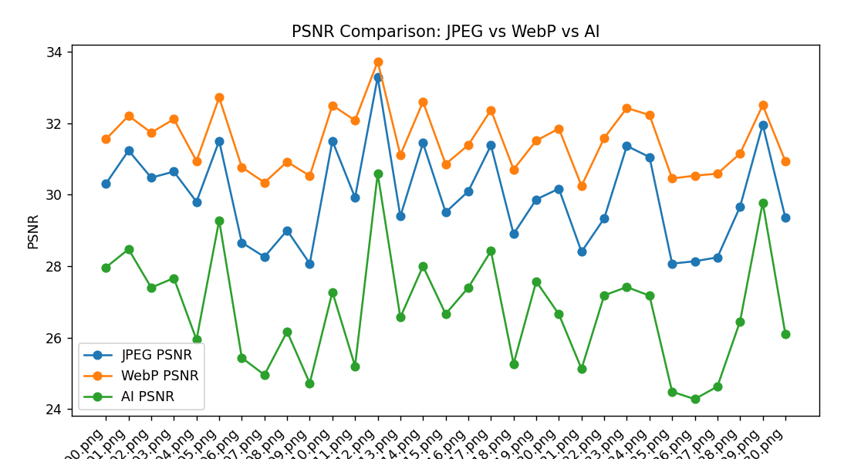
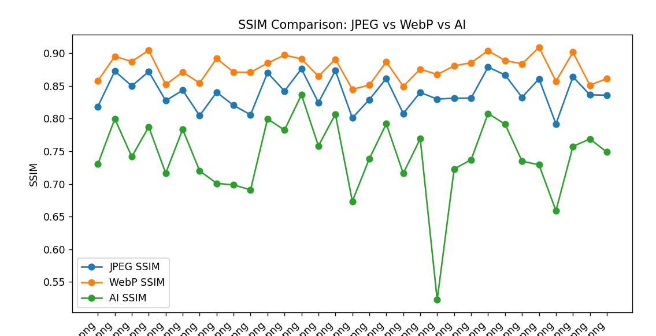
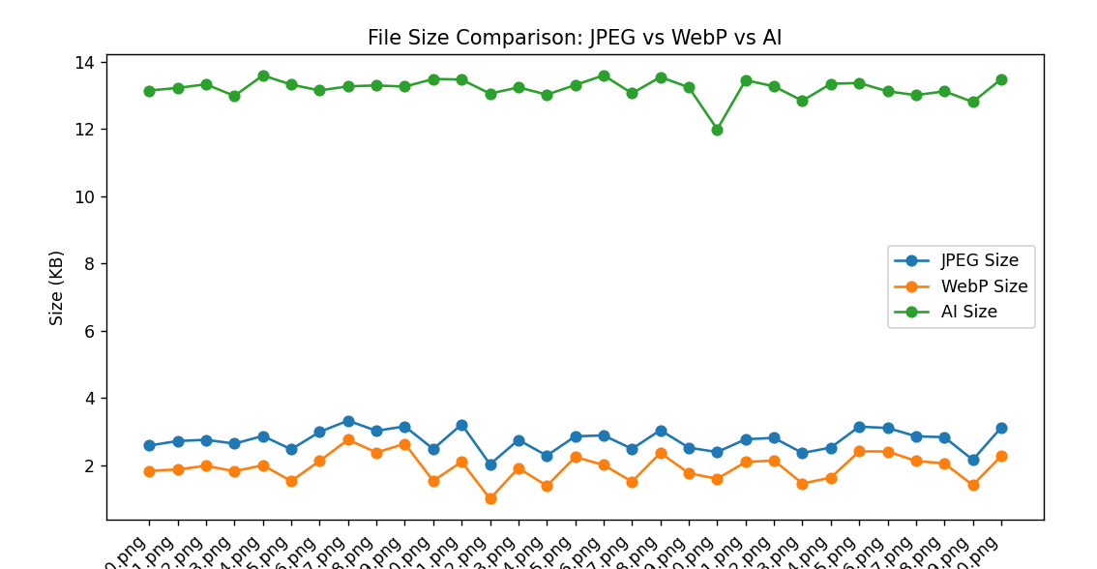
Results(52000 photos trained model)
V2

Slide 20
Conclusion and next step
File size is smaller, but we need to work on them a little bit more to compete with jpeg/webm
V2

Slide 21
Code explanation
Learning Type: supervised Learning – model learns by minimizing reconstruction error using MSE loss.
Loss Function: Mean Squared Error (MSE)
Activation Functions(Introduce non-linearity → Enable the model to learn complex patterns):
1) ReLU 2) Sigmoid
Architecture(5 layers):
Encoder & Decoder: 5 layers(AI model size – 4MB)
V3

Slide 22
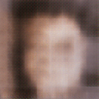
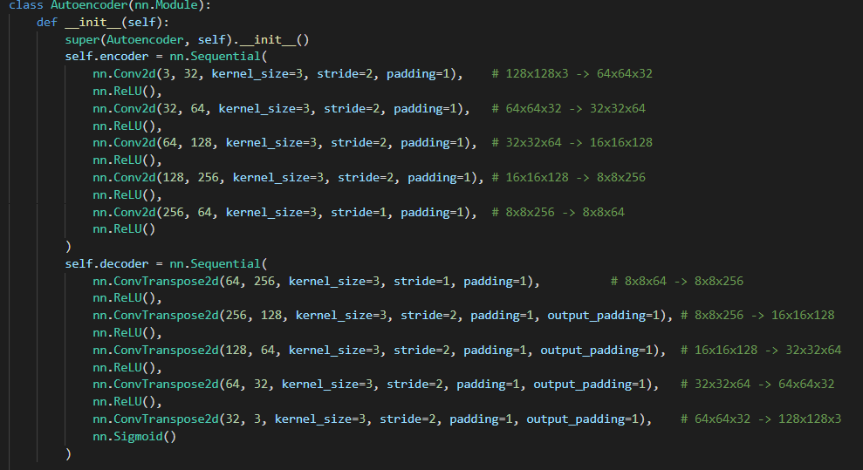
34KB
30 photos dataset(128x128px)
4.62kb encoded
29KB decoded
Training time – 1 min
V3

Slide 23

34KB
52000 photos dataset(128x128px)
5.8kb encoded
25KB decoded
Training time – 250 minutes
V3

Slide 24
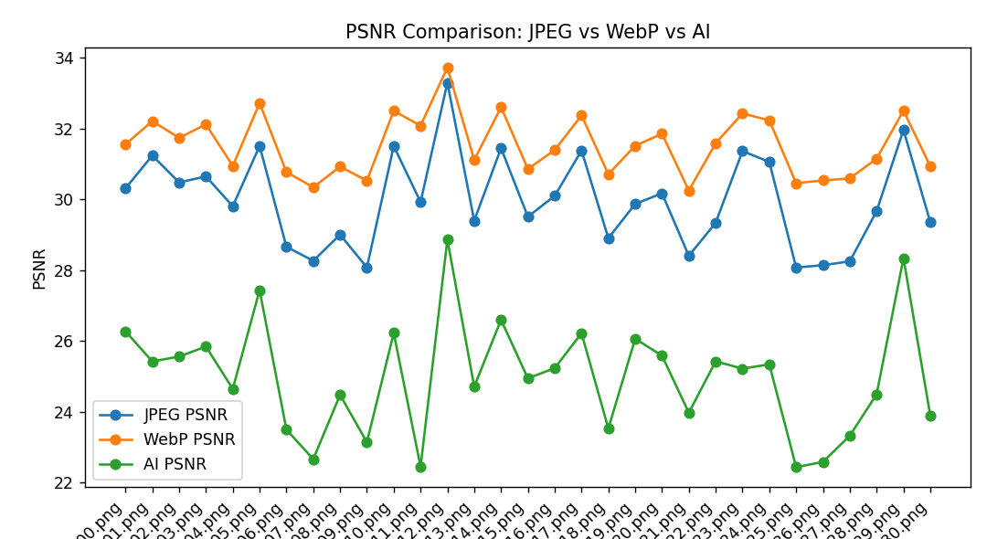
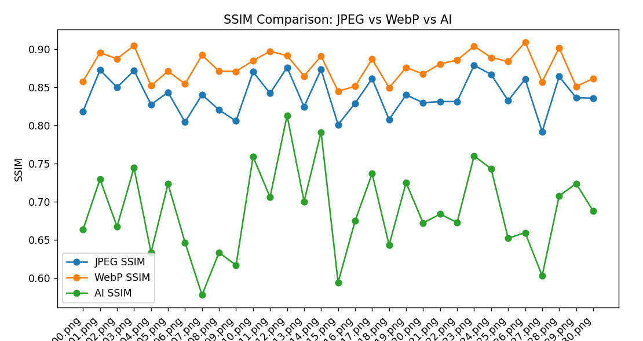
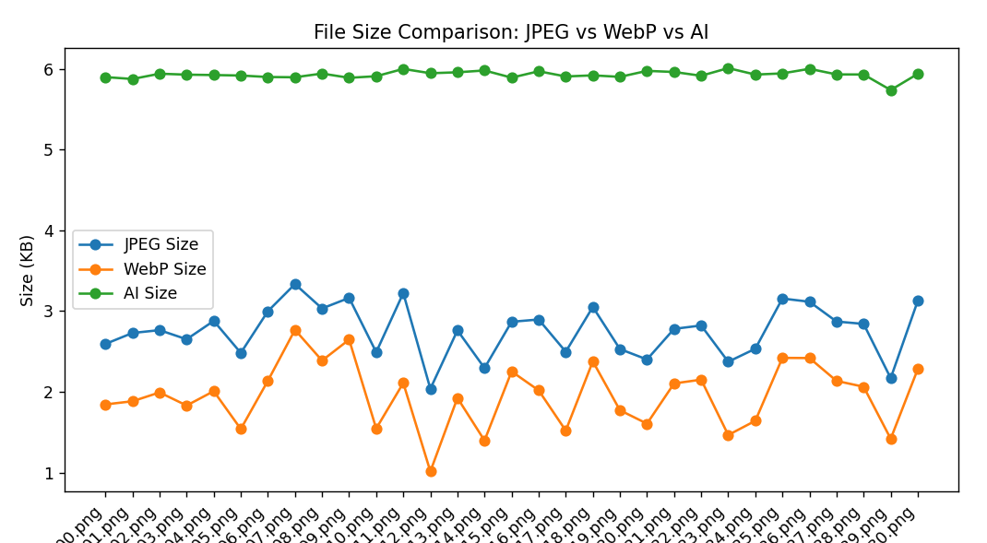
Results(52000 photos trained model)
V3

Slide 25
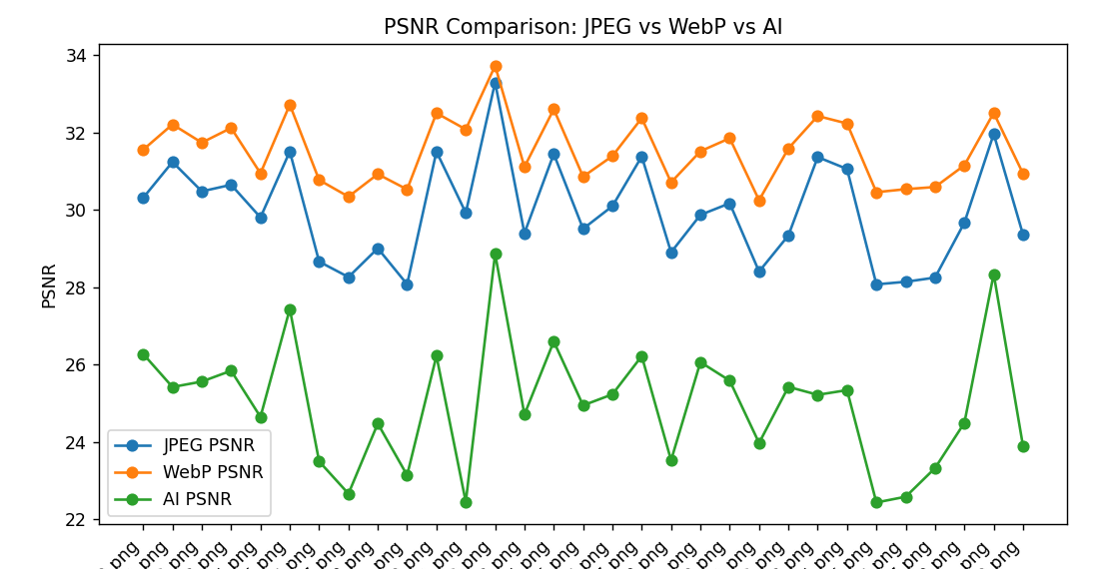
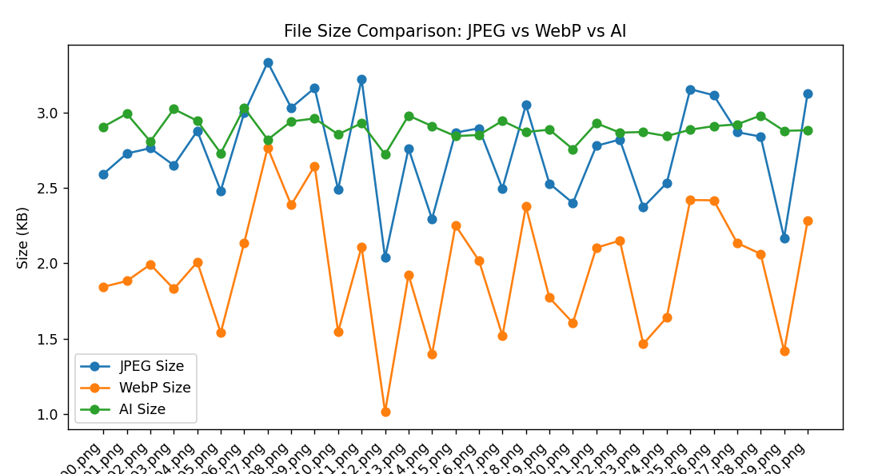
Compression of the encoded image file(.pt file)
1) With gzip: 5.89KB
No loss
No loss after compression
2) Lzma instead of gzip: 5.58KB
No loss
3) Lzma + quantization(FP16 → INT8): 2.9KB
The weight of a neuron narrows the range to [-127, 128]
Loss is so small, that there is no difference, because
V3

Slide 26
Conclusion and next step
Now size can compete with jpeg, we need to work on quality.
We will test different hypotheses for that – optimizations, different loss/activation functions
V3

Slide 27
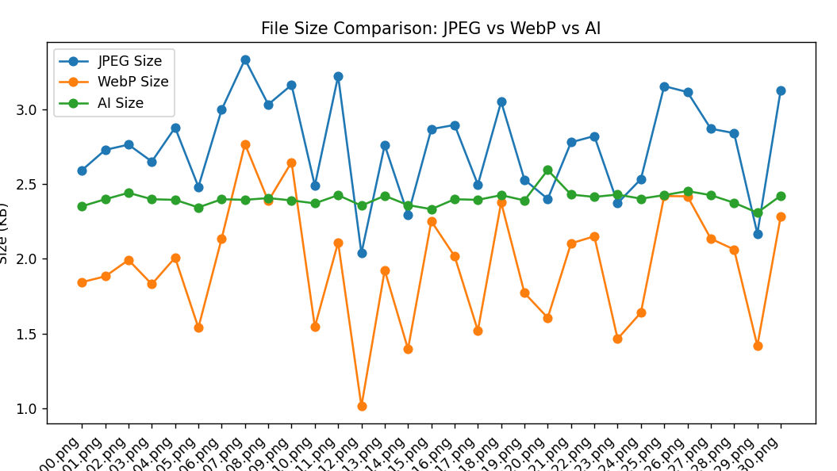
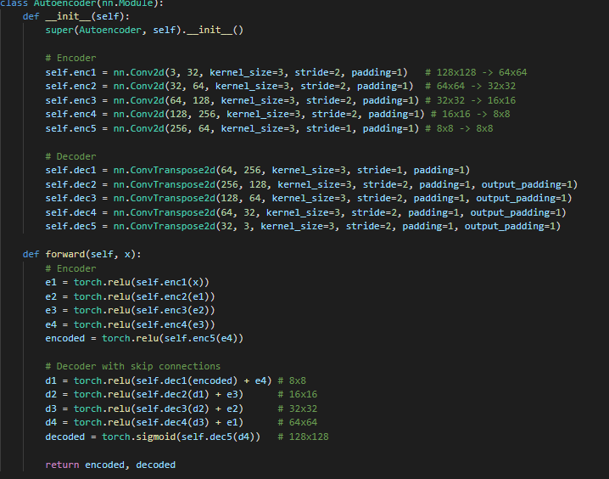
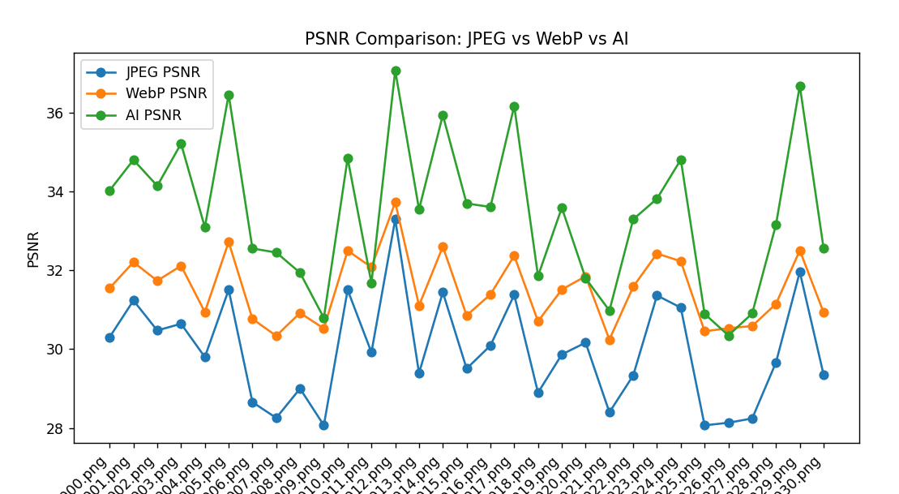
1 hypothesis
Hypothesis -Use Skip Connections (U-Net Style)
Training time: 9 hours
Now our AI works better than jpeg and take less size, but let`s try some more changes to increase the quality
FN – final loss(it should be small)
Old(FN - 0.0039)
new(FN – 0.0007)
V4
Look at green line

Slide 28
2 hypothesis
Hypothesis -Use LeakyReLU instead of relu, add Batch Normalization, make learning rate dynamic, not static
Quality increased, but Decoded image size increased, because that methods save more artifacts than simple relu, so we returned to first hypothesis code
V4

Slide 29
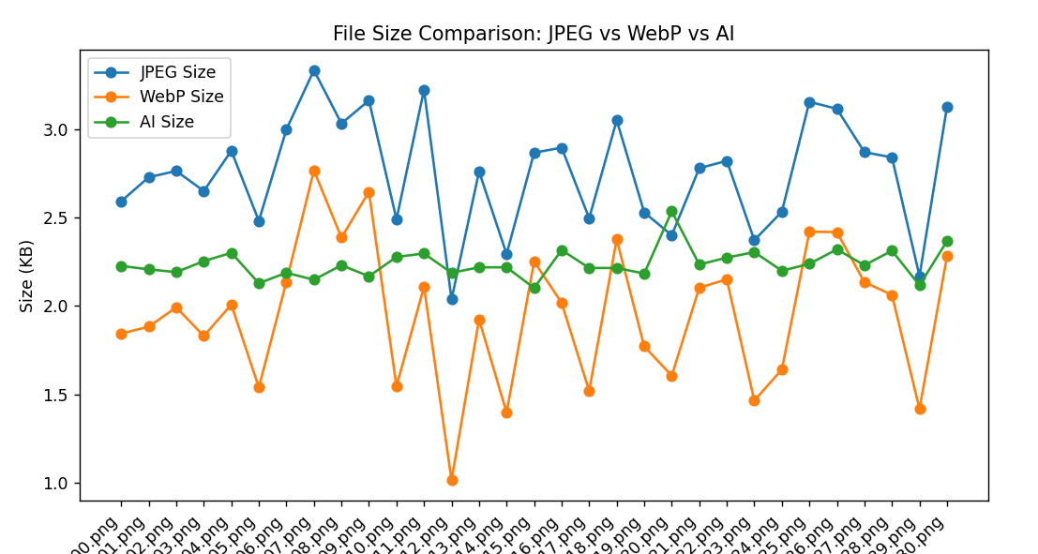
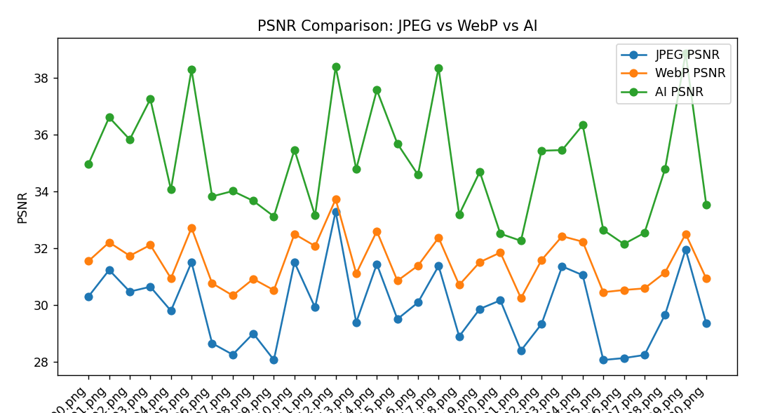
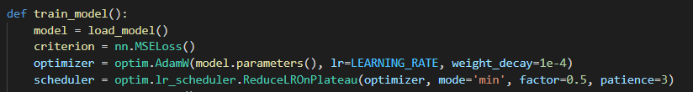
3 hypothesis
Hypothesis -Use smart learning rate and more learning epochs(40 instead of 30)
Training time: 400 minutes
Now our AI works better than jpeg and take less size, but let`s try some more changes to increase the quality
FN – final loss(it should be small)
Old(FN - 0.0007)
new(FN – 0.0004)
V4
Look at green line

Slide 30
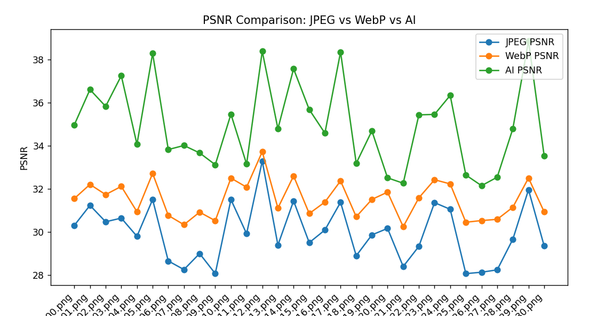
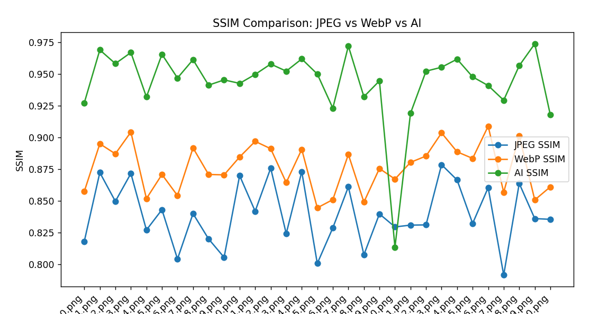
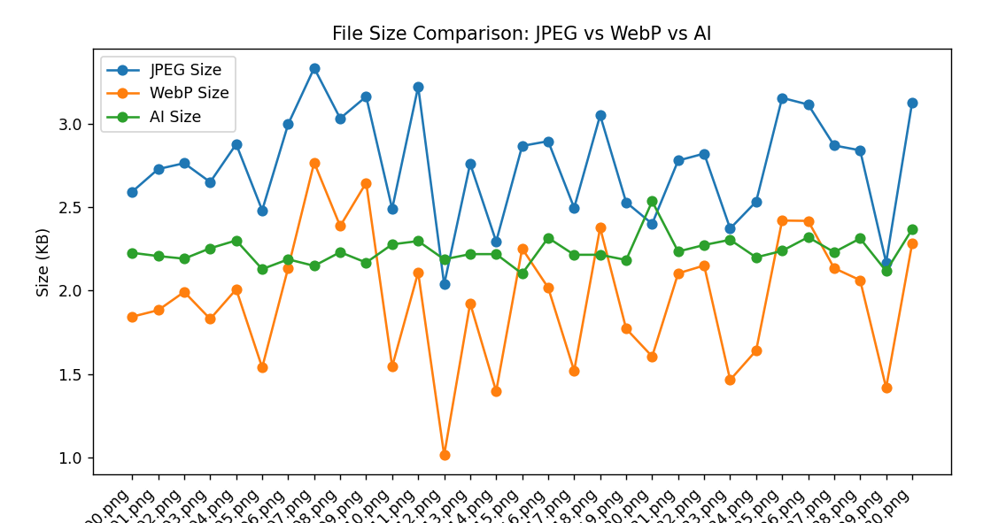
Results(52000 photos(128x128px) trained model)
V4

Slide 31
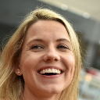
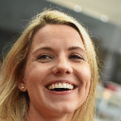

Results(52000 photos trained model)
PNG(32KB)
AI
Compressed 2.2KB
Decompressed 30.6KB
JPG(2.72KB)
V4

Slide 32
Step 5
In step 5 we will compare the time of compression and the requirements for jpg/ai compression
Then we will try to optimize the time of ai compression/decompression

Slide 33
Time comparison
JPG
CT - 0.0005 seconds
AI
CT - 0.0295 seconds
DT - 0.0098 seconds
All numbers include LZMA and quantization
CT - Compression time
DT – Decompression time

Slide 34
Step 6
In step 6 we will Learn model on the 1024x1024px images to see, how model will compete with jpeg on high-quality images

Slide 35
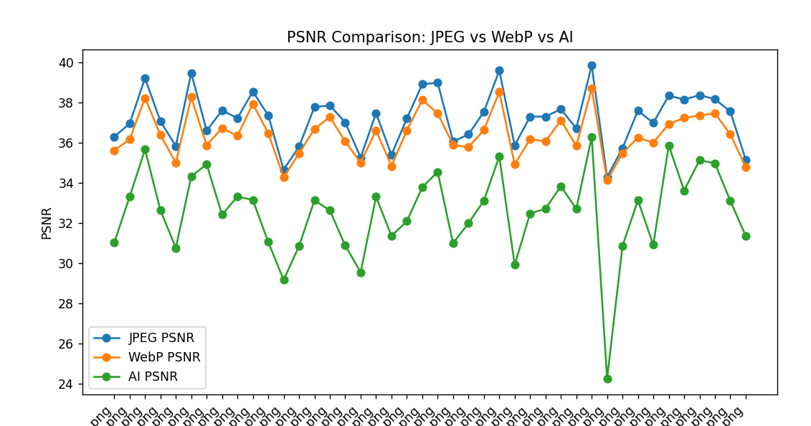
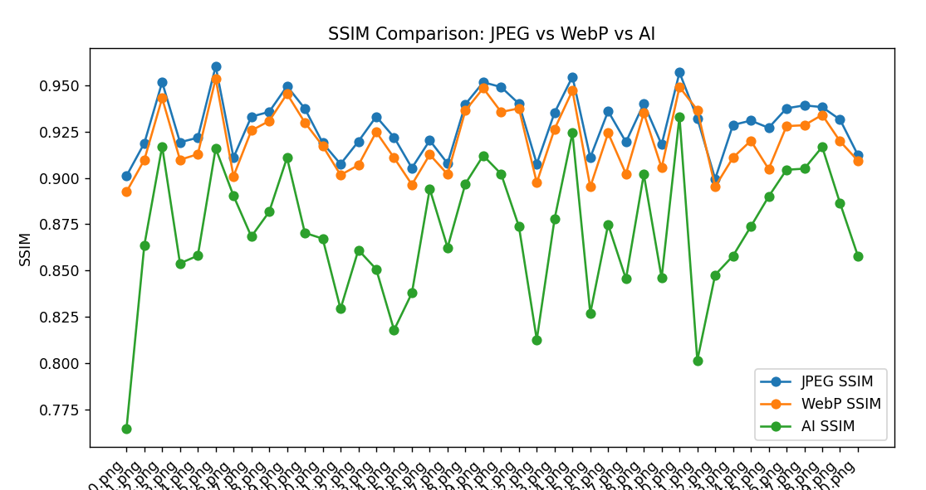
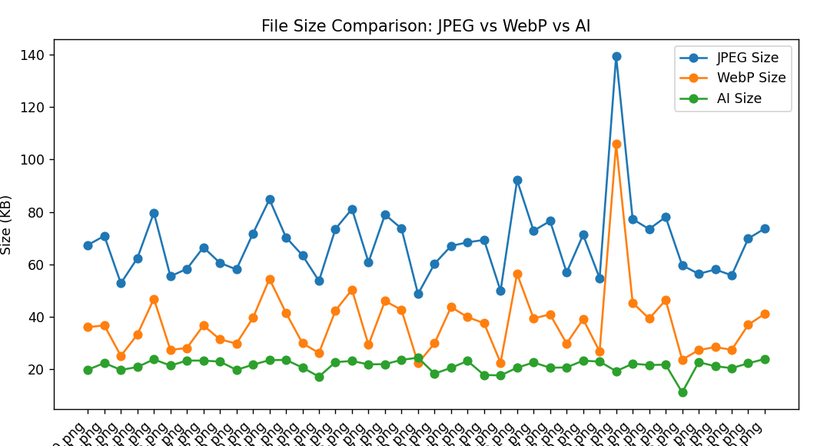
Results(1000 1024x1024px images trained model)
Learning time: 30 hours
Step 6

Slide 36
Now we see that quality is not so good, but the size is very small, lets increase the size a little bit to see, can we achieve the same quality
We will use LeakyReLU(0.2) Instead of relu(new activation function) - solves the problem of "dead neurons" when part of the network stops learning.
Step 7

Slide 37
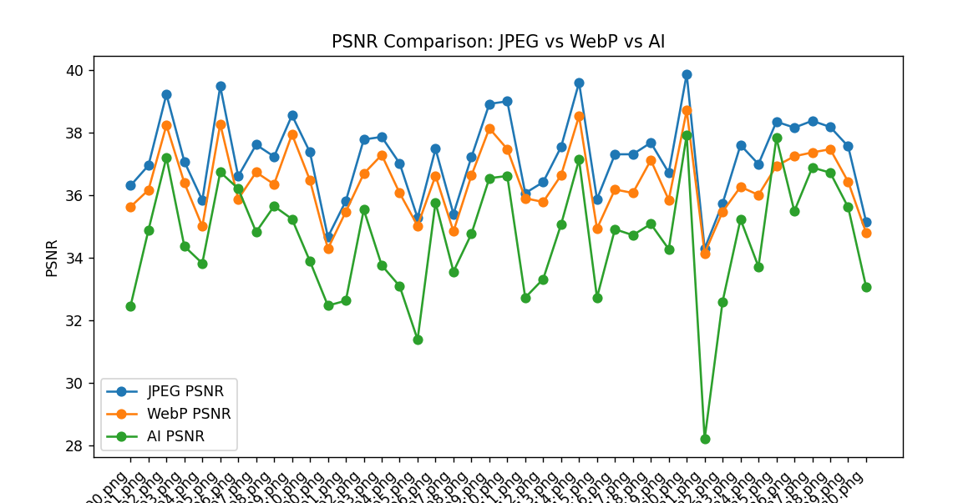
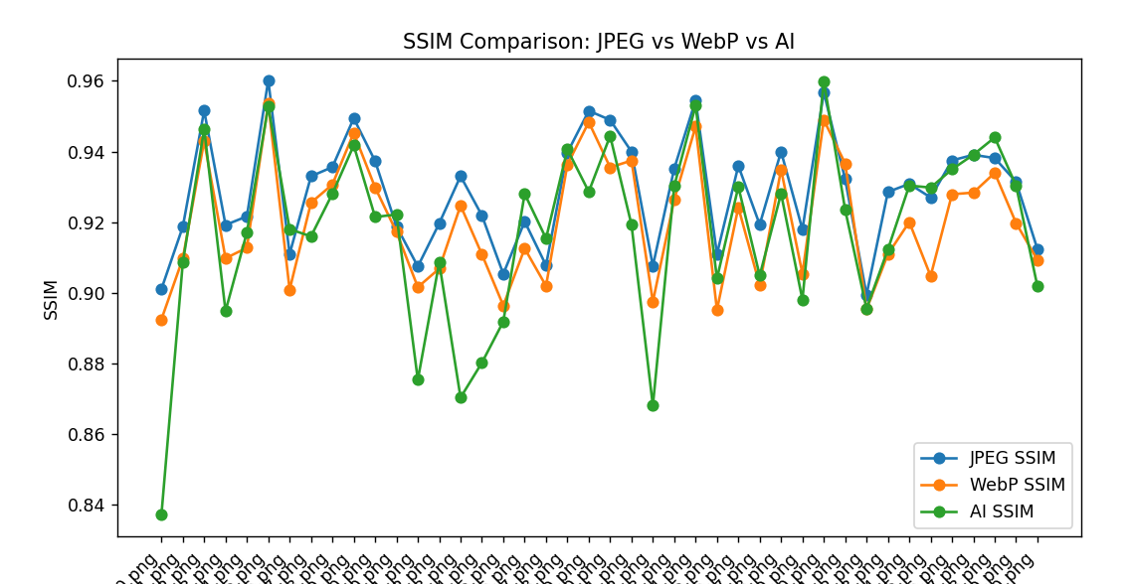
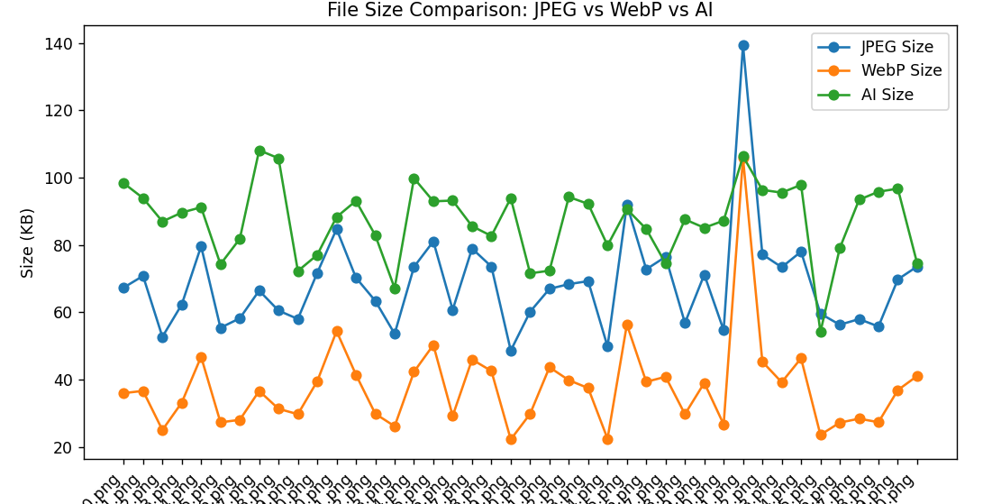
Results(1000 1024x1024px images trained model)
Step 7

Slide 38
Time comparison
JPG
CT - 0.08 seconds
AI
CT - 1 seconds
DT - 0.2 seconds
All numbers include LZMA and quantization
Step 7
CT - Compression time
DT – Decompression time

Slide 39
Results on high quality images
JPEG(+)
40 time faster compression
Better compressed quality
Adaptable to different photo sizes and ratios
Ability to select compression force
Doesn’t require python environment and libraries to work – just simple math
AI(+)
There are no pluses
Step 7

Slide 40
Conclusion
AI can work well, in our example it worked better than math on example of poor quality photos
But even in that case the compression time was 60 times more than simple math – in case of image compression that is one of the main troubles
In that research we got an extremely interesting conclusion - AI is not a magician, sometimes it loses to a regular mathematical formula and information theory in general.
AI creates a wow effect, that is why IT has produced such a worldwide boom in the popularity of AI, but in low-level calculations aimed at maximum performance, it loses greatly.

Slide 41
Thank you

