Slide 1
Optimizing Data Compression Techniques: Enhancing Efficiency and Scalability for Diverse Applications by implementing AI
Author: Grigoriy Kovrizhnykh, Arslan Koshimov

Slide 2
Agenda
4. Codebase
5. Dataset and Tools
6. Numerical experiments
7. Further…
Introduction
Background
3. Research Goal

Slide 3
Introduction
Problem:
The world is generating data at an unprecedented rate, creating challenges for storage and transmission.
Solution:
Data compression reduces file sizes, enabling efficient storage and faster data transfer.

Slide 4
Background
Lossless Compression
Preserves all original data, ideal for text and databases.
Lossy Compression
Removes less noticeable data, suitable for images, videos, and audio.
AI-Powered Compression
Machine learning models enhance compression efficiency by recognizing patterns in data.

Slide 5

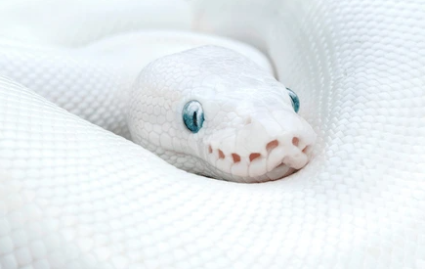




Research Goal
Develop Efficient and Adaptable Compression Techniques
1
2
Python Implementation
3
Performance Evaluation

Slide 6



Codebase
/examples
Ready-to-run examples demonstrating compression of images.
/src
Python scripts for the algorithms, methods.
/docs
Documentation including installation instructions, tutorials, and integration guides.

Slide 7


Dataset & Tools

Slide 8
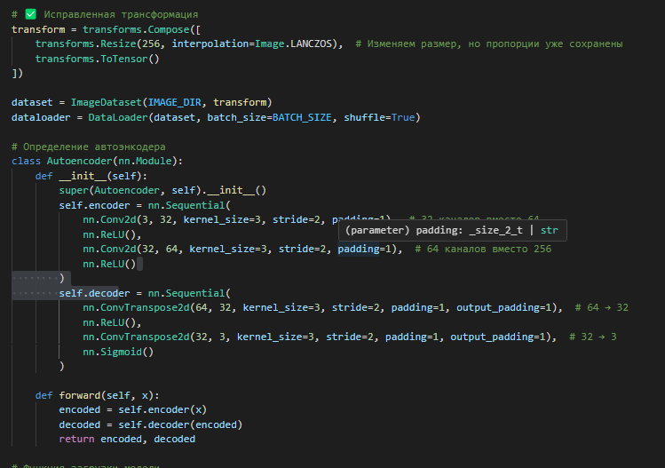
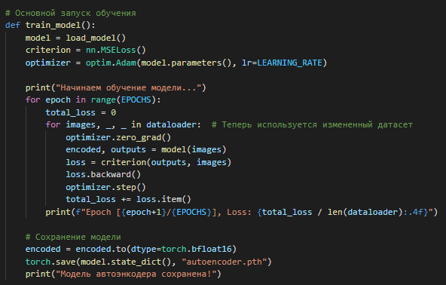

Code

Slide 9
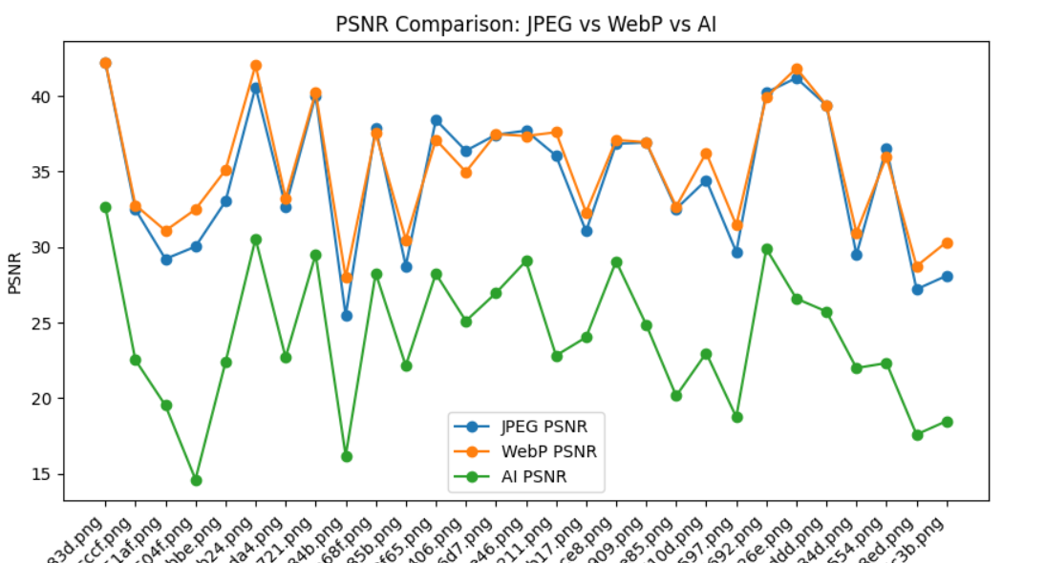
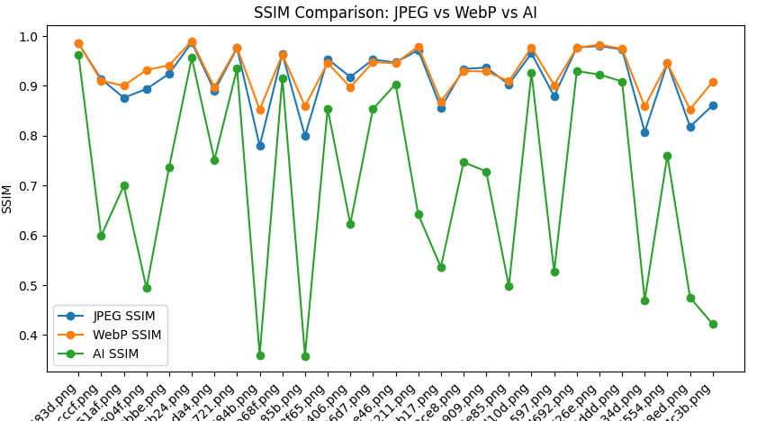
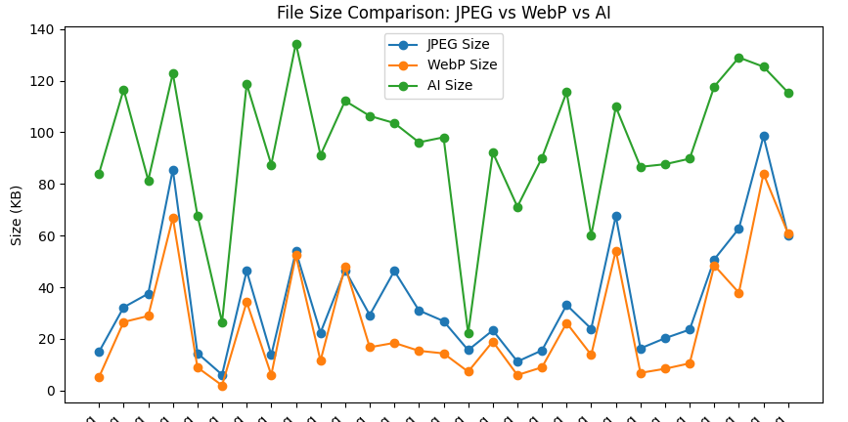
Numerical experiments on out own neural network

Slide 10
Further…
Model Development
convolutional autoencoder, transformers, variational autoencoder, information theory concepts
Training and Validation
training the different kind of models on a big openSource photo datasets
Testing and Analysis
PSNR, SSIM, and other metrics
Compare with JPEG, WebM etc

Slide 11
Thank you

