Slide 1
Photo ai enhancing: improving photo quality by implementing ai
Author: Grigoriy Kovrizhnykh, Arslan Koshimov

Slide 2
Agenda
4. Dataset and Tools
5. Numerical experiments
6. Further…
Introduction
Background
3. Research Goal

Slide 3
Introduction
Problem:
There are millions of images being made every day, and lots of them have poor quality
Solution:
AI-based enhancing can help to increase photos and videos quality

Slide 4
Background
1) Manual Editing
Hands-on adjustments using traditional tools — offers full control over lighting, color, and details.
2) AI-based Enhancement
Automated photo improvement using neural networks — ideal for quick upscaling, deblurring, and facial restoration.

Slide 5

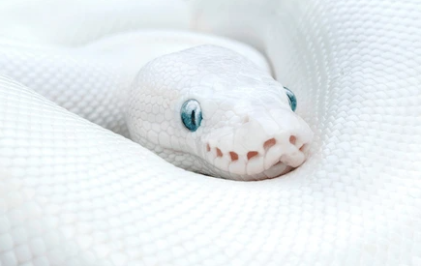



Research Goal
Develop Efficient and Adaptable AI photo enhancing Techniques
1
2
Python Implementation
3
Performance Evaluation

Slide 6
Dataset & Tools
Flickr Faces Dataset Resized(52000 photos)
(OpenSource faces image dataset)

Slide 7
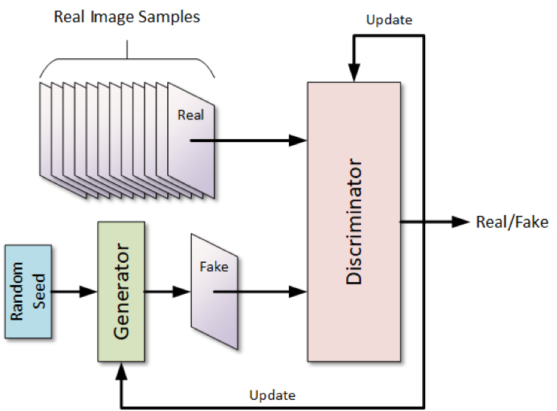
Architecture explanation
SRGAN: Super-Resolution Using GAN
Objective: Reconstruct fine details and realistic textures in upscaled images
Uses a Generative Adversarial Network (GAN) consisting of:
A Generator that upsamples low-resolution images (128×128 → 256×256)
A Discriminator that distinguishes real high-resolution images from generated ones
Trained on paired face images:
Low-resolution inputs (128×128px)
High-resolution targets (256×256px)
Loss functions include:
Perceptual loss (VGG19-based)
Pixel-wise MSE loss
Color loss (HSV hue)
Adversarial loss

Slide 8
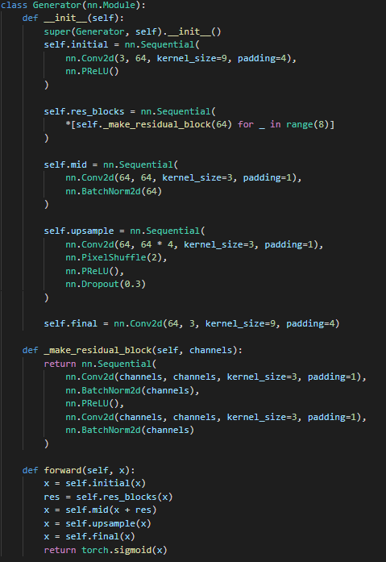
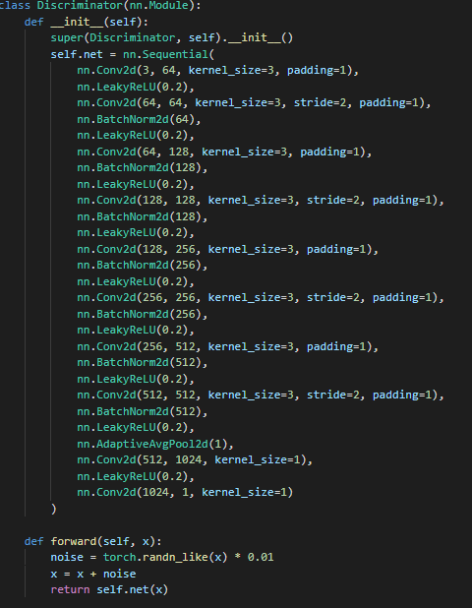
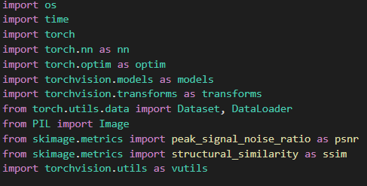

Code
Loss functions:
nn.MSELoss() for pixels difference loss
VGG19Loss for perceptual loss

Slide 9
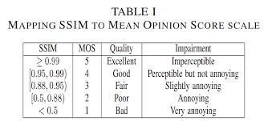

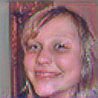

Numerical experiments on our own neural network(1000 photos dataset)
PSNR: 21.43, SSIM: 0.6049
Original 64px
AI 128px
Original 128px
Conclusion: we see, that SSIM is too small, so we added color loss function and increased residual blocks number
Each block "refines" the image - adds details, improves structure and texture. More blocks → higher ability to restore complex and realistic details.
V1

Slide 10
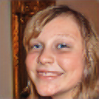
Numerical experiments on our own neural network(1000 photos dataset)
PSNR: 26.43, SSIM: 0.8029
Original 64px
AI 128px
Original 128px
Conclusion: we see, results are better, but not so good. In next step we change dataset from 64->128 to 128->256px photos enhancement
Neural network can not draw magic, if it doesn’t have enough data, so lets increase photos quality to check that theory
V2

Slide 11
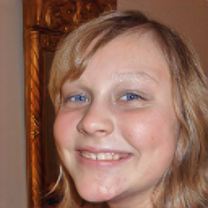
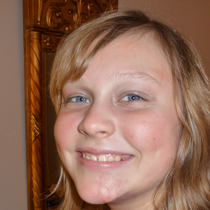
Numerical experiments on our own neural network(1000 photos dataset)
PSNR: 28.18, SSIM: 0.8473
Original 128px
AI 256px
Original 256px
Conclusion: we see, results are better, that means that as quality increases -> neural network can enhance better
Now, lets add more residential blocks to check, if it have affect
V3

Slide 12
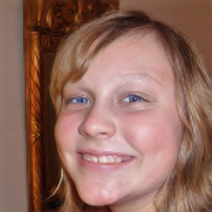
Problem
PSNR: 28.12, SSIM: 0.8495
Original 128px
AI 256px
Original 256px
We increased number of residual blocks from 8 to 12, and it didn’t make any change. That means, 8 blocks are enough for our image quality
Lets go back to 8 blocks, increase the dataset size and learn an AI a little more
V4

Slide 13
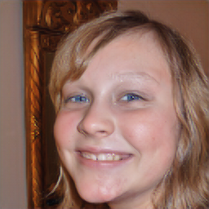
Numerical experiments on our own neural network(3000 photos dataset)
PSNR: 30.18, SSIM: 0.8573
Original 128px
AI 256px
Original 256px
Quality increased a little bit
V5

Slide 14
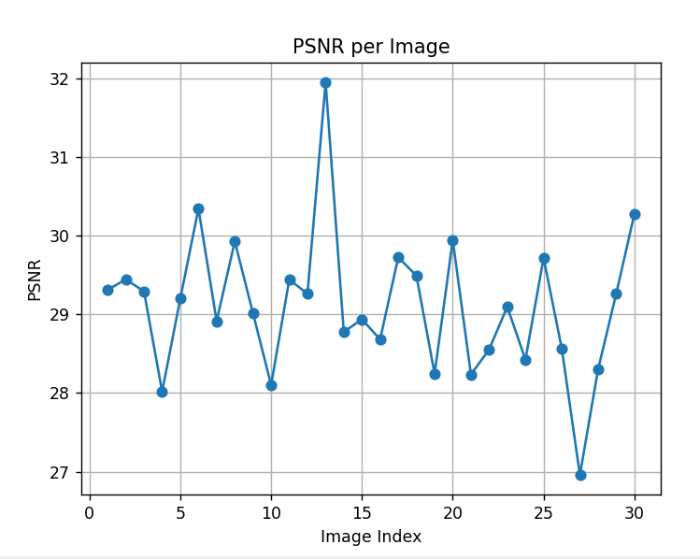
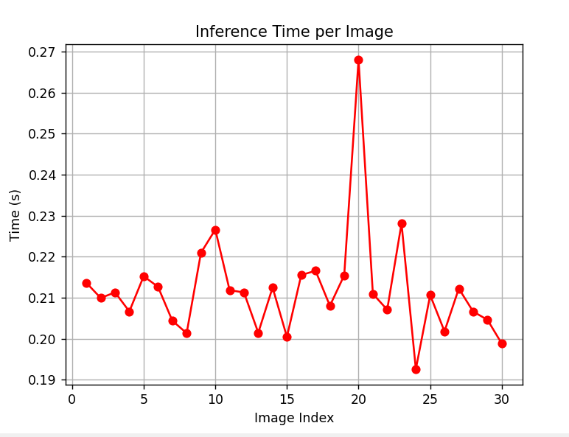
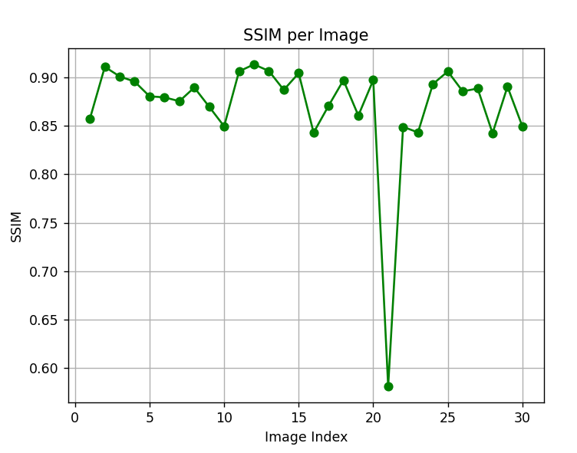
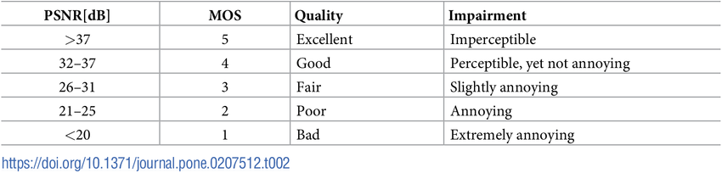
Results
We approached a 0.85-0.90 SSIM and 28-30 PSNR, which makes our generated photo “fair quality”.
That is maximum that our NN(128->256) can show.
By increasing quality we can increase that metric.
Time to enhance photo from 128 to 256 pixels is 0.21 seconds

Slide 15

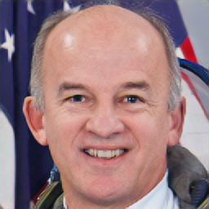
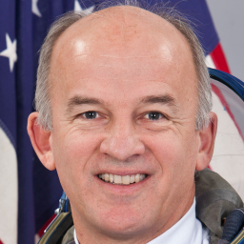

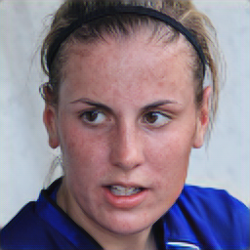
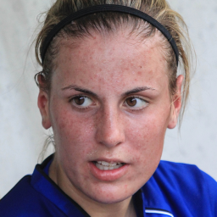
Results
Original 128px
AI 256px
Original 256px

Slide 16
Conclusion
We proved that ai can enhance photo quality
It takes not so much time and gives a quite-well quality, which we can increase by learning neural network on better quality images
But as quality of images rises, neural network takes more and more time to learn, so to build a strong ai we need an enormous amount of resources
AI really helped us to create a wow effect, that implementation of ai shows why it created an ai-boom in a modern world

Slide 17
Thank you

