Slide 1
Optimizing Data Compression Techniques: Enhancing Efficiency and Scalability for Diverse Applications by implementing AI
Author: Grigoriy Kovrizhnykh, Arslan Koshimov

Slide 2
Agenda
4. Codebase
5. Dataset and Tools
6. Numerical experiments
7. Further…
Introduction
Background
3. Research Goal

Slide 3
Introduction
Problem:
The world is generating data at an unprecedented rate, creating challenges for storage and transmission.
Solution:
Data compression reduces file sizes, enabling efficient storage and faster data transfer.

Slide 4
Background
Lossless Compression
Preserves all original data, ideal for text and databases.
Lossy Compression
Removes less noticeable data, suitable for images, videos, and audio.
AI-Powered Compression
Machine learning models enhance compression efficiency by recognizing patterns in data.

Slide 5

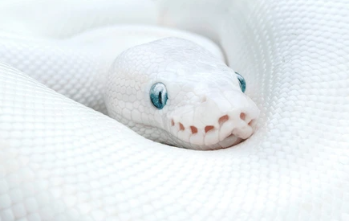




Research Goal
Develop Efficient and Adaptable Compression Techniques
1
2
Python Implementation
3
Performance Evaluation

Slide 6



Codebase
/examples
Ready-to-run examples demonstrating compression of images.
/src
Python scripts for the algorithms, methods.
/docs
Documentation including installation instructions, tutorials, and integration guides.

Slide 7


Dataset & Tools

Slide 8
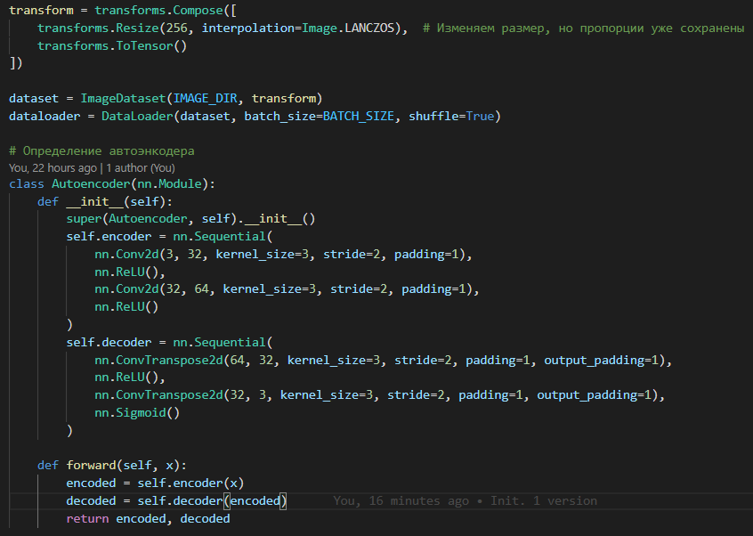
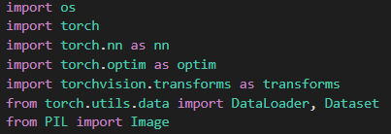
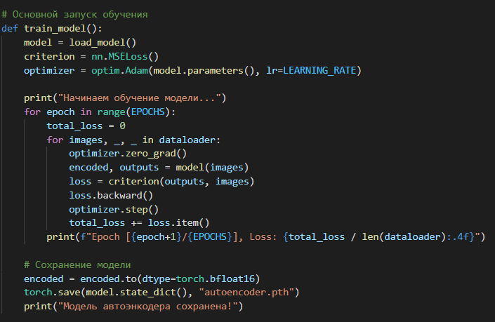

Code
V1

Slide 9
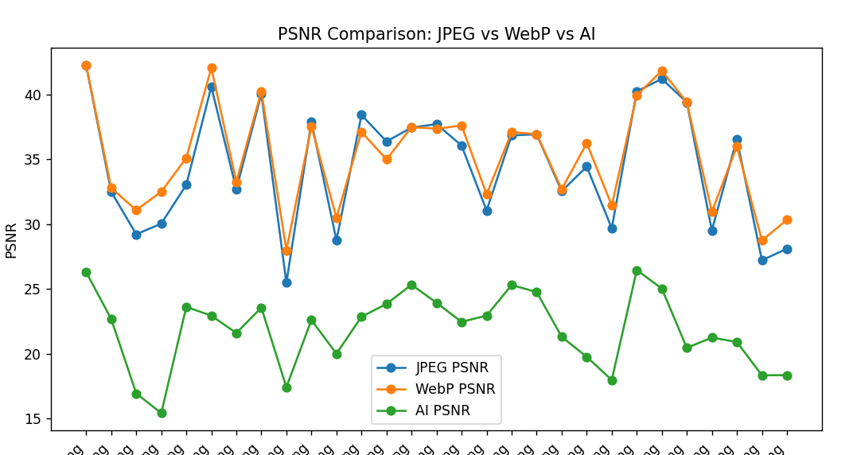
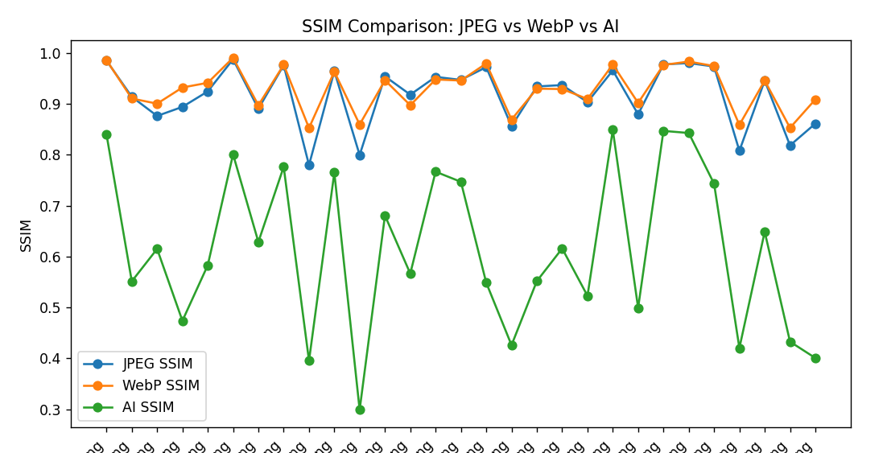
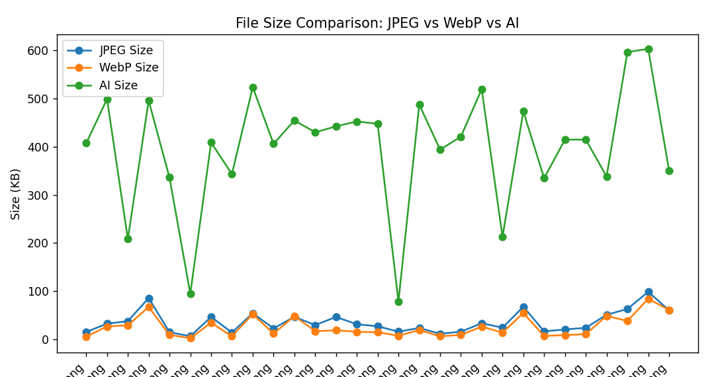
Numerical experiments on our own neural network(30 photos dataset)
V1

Slide 10
Further…
Model Development
Development of the ai encoder learning methods, implementation of the information theory concepts
Training and Validation
training the different kind of models on a big open source photo datasets
Working on less file size
decreasing encoded images size to compete with jpeg
V1

Slide 11
Thank you

