Slide 1
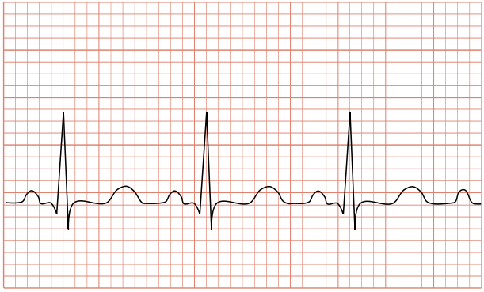

Noise and Artefact Removal from ECG using Variants of Empirical Mode Decomposition
Supervised Research Exposition
Dharmashloka Debashis (13D070053)
Guide: Dr. Rajbabu Velmurugan

Slide 2
Things in Store…
ECG Introduction
Challenges in noise removal
Empirical Mode Decomposition (EMD)
Variations of EMD
Baseline wander removal
High frequency noise removal
Experiments
Conclusions

Slide 3
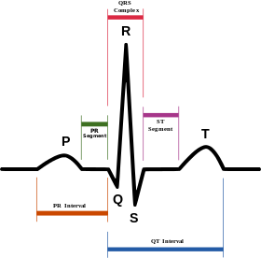
What is ECG? Why Do We Care?
Electrocardiogram (ECG) signal – Electrical activity of heart
Analysed to diagnose heart diseases
Image source: https://en.wikipedia.org/wiki/Electrocardiography

Slide 4
Noise/artefact is a Problem
Practically, ECG signals are corrupted with noise/artefacts
Noise: A persistent contamination
Artefact: A transient contamination
Types of noise/artefacts:
Electromyography (EMG) noise due to muscle contraction
Baseline wander (BW) due to respiration of the patient
50 Hz powerline interference
Motion artefacts due to movement of patient

Slide 5
Noise/artefact is a Problem
Our focus is on:
EMG noise (A high-frequency noise)
Baseline wander (A low frequency noise)

Slide 6
Will Bandpass Filtering Work?
ECG signals are non-stationary
Bandpass filtering won’t work
Popular techniques:
Adaptive filtering
Wavelet transform
Empirical Mode Decomposition (EMD)
We explore EMD

Slide 7
Empirical Mode Decomposition (EMD) (Huang, et al., The empirical mode decomposition and Hilbert spectrum for nonlinear and nonstationary time series analysis, 1998)
Decomposes a signal into Intrinsic Mode Functions (IMFs)
IMF properties:
Exactly one extremum between zero-crossings
Envelope of the local maxima and that of the local minima are symmetric around zero.
Lower order IMFs: Rapidly varying signal components
Higher order IMFs: Slowly varying signal components
The IMFs do not belong to a family of basis functions, unlike Fourier transform and wavelet transform, but are extracted from the data.

Slide 8
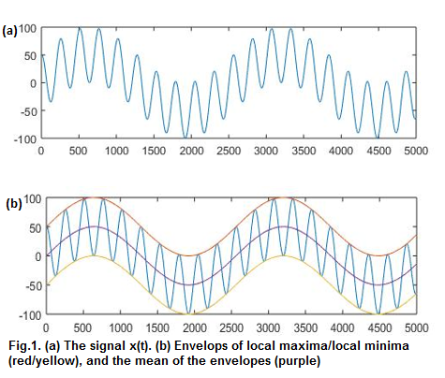
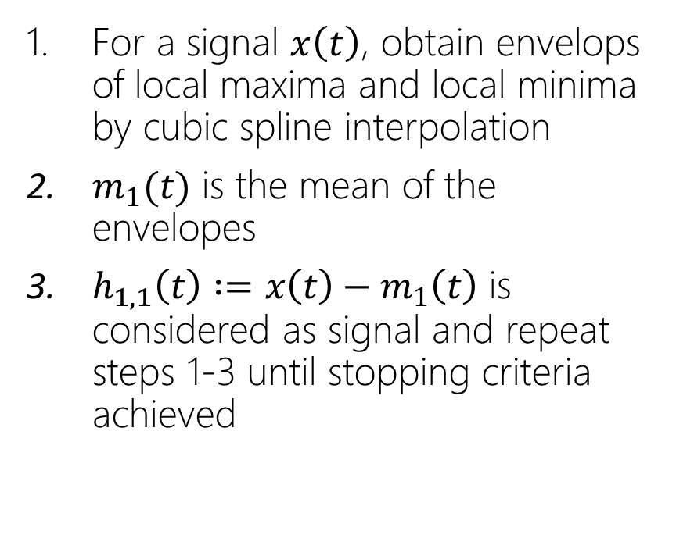
Sifting to Obtain IMFs
For a signal $x\left(t\right)$, obtain envelops of local maxima and local minima by cubic spline interpolation
$m_{1}(t)$ is the mean of the envelopes
$h_{1,1}\left(t\right) :=x\left(t\right)−m_{1}\left(t\right)$ is considered as signal and repeat steps 1-3 until stopping criteria achieved

Slide 9
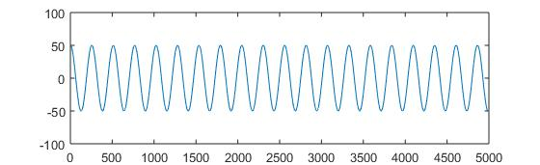
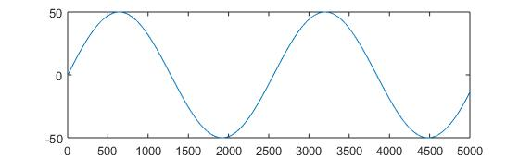
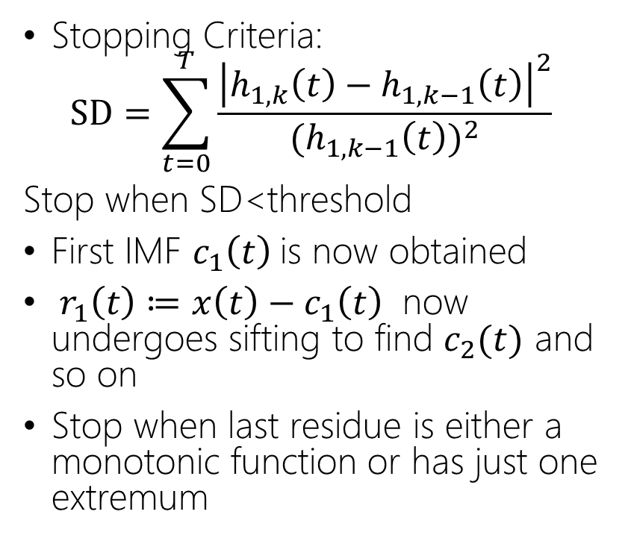
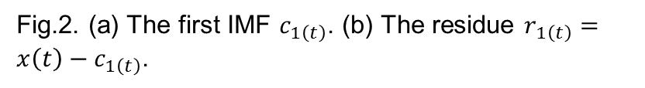
Sifting to Obtain IMFs
(a)
Stopping Criteria:
$$SD=\sum_{t=0}^{T}{\frac{{\left|h_{1,k}\left(t\right)−h_{1,k−1}\left(t\right)\right|}^{2}}{{(h}_{1,k−1}{\left(t\right))}^{2}}}$$
Stop when SD<threshold
First IMF $c_{1}\left(t\right)$is now obtained
$r_{1}\left(t\right)≔x\left(t\right)−c_{1}\left(t\right)$ now undergoes sifting to find $c_{2}(t)$ and so on
Stop when last residue is either a monotonic function or has just one extremum
(b)
Fig.2. (a) The first IMF $c_{1\left(t\right)}$. (b) The residue $r_{1\left(t\right)}=x\left(t\right)−c_{1\left(t\right)}$.

Slide 10
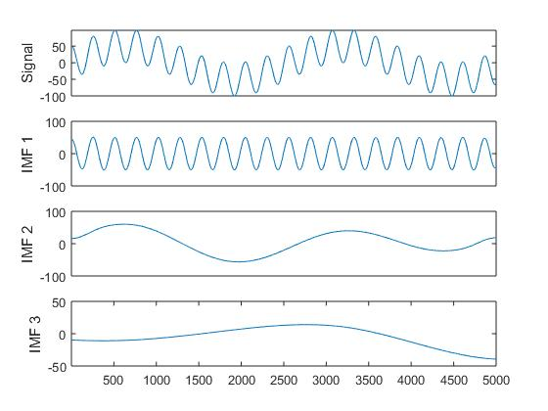
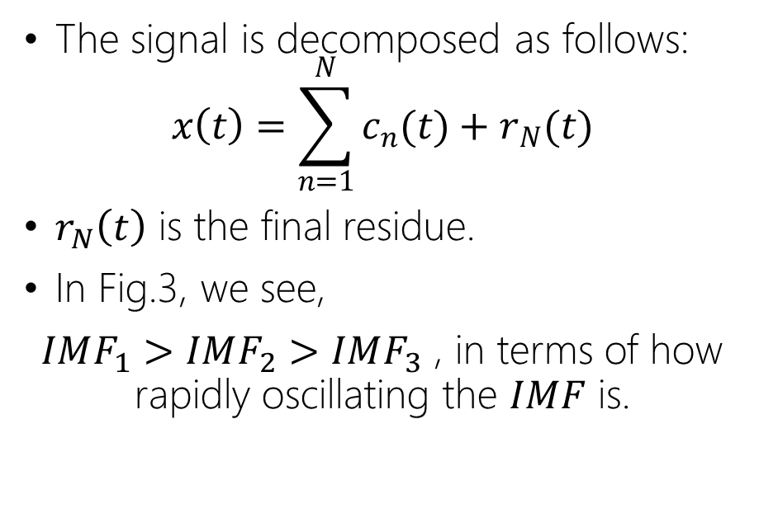
Sifting to Obtain IMFs
The signal is decomposed as follows:
$$x\left(t\right)=\sum_{n=1}^{N}{c_{n}(t})+r_{N}(t)$$
$r_{N}\left(t\right)$ is the final residue.
In Fig.3, we see,
$IMF_{1}>IMF_{2}>IMF_{3}$ , in terms of how rapidly oscillating the $IMF$ is.
Fig.3. A signal and its IMFs

Slide 11
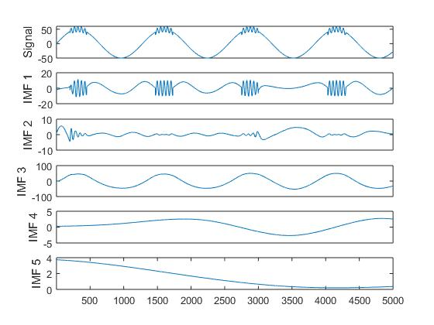
Problem of “Mode Mixing”
Fig.4. Demonstration of mode mixing problem

Slide 12
Improvements upon EMD
Ensemble EMD (EEMD)
Complementary EEMD (CEEMD)
Complete EEMD with Adaptive noise (CEEMDAN)

Slide 13
Ensemble EMD (EEMD) (Wu, et al., Ensemble empirical mode decomposition: a noise-assisted data analysis method, 2009)
Add white Gaussian noise to signal, perform EMD to obtain IMFs
Add multiple noise realizations to obtain different versions of IMFs
Average corresponding IMFs
The added noise populates the signal, thus making the signal not intermittent. Alleviates mode mixing problem
For every noise realization, we also add the negative (complementary) of that noise. Less ensembles are needed to cancel out noise in IMFs.

Slide 14
Complementary EEMD (CEEMD) (Yeh, et al., Complementary ensemble empirical mode decomposition: a novel noise enhanced data analysis method, 2010)
For every noise realization, we also add the negative (complementary) of that noise to calculate another set of IMFs
Less ensembles are needed to cancel out noise in IMFs
Problems:
Number of IMFs may not match across realizations
Thus, hard to find correspondences among IMFs while averaging

Slide 15
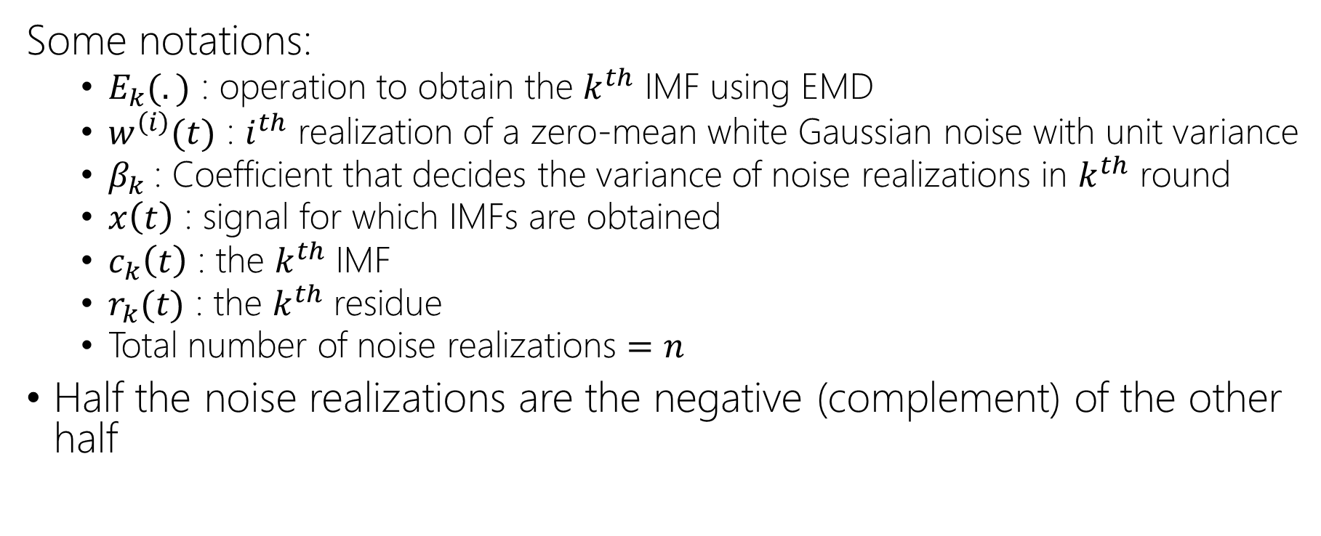
Complete EEMD with Adaptive Noise (CEEMDAN) (Colominas, et al., Improved complete ensemble EMD: A suitable tool for biomedical signal processing, 2014)
Some notations:
$E_{k}(.)$ : operation to obtain the $k^{th}$ IMF using EMD
$w^{\left(i\right)}(t)$ : $i^{th}$ realization of a zero-mean white Gaussian noise with unit variance
$β_{k}$: Coefficient that decides the variance of noise realizations in $k^{th}$ round
$x\left(t\right)$ : signal for which IMFs are obtained
$c_{k}\left(t\right)$ : the $k^{th}$ IMF
$r_{k}(t)$ : the $k^{th}$ residue
Total number of noise realizations $=n$
Half the noise realizations are the negative (complement) of the other half

Slide 16
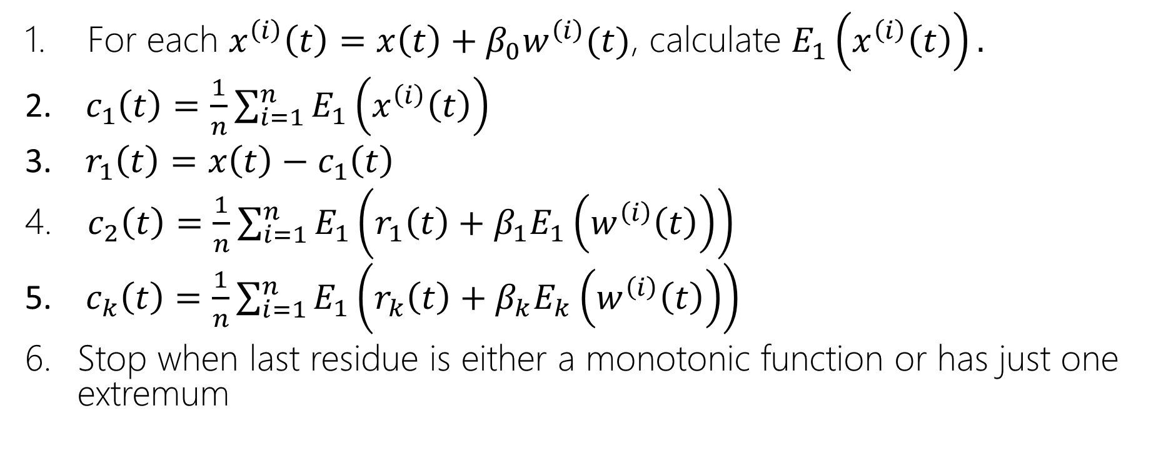
Steps for CEEMDAN
For each $x^{\left(i\right)}\left(t\right)=x\left(t\right)+β_{0}w^{\left(i\right)}(t)$, calculate $E_{1}\left(x^{\left(i\right)}\left(t\right)\right).$
$c_{1}\left(t\right)=\frac{1}{n}\sum_{i=1}^{n}{E_{1}\left(x^{\left(i\right)}\left(t\right)\right)}$
$r_{1}\left(t\right)=x\left(t\right)−c_{1}\left(t\right)$
$c_{2}\left(t\right)=\frac{1}{n}\sum_{i=1}^{n}{E_{1}\left(r_{1}\left(t\right)+β_{1}E_{1}\left(w^{\left(i\right)}\left(t\right)\right)\right)}$
$c_{k}\left(t\right)=\frac{1}{n}\sum_{i=1}^{n}{E_{1}\left(r_{k}\left(t\right)+β_{k}E_{k}\left(w^{\left(i\right)}\left(t\right)\right)\right)}$
Stop when last residue is either a monotonic function or has just one extremum

Slide 17
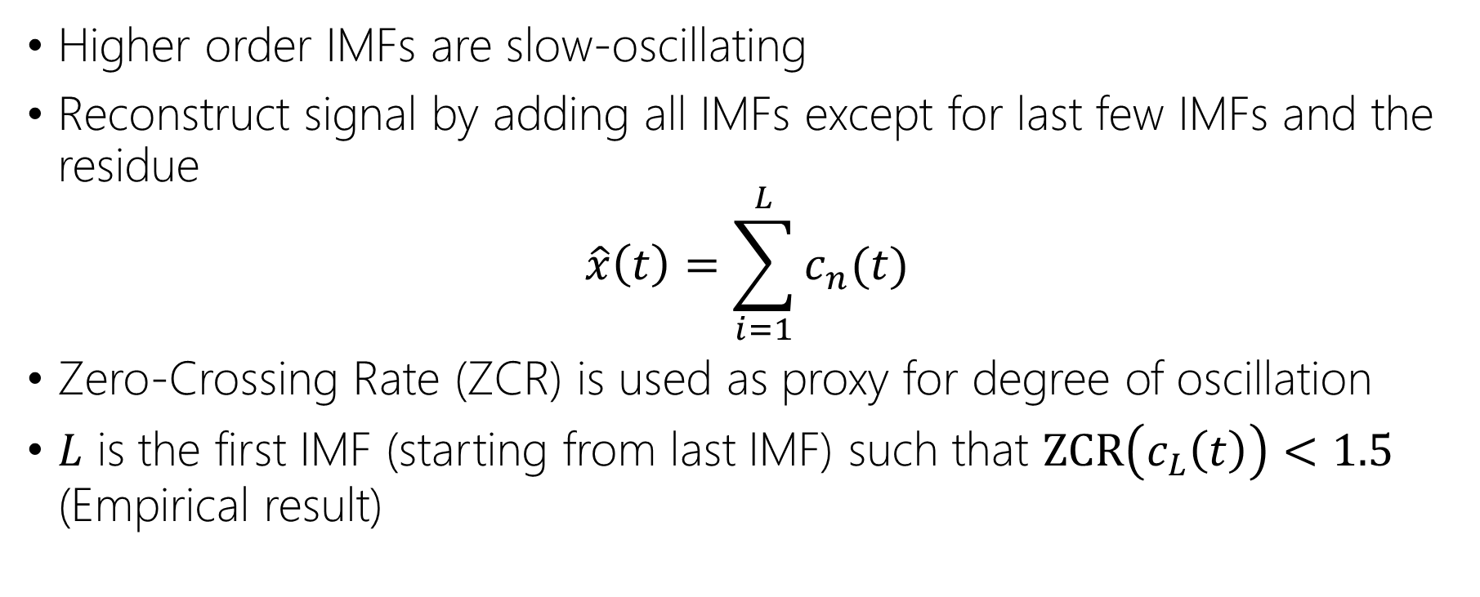
Baseline Wander Removal using CEEMDAN (Weiwei, et al., ECG Baseline Wander Correction Based on Ensemble Empirical Mode Decomposition with Complementary Adaptive Noise, 2015)
Higher order IMFs are slow-oscillating
Reconstruct signal by adding all IMFs except for last few IMFs and the residue
$$\hat{x}\left(t\right)=\sum_{i=1}^{L}{c_{n}(t)}$$
Zero-Crossing Rate (ZCR) is used as proxy for degree of oscillation
$L$ is the first IMF (starting from last IMF) such that $ZCR\left(c_{L}\left(t\right)\right)<1.5$ (Empirical result)

Slide 18
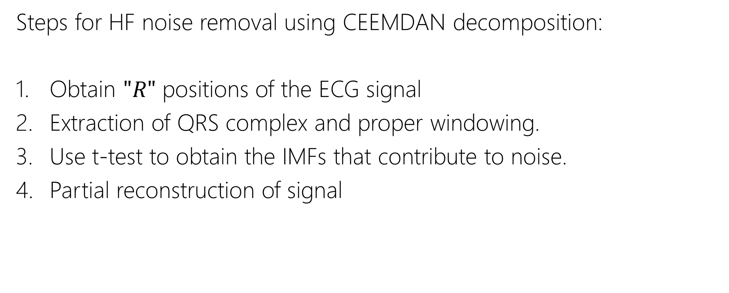
High Frequency Noise Removal (Blanco-Velasco, et al., ECG signal denoising and baseline wander correction based on the empirical mode decomposition, 2008)
Steps for HF noise removal using CEEMDAN decomposition:
Obtain $"R"$ positions of the ECG signal
Extraction of QRS complex and proper windowing.
Use t-test to obtain the IMFs that contribute to noise.
Partial reconstruction of signal

Slide 19
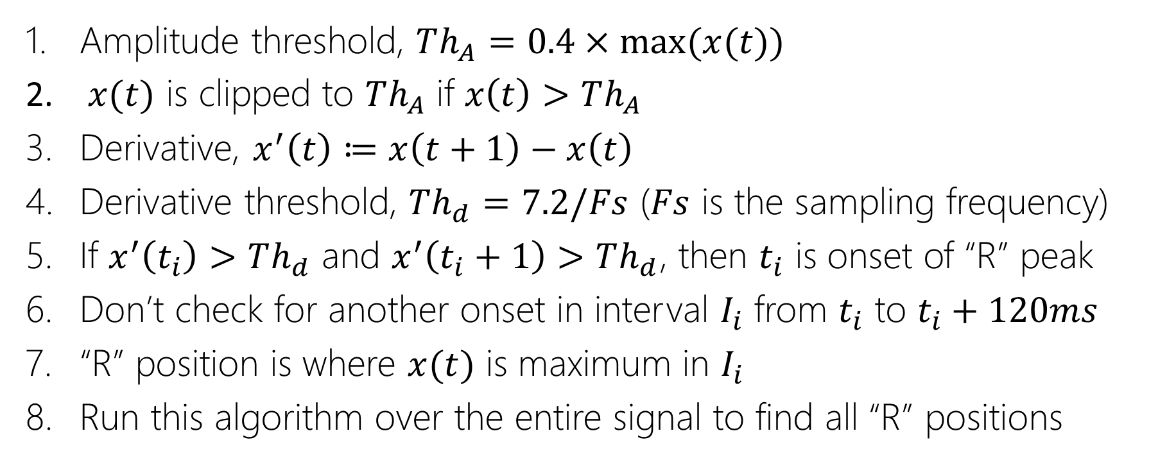
Obtaining “R” Positions
Amplitude threshold, $Th_{A}=0.4×\max{(x(t))}$
$x(t)$ is clipped to $Th_{A}$ if $x\left(t\right)>Th_{A}$
Derivative, $x^{′}\left(t\right)≔x\left(t+1\right)−x\left(t\right)$
Derivative threshold, $Th_{d}=7.2/Fs$ ($Fs$ is the sampling frequency)
If $x^{′}\left(t_{i}\right)>Th_{d}$ and $x^{′}\left(t_{i}+1\right)>Th_{d}$, then $t_{i}$ is onset of “R” peak
Don’t check for another onset in interval $I_{i}$ from $t_{i}$ to $t_{i}+120ms$
“R” position is where $x(t)$ is maximum in $I_{i}$
Run this algorithm over the entire signal to find all “R” positions

Slide 20
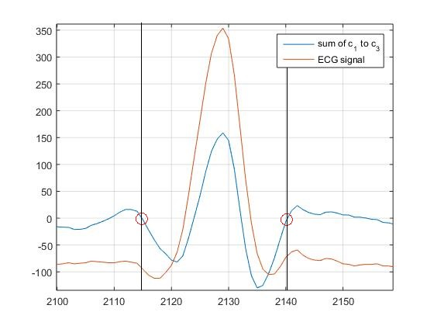
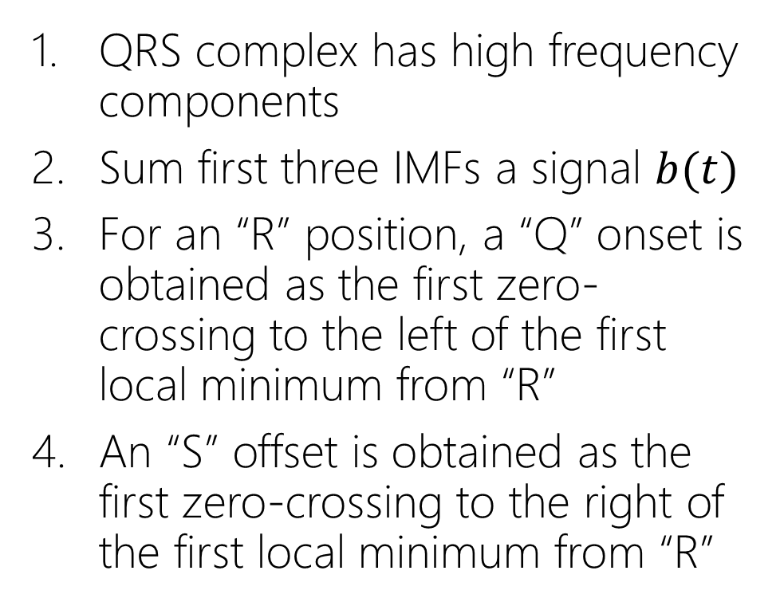
Extraction of QRS Complex
QRS complex has high frequency components
Sum first three IMFs a signal $b(t)$
For an “R” position, a “Q” onset is obtained as the first zero-crossing to the left of the first local minimum from “R”
An “S” offset is obtained as the first zero-crossing to the right of the first local minimum from “R”
Fig.5. Extraction of QRS complex. Red circles show the onset of Q (left) and offset of S (right).

Slide 21
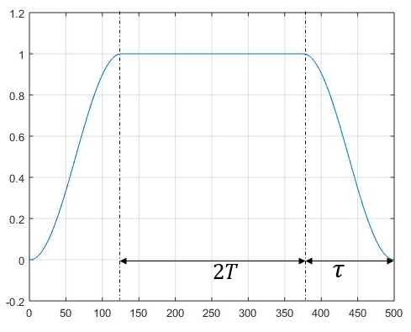
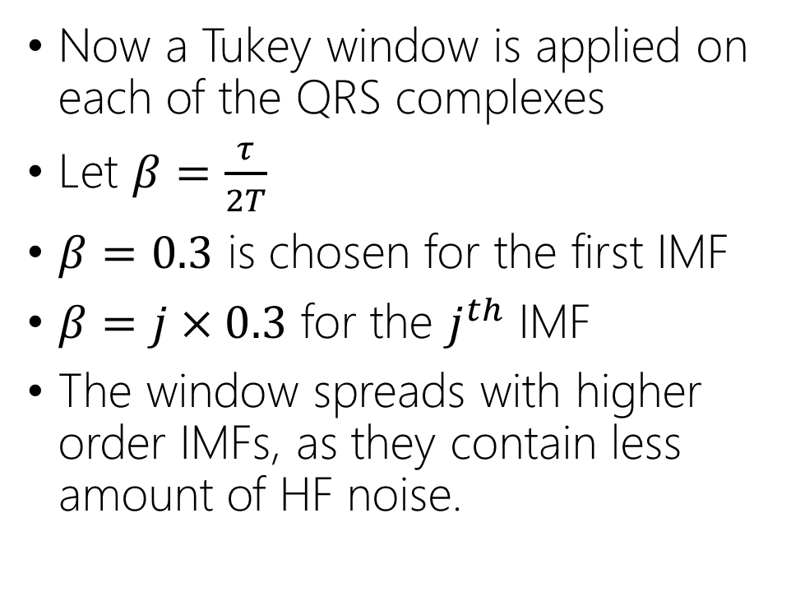
Extraction of QRS Complex
Now a Tukey window is applied on each of the QRS complexes
Let $β=\frac{τ}{2T}$
$β=0.3$ is chosen for the first IMF
$β=j×0.3$ for the $j^{th}$ IMF
The window spreads with higher order IMFs, as they contain less amount of HF noise.
Fig.6. Tukey window

Slide 22
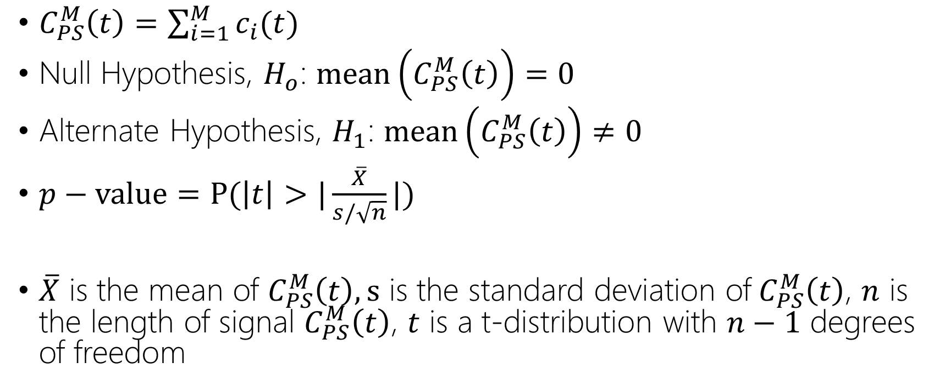
IMF Order using t-test
$C_{PS}^{M}\left(t\right)=\sum_{i=1}^{M}{c_{i}(t)}$
Null Hypothesis, $H_{o}$: $mean\left(C_{PS}^{M}\left(t\right)\right)=0$
Alternate Hypothesis, $H_{1}$: $mean\left(C_{PS}^{M}\left(t\right)\right)≠0$
$p−value=P(\left|t\right|>|\frac{\overline{X}}{s/\sqrt{n}}|)$
$\overline{X}$ is the mean of $C_{PS}^{M}\left(t\right), s$ is the standard deviation of$C_{PS}^{M}\left(t\right)$, $n$ is the length of signal $C_{PS}^{M}\left(t\right)$, $t$ is a t-distribution with $n−1$ degrees of freedom

Slide 23

IMF Order using t-test
$p−value<α⇒H_{0}$ is rejected in favour of $H_{1}$
The significance $α$ is chosen appropriately
$P$ is the max IMF number for which $H_{0}$ is not rejected

Slide 24
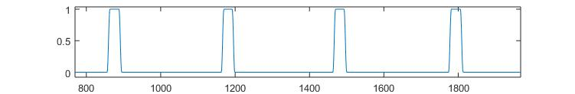
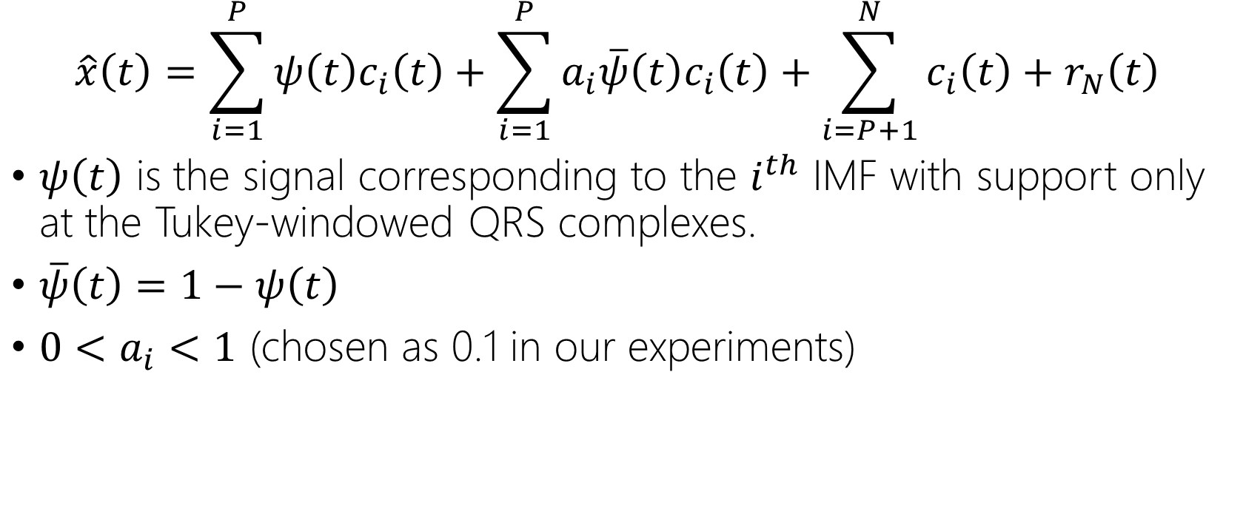
Partial Reconstruction of ECG Signal
$$\hat{x}\left(t\right)=\sum_{i=1}^{P}{ψ\left(t\right)c_{i}\left(t\right)}+\sum_{i=1}^{P}{a_{i}\overline{ψ}\left(t\right)c_{i}\left(t\right)}+\sum_{i=P+1}^{N}{c_{i}\left(t\right)}+r_{N}\left(t\right)$$
$ψ\left(t\right)$ is the signal corresponding to the $i^{th}$ IMF with support only at the Tukey-windowed QRS complexes.
$\overline{ψ}\left(t\right)=1−ψ\left(t\right)$
$0<a_{i}<1$ (chosen as 0.1 in our experiments)

Slide 25
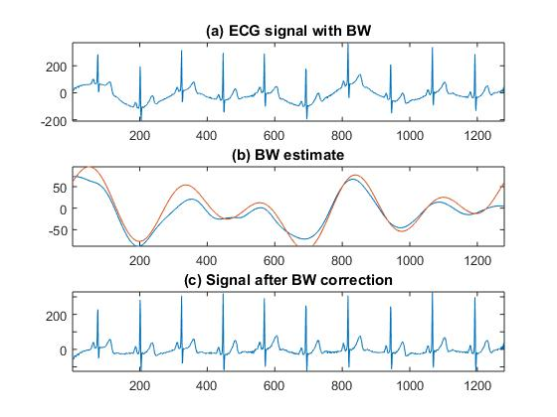
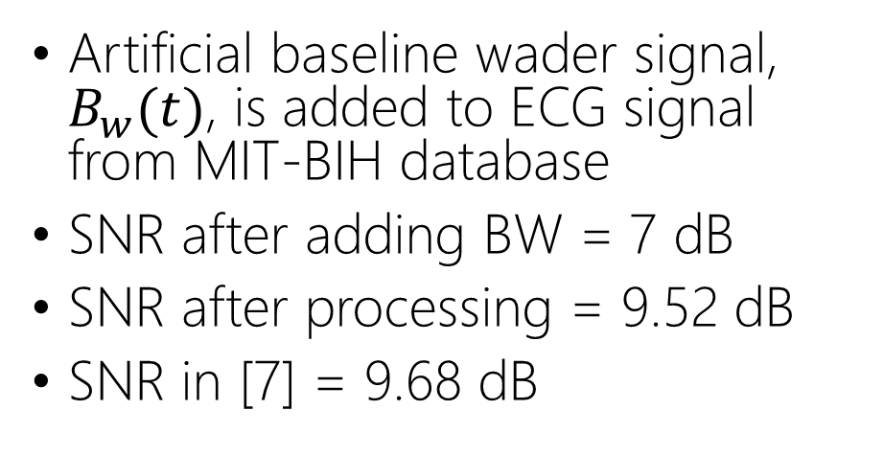

BW Removal Experiments
$$B_{w}(t) = 50sin⁡(t) + 40cos⁡(0.6t) + 20cos⁡(0.2t)$$
Artificial baseline wader signal, $B_{w}(t)$, is added to ECG signal from MIT-BIH database
SNR after adding BW = 7 dB
SNR after processing = 9.52 dB
SNR in [7] = 9.68 dB
Fig.7. BW correction results for the 16272 signal from the MIT-BIH Normal Sinus Rhythm Database. (a) Signal corrupted with BW. (b) The blue plot is the estimated BW and the red plot is actual BW. (c) Signal after BW correction.

Slide 26
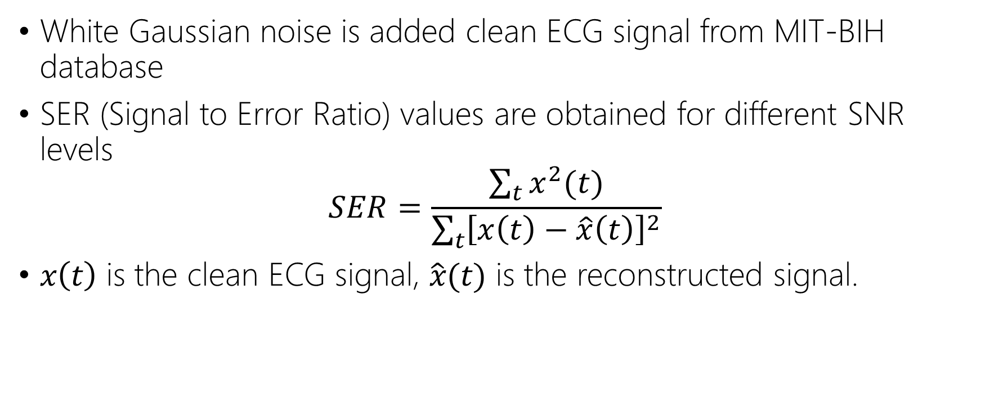
HF Noise Removal Experiments
White Gaussian noise is added clean ECG signal from MIT-BIH database
SER (Signal to Error Ratio) values are obtained for different SNR levels
$$SER=\frac{\sum_{t}{x^{2}(t)}}{\sum_{t}{{\left[x\left(t\right)−\hat{x}\left(t\right)\right]}^{2}}}$$
$x\left(t\right)$ is the clean ECG signal, $\hat{x}(t)$ is the reconstructed signal.

Slide 27
HF Noise Removal Experiments

Slide 28
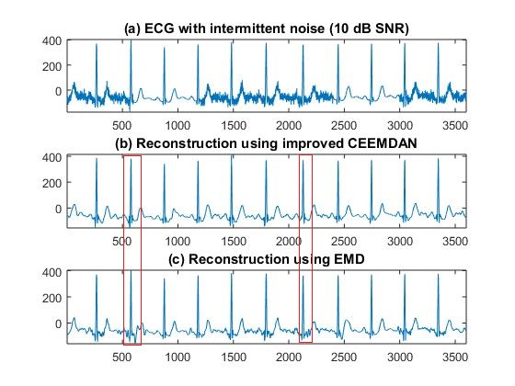
HF Noise Removal Experiments
Fig.8. Comparison of HF noise removal results for EMD method and improved CEEMDAN method for obtaining IMFs. (a) Signal corrupted with intermittent AWGN. (b) Reconstructed signal for CEEMDAN. (c) Reconstructed signal for EMD.

Slide 29
Conclusions
CEEMDAN performs slightly better for intermittent HF noise in our experiments
A lot of parameter tuning is need to achieve good noise removal using CEEMDAN
Best thing about EMD based techniques, is the extraction of the QRS complex (no parameter tuning needed!)
After Extraction of QRS complex, other signal processing techniques can be used for noise/artefact removal

Slide 30
Thank You
References
Friesen, G. M., et al., “A Comparison of the Noise Sensitivity of Nine QRS Detection Algorithms,”IEEE Trans. Biomed. Eng., Vol. 37, No. 1, pp. 85–98, 1990
N.E. Huang, Z. Shen, S.R. Long, M.C. Wu, H.H. Shih, Q. Zheng, N.C. Yen, C.C. Tung, H.H. Liu, The empirical mode decomposition and Hilbert spectrum for nonlinear and nonstationary time series analysis, Proc. R. Soc. London 454 903–995, 1998.
Z. Wu, N.E. Huang, Ensemble empirical mode decomposition: a noise-assisted data analysis method, Adv. Adapt. Data Anal. 1 (1) 1–41, 2009
J.-R. Yeh, J.-S. Shieh, N.E. Huang, Complementary ensemble empirical mode decomposition: a novel noise enhanced data analysis method, Adv. Adap. Data Anal. 2 (02) 135–156, 2010
M.E. Torres, M.A. Colominas, G. Schlotthauer, P. Flandrin, A complete ensem- ble empirical mode decomposition with adaptive noise, in: Proc. 36th IEEE Int. Conf. on Acoust., Speech and Signal Process, Prague, Czech Republic, 2011, pp. 4144–4147, ICASSP 2011
“Improved complete ensemble EMD: A suitable tool for biomedicalsignal processing” M.A. Colominas et al. / Biomedical Signal Processing and Control 14 19–29, 2014
“ECG Baseline Wander Correction Based on En-semble Empirical Mode Decomposition with Com-plementary Adaptive Noise” Journal of Medical Imaging and Health Informatics Vol. 5, 1–4, 2015
Manuel Blanco-Velascoa, Binwei Wengb, Kenneth E. Barnerc "ECG signal denoising and baselinewan-der correction based on the empirical mode decompo-sition", Computers in Biology and Medicine 38 1–13, 2008
“Empirical mode decomposition based ECG enhancement and QRS detection” S. Pal, M. Mitra / Computers in Biology and Medicine 42 83–92, 2012
https://www.physionet.org/cgi-bin/atm/ATM [Available online]

