Slide 1

Final presentation Supervised Research Exposition
Redundancy in cloud systems to efficiently reduce latency
Aditya Mate
Fourth year undergraduate, IIT Bombay (Guide: Dr. Sharayu Moharir)
Department of Electrical Engineering, IIT Bombay

Slide 2
Contents
Background
Introduction and key idea
Scheduling policy analysis
Problem description
Performance metrics
Single Fork Policy analysis
Further additions
Simulations
Implementation results

Slide 3
Executive Summary
Objective
To carry out literature study of current research being carried out by familiarizing with concepts described in relevant research papers.
Scope & process
Papers by quite a few authors were used for reference. Focus was laid on [1] and replication study was carried out by implementing the described algorithm.
Results & Conclusion
Replication results on lines of paper were obtained
[1]- Da Wang, Gauri Joshi and Gregory Wornell, Using Straggler Replication to Reduce Latency in Large-scale Parallel Computing

Slide 4

Introduction
Cloud based systems
Applications: Dropbox, Google
Cloud computing services
Servers given out on rent
Cost = ₹ per server per unit time
Objective
Minimize the waiting time (execution time) for a job while keeping the computational cost in check!

Slide 5
Introduction
Key idea:
Launch multiple copies of every job and wait for the earliest copy to finish. Then terminate the other copies!

Slide 6
Key Idea
Why just 3 copies? Why not 3000?
Latency /Cost trade-off
More the copies of every task, faster will be the server response for that task
But more servers busy, so more will be the computational cost.
Optimal point: What is the best strategy?
Focus of research in this paper!

Slide 7

Problem description
Wait for at least one copy of every task to finish
Job is complete when all tasks finish execution.
Straggling tasks are the bottle-neck
Run all tasks in parallel
Job with large number of small tasks
Straggling tasks (take longer to finish)

Slide 8


Performance metrics
Expected latency Expected time taken for at least one copy of each task of the job to finish
Expected Cost Expected cost is the expected sum of running times of all machines normalized by the number of tasks in the job
JOB: Solve x+2=4
DONE! x=4
t=0
t= T
Latency = T Expected Latency= E[T]
Cost= T1+ T2+T3+T4
T1
T2
T3
T4

Slide 9

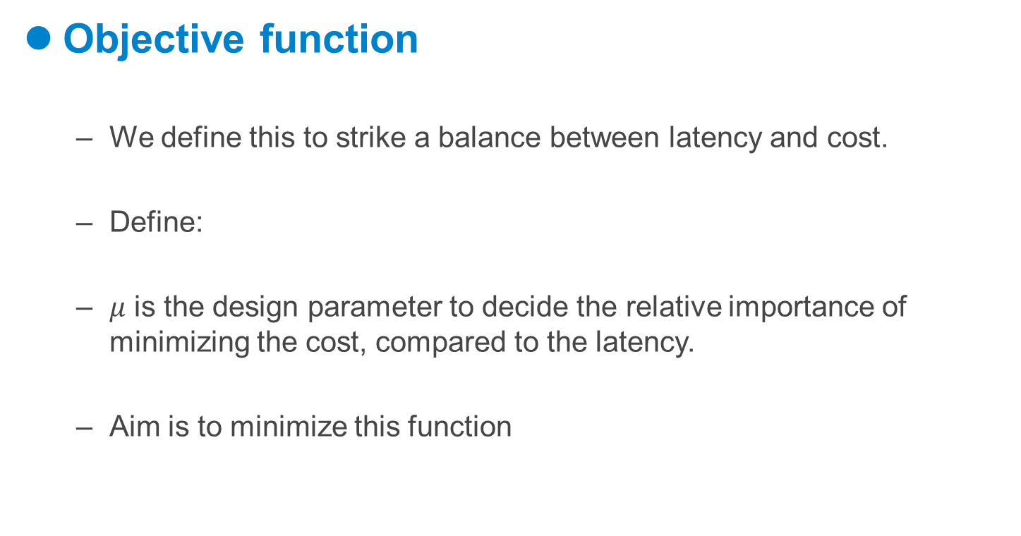
Performance metrics
Objective function
We define this to strike a balance between latency and cost.
Define:
$μ$ is the design parameter to decide the relative importance of minimizing the cost, compared to the latency.
Aim is to minimize this function

Slide 10
Single-Fork Policy
Launch all ‘n’ tasks in parallel at t=0
Assume a fraction, ‘p’ of all the tasks to be ‘straggling tasks’.

Slide 11
Single-Fork Policy
Wait for the earliest n.(1-p) fraction of tasks to finish
Now create ‘r’ new replicas of each straggling task (Here r=1)
The original copy can be killed and re-launched (l=0) OR The original copy may be retained (l=1)

Slide 12
Single-Fork Policy
We now wait for the earliest copy of each straggling task to finish.

Slide 13

Single-Fork Policy Analysis
Expected latency and cost
X (random variable) denotes the service time of a task on a server
Y (random variable) denotes the service time for a straggling task after replication
The policy parameters are: (p, r, l)

Slide 14
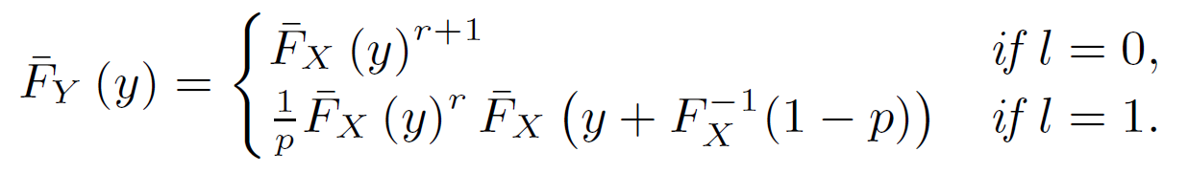

Single-Fork Policy Analysis
Residual straggler execution time
Proof Sketch
For every newly launched replica, will give the distribution
For the original copy, we add the time until the forking point to one of the terms and use same analysis as before, for other ‘r’ terms.

Slide 15
Heuristic algorithm
System model (service time distribution) may not be known in real systems
Generate an estimate
Estimate by experimentally measuring the service time large number of times
Try all combinations of (p,r,l) for estimate
Gradient descent on ‘p’ to minimize the objective function, if it converges

Slide 16
Additional contributions
Experimental simulation setup
Implementation of above algorithm using Python IDE
System model assumed to be Hyper-exponential
Method developed to estimate the best forking policy
Dependence of p on hyper-exponential parameter (q)
Intuitive guess: p = q? Why?
3D graphs to investigate the dependence

Slide 17
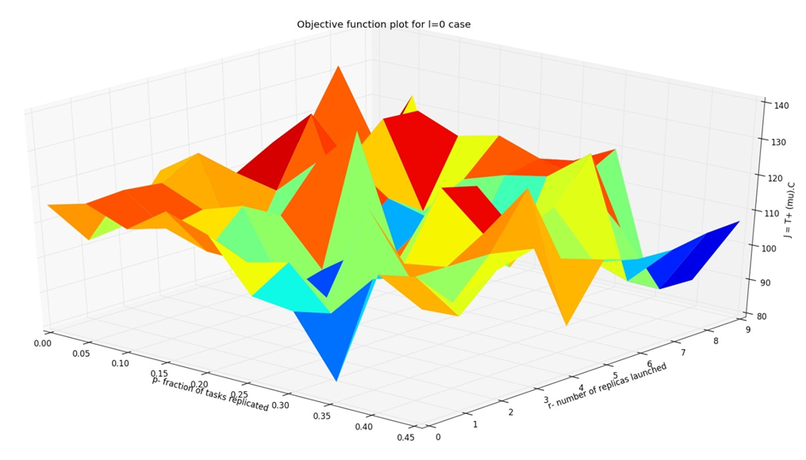
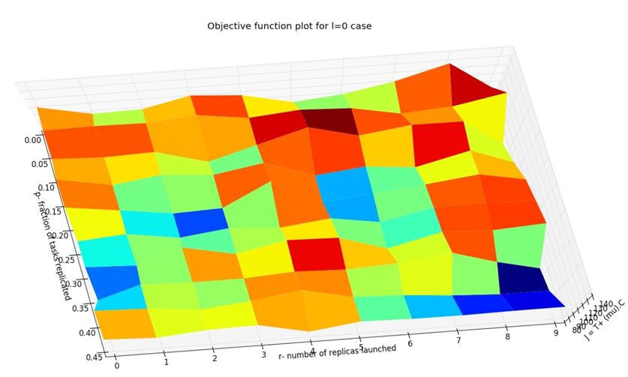
3D Plots
Figure 1. 3D plot of objective function against p-axis and r-axis with l=0 (i.e. termination of original copy of straggling task). Warmer colours indicate
higher value of objective function. We choose the blue point, with the lowest
value of objective function
3D plot of objective function for l = 0 case when viewed from top.

Slide 18
Conclusions and Discussion
Scheduling policy to efficiently introduce redundancy to reduce latency is described
Analytical expression for cost/latency under this scheduling policy is analyzed
Heuristic algorithm to implement this policy even in real scenarios is described
Replication study of algorithm carried out

Slide 19
THANK YOU!!
Dr. Sharayu Moharir, Supervisor
All friends, for immense support!

