Slide 1

FYP1 Presentation
Elderly-Friendly AI-Based Travel Recommendation Chatbot in Malaysia
JomVoyage
Presented By:
Supervisor:
Chum Dao Shen (2302347)
Dr. Zurida binti Ishak

Slide 2
Problem Statement
Information is scattered
  Malaysian attraction information is distributed across tourism websites, maps, blogs and social media.
  Travellers must manually compare location, cost, activities, visit duration and accessibility.
  This can create information overload, especially when planning for an elderly traveller.
Accessibility information is incomplete
  General tourism pages usually promote scenery and activities.
  Important details such as walking difficulty, step-free access, seating, accessible toilets, parking and shelter are not always provided.
  A place may be described as suitable without explaining why it is suitable.
  Treating missing information as available could produce an inappropriate recommendation.
Existing interfaces may be difficult for older users
  Small text, weak contrast, long result lists and complicated filters can make travel planning harder.
  Users may need to move between several pages to compare destinations.
  Conventional search systems may not remember preferences expressed during a conversation.

Slide 3
Motivation
Why this project matters:
Malaysia has an ageing population.
Older travellers have different mobility and accessibility requirements.
They need a simpler way to compare destinations.
Unknown accessibility information should not be presented as confirmed.

Slide 4
Objectives
Develop an accessible travel recommendation chatbot for Malaysian attractions.
Use NLP to recognise intentions, extract preferences and support multi-turn conversations.
Build and evaluate an explainable retrieval system using tourism and reviewed accessibility data.
Scope
  13 Malaysian states and three federal territories
  430 general attractions
  66 attractions with reviewed elderly-accessibility information
  English, Malay and Simplified Chinese controlled input
  Web prototype rather than a booking or medical-assessment system

Slide 5
Literature Review
The literature shaped four requirements for an elderly-oriented travel chatbot
Accessible interaction
Relevant recommendations
Conversation context
Grounded explanations
Readable text, sufficient contrast, large controls and predictable navigation reduce common barriers.
Knowledge-based filters suit a new system because travellers can state clear constraints.
The chatbot must collect preferences gradually, remember them and support later changes.
Accessibility claims should use stored evidence. Unknown details stay visible.

Slide 6
Existing elderly-oriented conversational products
The reviewed products contributed interaction ideas, but they addressed different services
System | Primary purpose | Useful idea | Difference from JomVoyage
Meela Rides | Telephone-based transport booking | Low setup effort and accessibility preferences | Focuses on transportation
ElliQ | AI companionship and daily support | Voice, large text and remembered preferences | Requires dedicated hardware
SeniorTalk | Familiar voice and text channels | Speech support and adjustable presentation | Does not provide a curated Malaysian catalogue
JomVoyage | Malaysian attraction recommendation | Guided chat, visible preferences and grounded explanations | Focuses on tourism and recorded accessibility evidence

Slide 7
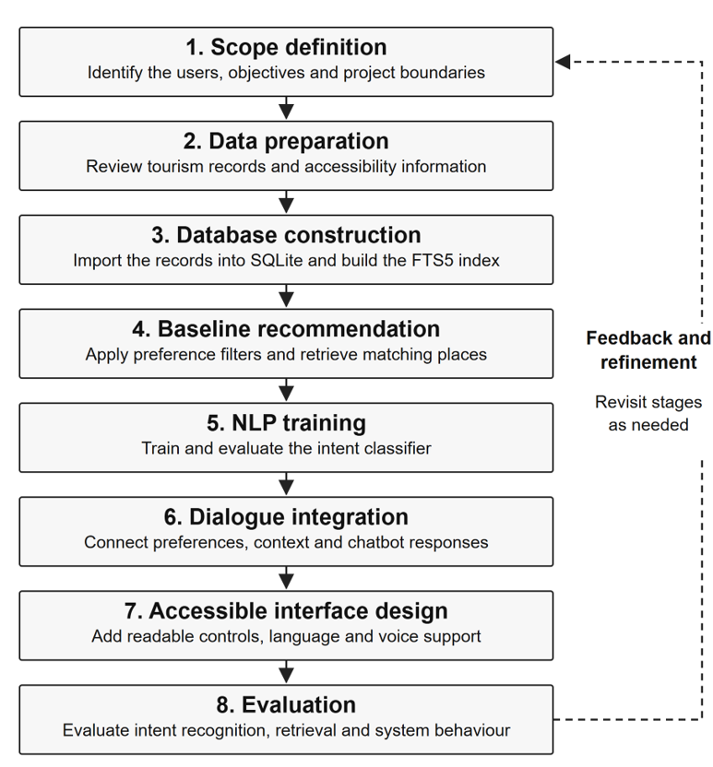
Proposed development method

Slide 8
System architecture design
Traveller
Web interface
Flask service
NLP and dialogue
Types text, uses speech input or selects a quick answer
Provides accessible controls and recommendation cards
Validates requests and manage sessions and API endpoints
Handles intents, entities, context, clarification, and correction
Displayed reply
Grounded response
SQLite knowledge base
Hybrid retrieval
Shows the conversation, images, read-aloud audio and refinements
Builds recommendation reasons, limitations, sources, and speech
Stores 430 attractions, 66 reviewed accessibility records and 43 attributes
Combines structured filters, FTS5, and adaptive semantic ranking

Slide 9
NLP and recommendation process
A controlled pipeline turns a message into an evidence-based reply
01
02
03
04
05
06
User message
Understand
Keep context
Filter
Rank
Respond
Typed, spoken or selected
Normalise language and detect intent
Extract and update preferences
Apply state, cost and accessibility needs
FTS5 and adaptive semantic comparison
Grounded cards and explanations
AI components
Trained spaCy intent classifier
Preference extraction rules
Approximate name correction
Semantic similarity ranking
Structured filters control the final candidate set. Semantic ranking cannot ignore required travel preferences.
Notes:
The trained spaCy model identifies the user’s intent. Rules extract travel preferences and approximate matching helps with likely speech recognition errors. The retrieval stage first applies structured conditions such as state and accessibility. FTS5 ranks keyword matches, while semantic similarity helps when the wording differs. The stored constraints remain in control.
Source: FYP1 report, Sections 3.3 and 3.3.1.

Slide 10
Dataset preparation
430
General attraction catalogue | Reviewed accessibility layer
Name, state and district | Walking difficulty
Category, cost and duration | Step-free and wheelchair access
Tags and descriptions | Seats, toilets, parking and shelter
Images and tourism information | Suitability reason, limitations and evidence links
general attractions
13 states and 3 federal territories
66
reviewed accessibility entries
Used for elderly and mobility-focused requests
Notes:
The general catalogue provides broad tourism coverage through 430 attractions. A separate reviewed layer contains 66 attractions with recorded elderly-accessibility details. General searches can use the whole catalogue. Requests involving elderly travellers, wheelchair access or easier mobility use the reviewed layer. The system keeps unknown values as not recorded instead of treating them as available.
Source: FYP1 report, Sections 3.2, 3.4 and 4.1.

Slide 11
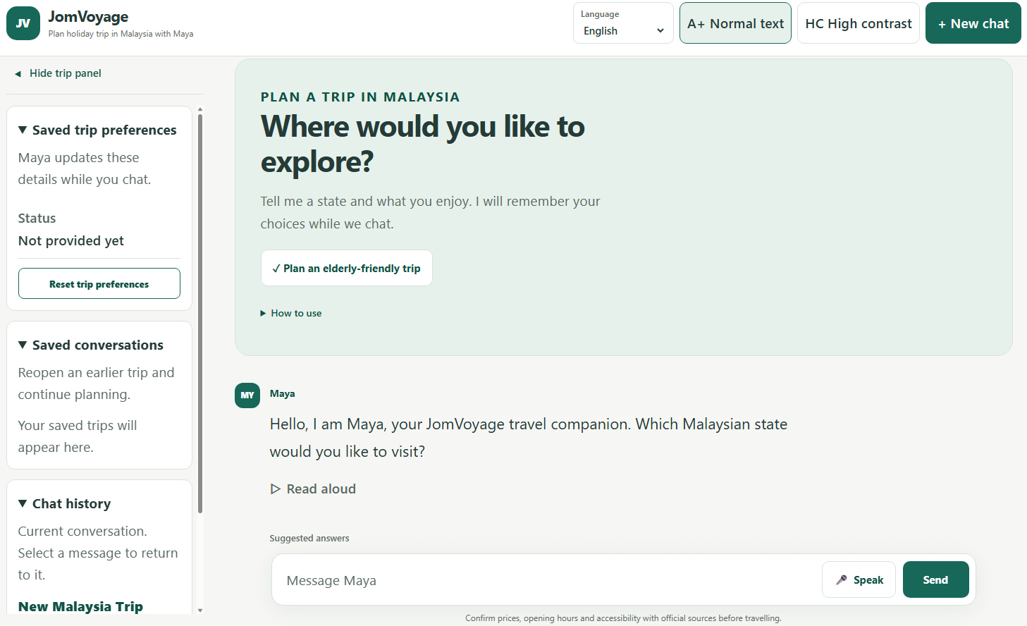
Key features
Guided conversation
Maya collects preferences gradually, remembers changes and asks when important details are missing.
Accessible interaction
The interface provides larger text, high contrast, speech input, read-aloud audio and large controls.
Continued planning
Users can save chats, request more options and clarify similar attraction names.
English, Malay and Simplified Chinese modes use controlled phrase support.
Notes:
The main interface features support a guided trip-planning conversation. Maya remembers the current preferences and lets the user change them. The interface provides larger text, high contrast, speech input and generated read-aloud audio. Users can also save conversations and request additional options without losing earlier cards. Malay and Simplified Chinese support uses a controlled phrase vocabulary rather than unrestricted conversation.
Source: FYP1 report, Sections 3.3.4 and 4.2.

Slide 12
Current limitations
01
Accessibility coverage
Only 66 attractions have reviewed accessibility information.
02
Multilingual input
Malay and Chinese support uses controlled phrases.
03
Speech recognition
Accuracy depends on the speaking conditions.
04
User evaluation
Formal testing with elderly participants has not yet been completed.
The system recommends attractions. It does not provide bookings or medical assessments.
Notes:
The current prototype has four main limitations. Accessibility evidence covers only 66 attractions. Malay and Chinese input follows a controlled vocabulary. Speech recognition quality depends on the device and browser. The project has not yet conducted formal usability testing with elderly participants. The system also provides travel recommendations only. It does not perform booking or medical assessment.
Source: FYP1 report, Sections 1.3 and 5.2.

Slide 13
FYP2 Plan
Priorities
01
Expand and review accessibility evidence
02
Test the system with elderly users using tasks, observations and SUS
03
Improve the interface, dialogue and language support based on findings
04
Complete the final evaluation and consider a mobile prototype after the workflow is stable
Notes:
FYP2 will focus on evidence coverage and evaluation with the intended users. I plan to expand the reviewed accessibility records, conduct task-based sessions with elderly participants and collect a System Usability Scale score. Their observations will guide improvements to the dialogue and interface. The final phase will repeat the technical evaluation and complete the report. A mobile prototype remains optional until the web workflow is stable.
Source: FYP1 report, Sections 1.4 and 5.2, and the project Gantt chart.

Slide 14
Conclusion
JomVoyage
Guided conversation
The chatbot reduces the effort needed to express and change travel preferences.
A local and explainable travel recommendation chatbot for elderly-oriented trip discovery in Malaysia
Evidence-based retrieval
Attraction and accessibility statements remain tied to stored records and visible limitations.
Next priority
FYP2 will evaluate the prototype with elderly users and improve it using their feedback.
Notes:
JomVoyage demonstrates that an AI-based travel chatbot can use a trained intent classifier, preference extraction and controlled retrieval without relying on an unrestricted large language model. The prototype already supports guided planning and evidence-based accessibility explanations. The next priority is to evaluate whether elderly users can complete planning tasks comfortably and understand the results.
Source: FYP1 report, Chapter 5.

Slide 15
Q&A
Thank you
JomVoyage
Elderly-Friendly AI-Based Travel Recommendation Chatbot in Malaysia
Notes:
Thank you. I am ready for your questions.

