Slide 2
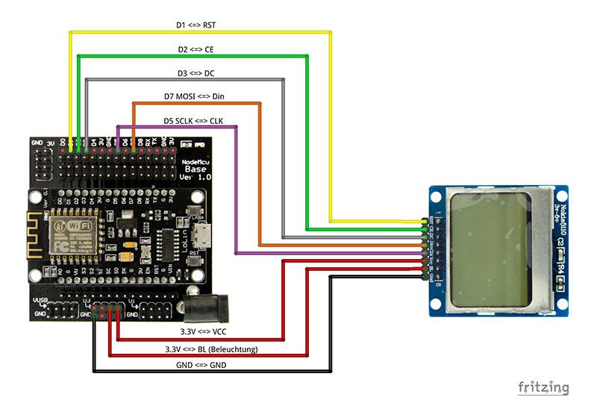

Slide 3
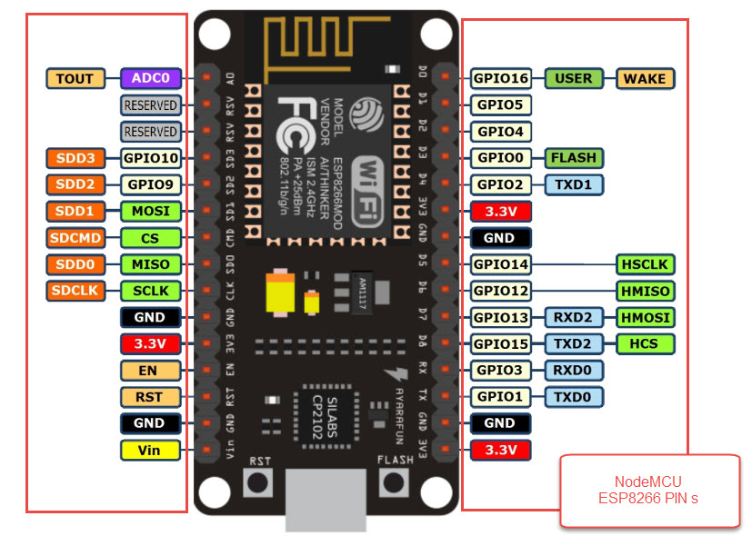

Slide 4
Treiber
https://github.com/olikraus/u8g2/wiki

