Slide 1
Week 1: Correlation-Based Clustering & Mean-Reversion Strategy
Heiley Wong

Slide 2
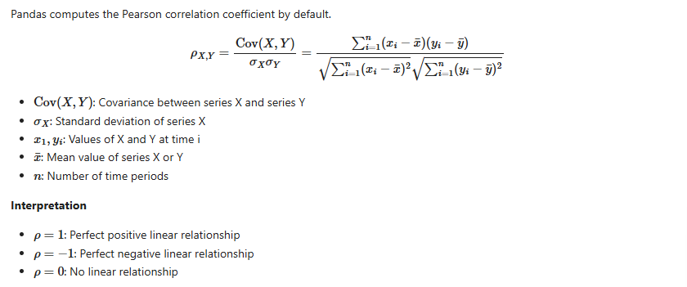
Subtask A: Correlation Metrics

Slide 3
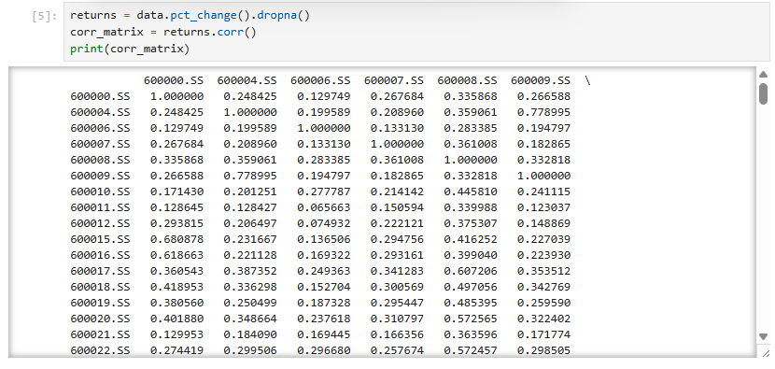
Result

Slide 4
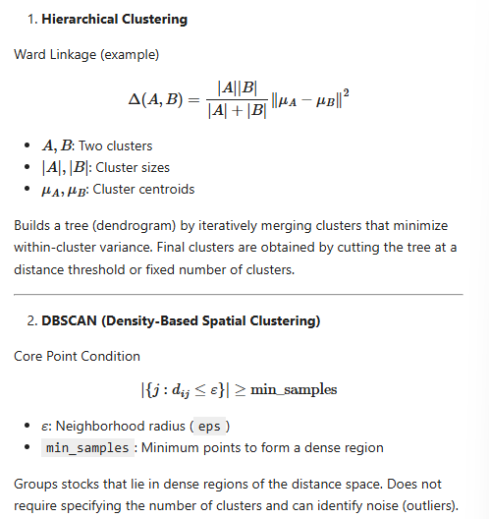
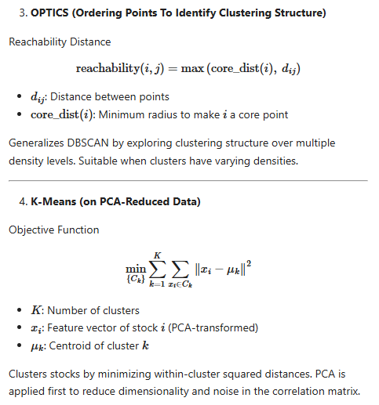
Subtask B: Clustering Model
Comparison of clustering methods

Slide 5
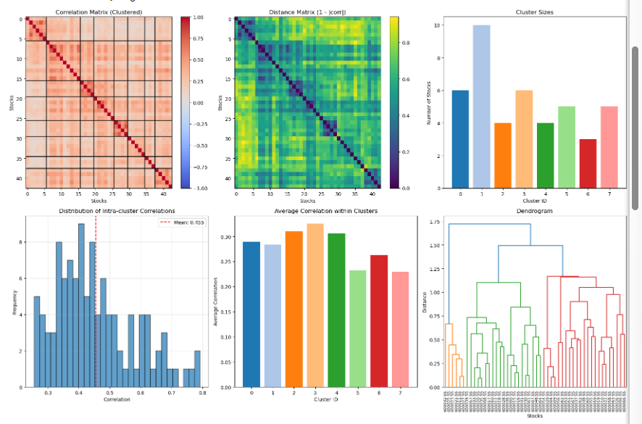
Clustering of 50 stocks
Clustering Performance Metrics:
Number of clusters: 8
Silhouette Score: 0.235
Calinski-Harabasz Score: 9.5

Slide 6
Subtask C: Mean-Reversion Strategy
Approach
Highly correlated stocks tend to revert to group mean
Temporary deviations create trading opportunities
Trade relative value instead of market direction
Market-neutral by construction
Assumptions
Stocks within a cluster are assumed to maintain similar behavior over time, so historical correlations remain valid.
Deviations of a stock from its cluster mean are temporary and expected to revert toward zero.
Liquidity and Tradability: All stocks can be traded daily with minimal slippage and transaction costs.

Slide 7
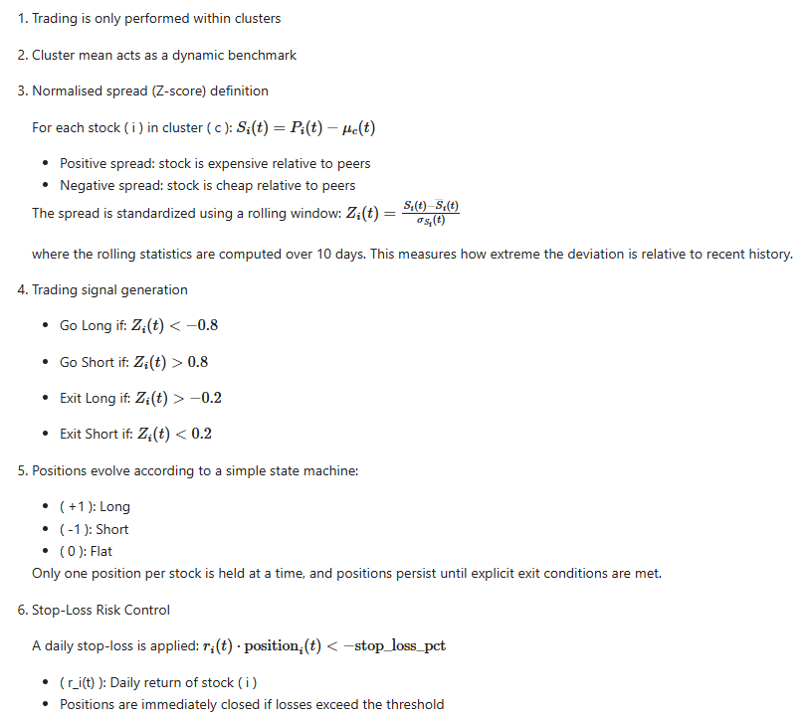
Detailed strategy

Slide 8
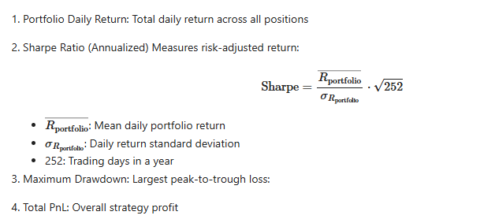
Subtask D: Backtesting Method
Performance metrics

Slide 9
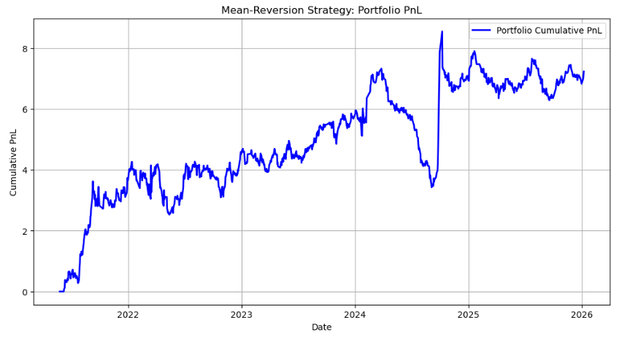
Result
Number of stocks traded: 43
Total Portfolio PnL: 7.2352
Annualized Sharpe Ratio: 0.7118
Max Drawdown: -3.9004

Slide 10
Summary
Positive PnL indicates successful mean-reversion capture
Further improvements: back testing on larger sets of data, risk scaling, costs, neutrality

Slide 11
Thank You!

