Slide 1

Construction of a question-answering system for stock knowledge graph.
zmg组

Slide 2
1
Project Introduction
2
Overview of the Requirements
Layer
3
Overview of the
Model Layer
Contents
目录
4
Overview of the
Application Layer
5
Summary and Outlook

Slide 3
PART 01
Project introduction

Slide 4
Project Introduction
Stage 1
Construction of Financial Knowledge Graph for Wencai Website Data
Project Content
Stage 2
Construction of an Automatic Question and Answer System for Financial Knowledge Graph

Slide 5
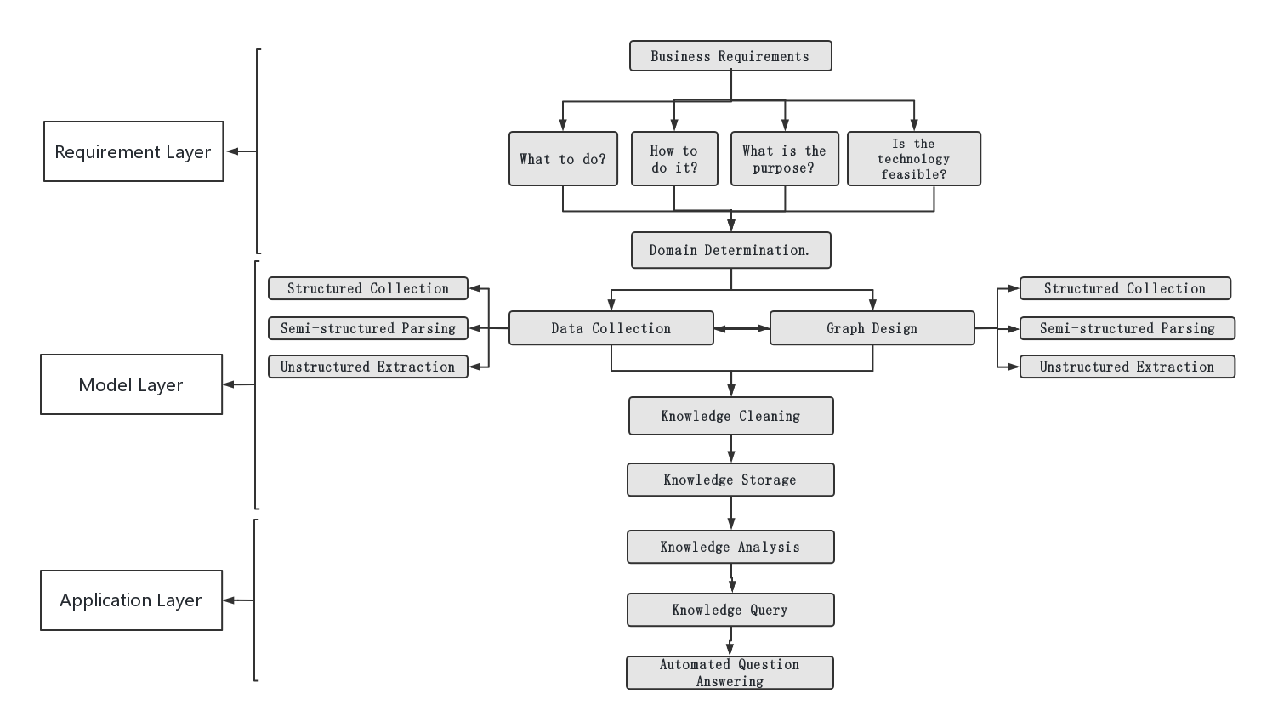
A business-driven knowledge graph building framework

Slide 6
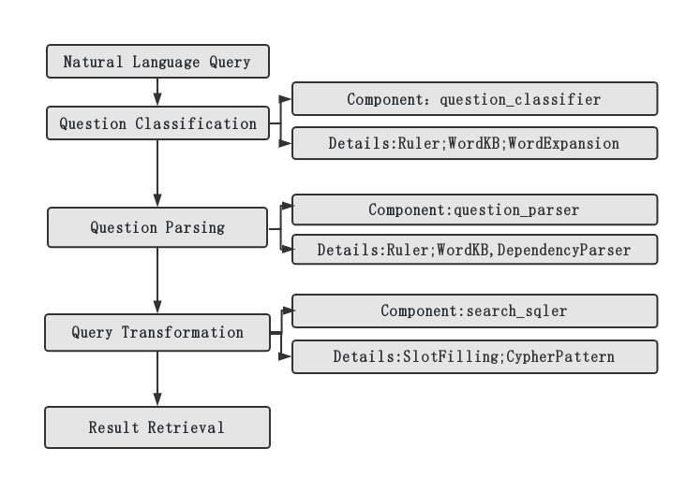
A question and answer framework based on a knowledge graph

Slide 7
PART 02
Overview of the requirements layer

Slide 8
Requirement Layer - Why Create a Stock Knowledge Graph
The stock knowledge graph is an important tool in the financial field today, providing investors and decision-makers with an opportunity to gain a deeper understanding of the stock market. Here are a few reasons why we need to do a stock knowledge graph:
1
Identify potential
opportunities
2
Innovation and Development
3
Addressing complexity
The stock knowledge graph can also help us identify potential opportunities and risks in the market. By analyzing the stock knowledge graph, we can discover the correlation and correlation between stocks, and identify potential opportunities and trends in the market. At the same time, the stock knowledge graph can also help us identify potential risks and uncertainties, thereby better avoiding risks and protecting the interests of investors.
The establishment of a stock knowledge graph can also promote innovation and development in the financial field. Through the research and application of stock knowledge graphs, we can discover new investment strategies and models, improving investment efficiency and returns. At the same time, the stock knowledge graph can also provide important data foundation and support for the development of financial technology and artificial intelligence, promoting innovation and progress in the financial field.
The stock knowledge graph can help us better understand the complexity of the stock market. The stock market is a large and complex system that includes a large number of stocks, companies, and investors. By constructing a stock knowledge graph, we can integrate these complex relationships and information to form an intuitive and visual network structure, thereby better understanding the interrelationships between various factors in the market.

Slide 9
Requirement Layer - How to Construct a Stock Knowledge Graph
1
2
3
Collect and organize data
Establishing entities and relationships
Constructing a hierarchical structure of knowledge graph
Collect data related to the stock market, including basic information on stocks, company financial data, market situation data, etc. Data can be obtained from financial data suppliers, financial websites, company reports, and other channels, and organized and cleaned to ensure the accuracy and completeness of the data.
Based on the collected data, determine the entities and relationships of the stock knowledge graph. Entities can include stocks, companies, investors, etc. Relationships can include the relationship between stocks and companies, as well as the holding relationship between investors and stocks. Use a graph database, such as Neo4j, to establish connections between entities and relationships.
Organize and classify entities and relationships based on the hierarchical structure of the stock market. The hierarchical structure of the knowledge graph can be organized according to different dimensions such as market, industry, and company, making it clearer and easier to understand.
4
5
Conduct correlation analysis and inference
Updated and improved
Utilize the correlation and structural characteristics of the knowledge graph to conduct correlation analysis and inference. Discover the patterns and patterns of association between entities, predict market trends and risks. At the same time, reasoning and inference can also be used to fill in the gaps and incompleteness of data, improving the accuracy and completeness of the knowledge graph.
The stock market is a dynamically changing system, so the stock knowledge graph also needs to be constantly updated and improved. Timely update data, track market changes, and maintain real-time and accurate knowledge graphs.

Slide 10
Requirement Layer - Technical Feasibility Analysis
Knowledge graph modeling technology: The development of knowledge graph modeling tools and graph databases has made constructing knowledge graphs more convenient and efficient. Tools such as Neo4j and Prot é g é provide friendly interfaces and functions, supporting the establishment, querying, and inference of entities and relationships.
At present, financial data providers, financial websites, and company reports provide rich stock market data. At the same time, the technology of data cleaning and organization is relatively mature, and the accuracy and completeness of data can be ensured through the process of data cleaning and preprocessing
Correlation Analysis and Reasoning Techniques
Through graph algorithms, it is possible to discover the association patterns and patterns between entities, predict market trends and risks
Visualization and interactive display technology
Data collection and organization technology
In summary, from the perspective of technical feasibility, constructing a stock knowledge graph is feasible, which can be achieved through data collection and organization technology, knowledge graph modeling technology, association analysis and inference technology, as well as visualization and interactive display technology. However, attention needs to be paid to challenges and limitations in data quality, professional knowledge, and ongoing maintenance.

Slide 11
PART 03
Overview of Model Layer

Slide 12

Model Layer - Data Collection
Structured collection
Semi structured analysis
Unstructured extraction
Extract organized and formatted data from structured data sources, and generate JSON or CSV files by accessing the Tonghuashun website to obtain the data
Organized and formatted data will be extracted from semi-structured data sources (such as JSON, CSV, etc.) in structured collection.
Extract useful information from unstructured data sources such as text documents, web pages, etc.

Slide 13
Model Layer - Graph Design
Entity Definition
Attribute Definition
Relationship Definition
Entity refers to concrete or abstract things, objects, or concepts in the real world. Entity definitions are used to determine the name, features, and attributes of an entity.
Such as stock size, actual controller type, executives, etc.
Attributes refer to the characteristics or properties that describe an entity. Attribute definition is the process of clearly defining and describing entity attributes. Such as stock type, etc.
Relationships refer to the connections or connections between entities. Relationship definition is the process of clearly defining and describing the relationships between entities. For example, stock market type, stock executive, executive graduation school, etc.

Slide 14
Model layer - data cleaning
Solid disambiguation
Relationship fusion
Knowledge storage
When an entity (such as a person, location, organization, etc.) is mentioned in the text, there may be multiple candidate entities corresponding to it, and the goal of entity disambiguation is to determine the correct entity reference.
It refers to the process of merging and integrating multiple relationship information obtained from different data sources or different relationship extraction methods.
It refers to the process of storing and managing acquired knowledge and information. For subsequent queries, reasoning, and analysis. This article uses Neo4j for knowledge storage

Slide 15
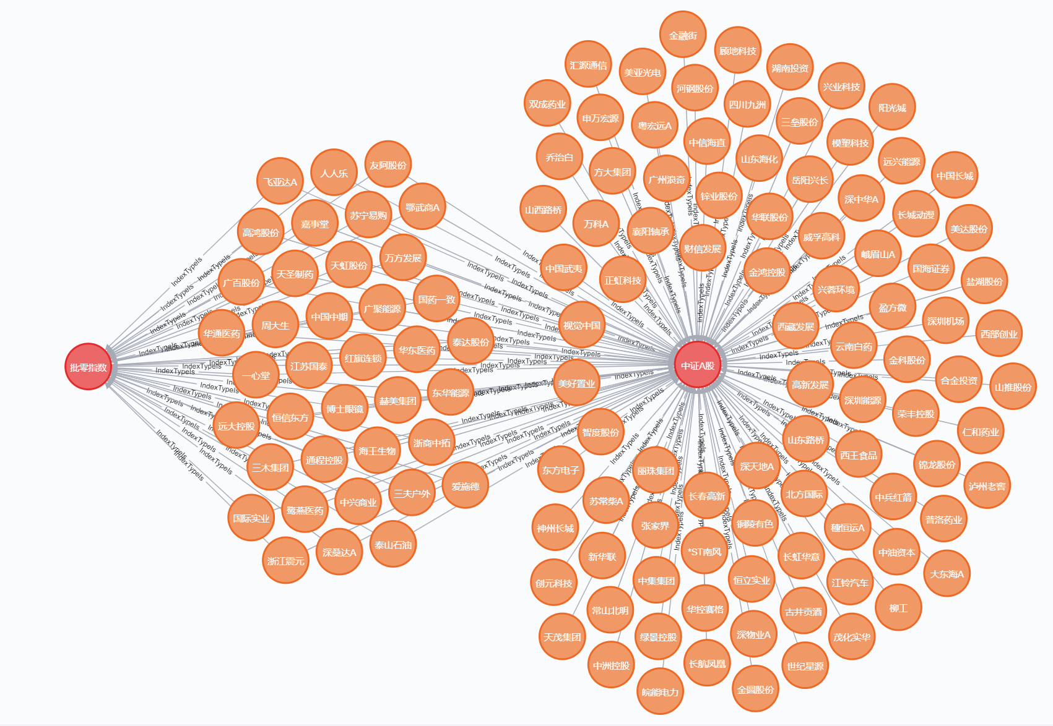
Model layer - effect display

Slide 16
PART 04
Application Layer Overview

Slide 17
Application layer - question classification
Ruler（规则引擎）
RWord Expansion（词扩展
WordKB（词知识库
Word expansion refers to the generation of relevant words or phrases from a given vocabulary or phrase through various methods and techniques. Word expansion can be achieved through synonym substitution, root derivation, etc.
Receive input data and infer, match, or perform related operations based on a pre-defined ruleset.
A word knowledge base is a database or knowledge graph that stores vocabulary and related knowledge. It contains information such as the definition of vocabulary, synonyms, antonyms, part of speech, and semantic relationships.

Slide 18
Application Layer - Question Analysis
Ruler（规则引擎）
Dependency Parser（依存句法分析器）
WordKB（词知识库
Used to analyze the dependency relationships between words in sentences. It determines the dependency relationships between words, as well as their syntactic roles and hierarchical relationships within the sentence by analyzing the grammatical structure of the sentence.
Receive input data and infer, match, or perform related operations based on a pre-defined ruleset
A word knowledge base is a database or knowledge graph that stores vocabulary and related knowledge. It contains information such as the definition of vocabulary, synonyms, antonyms, part of speech, and semantic relationships.

Slide 19
Application layer - query statement conversion
Slot Filling（槽填充）
Cypher Pattern（Cypher模式）
The process of extracting specific information or entities from text and filling them into predefined slots. Slots are predefined data fields used to store specific types of information, such as name, date, location, etc.
Cypher is a query language for the graph database Neo4j. The Cypher pattern is a syntax used to describe and match graph patterns in graph databases. Through the Cypher pattern, nodes, relationships, and constraints between them can be specified to retrieve data that meets a specific pattern from the graph database.

Slide 20
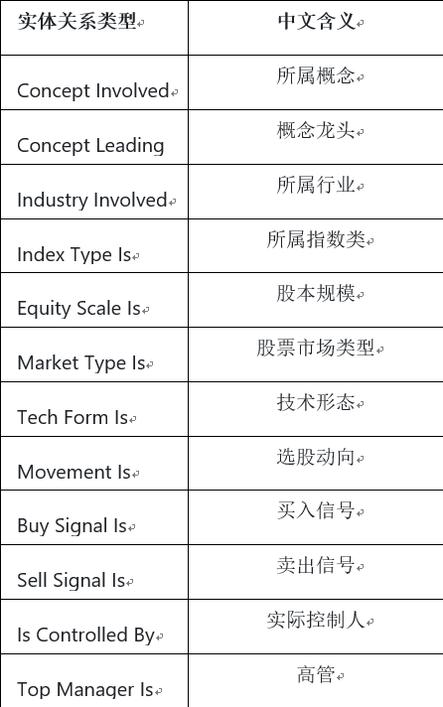
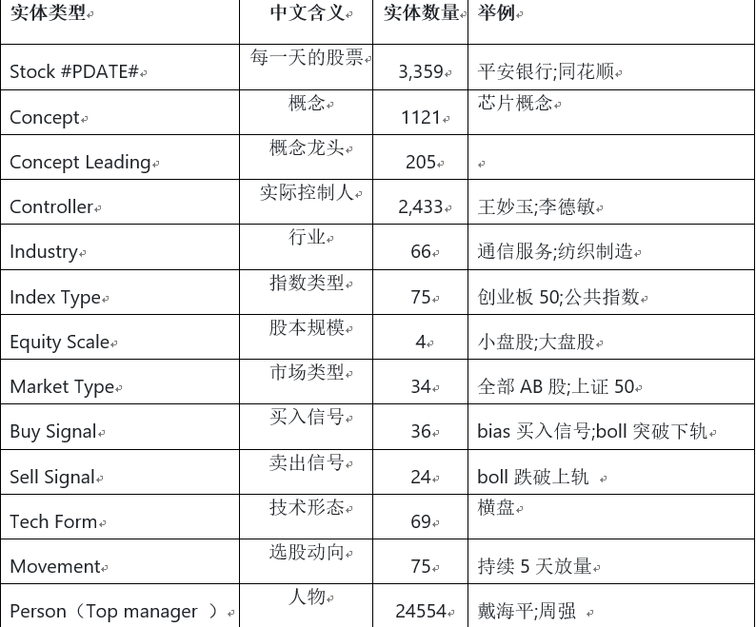
Application layer - return results
Knowledge graph entity type
Type of entity relationship of knowledge graph

Slide 21
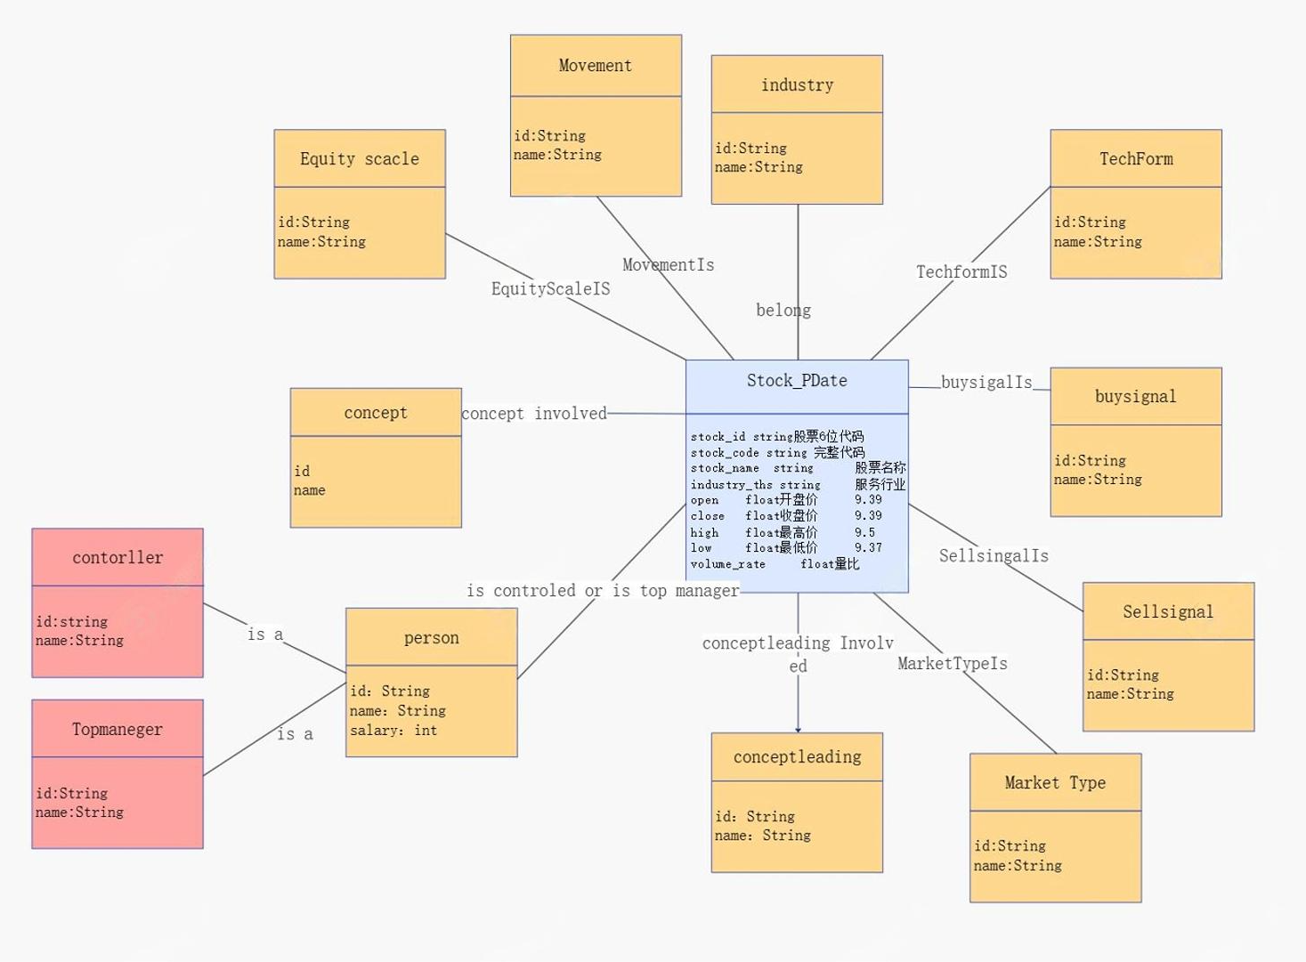
Application layer - return results

Slide 22
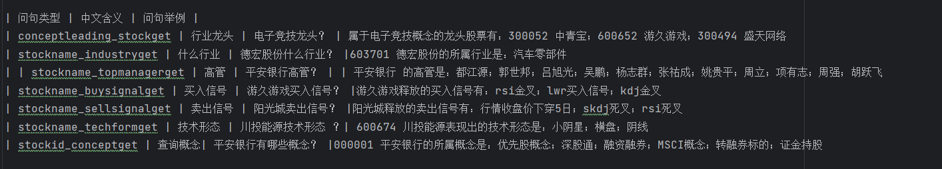
Application layer - return results
In this section, you can ask some questions, and the Q&A system can return answers

Slide 23
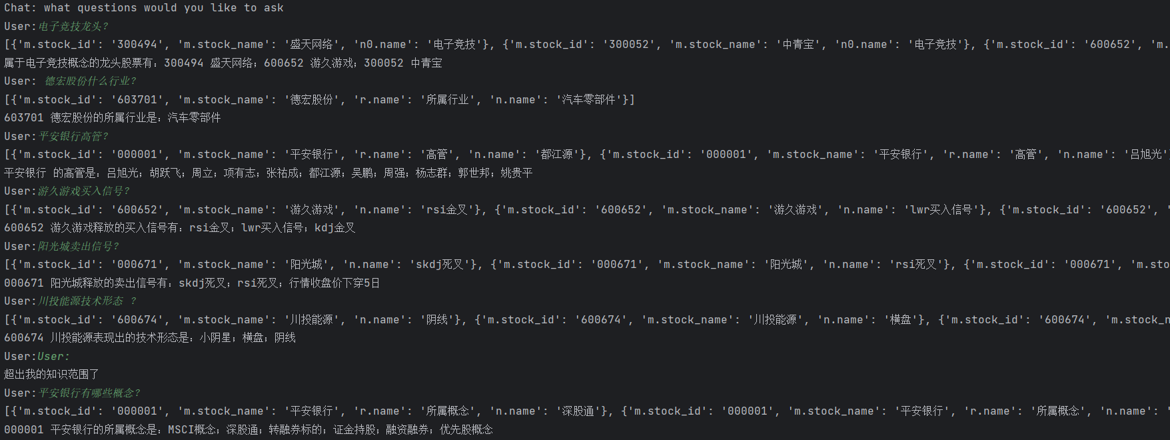
Application layer - return results

Slide 24
PART 05
Summary and Outlook

Slide 25
summary
Knowledge Graph Construction
Q&A system construction
This article introduces how to use knowledge graphs to construct a stock question answering system from a practical perspective. Knowledge graph is a technique that represents entities, attributes, and relationships in a graphical structure, which can help us organize and understand a large amount of stock related knowledge. By constructing a stock knowledge graph, we can structurally represent entities related to stocks (such as companies, industries, indices, etc.), attributes (such as stock prices, market capitalization, financial indicators, etc.), and the relationships between them (such as belonging, owning, related, etc.).
After constructing the stock knowledge graph, we can use a question and answer system to provide answers to stock related questions. The question answering system analyzes the questions raised by users, finds relevant entities and attributes from the knowledge graph, and generates accurate answers. For example, users can ask about the attributes of a certain company, and the system will find the corresponding attribute values for that company and provide answers.
By constructing a stock knowledge graph and Q&A system, we can provide more convenient and accurate tools for stock information query and analysis. Users can directly obtain stock related information that they are interested in through the Q&A system, without the need for tedious search and reading of a large amount of information. At the same time, the structured representation of knowledge graphs provides a better foundation for the analysis and mining of stock data, which can help investors make more informed decisions.

Slide 26
expectation
A new method of Knowledge Graph Attention Network (KGAT) that explicitly models high-order connectivity in KG in an end-to-end manner. It recursively propagates embeddings from nodes' neighbors (which can be users, items, or attributes) to improve node embeddings, and adopts attention mechanisms to distinguish the importance of neighbors.
The success of recommendation systems has made them widely used in web applications, including search engines, e-commerce, social media, and news portals. Almost all services that provide content to users are equipped with recommendation systems. Their weakness lies in modeling each interaction as an independent data instance without considering their relationships. This makes it difficult for them to effectively extract attribute based collaborative signals from the collective behavior of users.
Therefore, we hope to increase attention mechanisms and better construct recommendation systems in future work.

