Slide 1
NFT+Hyperledger Fabric+IPFS

Slide 2
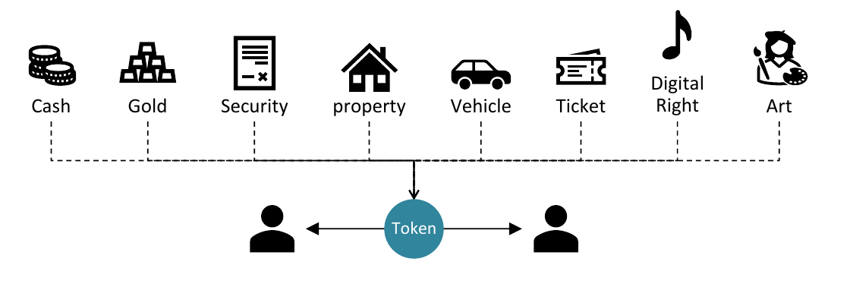
NFT: Non-Fungible Token
What is a Token？
a token represents ownership over digital or physical assets
such as：

Slide 3
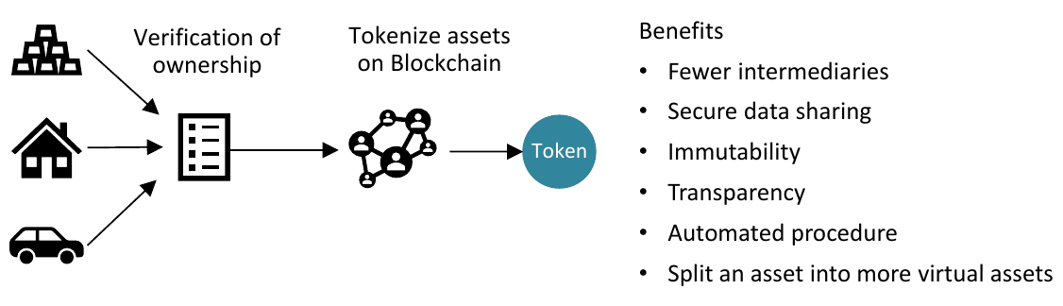
Tokenization on Blockchain

Slide 4
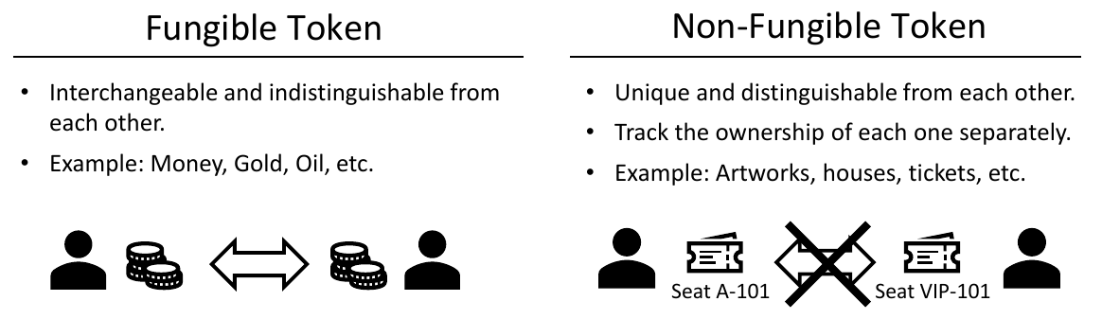
Fungible Token and Non-Fungible Token

Slide 5
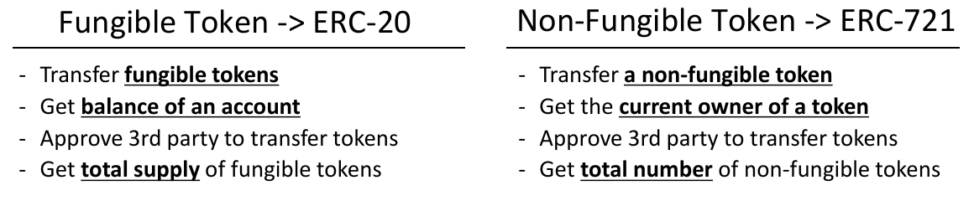
NFT Standard
Standardized Token Specification
NFT now heavily relies on Ethereum

Slide 6
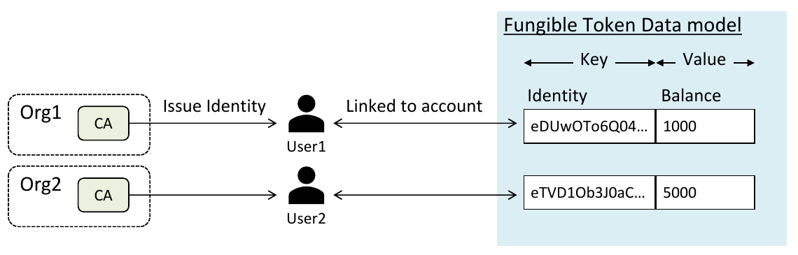
NFT Smart Contract in Hyperledger Fabric
Hyperledger Fabric is suitable for a use case that requires legal identities and clear governance
Identity Management：
User accounts are linked to Client Identities issued by organizations
Each organization has a Certificate Authority to register and enroll users

Slide 7
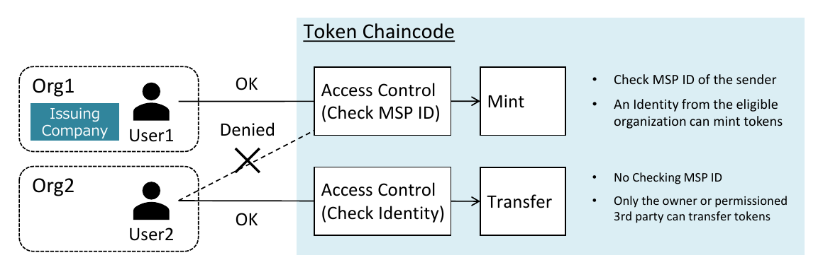
Access Control：
based on MSP ID（organization） or identity
only identities from permitted organizations can issue and redeem tokens
only the owner or permissioned 3rd party can transfer tokens

Slide 8
IPFS for NFT Smart Contract
Why off-chain storage counts?
Expensive on-chain storage: data needs to be processed, verified, and replicated across the entire blockchain network
Need of store each NFT: each NFT is unique, they're owned and traded individually, means store individually
Need of store linked data: NFT has the ability to link data, such as digital collectibles or artwork
Why traditional location-based addressing(store off-chain data in remote server or local storage) aren't a great fit?
Lack of integrity guarantee
an artist changed his NFT images after they were minted and sold
How IPFS helps?
Content-based Addressing
With a content identifier(CID), user can fetch the data from any IPFS node in the network, and verify the data integrity with CID -> Integrity guarantee
Each IPFS node can keep a local copy of data, temporarily or permanently, partially of entirely after fetching -> persistence and avalibility
With multiple nodes stores the requested data, IPFS fetch from closer node or from multiple node at the same time -> throughput

Slide 9
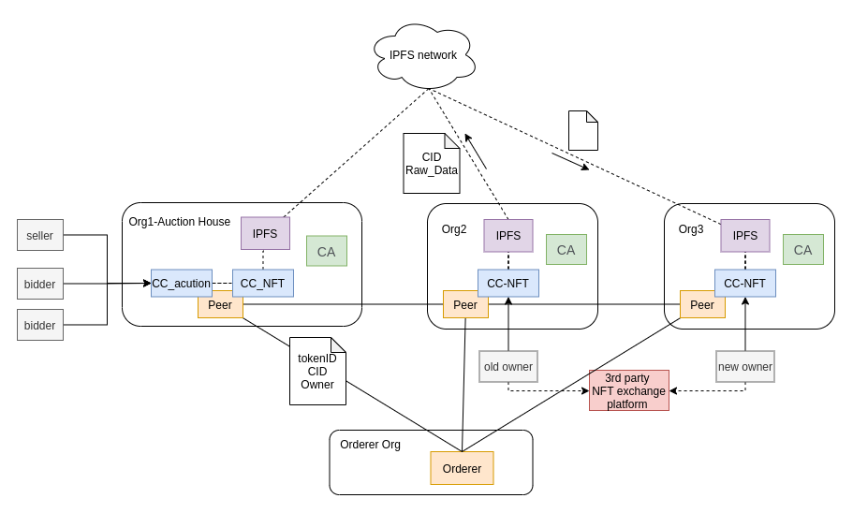
System Architecture

Slide 10
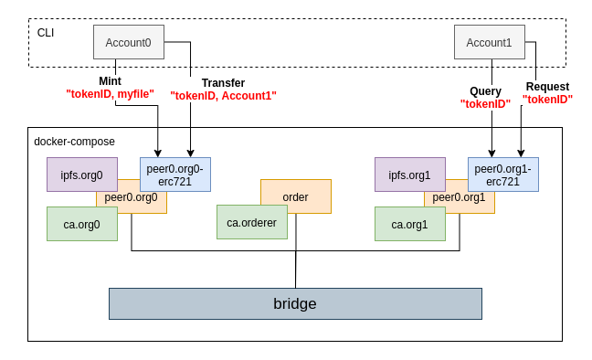
Basic Implementation
Test_Network in Docker-compose:
1 order
2 org，each with 1 peer
3 CA
Chaincode: ERC 721
2 IPFS Node
bridge between all container
Function：
Mint
Transfer
Query
Request
source code: https://github.com/quieoo/nft_fabric_ipfs

Slide 11
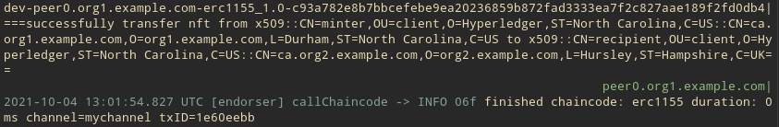
￼

Slide 12
