Slide 1
DATA MINING PROJECT
Cluster Characteristic Profiles
Eurasian Tree Sparrow building and environmental groups
501 training records
K-means k = 5
Seven standardized features

Slide 2
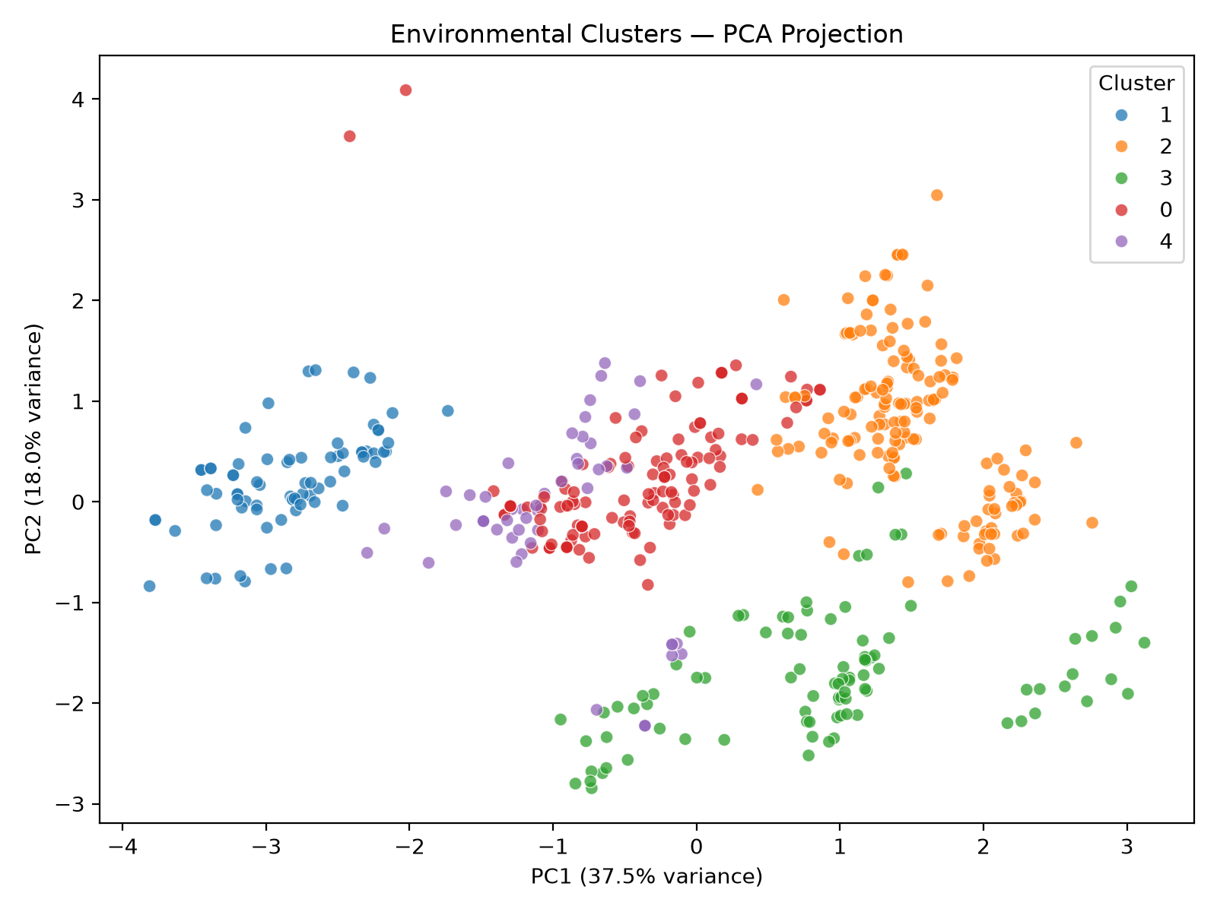
CLUSTER ANALYSIS / 02
How the profiles were formed
K-means input
Building height and width
Altitude and average noise
Temperature, precipitation and wind
Why standardize?
StandardScaler gives every feature equal influence despite different units.
NestCount was excluded from K-means and compared after clustering.

Slide 3
CLUSTER ANALYSIS / 03
Five building and environmental profiles
Cluster profile | Records | Share | Defining characteristics | Mean nests
0 Moderate-altitude, noisy | 125 | 25.0% | Lower buildings, moderate altitude, highest noise and above-average precipitation | 5.31
1 Warm, wet, low-altitude | 76 | 15.2% | Lowest altitude, warmest and wettest conditions, relatively tall and narrow buildings | 13.58
2 High-altitude, dry, wide | 156 | 31.1% | Lowest and widest buildings, high altitude, driest conditions and slightly higher wind | 3.78
3 Highest-altitude, cool, low-wind | 93 | 18.6% | Highest altitude, coolest temperature and lowest wind, relatively low buildings | 2.86
4 Very tall buildings | 51 | 10.2% | Tallest buildings by a large margin, otherwise moderate environmental conditions | 5.65
Cluster 1 has the highest observed nest count. Cluster 3 has the lowest.

Slide 4
CLUSTER ANALYSIS / 04
Original-scale cluster means
Cluster | Height | Width | Altitude | Noise | Temp | Precip. | Wind
0 Moderate-altitude, noisy | 22.97 | 48.82 | 789.88 | 54.72 | 16.80 | 58.55 | 2.57
1 Warm, wet, low-altitude | 44.48 | 41.88 | 53.92 | 52.59 | 20.03 | 68.17 | 2.43
2 High-altitude, dry, wide | 21.23 | 59.28 | 1269.50 | 49.27 | 15.75 | 28.98 | 2.65
3 Highest-altitude, cool, low-wind | 24.51 | 48.62 | 1480.95 | 50.00 | 15.50 | 53.55 | 1.92
4 Very tall buildings | 79.25 | 52.14 | 881.14 | 52.71 | 16.72 | 56.19 | 2.44
These means describe the center of each cluster in the variables' original units.

Slide 5
CLUSTER ANALYSIS / 05
Interpretation and limits
Strongest contrasts
What the result supports
Cluster 1 combines very low altitude with the warmest and wettest conditions.
Cluster 3 combines the highest altitude with the coolest temperature and lowest wind.
Cluster 4 separates mainly through very tall buildings.
The profiles summarize similarity within the 501 training records. Nest differences are descriptive because NestCount did not form the clusters.
Silhouette = 0.267 indicates overlap between groups. The clusters should not be presented as sharply separated natural classes or causal effects.
Presentation answer: K-means provides interpretable environmental profiles, but the modest silhouette requires cautious interpretation.

