Slide 1
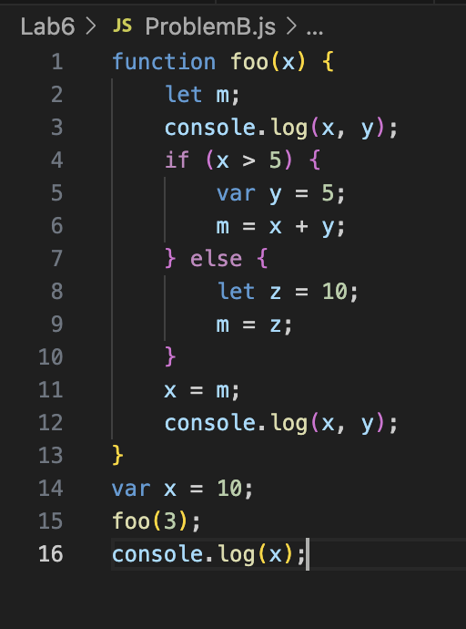
Global Execution Context: Creation
Lexical Environment{
foo: fun,
outer: null
}
Temp Data Zone

Slide 2
Global Execution Context: Creation
Lexical Environment{
foo: fun,
x: undefined,
outer: null
}
Temp Data Zone

Slide 3
Global Execution Context: Creation -> Execution
Lexical Environment{
foo: fun,
x: undefined,
outer: null
}
Temp Data Zone

Slide 4
Global Execution Context: Creation -> Execution
Lexical Environment{
foo: fun,
x: 10,
outer: null
}
Temp Data Zone

Slide 5
Fool Function Execution Context: Creation
Lexical Environment{
x:3,
arguments{0:3, length:1},
outer: global
}
Temp Data Zone
Global Execution Context: Creation -> Execution
Lexical Environment{
foo: fun,
x: 10,
outer: null
}
Temp Data Zone

Slide 6
Fool Function Execution Context: Creation
Lexical Environment{
x:3,
arguments{0:3, length:1},
outer: global
}
Temp Data Zone
let m
Global Execution Context: Creation -> Execution
Lexical Environment{
foo: fun,
x: 10,
outer: null
}
Temp Data Zone

Slide 7
Fool Function Execution Context: Creation
Lexical Environment{
x:3,
y: undefined,
arguments{0:3, length:1},
outer: global
}
Temp Data Zone
let m
Global Execution Context: Creation -> Execution
Lexical Environment{
foo: fun,
x: 10,
outer: null
}
Temp Data Zone

Slide 8
Fool Function Execution Context: Creation -> Execution
Lexical Environment{
x:3,
y: undefined,
arguments{0:3, length:1},
outer: global
}
Temp Data Zone
let m
Global Execution Context: Creation -> Execution
Lexical Environment{
foo: fun,
x: 10,
outer: null
}
Temp Data Zone

Slide 9
Fool Function Execution Context: Creation -> Execution
Lexical Environment{
x:3,
y: undefined,
arguments{0:3, length:1},
m: undefined,
outer: global
}
Temp Data Zone
let m,
Global Execution Context: Creation -> Execution
Lexical Environment{
foo: fun,
x: 10,
outer: null
}
Temp Data Zone

Slide 10
Fool Function Execution Context: Creation -> Execution
Lexical Environment{
x:3,
y: undefined,
arguments{0:3, length:1},
m: undefined,
outer: global
}
Temp Data Zone
let m,
Global Execution Context: Creation -> Execution
Lexical Environment{
foo: fun,
x: 10,
outer: null
}
Temp Data Zone
Console
3, undefined

Slide 11
else Function Execution Context: Creation
Lexical Environment{
outer: Fool
}
Temp Data Zone
let z,
Fool Function Execution Context: Creation -> Execution
Lexical Environment{
x:3,
y: undefined,
arguments{0:3, length:1},
m: undefined,
outer: global
}
Temp Data Zone
let m,
Global Execution Context: Creation -> Execution
Lexical Environment{
foo: fun,
x: 10,
outer: null
}
Temp Data Zone
Console
3, undefined

Slide 12
else Function Execution Context: Creation -> Execution
Lexical Environment{
z:10
outer: Fool
}
Temp Data Zone
let z,
Fool Function Execution Context: Creation -> Execution
Lexical Environment{
x:3,
y: undefined,
arguments{0:3, length:1},
m: undefined,
outer: global
}
Temp Data Zone
let m,
Global Execution Context: Creation -> Execution
Lexical Environment{
foo: fun,
x: 10,
outer: null
}
Temp Data Zone
Console
3, undefined

Slide 13
else Function Execution Context: Creation -> Execution
Lexical Environment{
z:10
outer: Fool
}
Temp Data Zone
let z,
Fool Function Execution Context: Creation -> Execution
Lexical Environment{
x:3,
y: undefined,
arguments{0:3, length:1},
m: 10,
outer: global
}
Temp Data Zone
let m,
Global Execution Context: Creation -> Execution
Lexical Environment{
foo: fun,
x: 10,
outer: null
}
Temp Data Zone
Console
3, undefined

Slide 14
Fool Function Execution Context: Creation -> Execution
Lexical Environment{
x:3,
y: undefined,
arguments{0:3, length:1},
m: 10,
outer: global
}
Temp Data Zone
let m,
Global Execution Context: Creation -> Execution
Lexical Environment{
foo: fun,
x: 10,
outer: null
}
Temp Data Zone
Console
3, undefined

Slide 15
Fool Function Execution Context: Creation -> Execution
Lexical Environment{
x:10,
y: undefined,
arguments{0:3, length:1},
m: 10,
outer: global
}
Temp Data Zone
let m,
Global Execution Context: Creation -> Execution
Lexical Environment{
foo: fun,
x: 10,
outer: null
}
Temp Data Zone
Console
3, undefined

Slide 16
Fool Function Execution Context: Creation -> Execution
Lexical Environment{
x:10,
y: undefined,
arguments{0:3, length:1},
m: 10,
outer: global
}
Temp Data Zone
let m
Global Execution Context: Creation -> Execution
Lexical Environment{
foo: fun,
x: 10,
outer: null
}
Temp Data Zone
Console
3, undefined
10, undefined

Slide 17
Global Execution Context: Creation -> Execution
Lexical Environment{
foo: fun,
x: 10,
outer: null
}
Temp Data Zone
Console
3, undefined
10, undefined
10

Slide 18
Console
3, undefined
10, undefined
10

