Slide 1
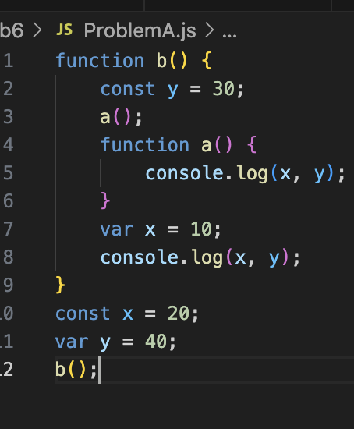
Global Execution Context: Creation
Lexical Environment{
b: fun,
outer: null
}
Temp Data Zone

Slide 2
Global Execution Context: Creation
Lexical Environment{
b: fun,
outer: null
}
Temp Data Zone
Const x

Slide 3
Global Execution Context: Creation
Lexical Environment{
b: fun,
y: undefined,
outer: null
}
Temp Data Zone
Const x

Slide 4
Global Execution Context: Creation -> Execution
Lexical Environment{
b: fun,
y: undefined,
x:20,
outer: null
}
Temp Data Zone
Const x

Slide 5
Global Execution Context: Creation -> Execution
Lexical Environment{
b: fun,
y: 40,
x:20,
outer: null
}
Temp Data Zone
Const x

Slide 6
B Function Execution Context: Creation
Lexical Environment{
argument:{length:0},
outer: Global
}
Temp Data Zone
Global Execution Context: Creation -> Execution
Lexical Environment{
b: fun,
y: 40,
x:20,
outer: null
}
Temp Data Zone
Const x

Slide 7
B Function Execution Context: Creation
Lexical Environment{
argument:{length:0},
outer: Global
}
Temp Data Zone
Const y
Global Execution Context: Creation -> Execution
Lexical Environment{
b: fun,
y: 40,
x:20,
outer: null
}
Temp Data Zone
Const x

Slide 8
B Function Execution Context: Creation
Lexical Environment{
argument:{length:0},
a: fun,
outer: Global
}
Temp Data Zone
Const y
Global Execution Context: Creation -> Execution
Lexical Environment{
b: fun,
y: 40,
x:20,
outer: null
}
Temp Data Zone
Const x

Slide 9
B Function Execution Context: Creation
Lexical Environment{
argument:{length:0},
a: fun,
x: undefined,
outer: Global
}
Temp Data Zone
Const y
Global Execution Context: Creation -> Execution
Lexical Environment{
b: fun,
y: 40,
x:20,
outer: null
}
Temp Data Zone
Const x

Slide 10
B Function Execution Context: Creation -> Execution
Lexical Environment{
argument:{length:0},
a: fun,
x: undefined,
y: 30,
outer: Global
}
Temp Data Zone
Const y
Global Execution Context: Creation -> Execution
Lexical Environment{
b: fun,
y: 40,
x:20,
outer: null
}
Temp Data Zone
Const x

Slide 11
A Function Execution Context: Creation
Lexical Environment{
outer: B Function
}
B Function Execution Context: Creation -> Execution
Lexical Environment{
argument:{length:0},
a: fun,
x: undefined,
y: 30,
outer: Global
}
Temp Data Zone
Const y
Global Execution Context: Creation -> Execution
Lexical Environment{
b: fun,
y: 40,
x:20,
outer: null
}
Temp Data Zone
Const x

Slide 12
A Function Execution Context: Creation_-> Execution
Lexical Environment{
outer: B Function
}
B Function Execution Context: Creation -> Execution
Lexical Environment{
argument:{length:0},
a: fun,
x: undefined,
y: 30,
outer: Global
}
Temp Data Zone
Const y
Global Execution Context: Creation -> Execution
Lexical Environment{
b: fun,
y: 40,
x:20,
outer: null
}
Console
Undefined, 30
Temp Data Zone
Const x

Slide 13
B Function Execution Context: Creation -> Execution
Lexical Environment{
argument:{length:0},
a: fun,
x: 10,
y: 30,
outer: Global
}
Temp Data Zone
Const y
Global Execution Context: Creation -> Execution
Lexical Environment{
b: fun,
y: 40,
x:20,
outer: null
}
Console
Undefined, 30
Temp Data Zone
Const x

Slide 14
B Function Execution Context: Creation -> Execution
Lexical Environment{
argument:{length:0},
a: fun,
x: 10,
y: 30,
outer: Global
}
Temp Data Zone
Const y
Global Execution Context: Creation -> Execution
Lexical Environment{
b: fun,
y: 40,
x:20,
outer: null
}
Console
Undefined, 30
10,30
Temp Data Zone
Const x

Slide 15
Global Execution Context: Creation -> Execution
Lexical Environment{
b: fun,
y: 40,
x:20,
outer: null
}
Console
Undefined, 30
10,30
Temp Data Zone
Const x

Slide 16
Console
Undefined, 30
10,30

