Slide 1
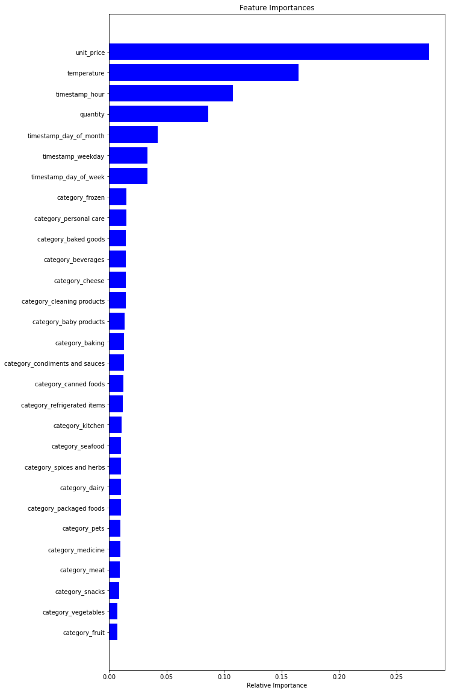
Strategic plan
Gala Groceries
INSIGHTS
Unit price, temperature and hours of days are the most relevant features.
We could use all the features from unit_price to timestamp_day_of_week accordingly and delete the irrelevant category features.
The test accuracy (Using Mean Absolute Error) is around 50%.
In order to enhance the accuracy, more datasets with relevant features are needed.
Feature Engineering will be repeatedly visited until reliable functionality is achieved.

