Slide 1
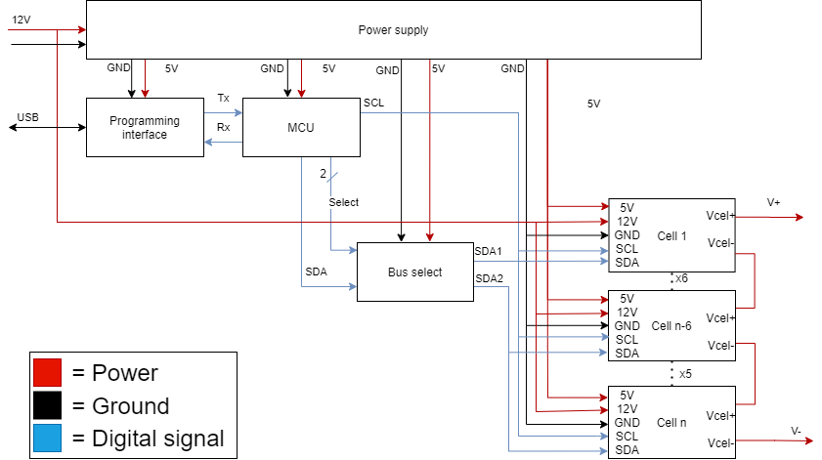
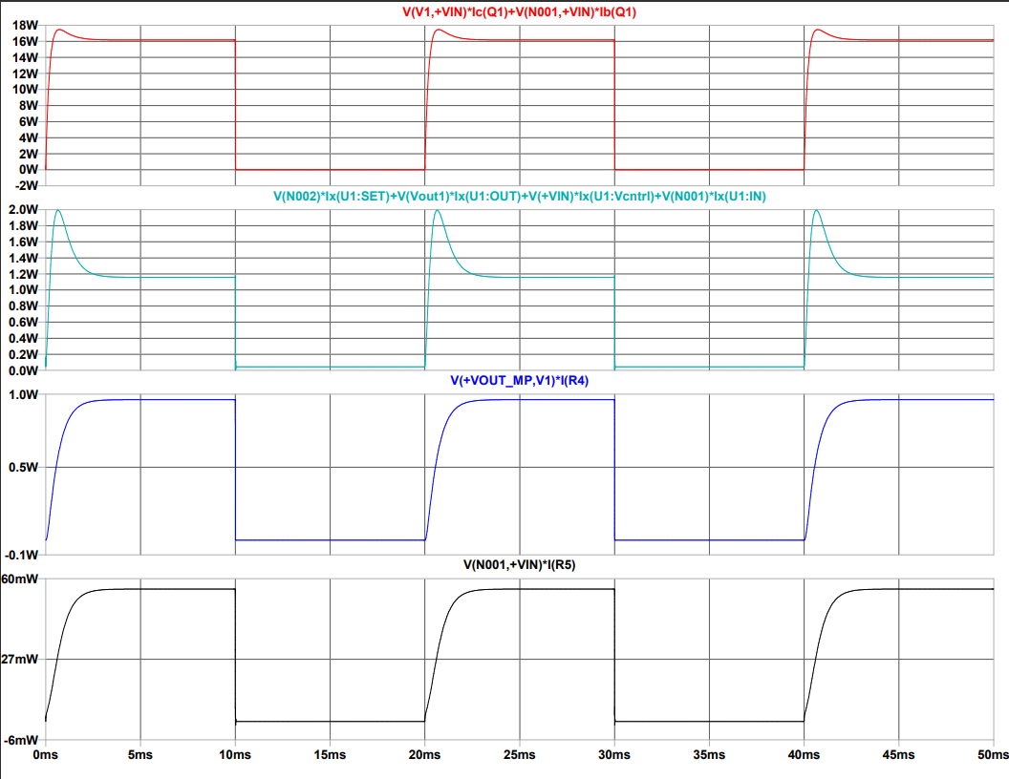
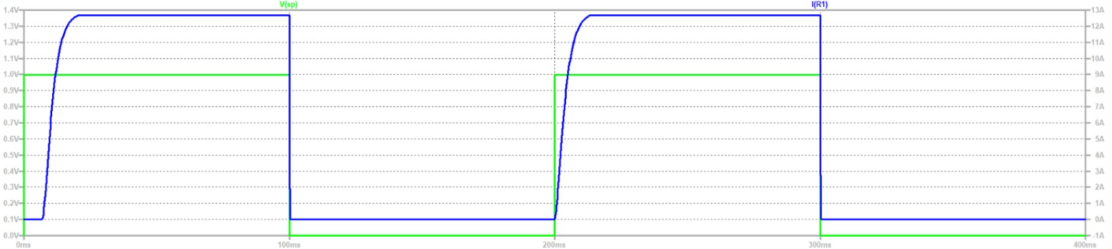
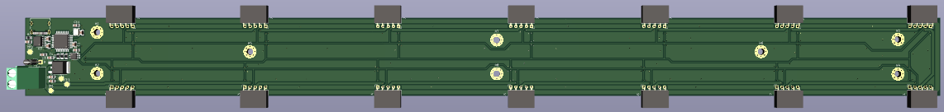
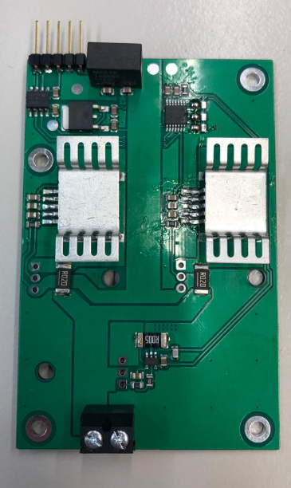
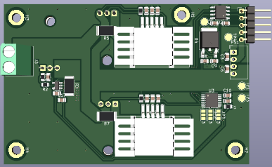
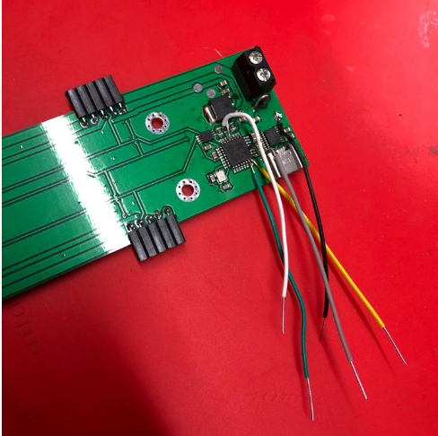
Battery Hardware Emulator
Introduction
Fontys Engineering is working with BatteryNL to develop a Battery Emulator to test a Battery Management System (BMS).
Modern Batteries are dangerous to test so a BMS is used. Using a battery emulator to test a BMS can avoid these dangers.
The goal of this project is to design, build, and test a battery emulator using an iterated method.
Hardware
Software
First iteration: Li-ion battery cell emulator capable of charging and discharging 100mA current with a voltage controlled by a mechanical resistor
Second Iteration: the mother board PCB is equipped with a microcontroller that can adjust the cell voltage and source current
Second Iteration: Make it modular- a mother board PCB to control up to 14 PCB cells that can sink and source current up to 12A
Simulation
Power Dissipation of Linear Regulator
Current through the DC-Load
Realization
Hein Verhallen, Nikola Panchev, Robin van den Dungen,
Youri Tils, Wyatt Southard

