Slide 1
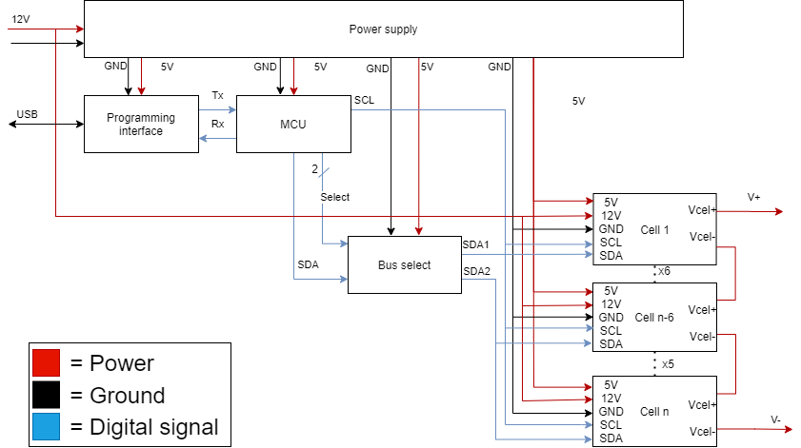
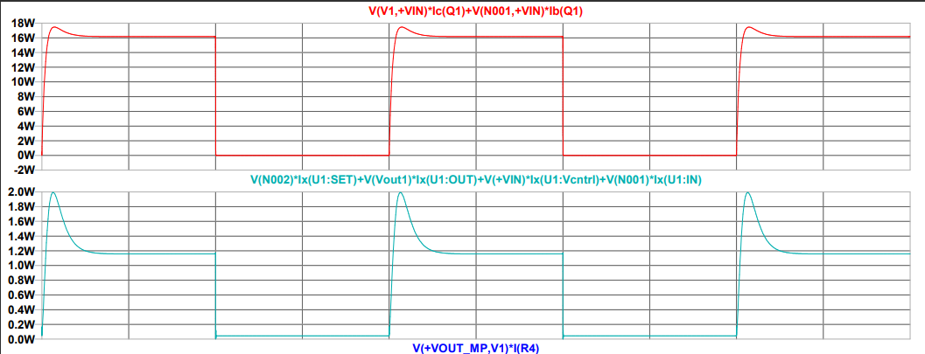
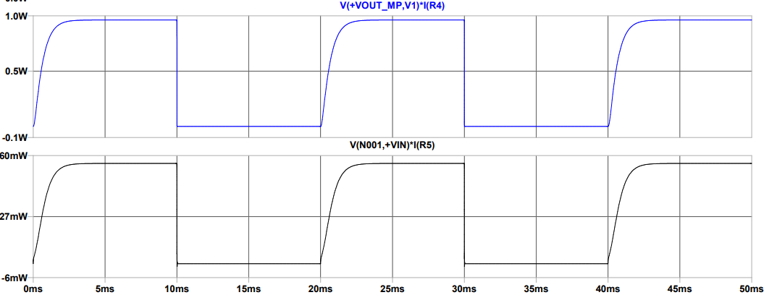
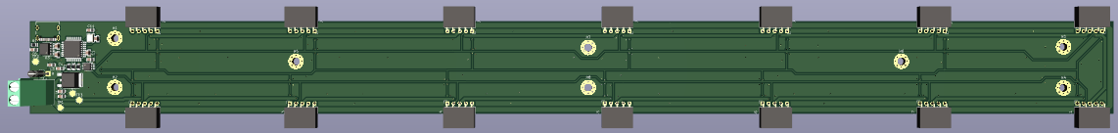
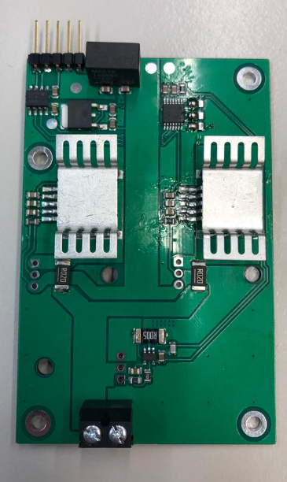
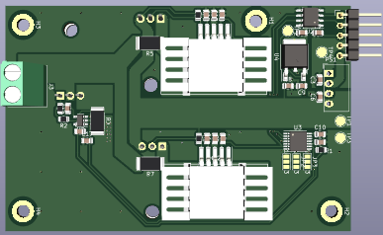
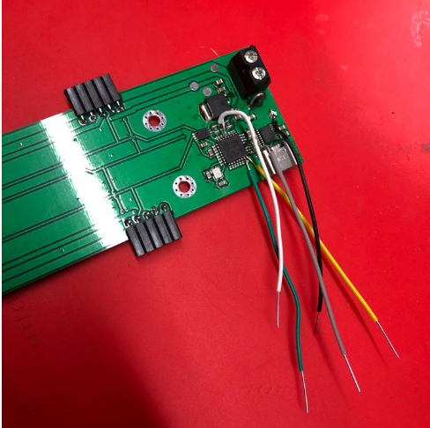
Battery Hardware Emulator
Introduction
Fontys Engineering is working with BatteryNL to develop a Battery Emulator to test a Battery Management System (BMS).
Modern Batteries are dangerous to test so a BMS is used. Using a battery emulator to test a BMS can avoid these dangers.
The goal of this project is to design, build, and test a battery emulator using an iterated method.
Hardware
Software
First iteration: Li-ion battery cell emulator capable of charging and discharging 100mA current with a voltage controlled by a mechanical resistor
Second Iteration: the mother board PCB is equipped with a microcontroller that can adjust the cell voltage and source current
Second Iteration: Make it modular- a mother board PCB to control up to 14 PCB cells that can sink and source current up to 12A
Simulation
Power Dissipation of Linear Regulator
Realization
Hein Verhallen, Nikola Panchev, Robin van den Dungen,
Youri Tils, Wyatt Southard

