Slide 1
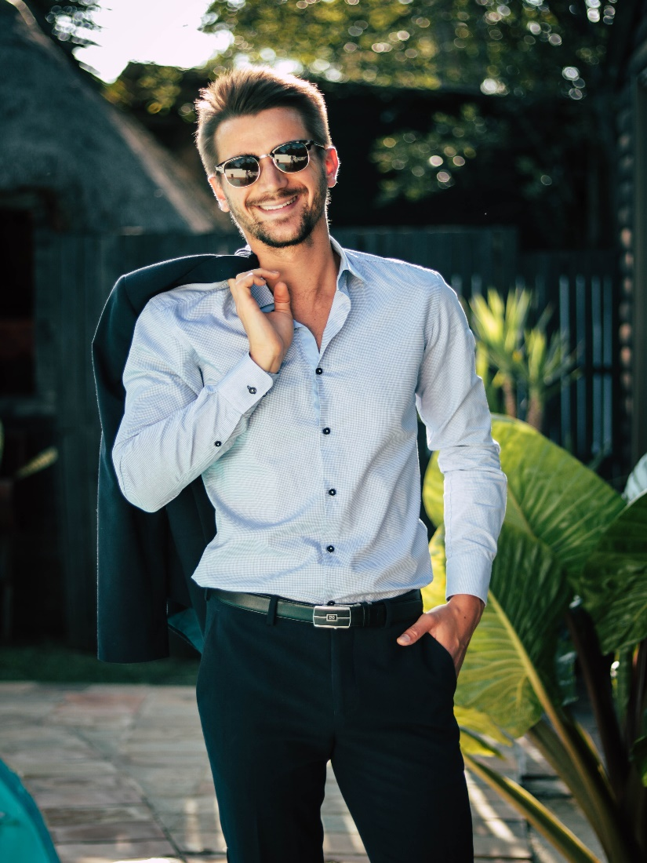




Johnathan
Johnathan is a 32-year-old active male. He does not have any kids and is not married. He seeks out tropical and exotic places.
Resides in Anaheim, CA
He has some disposable cash and is not afraid to spend it on the right type of vacation especially if it warm and tropical.
‘Tropical beaches and white sands are my weakness.’
Key goals
We must
Wants to experience excitement on vacation
Wants the best and does not have time to waste
Wants the most excitement for his dollar
Present activities that are appealing and energetic
Provide a wide range of activities
Need to be seen as a active an vital destination
Behaviours
We must not
Must feel alive and vibrant in all activities
Needs to feel invigorated and partaking in an adventure of a lifetime
Lives for unique and thrilling adventures
Waste his time with boring activities
Offer a website that is not intuitive to use
Waste his time or money

