Slide 1


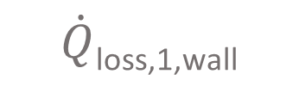
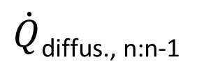

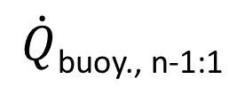
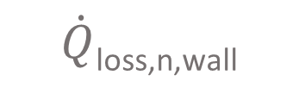

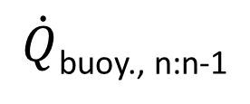
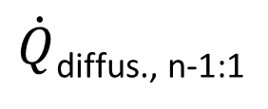
$\dot{Q}$_{loss,n,amb}
T_{amb}
A_{lid}, U_{lid}
$\dot{Q}$_{out}$,\dot{m}$_{out}
T_{ground}
T_{n}, V_{n}
$\dot{Q}$_{in}$, \dot{m}$_{in}
$\dot{Q}$_{loss,n,wall}
$\dot{Q}$_{buoy., n:n-1}
$\dot{Q}$_{diffus., n:n-1}
A_{wall} (n)
U_{wall}(n)
$\dot{Q}$_{loss,n-1,wall}
T_{n-1}, V_{n-1}
$\dot{Q}$_{buoy., n-1:1}
$\dot{Q}$_{diffus., n-1:1}
$\dot{Q}$_{loss,1,wall}
T₁, V₁
$\dot{Q}$_{loss,1,bottom}
A_{bottom}, U_{bottom}

