Slide 1
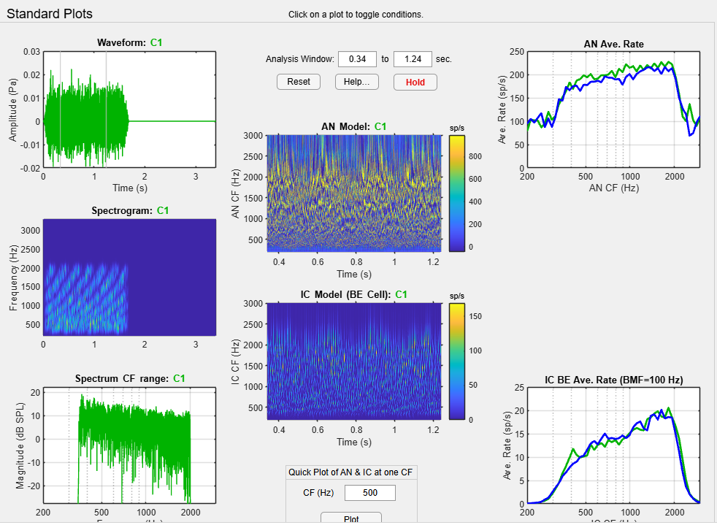
45dB human 2 cycle per octave

Slide 2
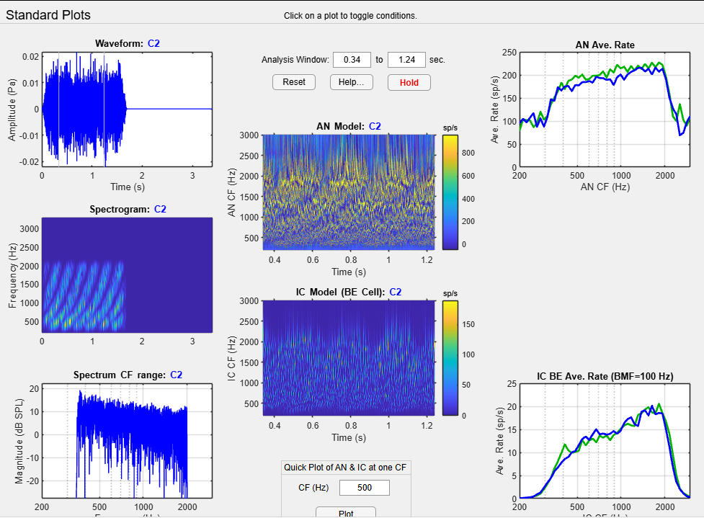
45dB human 1 cycle per octave

Slide 3
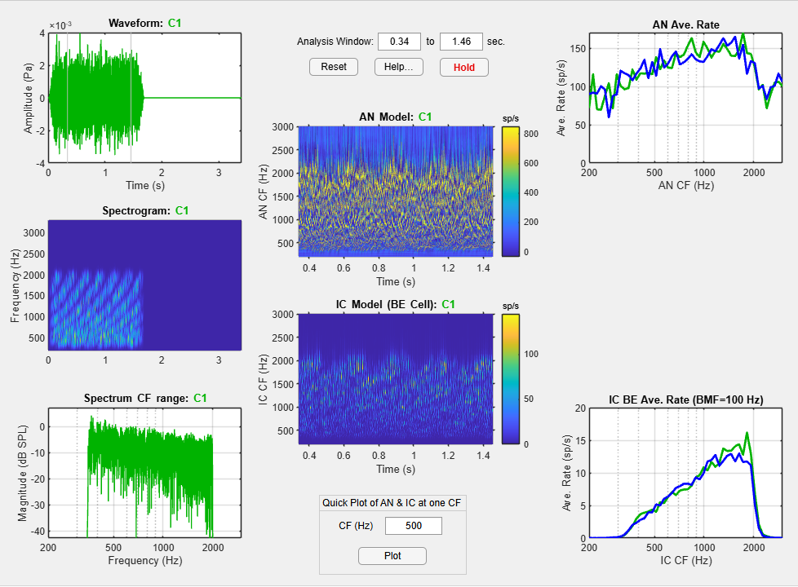
30dB human 2 cycle per octave

Slide 4
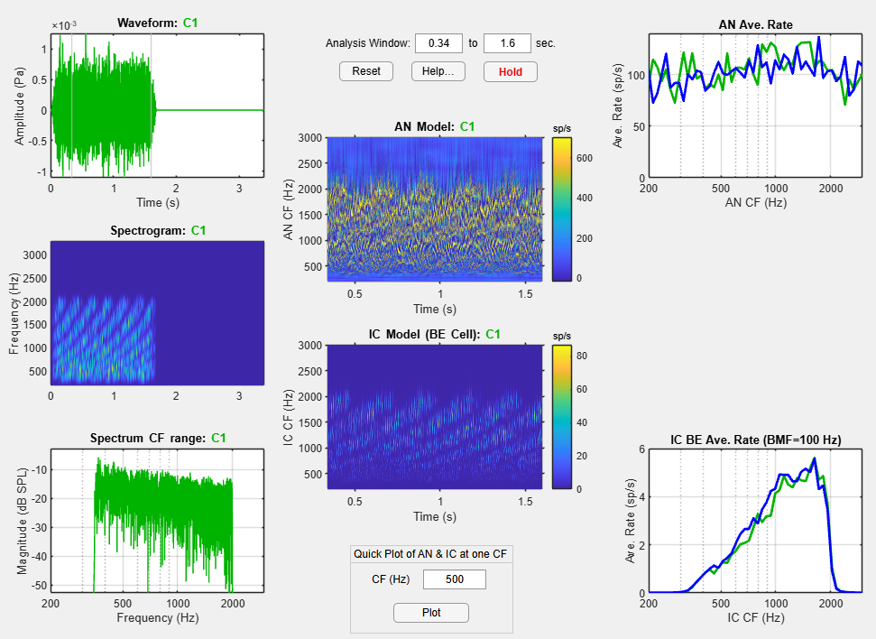
20 dB

Slide 5
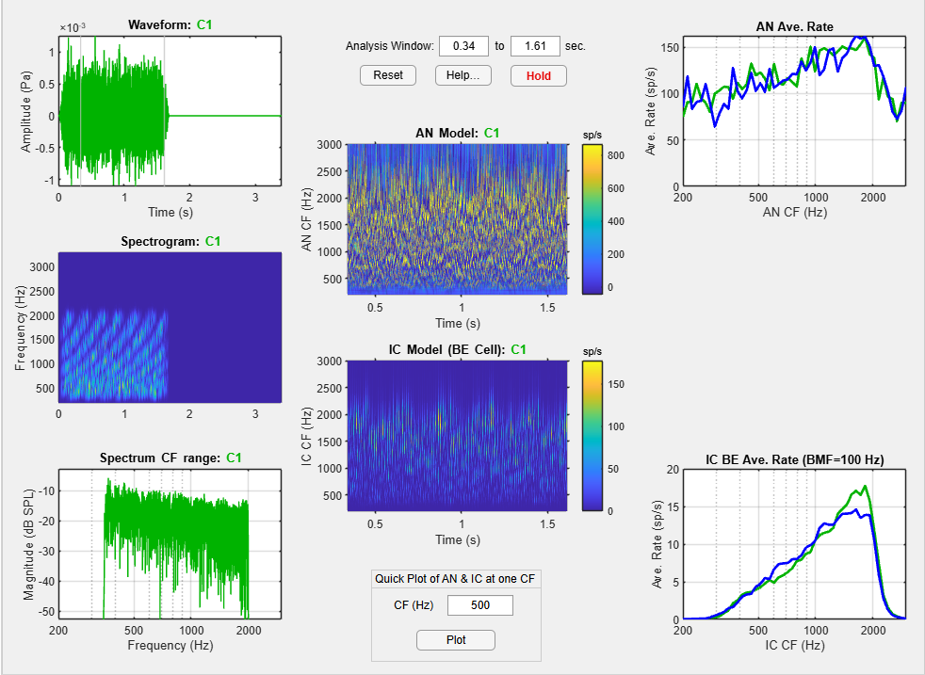
Same condition 20 dB and 2 cycle for cat

Slide 6
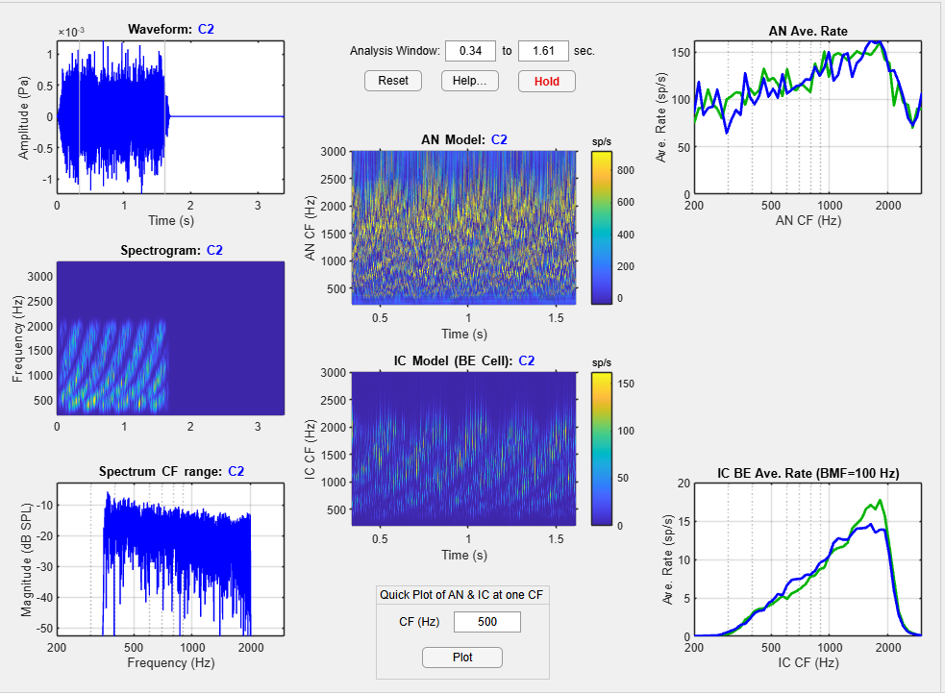
Fspec 1

Slide 7
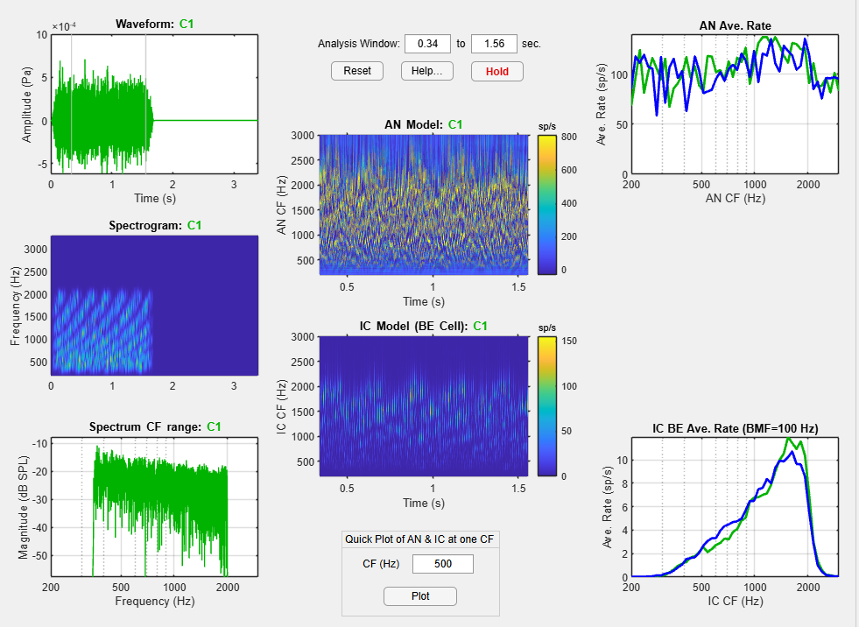
Lower the level to 15 !! But maybe closer to BML …

Slide 8
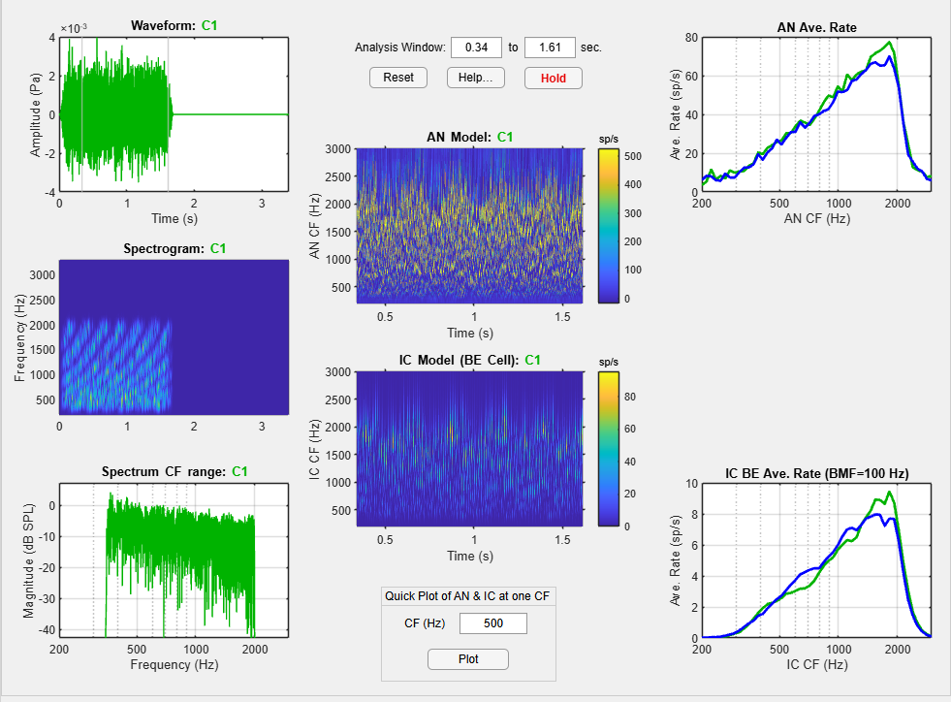
30 dB cat MSR 2 fspec

Slide 9
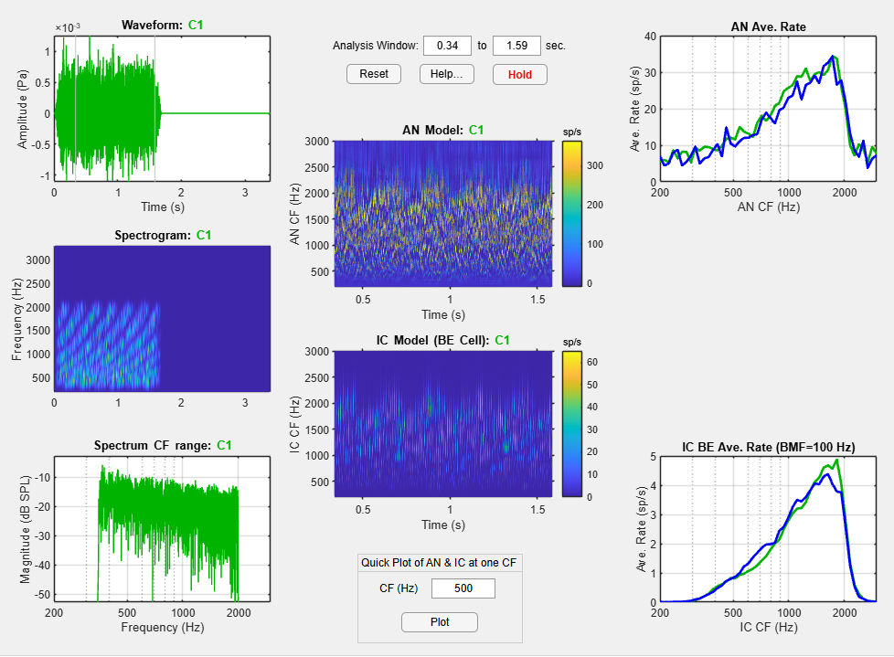
20 dB cat MSR 2 fspec

Slide 10
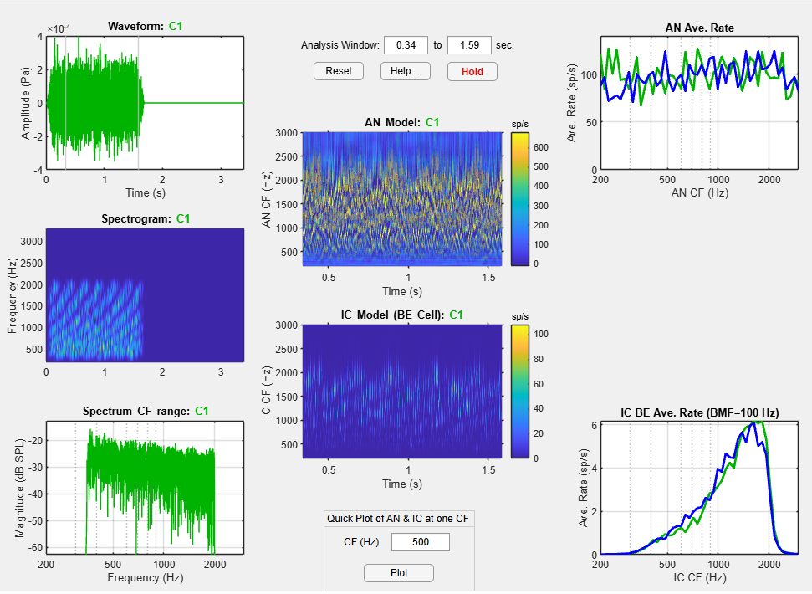
10 and HSR

