Slide 1
ENEL 525 · MACHINE LEARNING FOR ENGINEERS
01
Sensorless speed estimation
for a brushed DC motor
Polynomial regression and a one-hidden-layer network,
scored against the state-space speed.
Mohammad Elmougey Heinz Veintimilla
University of Calgary
Notes:
About 45 seconds. Name the course, the motor, and the claim: we try to beat the state-space speed without an encoder.

Slide 2
PROBLEM
02
The wheelchair needs speed, not an encoder
01
02
03
The rider
The sensor
The state
Head tilts command a chair for someone who cannot correct the loop by hand.
A shaft encoder costs space and money, and shock, heat, and moisture move its reading.
Current is measured on the drive. Shaft speed is the state the controller still needs.
Notes:
One minute. The ethical point is the rider, not a generic safety slide. Speed is the missing state.

Slide 3
LEARNING TASK
03
Predict measured speed at one instant
Inputs, standardized on the training slice only
ia
Measured armature current
TARGET
ω measured
i model
State-space current
Radians per second.
No lag window.
No reconstructed voltage.
ω model
State-space speed, also the baseline
Notes:
One minute. Stress instantaneous regression and that the baseline is one of the inputs.

Slide 4
DATA
04
Two 40-second runs, one locked
40,001
rows after alignment to 1 ms
Held fixed
Measured traces arrive at 50 µs and are sampled onto the model grid. Nothing is interpolated.
The test run is a smaller motion, about ±6 rad/s against about −13 to +11 on the development run.
Current is treated as amperes.
32,000
training rows, t < 32 s
8,001
validation rows, same recording
40,001
test rows, untouched until selection
Notes:
One minute. Say the cut is chronological and the test files were not opened for tuning.

Slide 5
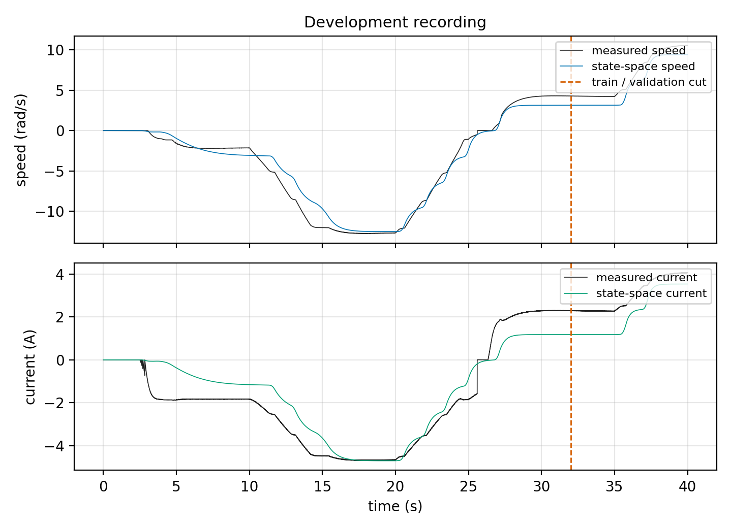
DEVELOPMENT RECORDING
05
The model follows the shape and misses the plateaus
The dashed line is the training cut. Validation is the last plateau, so a low validation error is not the whole story.
Notes:
45 seconds. Point at the offset between black and blue on the current plot, and at 32 seconds.

Slide 6
METHODS
06
Baseline, polynomials, and one network
Baseline
Polynomials
Network
Use the state-space speed as the prediction. No fitted weights.
Full degree 2–5, with cross terms. Least squares, and plain SGD at three learning rates.
16 or 32 ReLU units, linear output, same three inputs. Written in NumPy.
100 epochs · batch 256 · selection seed 525 · winner = lowest validation RMSE
Notes:
One minute. Say least squares and SGD are two trainers for one polynomial, and the network is the second model class.

Slide 7
VALIDATION
07
Degree 3 and a small step size win
Configuration | Val. RMSE
State-space speed | 1.113
Least squares, degree 2 | 1.452
Least squares, degree 5 | 137.7
SGD, degree 3, lr 0.001 | 0.387
Network, 32 units, lr 0.01 | 0.713
Higher degree lowers training error and destroys the validation error. Learning rate 0.1 diverges.
Condition number at degree 5: 3.9×10¹⁵.
Notes:
One minute. The bold row is the selection. Degree 5 is the trap if someone picks by training error.

Slide 8
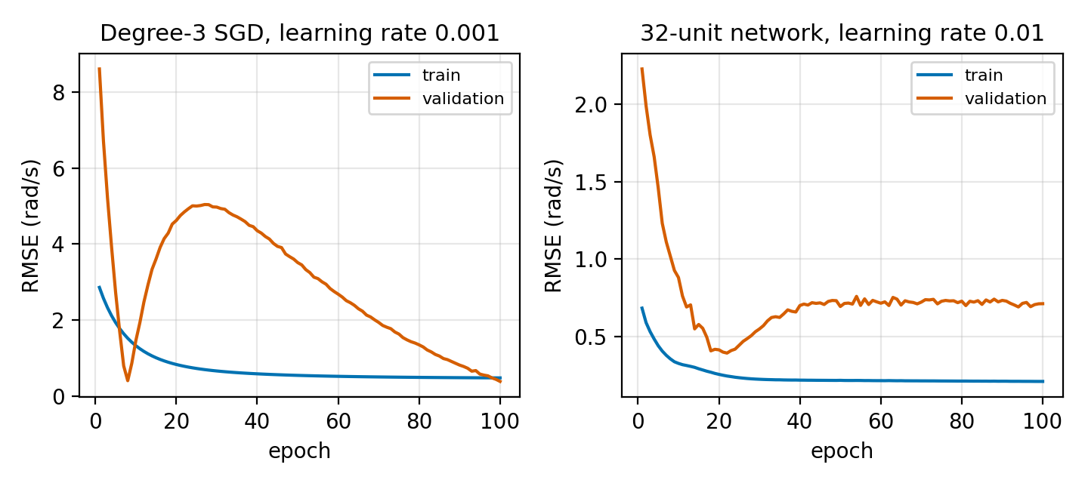
LEARNING CURVES
08
The epoch budget is part of the method
SGD validation error returns to its best region only near epoch 100.
The network is best near epoch 20, then the training error keeps falling. We still keep epoch 100.
Notes:
One minute. Point at the network's early minimum and say we did not early-stop.

Slide 9
LOCKED TEST
09
Only the cubic SGD model beats the baseline
0.890
1.061
State-space baseline
Best least squares
0.768
1.210
SGD, mean ± 0.043
Network, mean ± 0.154
Notes:
One minute. Read the four numbers. The dark card is the result to remember. Units are rad/s.

Slide 10
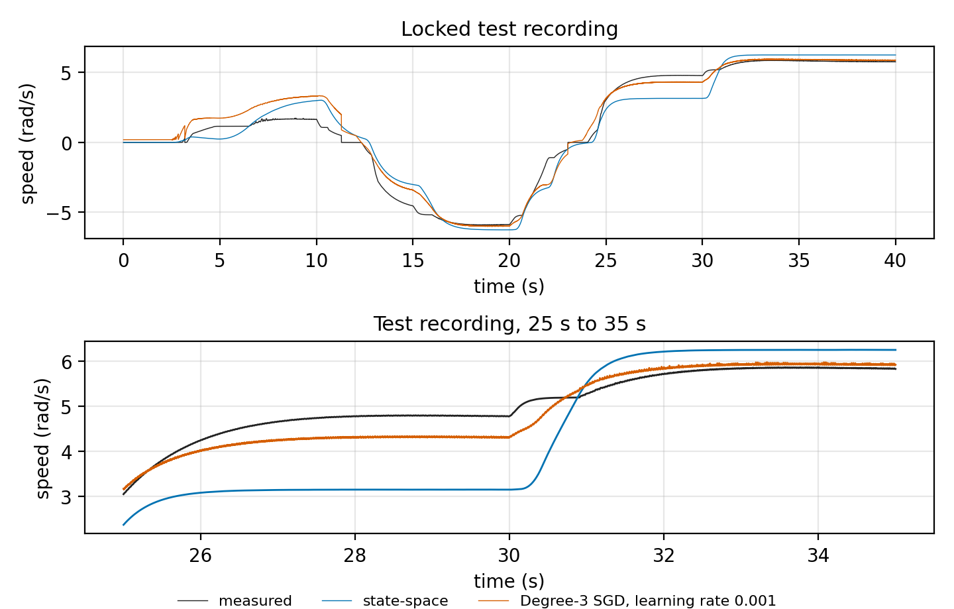
WHERE THE ERROR GOES
10
The average win hides the first 10 seconds
0–10 s
worse
0.98 vs 0.64 rad/s
20–30 s
better
0.59 vs 1.17 rad/s
30–40 s
better
0.16 vs 0.59 rad/s
Notes:
One minute. The lower panel is 25 to 35 seconds. Cubic RMSE is 0.31 against 1.14 for the state-space speed. The physics trace lags until 30 seconds, then overshoots the plateau. The miss on the full run is still the first 10 seconds. Seed 525.

Slide 11
LIMITS
11
A simulation RMSE is not a deployment argument
Simulated traces
No passenger load, brush wear, or a wheel leaving the ground.
Structured residual
About 1 rad/s of bias on a plateau still moves a speed loop.
Units
Amperes and rad/s are inferred from the scale of the files.
The rider
This person cannot grab the wheels if the loop is wrong.
Notes:
One minute. Do not soften the last point. Hardware is future work, not a claim.

Slide 12
CONCLUSION
12
Cubic SGD beats the
state-space speed.
0.768 ± 0.043 rad/s against 0.890 rad/s
Least squares overfits as the degree rises.
The network does not survive the locked test.
The error that remains is systematic in time.
Notes:
45 seconds, then take questions. Repeat the two numbers and stop.

