Slide 1
FinBERT

Slide 2
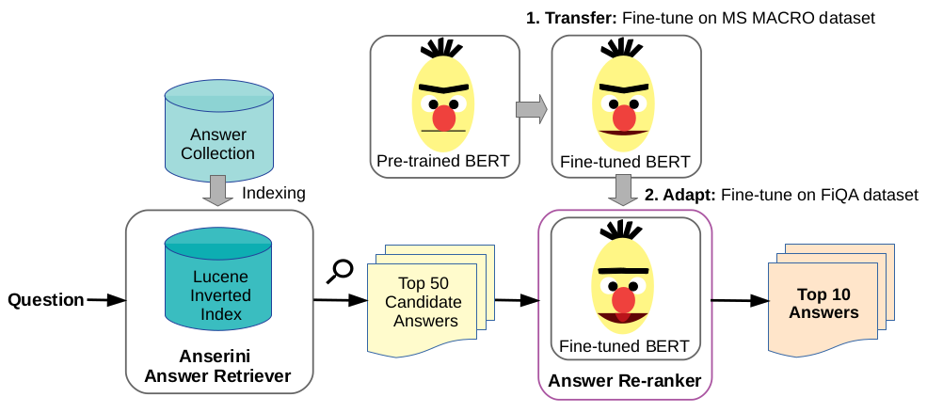
Overview of the model

Slide 3
Stages of training the model
Transfer learning: MS Macro dataset
Adaptive learning: FiQA dataset

Slide 4
Bert pointwise and Bert pairwise
Bert pointwise
Data-point: 1 Question and 1 Answer.
Advantage: Simpler to implement and train
Use-case: Sentiment Analysis, NER (person names, organizations, locations, etc)
Drawback: May not capture the overall context or dependencies between different documents or sentences.
Bert pairwise
Data-point: 1 Question and 2 Answers.
Advantage: Finds relative relevance
Use-case: Ranking and clustering, Textual Similarity
Drawback: Computationally expensive

Slide 5
Dataset
There are 3 types of dataset:
1) Raw data: It has 3 components:
FiQA_train_question_final.tsv
FiQA_train_doc_final.tsv
FiQA_train_question_doc_final.tsv
2) Processed dataset: The raw dataset is processed in the form of lists where each sample is a list of:
A question ID
A list of label answer IDs
A list of answer candidate IDs

Slide 6
Dataset for Financial based BERT model
(Required) ---> For utilizing the model for predictions on our custom dataset: In this case the custom dataset will be 'docs.tsv' file with the following structure:
docs.tsv: It consists of 2 columns separated by 'tab-space':
docid: The id of the particular paragraph/chunk/doc
doc: The text corresponding to that docid
(Optional) ---> For fine tuning the model on our custom dataset: In this case 3 raw files are required:
FiQA_train_question_final.tsv: It consists of 2 columns separated by 'tab-space':
qid: The id of the particular question
question: The question in the form of text corresponding to that qid
FiQA_train_doc_final.tsv: It consists of 2 columns separated by 'tab-space':
docid: The id of the particular paragraph/chunk/doc
doc: The text corresponding to that docid
FiQA_train_question_doc_final.tsv: It consists of 2 columns separated by 'tab-space':
qid: The question id belonging to 'FiQA_train_question_final.tsv'
docid: The docid taken from 'FiQA_train_doc_final.tsv' that is an answer to qid.

Slide 7
Sample processed dataset
[
[0, [18850], [53157, 14464, 32621, 33800, 15377, 35416, 18850]]
[1, [14255], [21279, 47006, 35416, 34672, 15644, 8199, 24461]]
[2, [734], [40230, 10834, 4520, 9032, 654, 23, 34562]]
.........]

Slide 8
Evaluation
MRR = 0.436
NDCG = 0.482

Slide 9
Prediction
Answer Collection: Answerini Retriever
Java information retrieval toolkit.
Uses Lucene indexer for indexing the chunks.
Uses BM-25 algo for finding relevant answers to the given query.
Answer Re-ranker: FinBERT-QA
Find top 10 relevant answers using BERT embeddings

