Slide 1
TEAM 9 Autonomous Quadruped Welcome
rhodeskesi
Intro to ROS SS2024 Project Team 9:
Autonomous Quadruped
30.07.2024
Xiaoyue Hu, Shaolong Tang, Yang Tang, Run Yuan, Xinyuan Zhu

Slide 2
TEAM 9 Autonomous Quadruped List of Contents
rhodeskesi
Overview
and Demo
Task Assigning
and Progress
Flow of
Messages
Controller
Node
Challenges
30.07.2024
Xiaoyue Hu, Shaolong Tang, Yang Tang, Run Yuan, Xinyuan Zhu

Slide 3
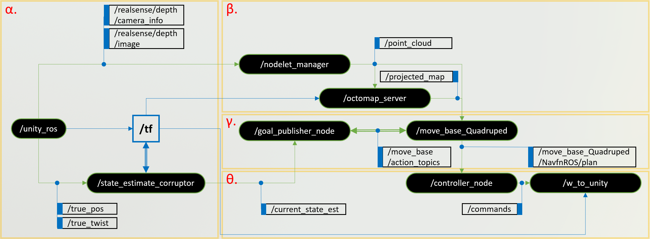
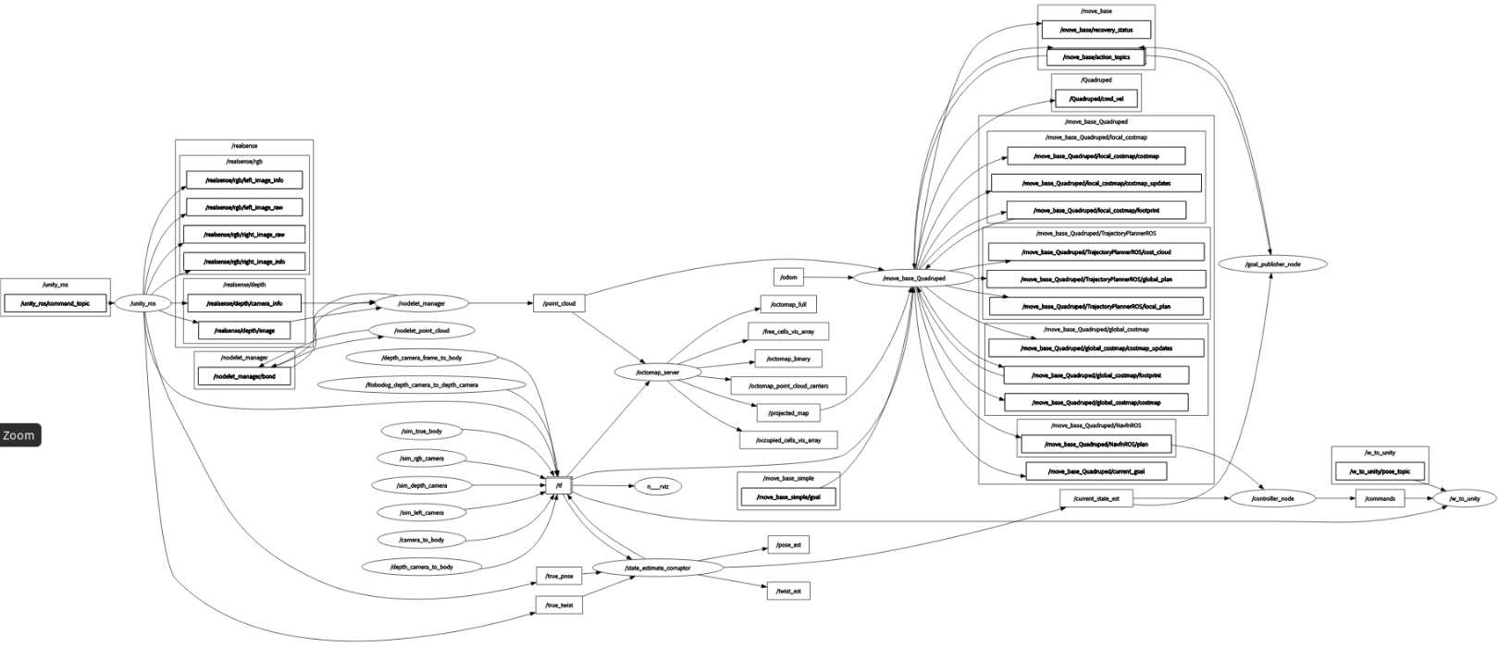
TEAM 9 Autonomous Quadruped Overview and Demo
rhodeskesi
Overview
1.
Project architecture based on rqt_graph
Overview
and
Demo
Overall structure
& demonstration video
30.07.2024
Xiaoyue Hu, Shaolong Tang, Yang Tang, Run Yuan, Xinyuan Zhu

Slide 4
TEAM 9 Autonomous Quadruped Overview and Demo
rhodeskesi
Demo Video
1.
Path finding + slope climbing
Overview
and
Demo
Overall structure
& demonstration video
For detailed video, please contact us
30.07.2024
Xiaoyue Hu, Shaolong Tang, Yang Tang, Run Yuan, Xinyuan Zhu

Slide 5
TEAM 9 Autonomous Quadruped Task Assigning
rhodeskesi
Perception
Mapping
Path Planning
Gait Controller
2.
Task Assigning and Progress
 | Perception | Mapping | Path Planning | Gait Controller | Presentation & Report
Xiaoyue Hu
Shaolong Tang
Yang Tang
Run Yuan
Xinyu Zhu
Dividing task roles
& Gantt chart
30.07.2024
Xiaoyue Hu, Shaolong Tang, Yang Tang, Run Yuan, Xinyuan Zhu

Slide 6
TEAM 9 Autonomous Quadruped Flow of Messages
rhodeskesi
3.
Flow of Messages
Pub – Sub relationships & custom msg type
30.07.2024
Xiaoyue Hu, Shaolong Tang, Yang Tang, Run Yuan, Xinyuan Zhu

Slide 7
TEAM 9 Autonomous Quadruped Flow of Messages
rhodeskesi
α.
β.
/realsense/depth
/camera_info
/realsense/depth
/image
/point_cloud
/nodelet_manager
/projected_map
/octomap_server
/tf
γ.
/unity_ros
/goal_publisher_node
/move_base_Quadruped
/move_base
/action_topics
/move_base_Quadruped/NavfnROS/plan
/state_estimate_corruptor
θ.
/controller_node
/w_to_unity
/true_pos
/current_state_est
/commands
/true_twist
30.07.2024
Xiaoyue Hu, Shaolong Tang, Yang Tang, Run Yuan, Xinyuan Zhu

Slide 8
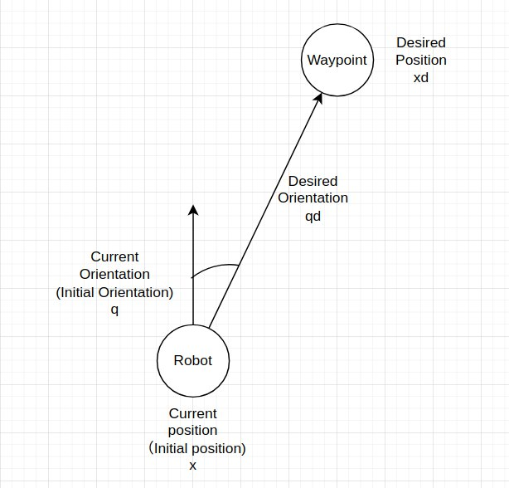
TEAM 9 Autonomous Quadruped Controller Node
rhodeskesi
Control logic
4.
Sub to /move_base_Quadruped/NavfnROS/plan
+ /current_state_est
Filter 1 in 40 waypoints
Controller
Node
Path planning waypoints -> move order
30.07.2024
Xiaoyue Hu, Shaolong Tang, Yang Tang, Run Yuan, Xinyuan Zhu

Slide 9
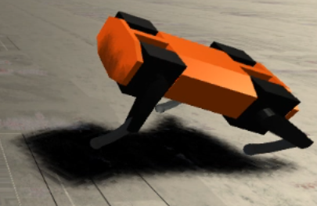
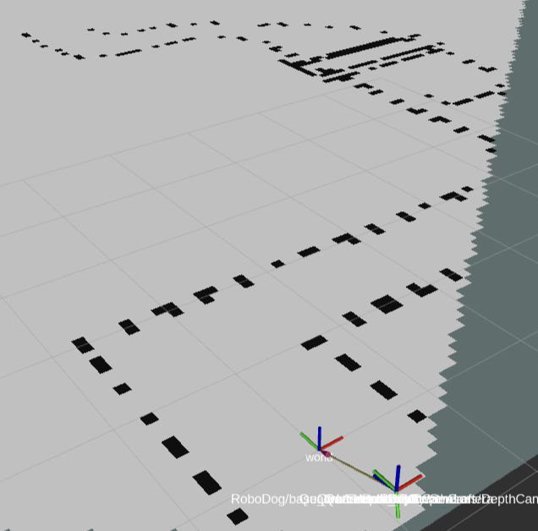
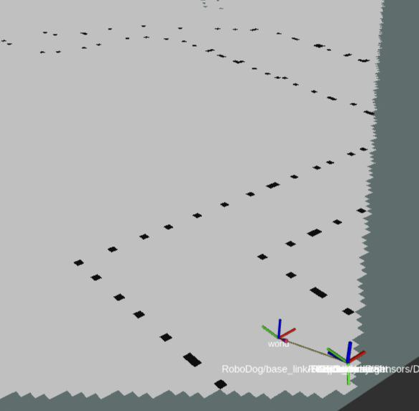
TEAM 9 Autonomous Quadruped Challenges
rhodeskesi
1
Quadruped’s Gait control: A Black-box
5.
Bumps and falls back while rotating
Unstable while climbing
Challenges
2
Global map unknown
Difficulties and Existing Problems
Explore local map, and set local goals
Local maps generated while in motion are blurry
3
More flexible planning algorithm
A* based planning provided by /Move_base has few tunable parameters
30.07.2024
Xiaoyue Hu, Shaolong Tang, Yang Tang, Run Yuan, Xinyuan Zhu

Slide 10
