Slide 1

Department of Computer Science Gujarat University
5 Year Integrated M.Sc.(Computer Science)
Semester – IV
Online Examination System
Presented By:
Ishika Thakkar (40018)
Lamin Janka (40021)
Parin Makwana (40034)
Juhi Modi (40038)
Under the Guidance of :
Dr. Maitri Jhaveri

Slide 2
Table of Content
Project Profile ……………………………………………………………………………………… 3
Introduction ………………………………………………………………………………………… 4-5
Tools, Technologies and Software Used …………………………………………….... 6
Work Division ………………………………………………………………………………………. 7
Timeline Chart …………………………………………………………………………………..... 8
System Architecture …………………………………………………………………………….. 9-11
Users of System …………………………………………………………………………………… 12
System Requirements ………………………………………………………………………….. 13-19
Requirements along with use cases
Activity Diagram ………………………………………………………………………………..... 20-23
Database Design ………………………………………………………………………………….. 24-25
ER Diagram ………………………………………………………………………………………….. 26-27
Data Dictionary …………………………………………………………………………………… 28-35
Screenshots of the system ………………………………………………………………….. 36-68
Future Work ………………………………………………………………………………………… 69
Bibliography ……………………………………………………………………………………….. 70
Video of The System …………………………………………………………………………… 71
Website : Online Examination System …………………………………………………. 72

Slide 3
Project Profile
Title | Description
Project title | Online Examination System
Aim of project | This project intends to create a system that is easily accessible and provides the user with a secure and feasible environment for conducting and appearing for his/her examinations. It also aims to revolutionize the traditional assessment system.
Project duration | 6 months
Team size | 4 members
Team Members | Lamin Janka(16) , Parin Makwana(17) , Juhi Modi(20), Ishika Thakkar(111)
Tools and technologies to use | XAMPP , PHP, JavaScript, HTML, CSS, Visual Studio Code
Guide | Dr Maitri Jhaveri
Title | Description
Project title | Online Examination System
Aim of project | This project intends to create a system that is easily accessible and provides the user with a secure and feasible environment for conducting and appearing for his/her examinations. It also aims to revolutionize the traditional assessment system.
Project duration | 6 months
Team size | 4 members
Team Members | Lamin Janka(16) , Parin Makwana(17) , Juhi Modi(20), Ishika Thakkar(111)
Tools and technologies to use | XAMPP , PHP, JavaScript, HTML, CSS, Visual Studio Code
Guide | Dr. Maitri Jhaveri

Slide 4
Introduction
As we know people are following old traditional exam preparation method such as
Referring to the previous year paper question sets
Some questionaries published by gala, marvel, Hardik etc.
This types of old traditional exam preparation method have several disadvantages including:
Time Consumption: Manually searching and solving questions can be time-consuming.
Paper Waste: Printing and handling physical copies contribute to paper waste.
Limited Question Bank: Traditional methods might not cover a wide range of possible questions.
Evaluation Deficiency: Manual evaluation can be slow and prone to errors.

Slide 5
So to overcome the problem we are introducing you……
ONLINE EXAMINATION SYSTEM
Here are some advantages :
Flexibility: Users can take exams anytime and anywhere.
Digital Question Banks: Providing a vast and easily accessible repository of questions.
Automated Assessment: The system will automatically assess exams and adjust the difficulty level based on performance.
Unlimited Attempts: Users can retake the exam as many times as they want.
Performance Enhancement: The system helps users practice time management by giving limited time to attempt a question and reduces the chance of leaving questions unanswered in final exams.

Slide 6
Tools, Technologies & Software Used
Tools And Technologies:
PHP
HTML
CSS
JavaScript
Software Used:
XAMPP
Apache
GitHub
MySQL
Visual Studio Code

Slide 7
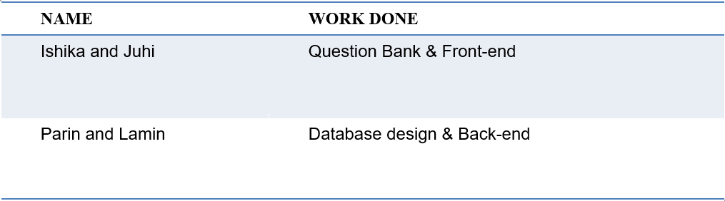
Work Division

Slide 8
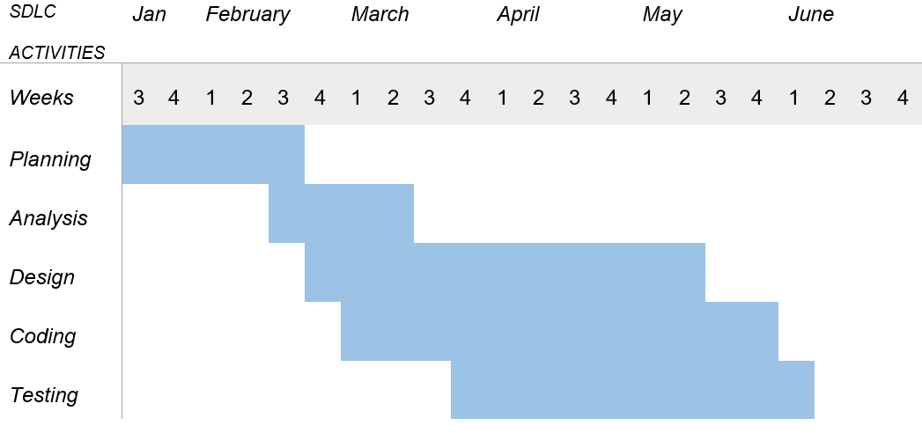
TimeLine Chart

Slide 9
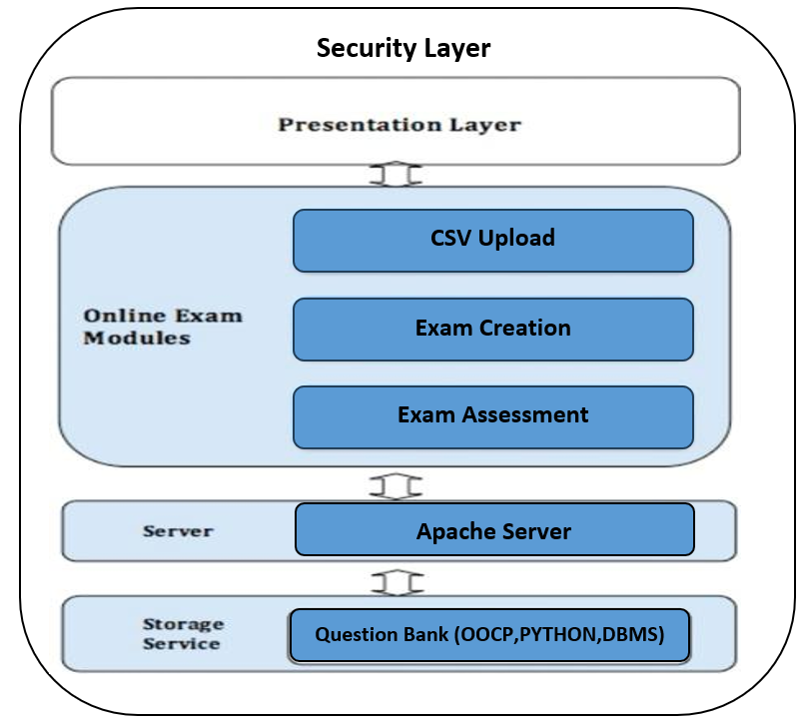
System Architecture

Slide 10
Presentation Layer:
User Interfaces: Separate interfaces for Students, Faculty, and Administrators, developed using HTML, CSS, and JavaScript to ensure a responsive and user-friendly experience.
Client-Side Scripting: PHP enhances the user experience by providing dynamic content updates and form validation.
Application Layer:
CSV Upload: Here faculty can upload questionaries by selecting subjects and topics respectively.
Exam Design: Building exams by randomizing the order of questions from the question bank based on user’s past performance i.e. change of difficulty levels and set limits for each questions which are handled efficiently and at last displaying the result.
Assessment of Student: Here students will be redirect to exam difficulty level based on previous performance.

Slide 11
Data Layer:
Database Management System (DBMS): MySQL is used to store and manage data, including user details, questions, answers, exam results, and session data.
Database Access: PHP scripts interact with the MySQL database to retrieve and update data as required by the application.
Security Layer:
Authentication and Authorization: Secure login mechanisms like approved by admin users can only access the system.
Data Encryption: Sensitive data such as passwords is encrypted to protect against unauthorized access.

Slide 12



Users Of The System
Student Admin Faculty

Slide 13
Requirement of System

Slide 14
For Users:
User authentication for three roles: student, admin, and faculty.
An option for users to create a new account with necessary details.
Each user role can have a unique username and password .
Support password encryption to enhance data security.
"Forgot Password" feature, allowing users to reset their password via security question.
Ensure robust security measures to protect user credentials and sensitive information.
Implement role-based access control to restrict functionalities based on user roles.
Implement error handling mechanisms to handle incorrect login attempts.

Slide 15
For Student :
Request registration to the admin. If approved, then proceed to login.
Username and password authentication.
Profile management features, allowing to update personal information.
Select subject and topic to generate the exam of the course he/she enrolled to.
Exam will be based on difficulty level.
Difficulty level management:
Easy | >0 or <8
Medium | >=8 or <12
Hard | >=12

Slide 16
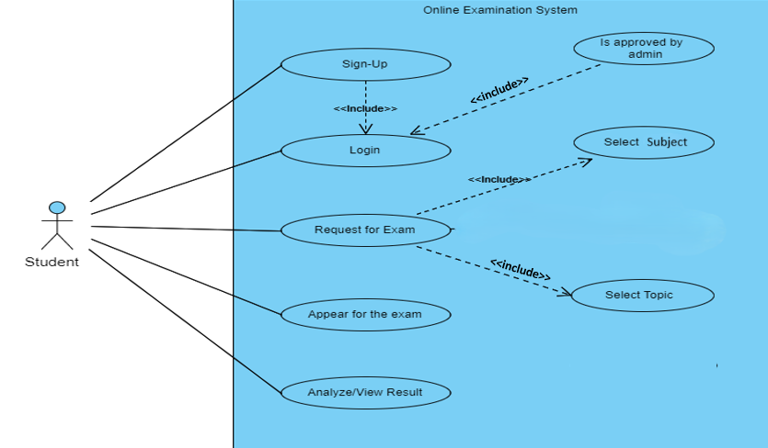
Based on user’s past score we set the difficulty level for that particular topic and we redirect him/her to an appropriate difficulty level exam.
Provide results by analyse student answers.

Slide 17
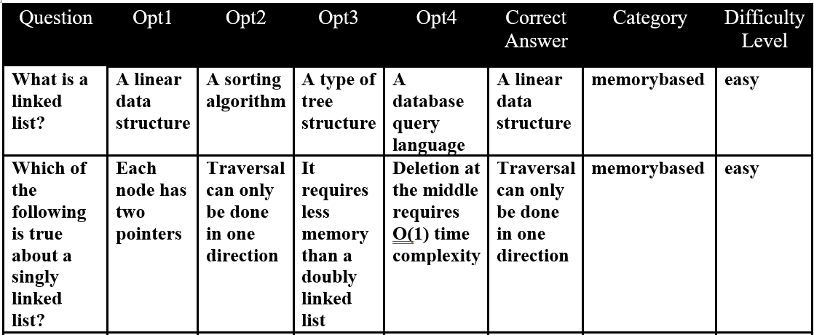
For Faculty :
Request for registration.
Login based on username and password.
Upload CSV files for each topic followed by it’s subject and course.
CSV files contain questions and answers based on it’s category and difficulty levels.
Can see students’ progression report/result.
Example of CSV Structure.

Slide 18
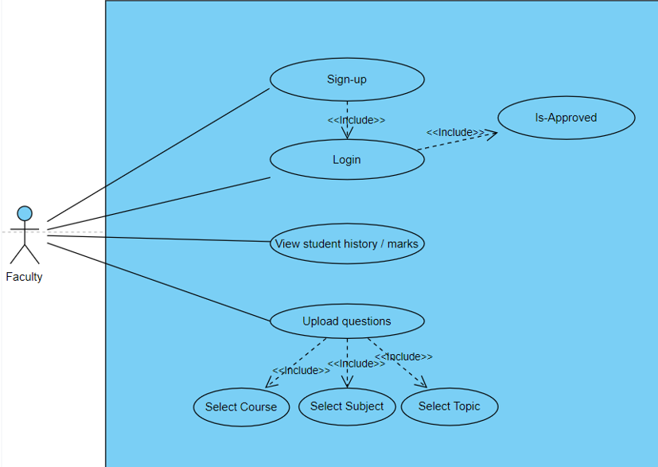
Use case for Faculty

Slide 19
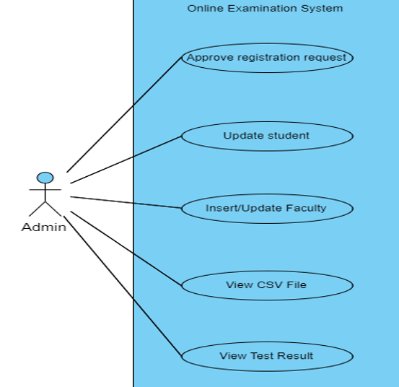
For Admin:
Secure login system with username and password authentication.
User management features for creating, updating, and deleting user accounts.
Ignore/approve logins of student/faculty.
Update student/faculty details.
Access all CSV files uploaded by
faculty.
Also have access to student
progress report/result.

Slide 20
ACTIVITY DIAGRAMS

Slide 21
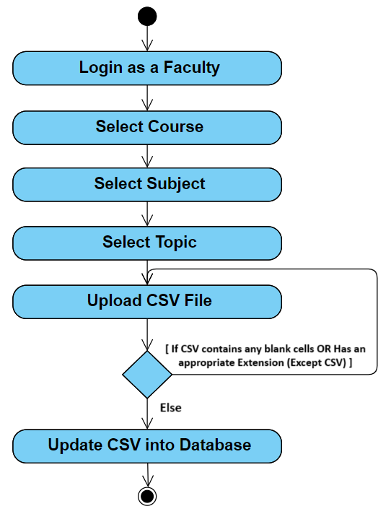
Activity Diagram For CSV Upload

Slide 22
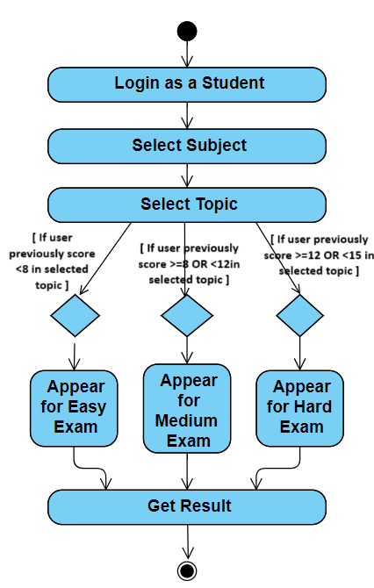
Activity Diagram for Exam Creation

Slide 23
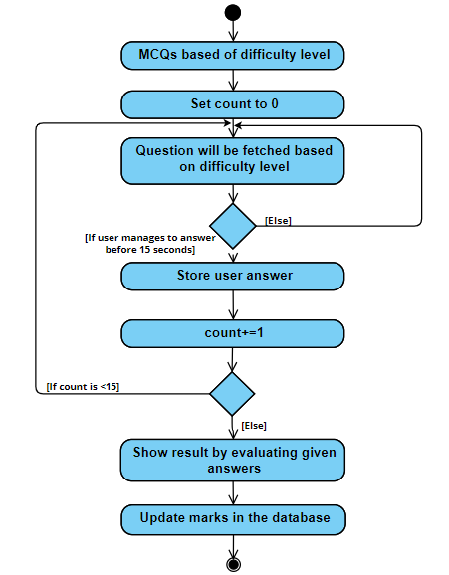
Detailed Diagram For Exam Creation

Slide 24
Database Design

Slide 25
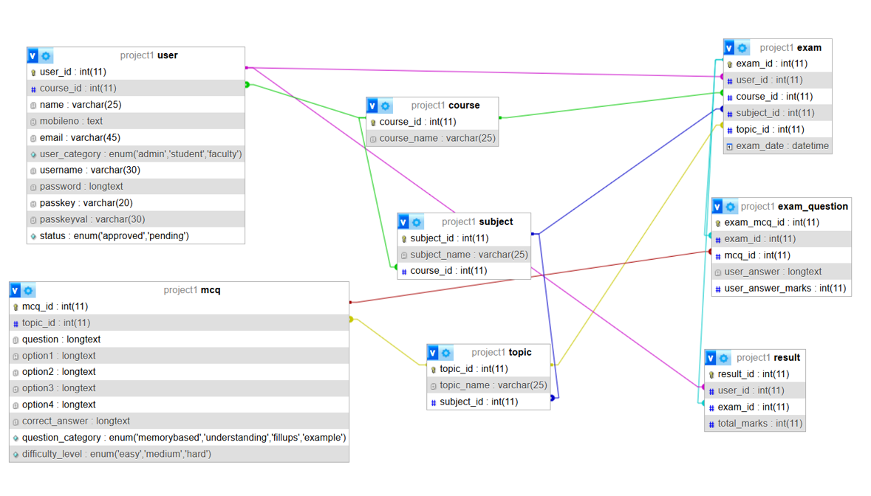

Slide 26
ER DIAGRAM

Slide 27
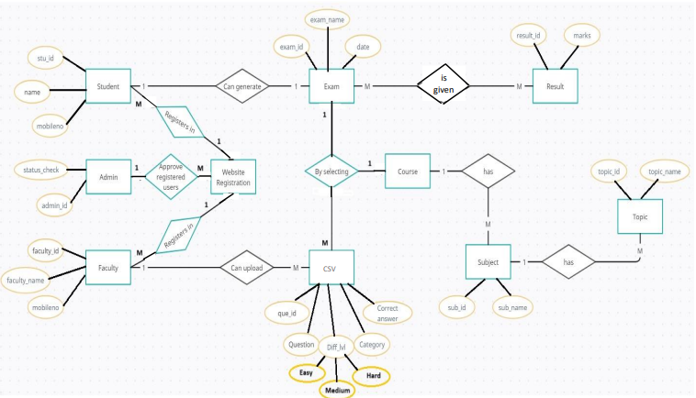
ER Diagram

Slide 28
Data Dictionary

Slide 29
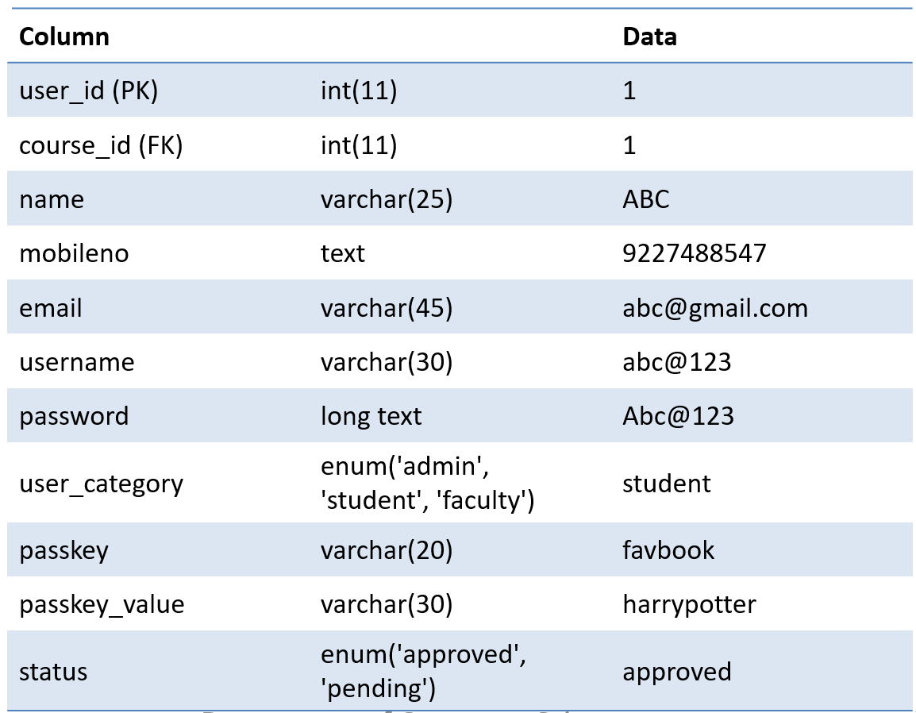
User Table

Slide 30
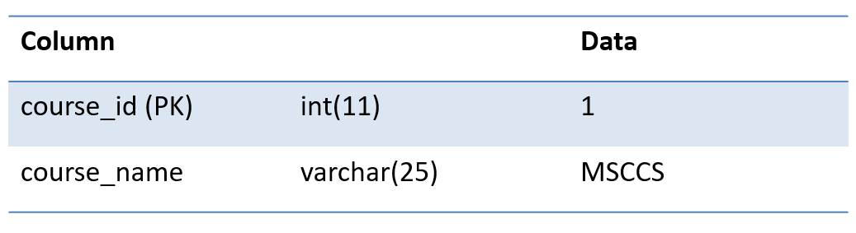
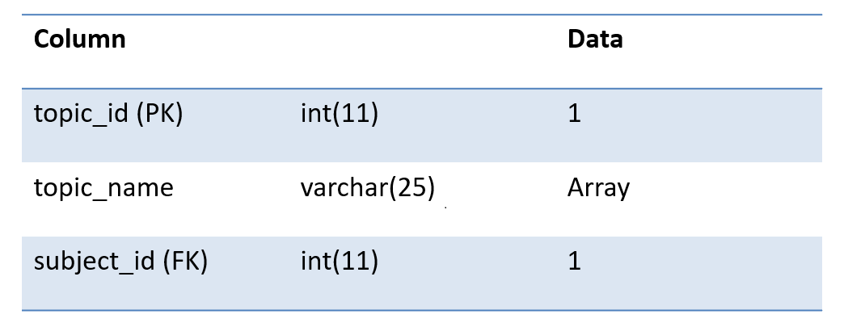
Subject Table
Course Table

Slide 31
Topic Table
Column |  | Data
Topic_id(PK) | int(11) | 1
Topic_name | varchar(25) | Array
Subject_id (FK) | int(11) | 1
31

Slide 32
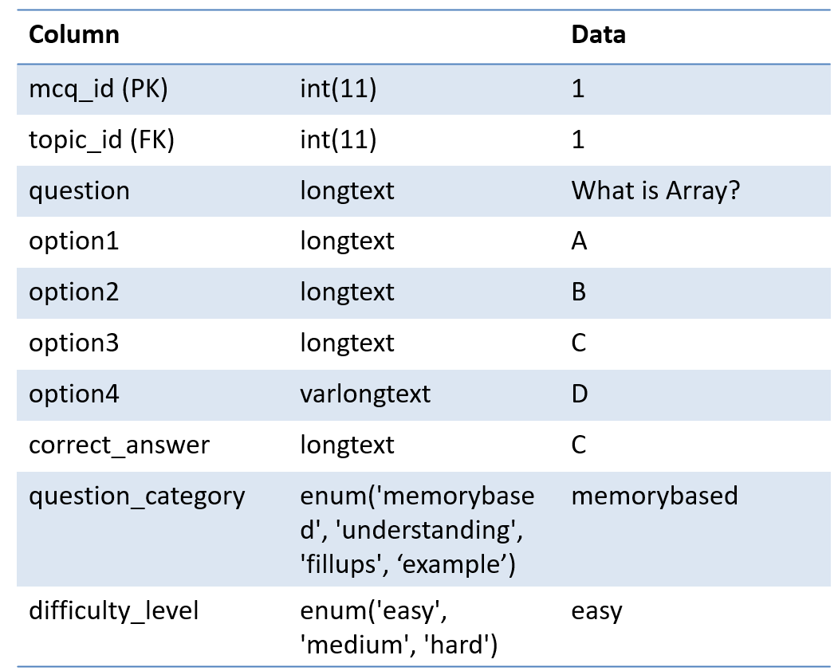
MCQ Table
32

Slide 33
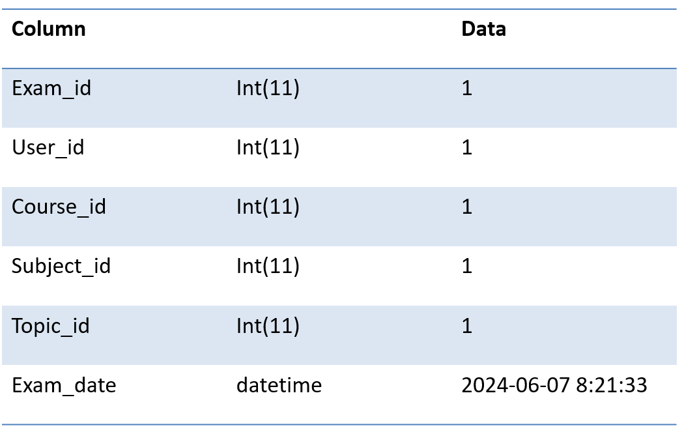
Exam Table

Slide 34
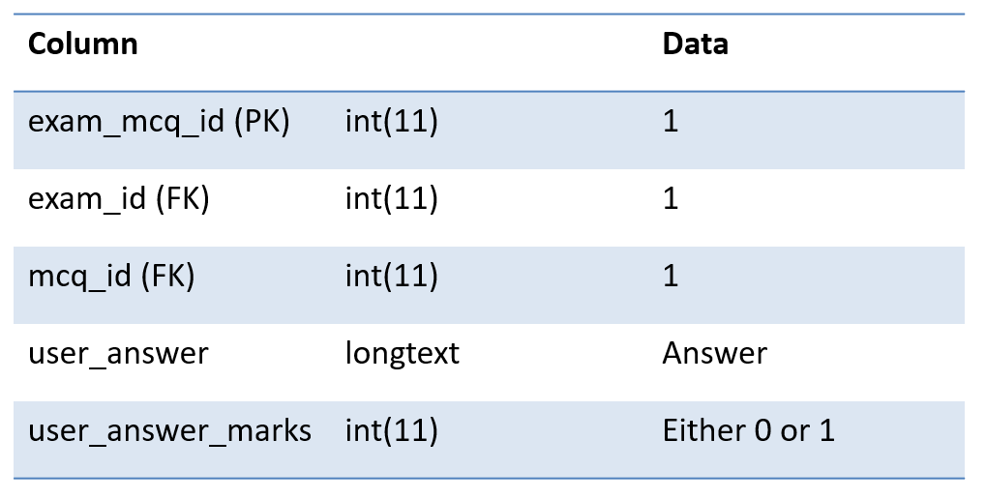
Exam_Question Table
34

Slide 35
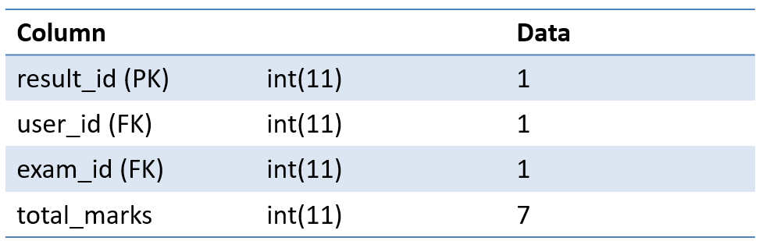
Result Table
35

Slide 36
Screenshots Of Our Website..
36

Slide 37
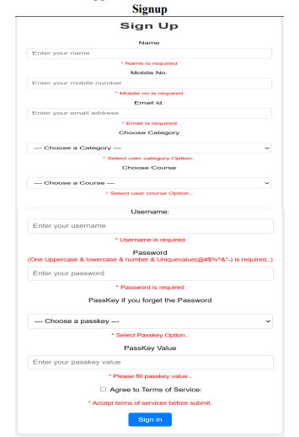
Sign-up page

Slide 38
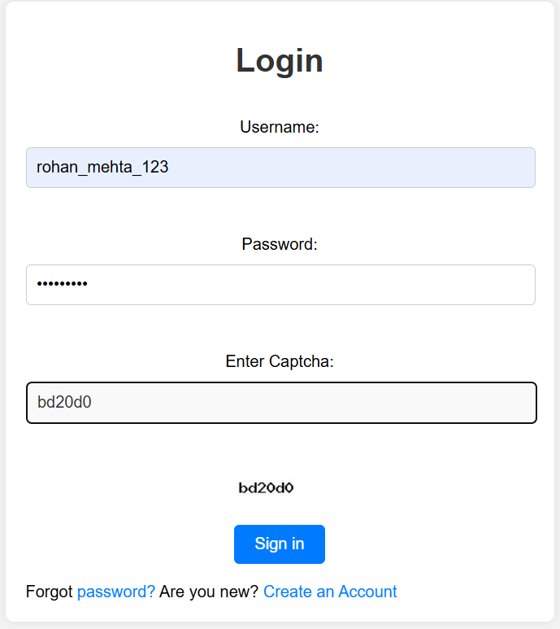
Login Page

Slide 39
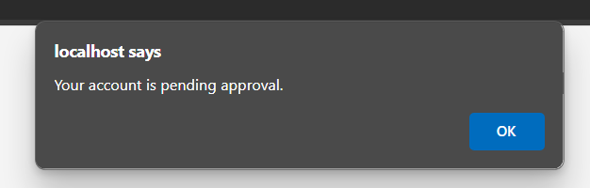
Request Sent To Admin For Account Approval

Slide 40
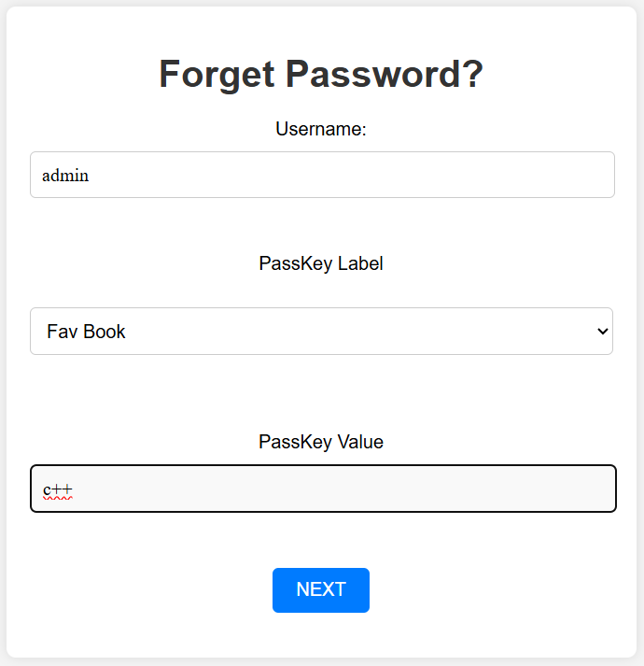
Forgot Password

Slide 41
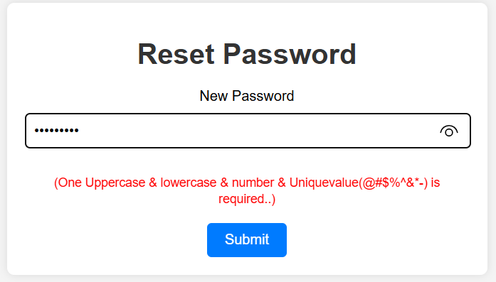
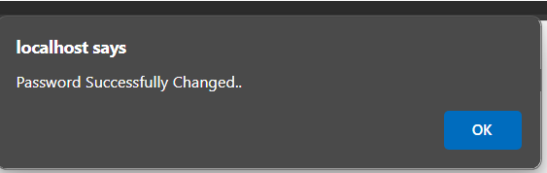
Reset Password

Slide 42
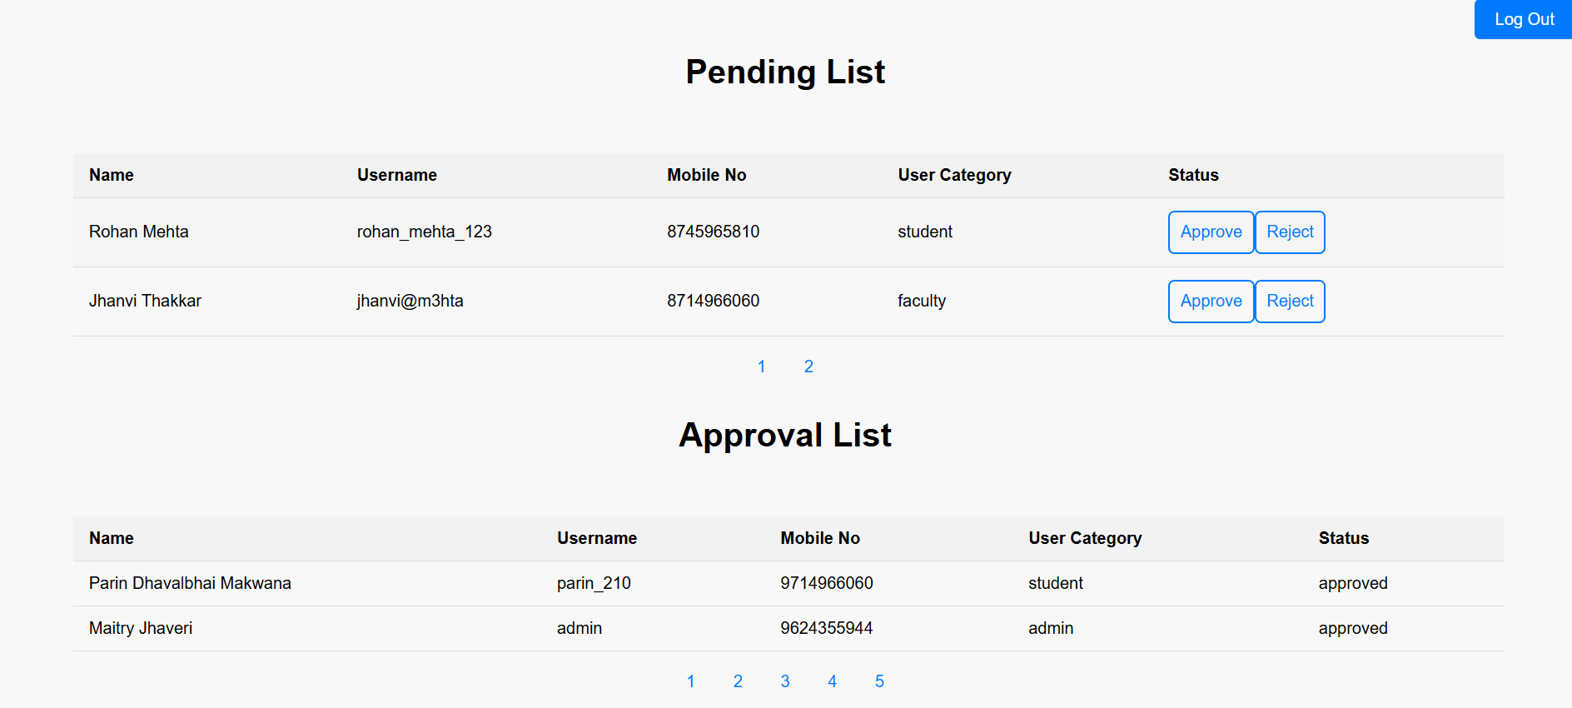
Admin Interface

Slide 43
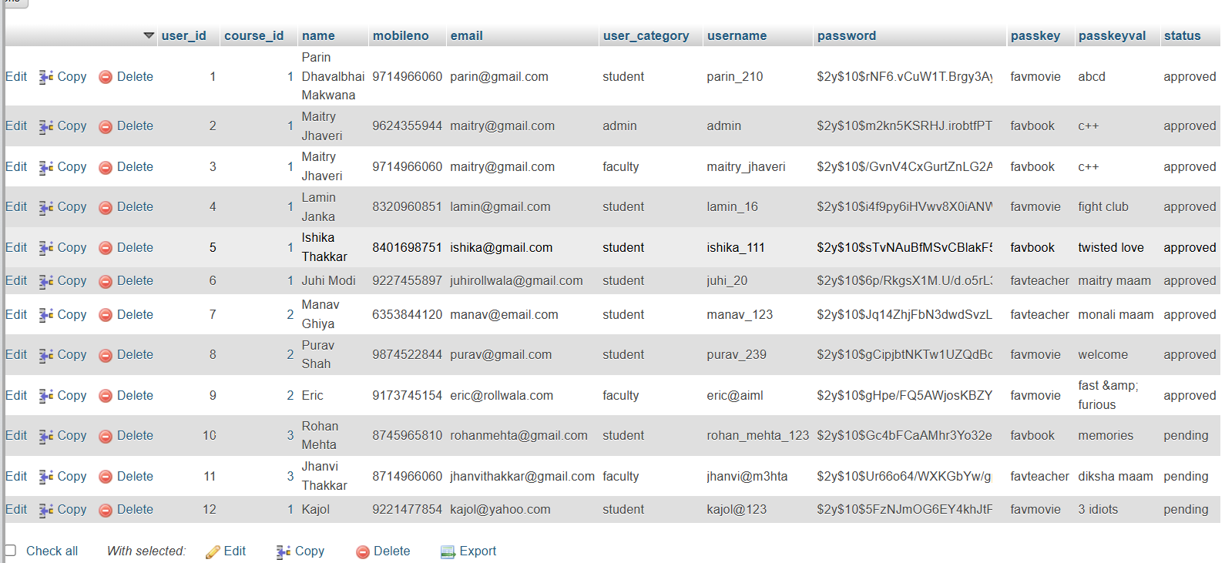

Slide 44
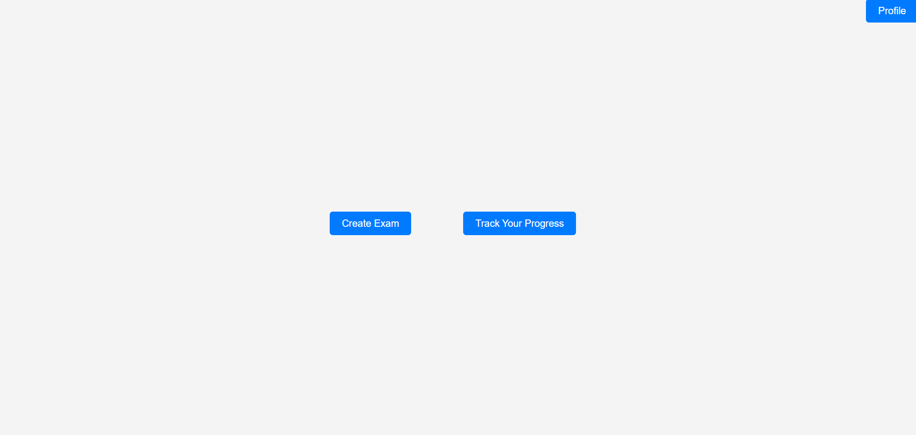
Student Interface

Slide 45
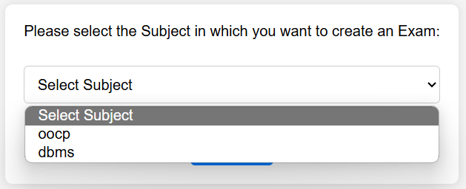
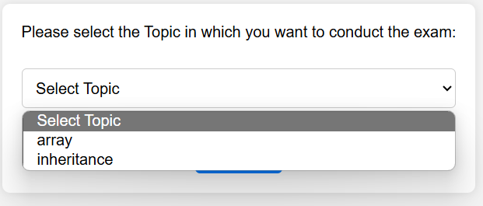
Subject And Topic Selection For Exam

Slide 46
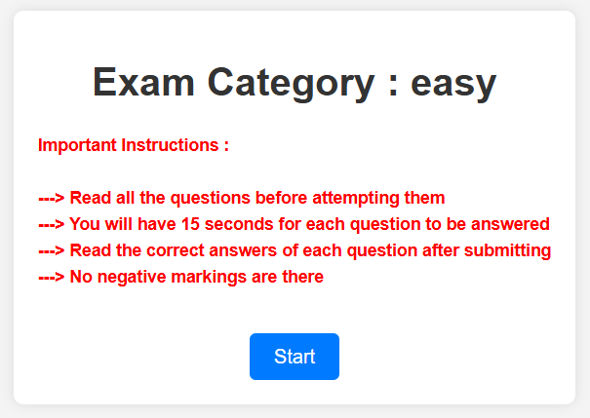
Exam difficulty Level

Slide 47
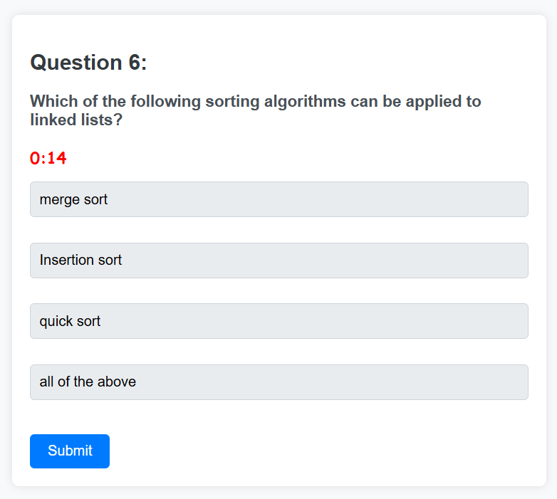
Exam Questions with Timer

Slide 48
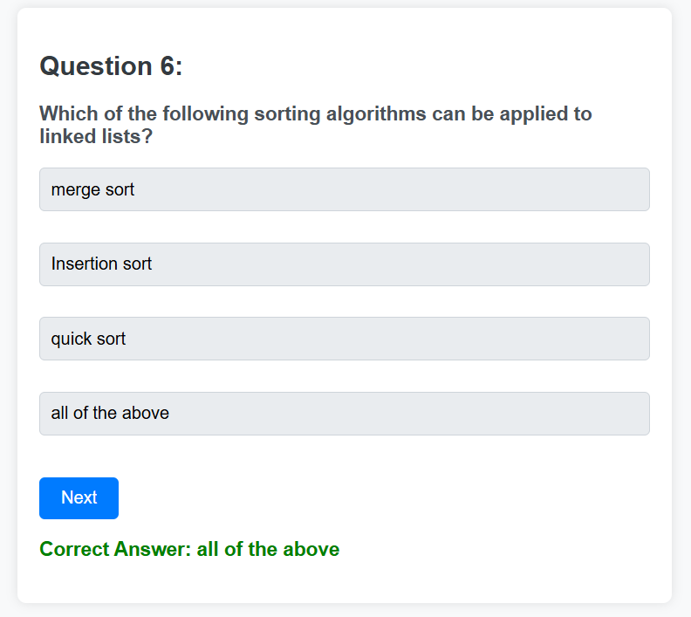
Displaying Correct Answer on Submission

Slide 49
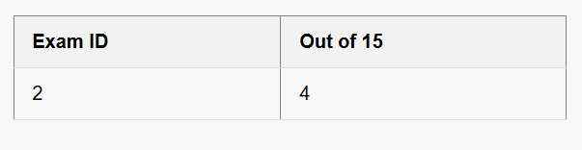
Displaying Score after completion of Exam

Slide 50
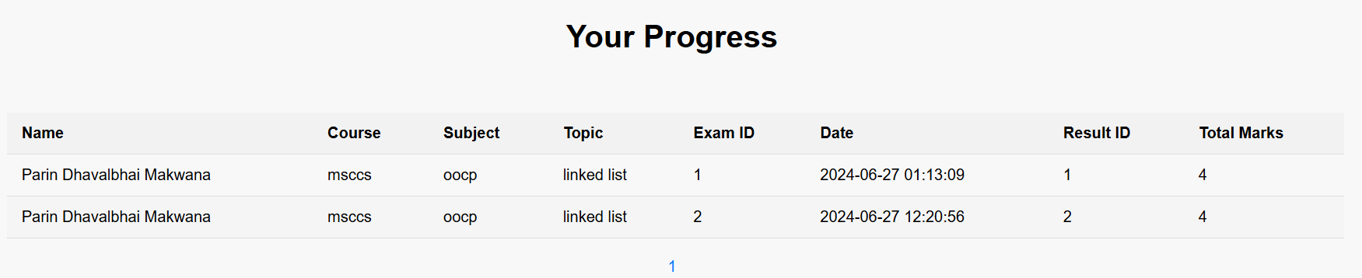
Student Progress

Slide 51

Date and Timestamp of Exam submission

Slide 52
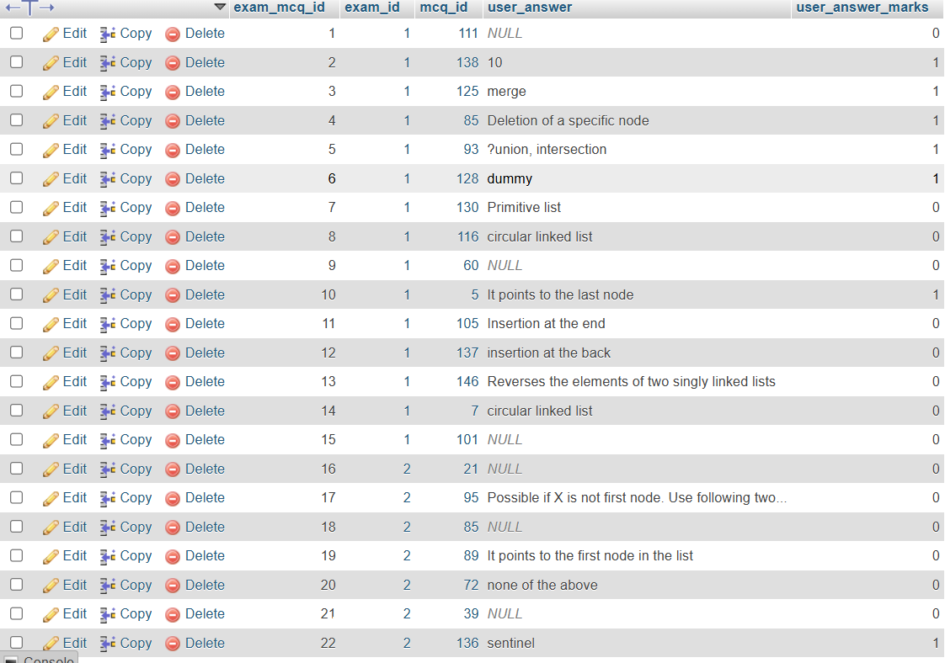
Displaying & Accessing Questions from Database

Slide 53
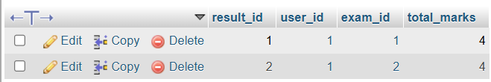
Database log- Student Score

Slide 54

Faculty Interface

Slide 55
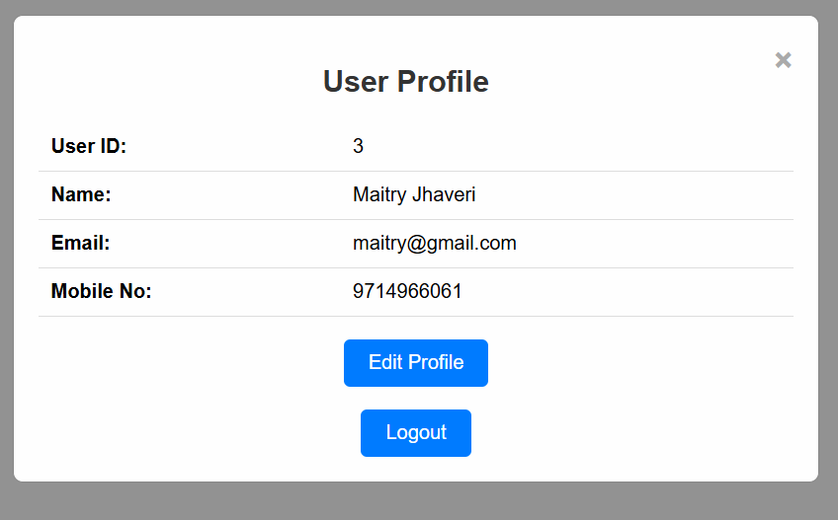
Faculty Profile

Slide 56
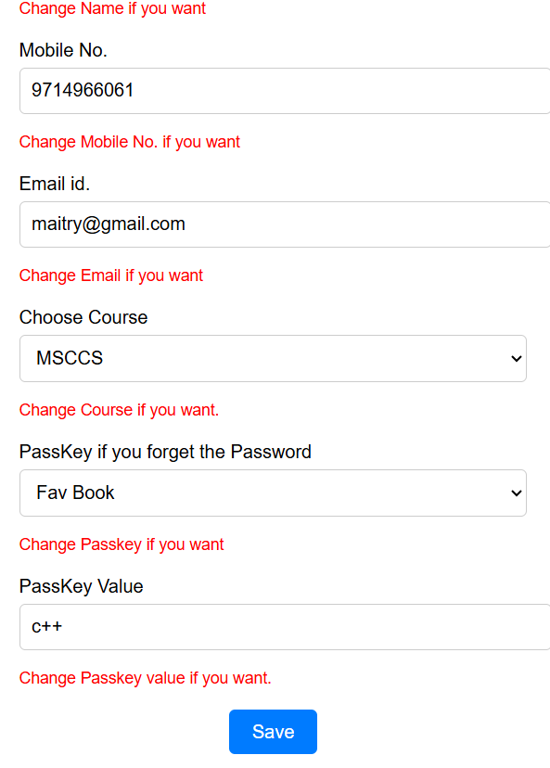
Update Profile

Slide 57
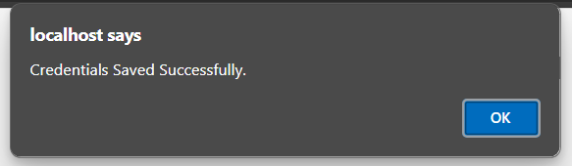
Profile Updated!

Slide 58
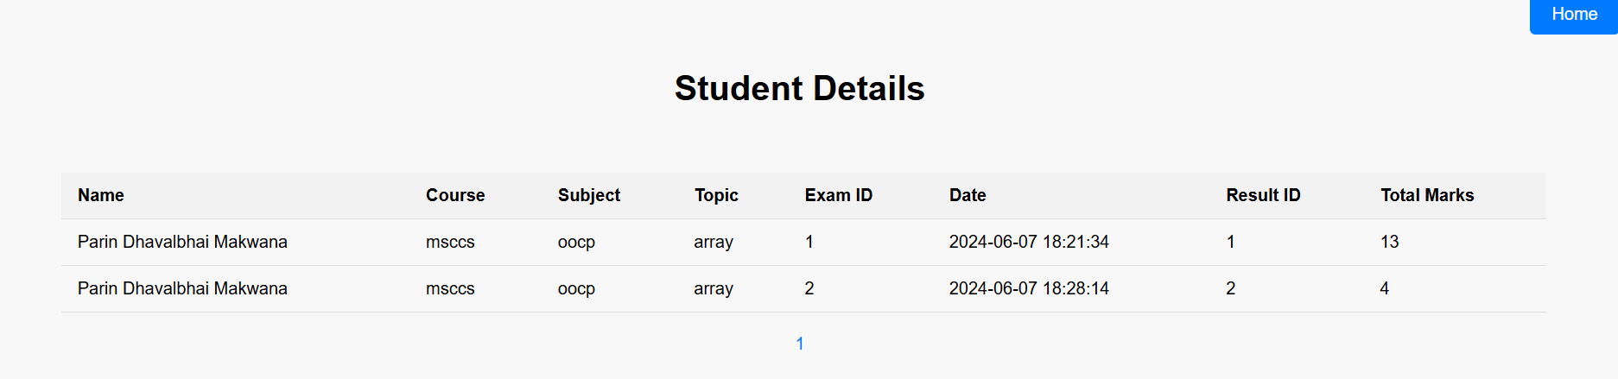

Slide 59
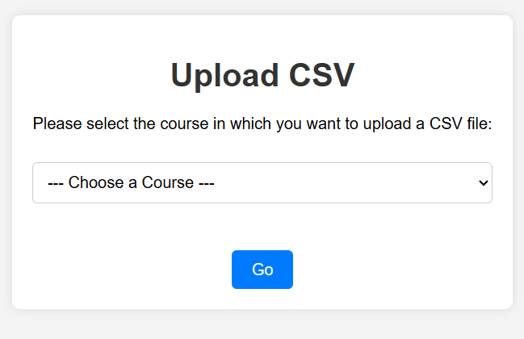
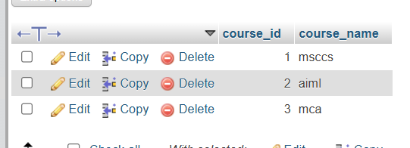
Csv Upload- Interface

Slide 60
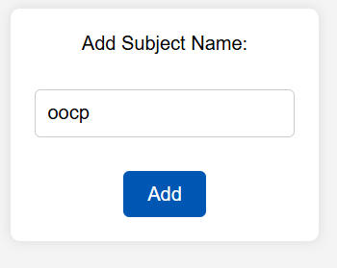
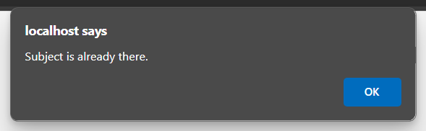
Select Subject and Topic

Slide 61
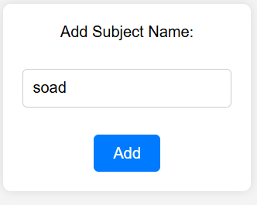
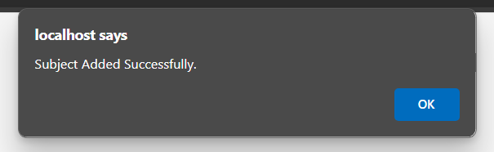

Slide 62
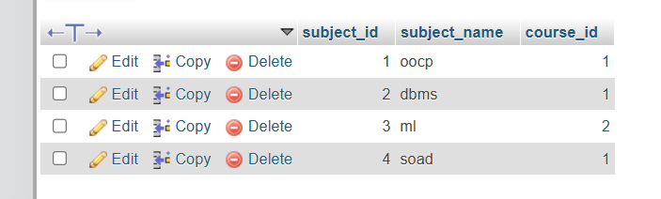

Slide 63
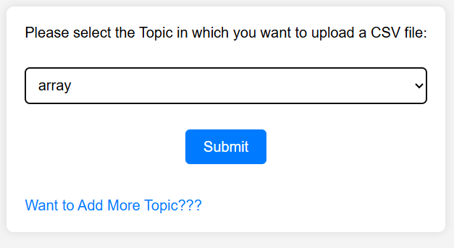
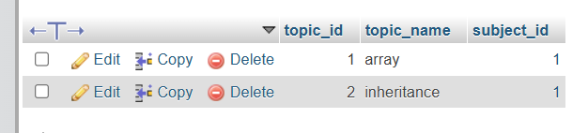
Select Topic

Slide 64

CSV Uploadation Interface

Slide 65


Extension Check

Slide 66


Check if there any blank cell in CSV file

Slide 67


Successful Uploadation

Slide 68

Csv file – stored in database

Slide 69
Future Work
OTP Generation for Two-Way Security : Implement OTP generation for password recovery using SMS or email.
Performance-Based Question Fetching : Implement an adaptive learning system that fetches questions by changing category (memory-based, example, fill-ups, or understanding) every time based on the student's past performance.
Subjective Questions Added The System : Use natural language processing (NLP) and similarity algorithms to evaluate student responses against the model answers. Additionally, implement a scoring system that can give partial marks for nearly correct answers.
AI-Driven Question Generation from Books uploaded : First, digitize the book and develop an AI model that can read the digitized content and generate questions based on the text, so that faculty do not have to make CSVs on their own each time.

Slide 70
Bibliography
Reference Websites :-
Arham Education
https://arhameducation.com/
Visual Paradigm
https://online.visual-paradigm.com/
Vedantu
https://www.vedantu.com/
Physics Wallah
https://www.pw.live/

Slide 71
Video Of The System

Slide 72
Website Link
www.onlinexamination.com

Slide 73
THANK YOU !!

