Slide 1

Computer Graphics
Week 2 : practice
Html and CSS
2024.09.09

Slide 2
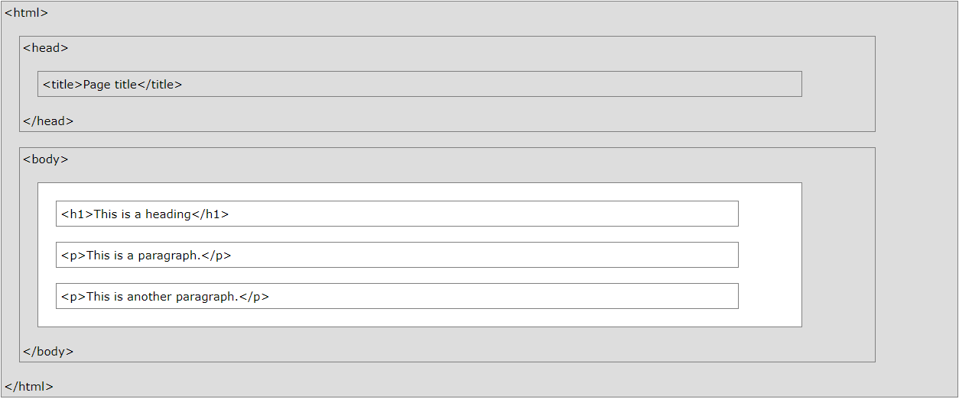
HTML page Structure
<!DOCTYPE html> <html>
<head>
<meta charset="utf-8"> <title>Page Title</title> </head>
<body>
<h1>This is a Heading</h1> <p>This is a paragraph.</p>
</body>
</html>

Slide 3
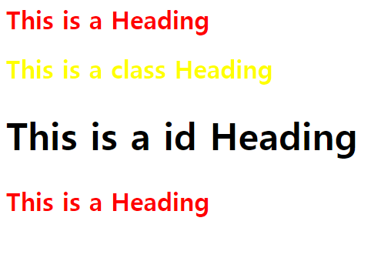
CSS Structure
h1{
color : red;
}
.cls {
color : yellow;
}
#head {
font-size : 300%;
}
…
<body> <h1>This is a Heading</h1>
<h1 class=“cls”>This is a class Heading</h1>
<h1 id=“head”>This is a id Heading</h1>
<h1>This is a Heading</h1>
</body>
…

Slide 4
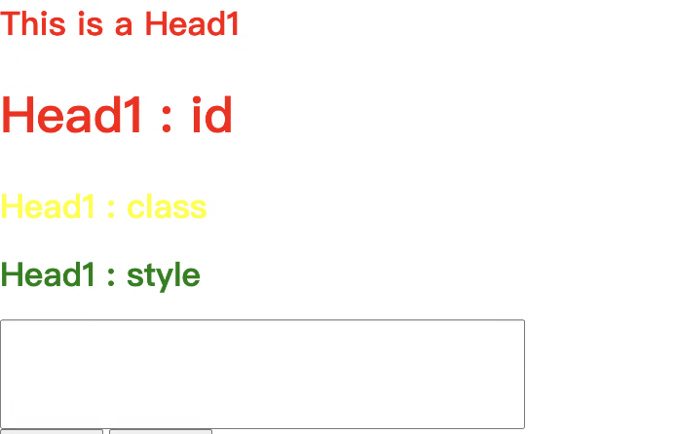
Tag Structure
…
<body> <h1>This is a Head1</h1>
<h1 id=“head1”>Head1 : id</h1>
<h1 class=“Class1”>Head1 : class</h1>
<h1 style=“color: red”>Head1 : style</h1>
<input type=“text” style=“width: 500px; height:100px; font-size:90px;”> </body>
…

Slide 5
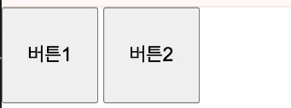
Div (영역 구분)
…
<body> <div> /
<button style=“width:100px; height:100px; font-size:20px;”>버튼</button>
<button style=“width:100px; height:100px; font-size:20px;”>버튼</button>
</div>
<div style=“display:flex;”></div> </body>
…

Slide 6
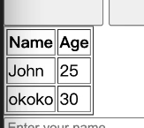
table
…
<body>
<table>
<tr>
<th>name</th>
<th>.....</th>
</tr>
<tr>
<td></td>
</tr>
</table> </body>

Slide 7
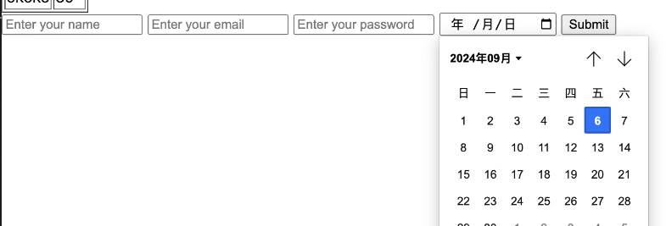
form (한번에 그룹 데이터 전송)
…
<body>
<form>
<input type=“text” placeholder="Enter your name">
<input type=“email”>
<input type=“password”>
<input type=“date”>
<button type=“submit”></button>
</form> </body>

Slide 8


form (한번에 그룹 데이터 전송)
…
<body>
<select>
<option value=“1” selected></option>
<option value=“2”></option>
</select> </body>

Slide 9
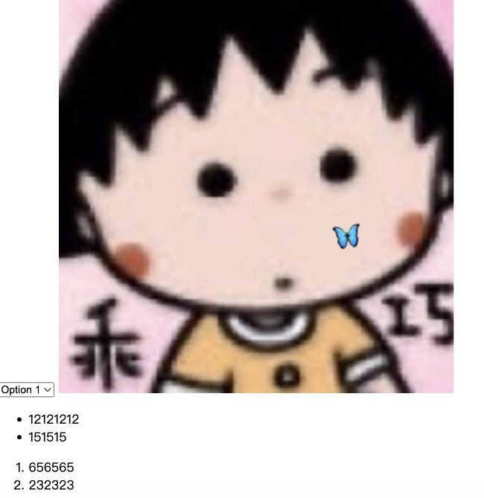
기타..
…
<body> <img src=“가져올 이미지 링크;” alt=“src가 실패 했을때 가져올 이미지 링크“width="500" ,height="auto";/>
<ul>
<li></li>
<li></li>
</ul>
<ol>
<li></li>
<li></li>
</ol>
</body>

Slide 10
JavaScript - jQuery
jQuery는 빠르고 작으며 기능이 풍부한 JavaScript 라이브러리.
다양한 브라우저에서 작동하는 사용하기 쉬운 API를 통해 HTML 문서 탐색 및 조작, 이벤트 처리, 애니메이션, Ajax 등을 훨씬 간단하게 만듬.
다용성과 확장성을 결합한 jQuery는 수백만 명의 사람들이 JavaScript를 작성하는 방식으로 변화.

Slide 11


JavaScript Tutorial
……
<body>
<p id=“demo”> JavaScript can change HTML content. </p>
<button type=“button” onclick=‘document.getElementById(“demo”).innerHTML = “Hello JavaScript!”’ > click me! </button>
</body>
……

Slide 12


JavaScript Tutorial
……
<body>
<p id=“demo”> JavaScript can change HTML content. </p>
<button type=“button” onclick=‘document.getElementById(“demo”).innerHTML = text’ > click me! </button>
<script>
let text = “Hello JS”
</script> </body>
……

Slide 13


JavaScript Tutorial
……
<body>
<p id=“demo”> JavaScript can change HTML content. </p>
<button type=“button” onclick=‘document.getElementById(“demo”).innerHTML = make2pow(num)’ > click me! </button>
<script>
function make2pow(num){
return Math.pow(num,2)
}
</script> </body>
……

Slide 14

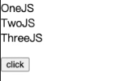
JavaScript Tutorial
……
<body>
<p id=“demo”> JavaScript can change HTML content. </p>
hdocument.getElementById("demo").innerHTML = makelist();
<script>
function makelist(){
const lists = ["OneJS", "TwoJS", "ThreeJS"];
let text="";
for (let i = 0; i < lists.length; i++) {
text += lists[i] + "<br>";
}
return text
}
</script> </body>
……

Slide 15
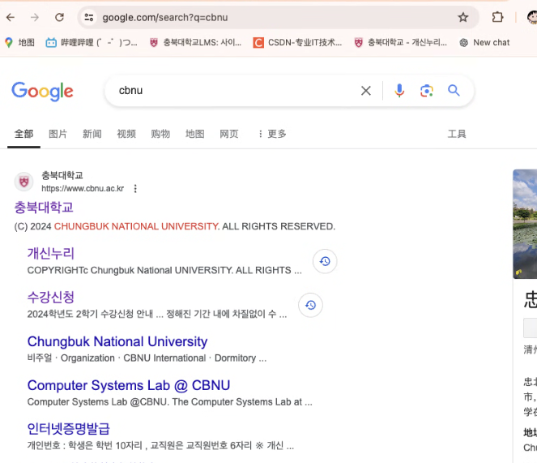

JavaScript Tutorial
……
<body>
<form action=“https://www.google.com/search” method=“GET” …>
<input name=“q” type=“text” …>
</form>
</body>
……

Slide 16
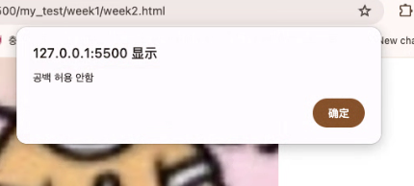

JavaScript Tutorial
……
<body>
<form name=“myform” action=“https://www.google.com/search” onsubmit=“return alertForm()” method=“GET” …>
<input name=“q” type=“text” …>
</form>
<script>
function alertForm() {
let x = document.forms[" myform "][" q "].value;
if (x == "") {
alert(＂공백허용안함");
return false;
}
}
<script>
</body>
……

Slide 17
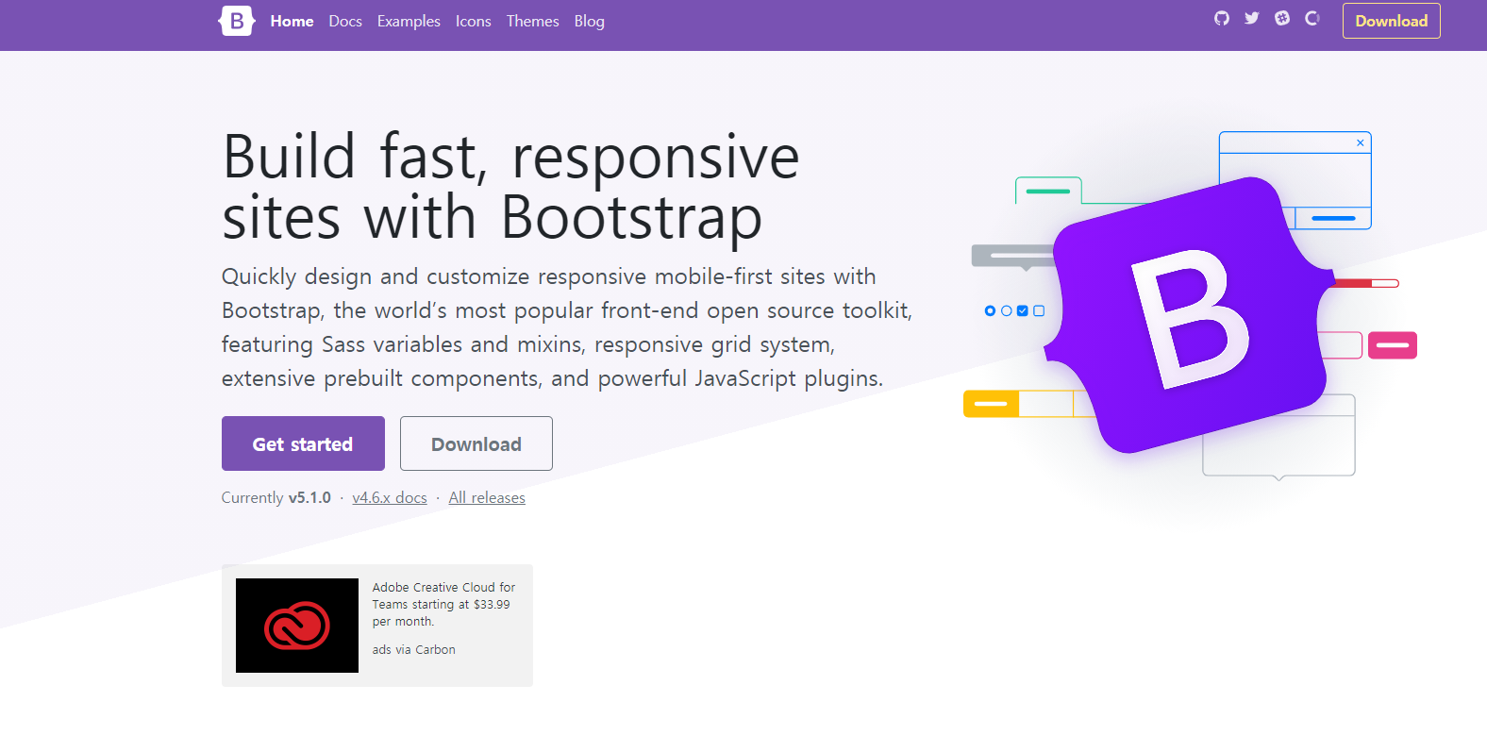
Bootstrap 적용하기

Slide 18
bootstrap Tutorial
https://getbootstrap.com/docs/5.3/getting-started/introduction/
……
<html>
<head>
<body> </body>
……

