Slide 1
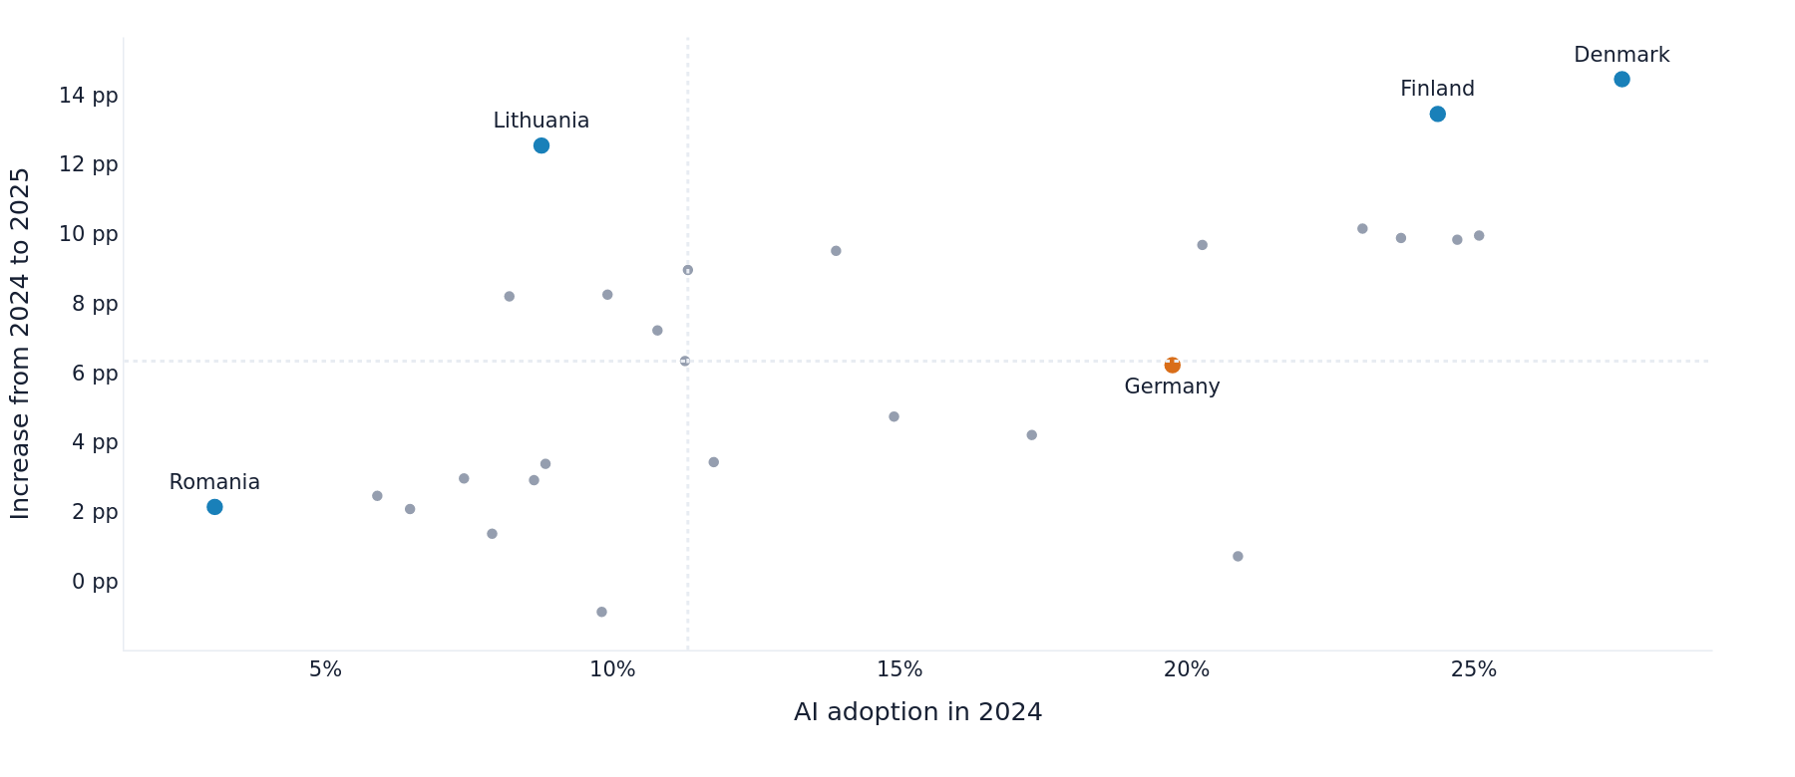
DATA VISUALIZATION - SUMMER 2026
Europe's AI Adoption Gap
Who is pulling ahead, where smaller firms fall behind, and what stops businesses from adopting AI? Usaid Aamer
1
Notes:
Open with the central tension: adoption is accelerating, but the gains are not converging.
[Sources]
- https://ec.europa.eu/eurostat/databrowser/view/isoc_eb_ai/default/table?lang=en
- https://ec.europa.eu/eurostat/databrowser/view/isoc_eb_ain2/default/table?lang=en
- https://ec.europa.eu/eurostat/statistics-explained/index.php?title=Use_of_artificial_intelligence_in_enterprises
[/Sources]

Slide 2
The analysis follows one question through four layers
Can rapid AI adoption close Europe's business capability gap?
01
Pace
How fast is adoption growing?
02
Divide
Official Eurostat survey data
27 EU countries
2023-2025
43,881 curated observations
Who is being left behind?
03
Depth
Are firms using one tool or a stack?
04
Blockers
What prevents interested firms from adopting?
Eurostat tables: isoc_eb_ai and isoc_eb_ain2
2
Notes:
Explain that every chart is tied to a multi-dimensional analytical question rather than preliminary description.
[Sources]
- https://ec.europa.eu/eurostat/databrowser/view/isoc_eb_ai/default/table?lang=en
- https://ec.europa.eu/eurostat/databrowser/view/isoc_eb_ain2/default/table?lang=en
- https://ec.europa.eu/eurostat/statistics-explained/index.php?title=Use_of_artificial_intelligence_in_enterprises
[/Sources]

Slide 3
The story in three numbers
The central pattern
EU enterprise AI adoption hit 20% in 2025. But national, firm-size, and capability gaps remain wide.
20.0%
38 pp
70.3%
EU firms using AI in 2025
Large-small adoption gap
Interested non-users citing skills
3
Notes:
Use the three metrics to preview the full argument before showing the evidence.
[Sources]
- https://ec.europa.eu/eurostat/databrowser/view/isoc_eb_ai/default/table?lang=en
- https://ec.europa.eu/eurostat/databrowser/view/isoc_eb_ain2/default/table?lang=en
- https://ec.europa.eu/eurostat/statistics-explained/index.php?title=Use_of_artificial_intelligence_in_enterprises
[/Sources]

Slide 4
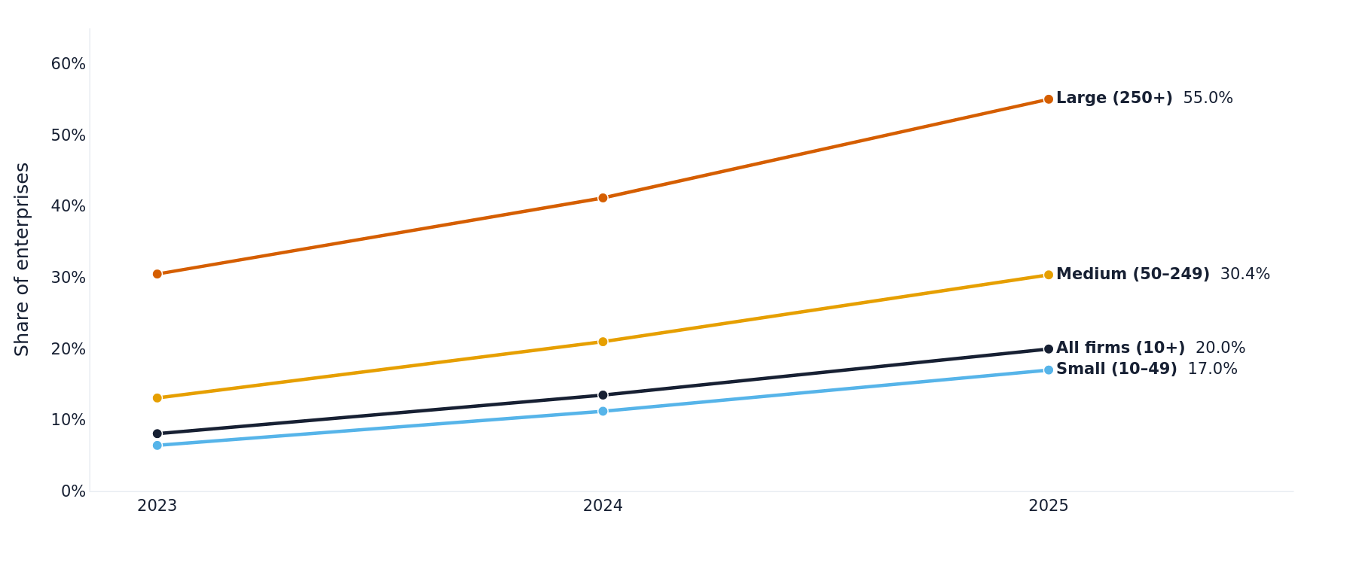
AI adoption surged, but large firms still lead by 38 points
What the chart means
55.0%
Large firms using AI
17.0%
Small firms using AI
Growth is broad, but it is not equal.
Eurostat - enterprise ICT survey, 2023-2025
4
Notes:
[Sources]
- https://ec.europa.eu/eurostat/databrowser/view/isoc_eb_ai/default/table?lang=en
- https://ec.europa.eu/eurostat/databrowser/view/isoc_eb_ain2/default/table?lang=en
- https://ec.europa.eu/eurostat/statistics-explained/index.php?title=Use_of_artificial_intelligence_in_enterprises
[/Sources]

Slide 5
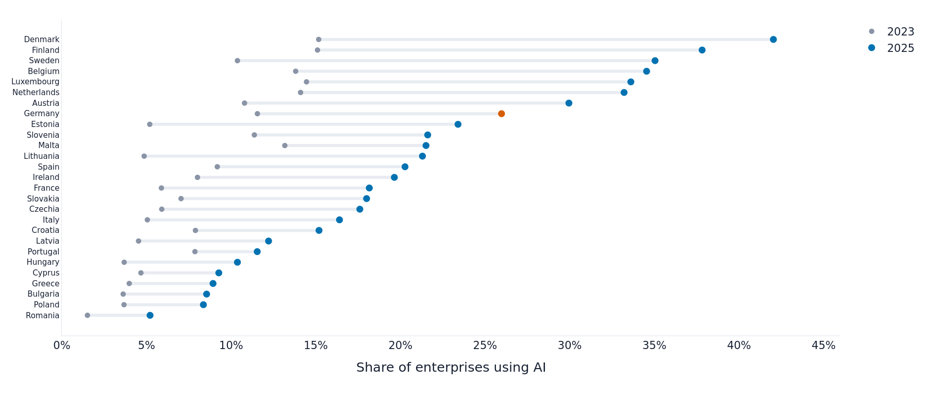
Rapid growth has not closed the 37-point country divide
What the chart means
42.0%
Denmark, 2025
5.2%
Romania, 2025
Several leaders accelerated faster than the laggards.
Eurostat - enterprise ICT survey, 2023-2025
5
Notes:
[Sources]
- https://ec.europa.eu/eurostat/databrowser/view/isoc_eb_ai/default/table?lang=en
- https://ec.europa.eu/eurostat/databrowser/view/isoc_eb_ain2/default/table?lang=en
- https://ec.europa.eu/eurostat/statistics-explained/index.php?title=Use_of_artificial_intelligence_in_enterprises
[/Sources]

Slide 6
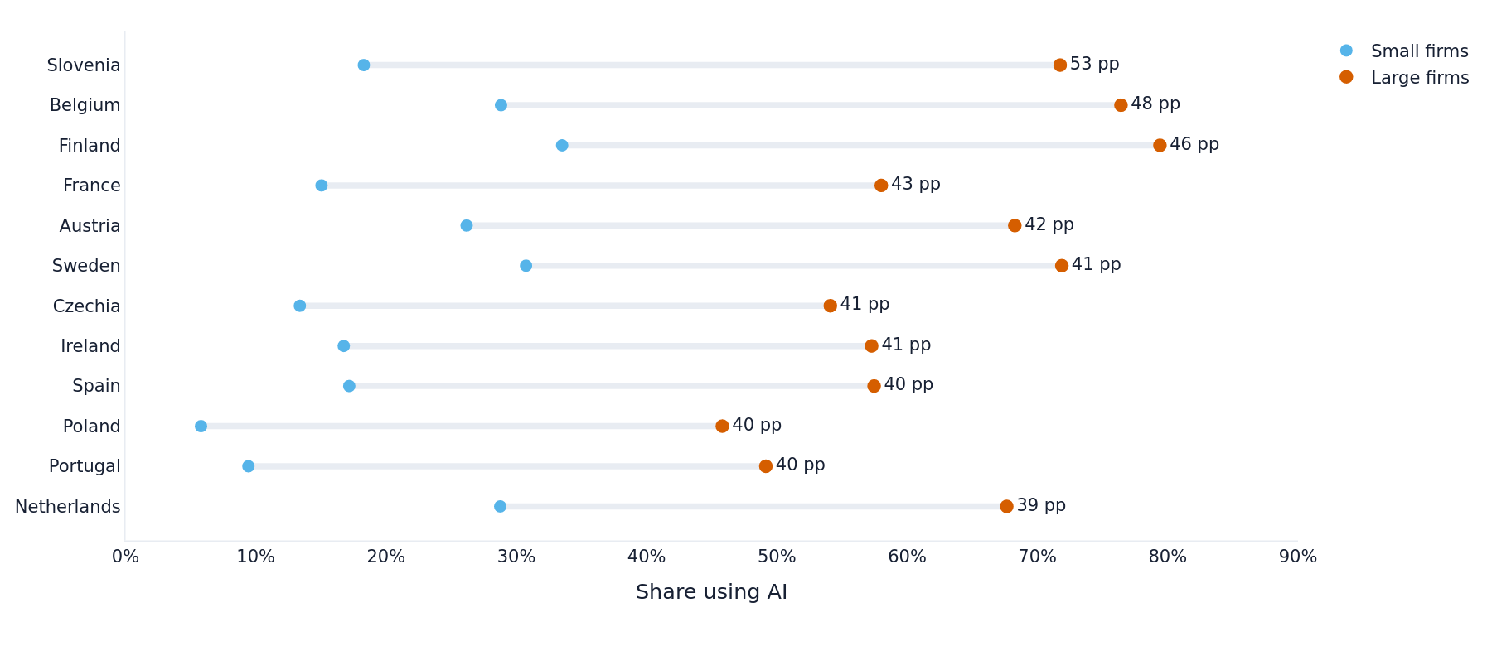
Firm size is Europe's most consistent AI fault line
What the chart means
53.5 pp
Slovenia's large-small gap
47.6 pp
Belgium's large-small gap
High national adoption does not guarantee equal access.
Eurostat - enterprise ICT survey, 2023-2025
6
Notes:
[Sources]
- https://ec.europa.eu/eurostat/databrowser/view/isoc_eb_ai/default/table?lang=en
- https://ec.europa.eu/eurostat/databrowser/view/isoc_eb_ain2/default/table?lang=en
- https://ec.europa.eu/eurostat/statistics-explained/index.php?title=Use_of_artificial_intelligence_in_enterprises
[/Sources]

Slide 7
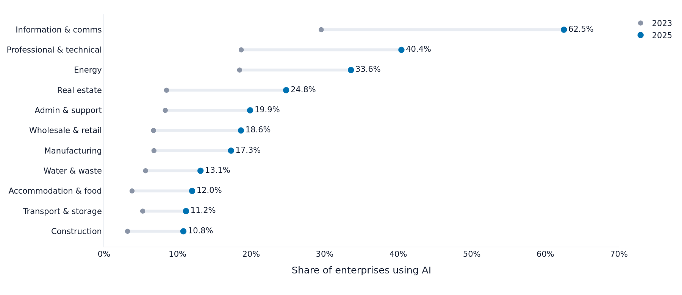
Information and communication reached 63%; construction stays near 11%
What the chart means
62.5%
Information and communication
10.8%
Construction
Sector relevance and digital maturity shape the ceiling.
Eurostat - enterprise ICT survey, 2023-2025
7
Notes:
[Sources]
- https://ec.europa.eu/eurostat/databrowser/view/isoc_eb_ai/default/table?lang=en
- https://ec.europa.eu/eurostat/databrowser/view/isoc_eb_ain2/default/table?lang=en
- https://ec.europa.eu/eurostat/statistics-explained/index.php?title=Use_of_artificial_intelligence_in_enterprises
[/Sources]

Slide 8
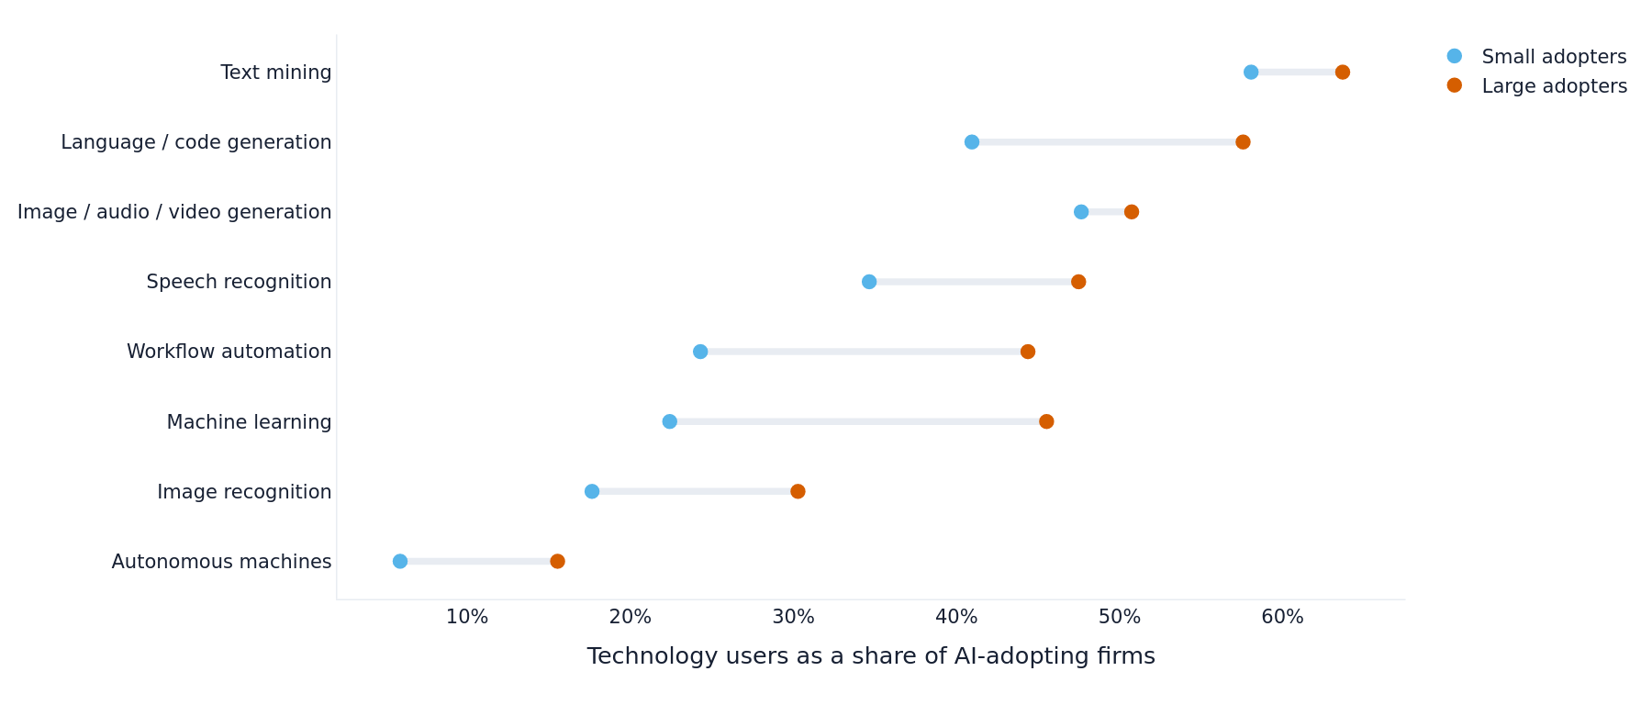
Large adopters build a broader AI technology stack
What the chart means
45.5%
Large adopters using machine learning
22.4%
Small adopters using machine learning
The gap is about capability depth, not just initial adoption.
Eurostat - enterprise ICT survey, 2023-2025
8
Notes:
[Sources]
- https://ec.europa.eu/eurostat/databrowser/view/isoc_eb_ai/default/table?lang=en
- https://ec.europa.eu/eurostat/databrowser/view/isoc_eb_ain2/default/table?lang=en
- https://ec.europa.eu/eurostat/statistics-explained/index.php?title=Use_of_artificial_intelligence_in_enterprises
[/Sources]

Slide 9
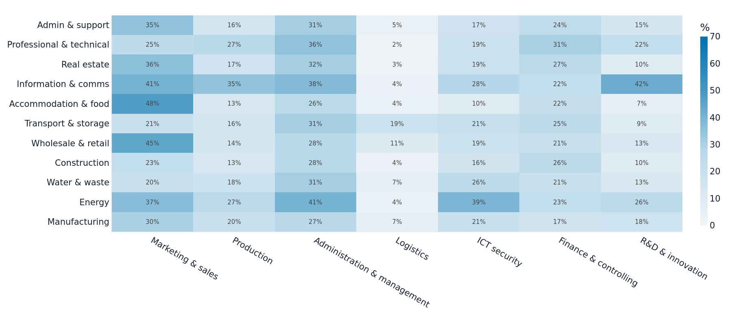
There is no universal AI playbook across sectors
Eurostat - enterprise ICT survey, 2023-2025
9
Notes:
[Sources]
- https://ec.europa.eu/eurostat/databrowser/view/isoc_eb_ai/default/table?lang=en
- https://ec.europa.eu/eurostat/databrowser/view/isoc_eb_ain2/default/table?lang=en
- https://ec.europa.eu/eurostat/statistics-explained/index.php?title=Use_of_artificial_intelligence_in_enterprises
[/Sources]

Slide 10
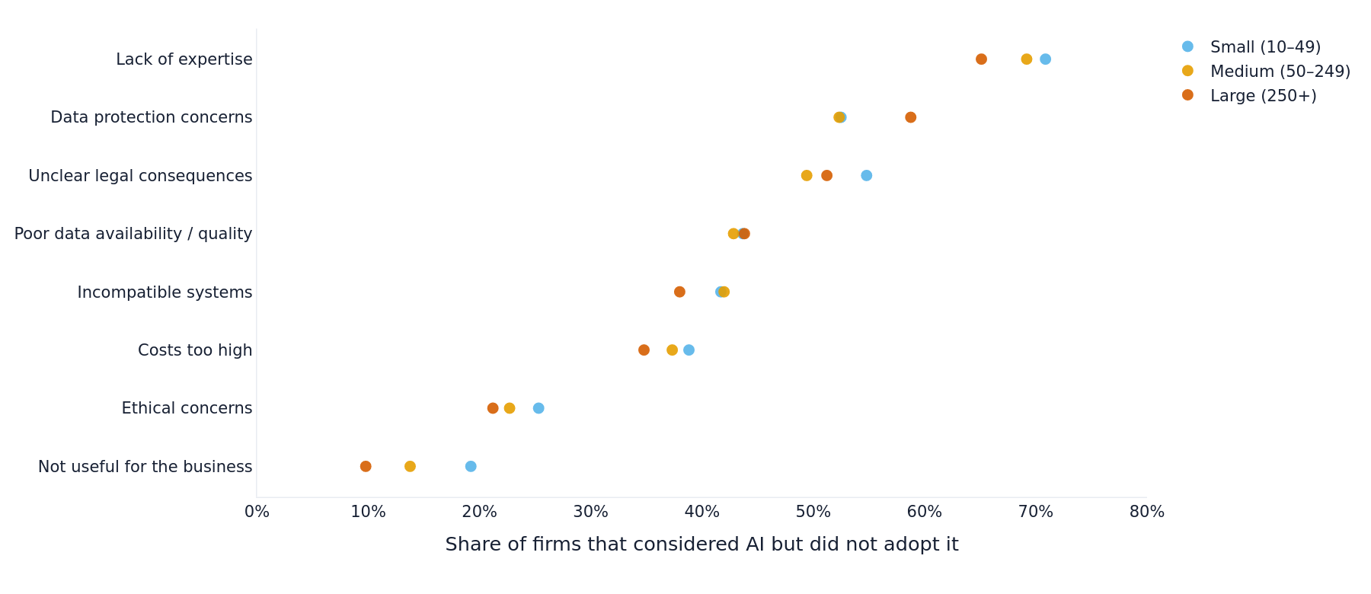
Skills - not cost - are the dominant AI blocker
What the chart means
70.3%
Cite a lack of expertise
#6
Cost's rank among eight barriers
Implementation capability and governance matter more than cheaper tools alone.
Eurostat - enterprise ICT survey, 2023-2025
10
Notes:
[Sources]
- https://ec.europa.eu/eurostat/databrowser/view/isoc_eb_ai/default/table?lang=en
- https://ec.europa.eu/eurostat/databrowser/view/isoc_eb_ain2/default/table?lang=en
- https://ec.europa.eu/eurostat/statistics-explained/index.php?title=Use_of_artificial_intelligence_in_enterprises
[/Sources]

Slide 11
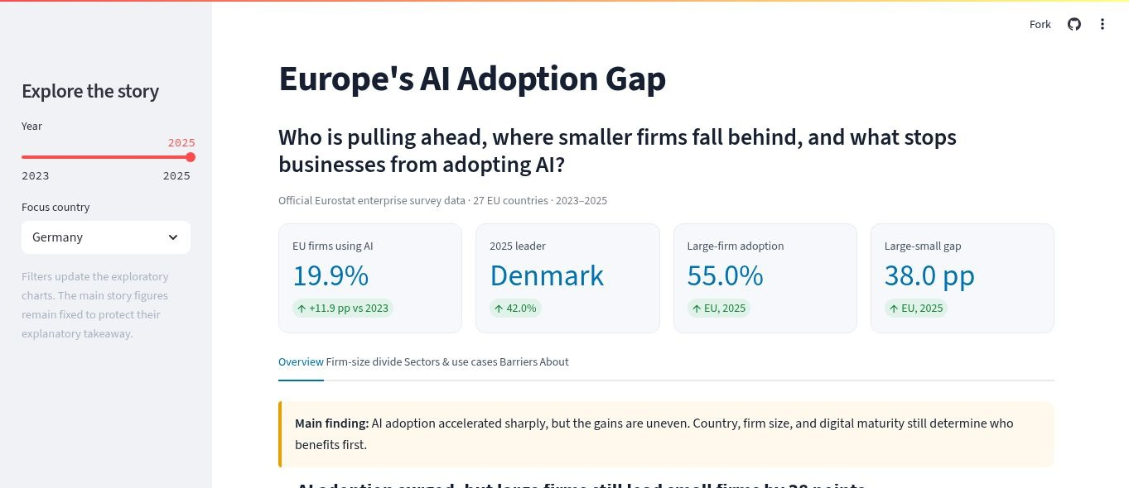
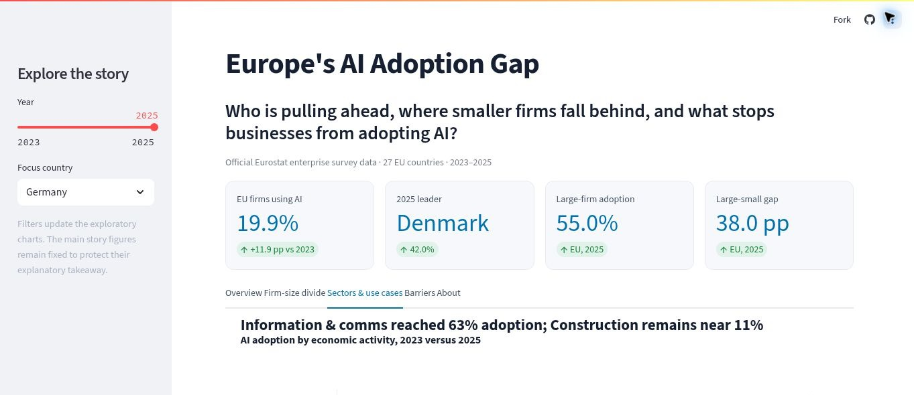
The dashboard turns the story into a guided exploration
Five tabs - year filter - country selector - sector and purpose explorer
GitHub: https://github.com/Heizenberg143/eu-ai-adoption-gap
Live dashboard: https://usaid-eu-ai-adoption-gap.streamlit.app/
Eurostat - enterprise ICT survey, 2023-2025
11
Notes:
The dashboard is deployed publicly and the link shown on this slide was verified on 25 July 2026.
[Sources]
- https://ec.europa.eu/eurostat/databrowser/view/isoc_eb_ai/default/table?lang=en
- https://ec.europa.eu/eurostat/databrowser/view/isoc_eb_ain2/default/table?lang=en
- https://ec.europa.eu/eurostat/statistics-explained/index.php?title=Use_of_artificial_intelligence_in_enterprises
- https://usaid-eu-ai-adoption-gap.streamlit.app/ (dashboard screenshots, captured 25 July 2026)
[/Sources]

Slide 12
CONCLUSION
Acceleration without convergence
Build implementation capability
Reduce governance uncertainty
Strengthen cloud and data foundations
Notes:
Close by resolving the opening tension: faster adoption alone will not close the capability gap.
[Sources]
- https://ec.europa.eu/eurostat/databrowser/view/isoc_eb_ai/default/table?lang=en
- https://ec.europa.eu/eurostat/databrowser/view/isoc_eb_ain2/default/table?lang=en
- https://ec.europa.eu/eurostat/statistics-explained/index.php?title=Use_of_artificial_intelligence_in_enterprises
[/Sources]

