Slide 1
Chapter 9
First-Order Differential Equations
Copyright © 2010 Pearson Education, Inc. Publishing as Pearson Addison-Wesley

Slide 2
9.1
Solutions, Slope Fields
Copyright © 2010 Pearson Education, Inc. Publishing as Pearson Addison-Wesley

Slide 3


Slide 4
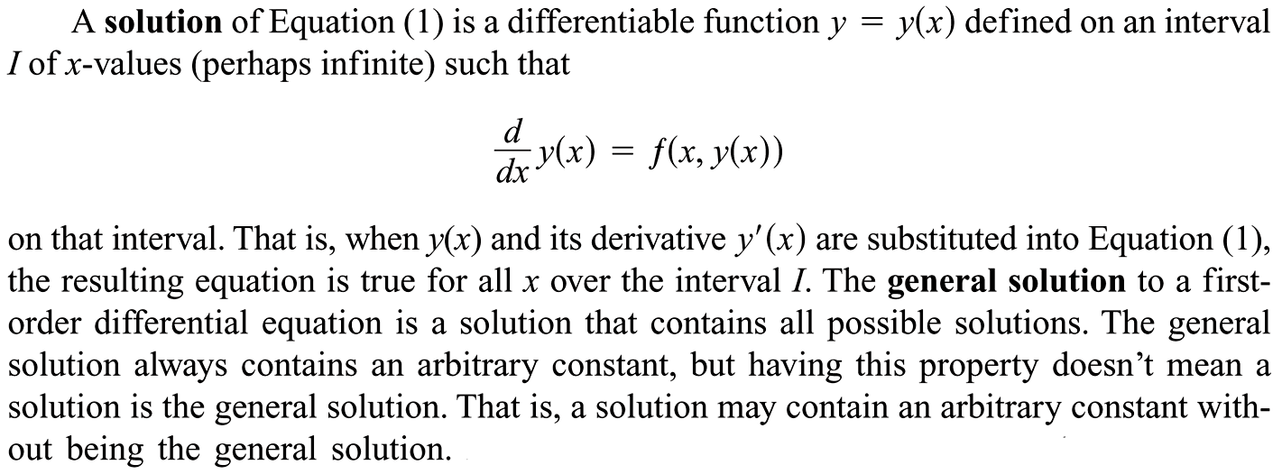

Slide 5


Slide 6









Slide 7


Slide 8
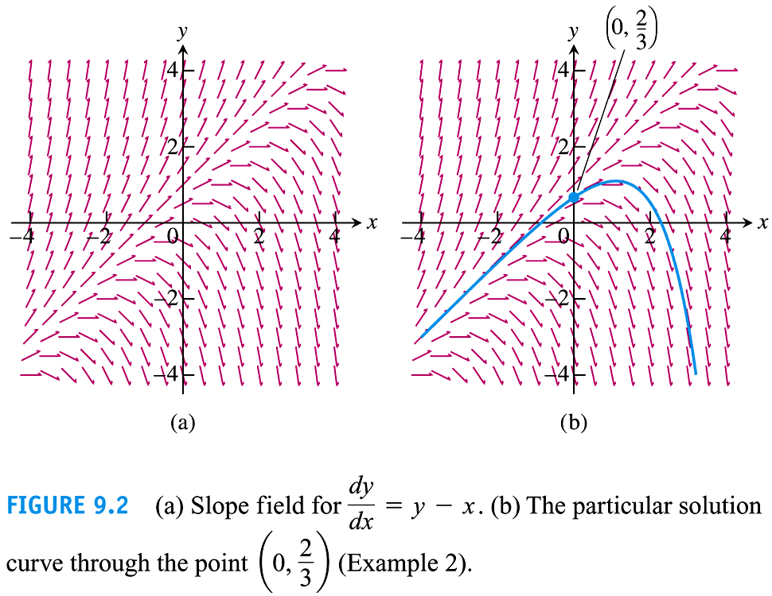

Slide 9
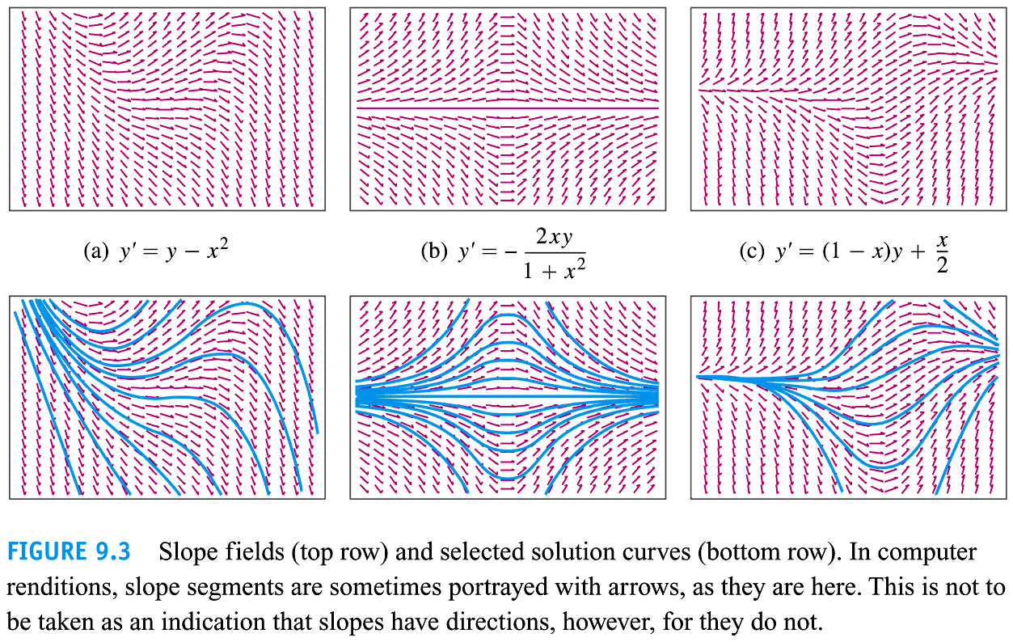

Slide 10


Slide 11




Slide 12
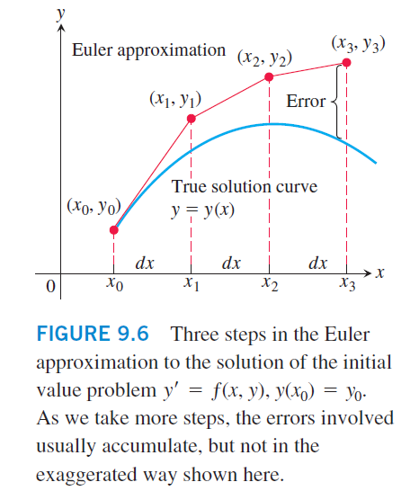
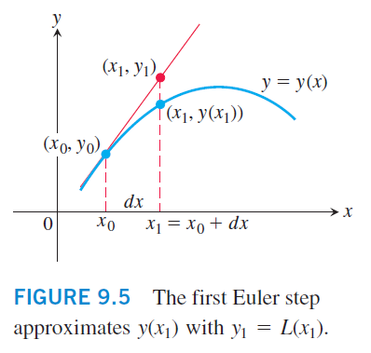

Slide 13






Slide 14

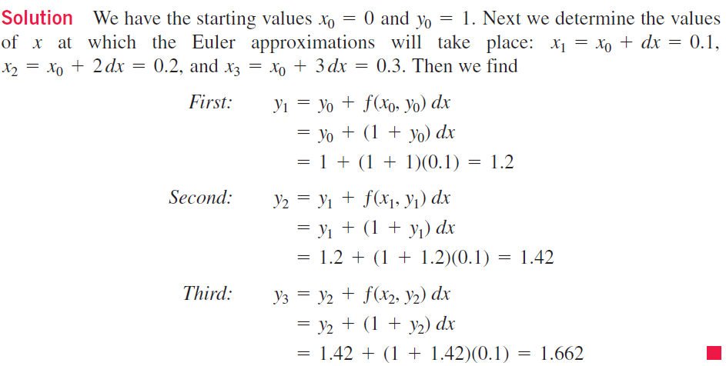

Slide 15


Slide 16
9.2
First-Order Linear Equations
Copyright © 2010 Pearson Education, Inc. Publishing as Pearson Addison-Wesley

Slide 17






Slide 18
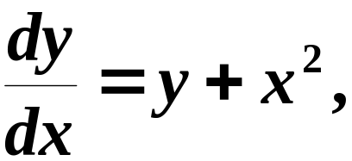
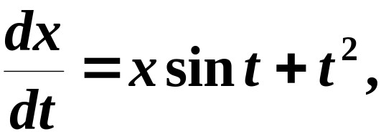




非线性的.

Slide 19


Slide 20
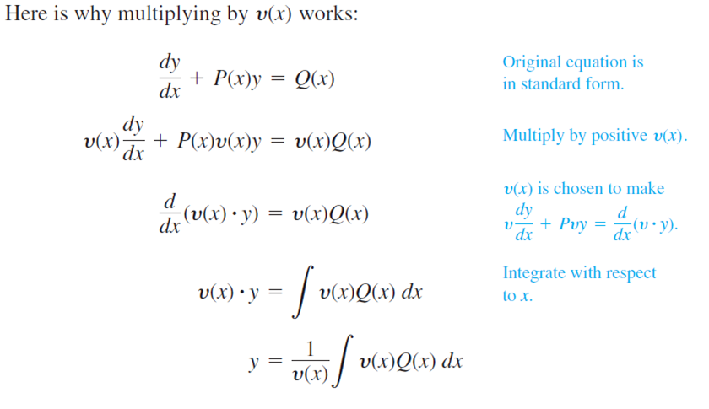

Slide 21











Slide 22








Slide 23
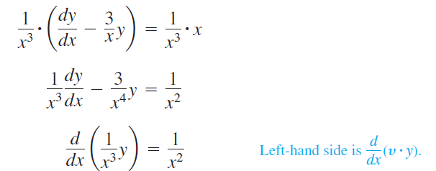




Slide 24






Slide 25









Slide 26
9.3
Applications
Copyright © 2010 Pearson Education, Inc. Publishing as Pearson Addison-Wesley

Slide 27




Slide 28









Slide 29




Slide 30




Slide 31

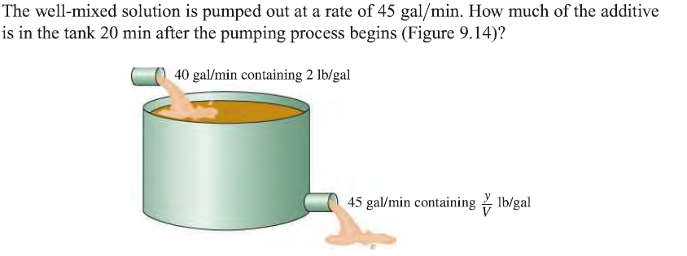


Slide 32
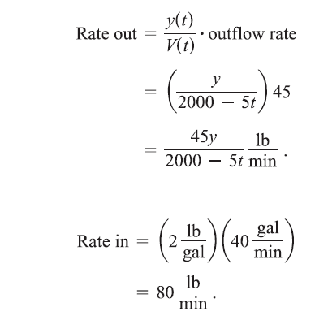


Slide 33




Slide 34
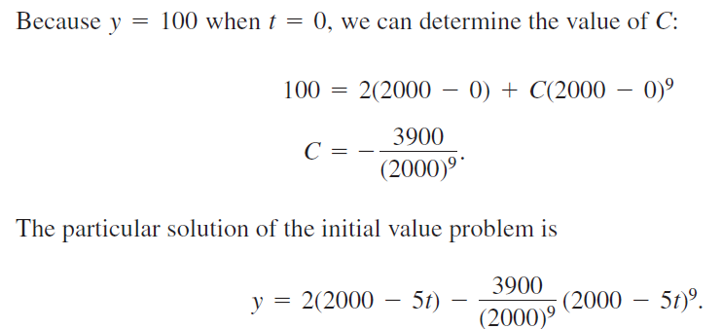


Slide 35
9.4
Graphical Solutions of
Autonomous Equations
Copyright © 2010 Pearson Education, Inc. Publishing as Pearson Addison-Wesley

Slide 36



Slide 37



Slide 38


Slide 39




Slide 40






Slide 41



Slide 42
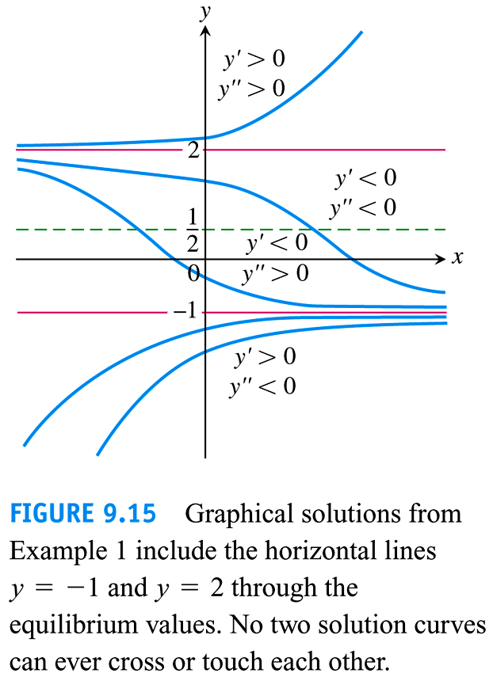

Slide 43


Slide 44
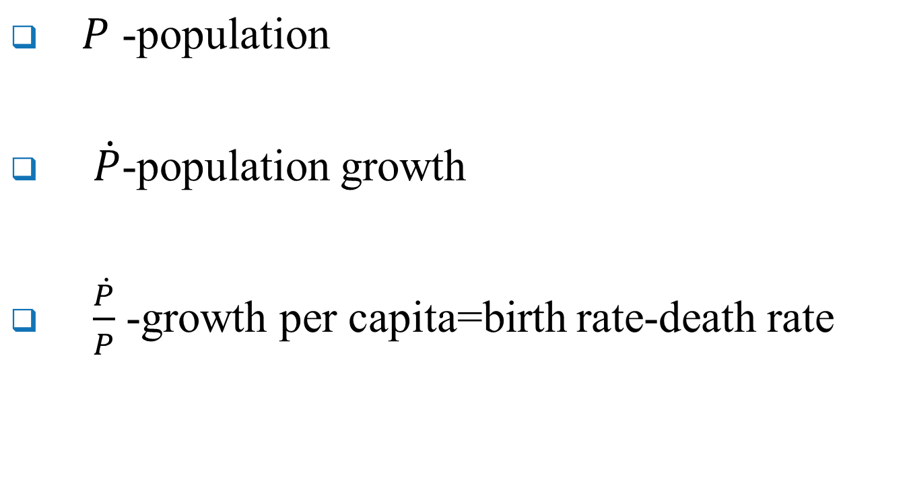
The Logistic Map-The Population Growth Model

Slide 45


Assume
We have to use a modified model due to limitation on natural source.

Slide 46



Slide 47

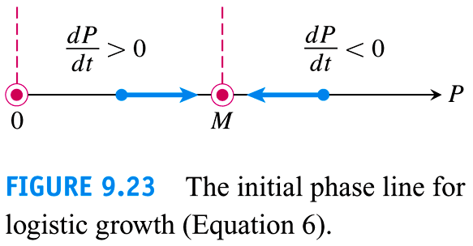

Slide 48


Slide 49
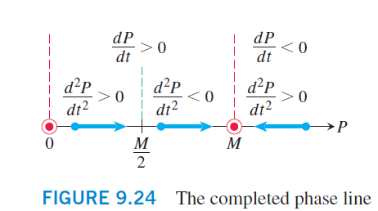


Slide 50
