Slide 1
Home Hub
Team 5: Jiaxin He, Yan Huang, Sha Liu

Slide 2
Intention:
We want to develop a website to provide various home services:
We hope this website can provide customers with various services
When the customer’s home has some problems, this website can provide repairs
Of course this website also sells some tools
In order to complete the ecology, it is also equipped with Reviews and Contact to facilitate interaction between customers and employees
Notes:
我们想做开发一个网址提供多方面居家服务，
我们希望这个网址能够为顾客提供各种服务
当顾客的家里出现了一些问题，这个网址可以提供维修
当然这个网址也出售一些工具
为了生态的齐全，还配备了Reviews和Contact方便顾客与员工interact
We want to develop a website to provide various home services,
We hope this website can provide customers with various services
When the customer’s home has some problems, this website can provide repairs
Of course this website also sells some tools
In order to complete the ecology, it is also equipped with Reviews and Contact to facilitate interaction between customers and employees

Slide 3


Home Page
We want to have a simple but not easy home page

Slide 4

Main Function
03
Tools are also sold in this website targeting on those who have sorts of abilities that fixes stuffs but lack of tools
Services is something we can do beyond the repair
01
Repair is the most direct service that can be provided to customers, and one of the main projects.
02
04
Reviews and contact are the most direct way to get in touch with the provider and customers

Slide 5
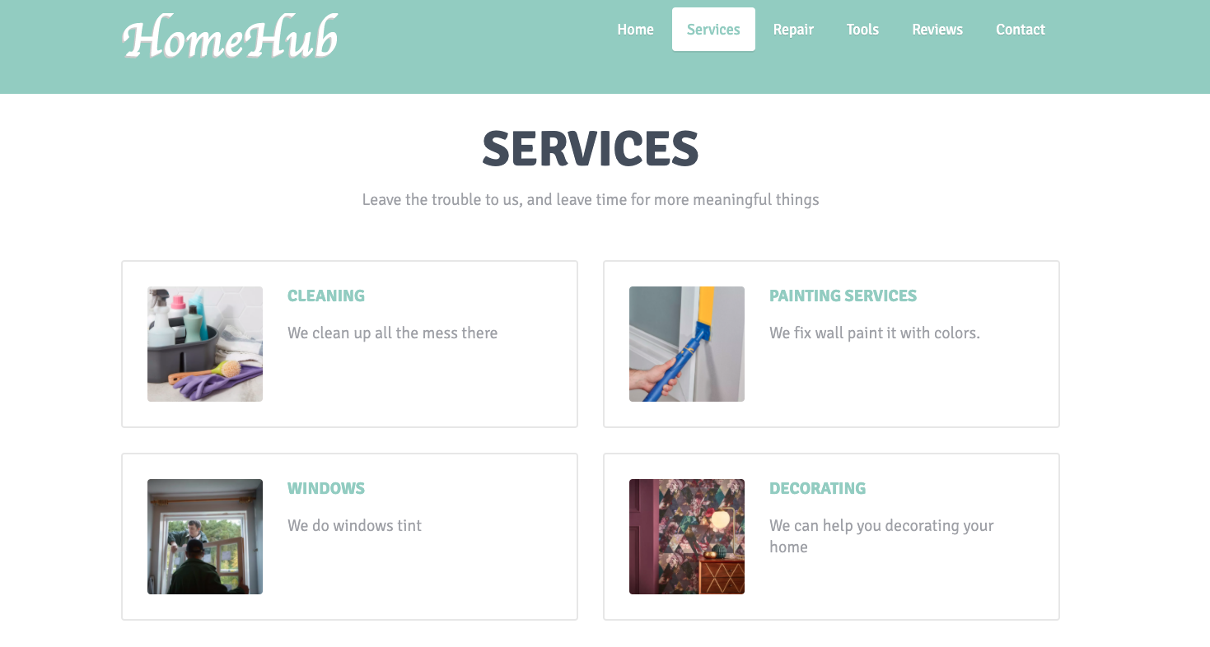
Services
Beyond Repair
Collect Request in MongoDB
Review by staff and send quote back
Notes:
In addition to repair, Homehub can also provide a variety of services that can cover all aspects of customers. Considering that these will be very personalized services, we consider setting up a personalized evaluation service for customers in each service. In the future, we can say that each requirement is stored in mongodb and reviewed by back-end staff
除了repair之外，Homehub还能够提供各种各样的服务，能够让服务覆盖到顾客的方方面面。考虑到这些将会是非常个性化的服务，我们考虑在每一个服务中都设置给顾客个性化估价服务，未来可以讲每一个需求储存在mongodb中由后台人员审核

Slide 6
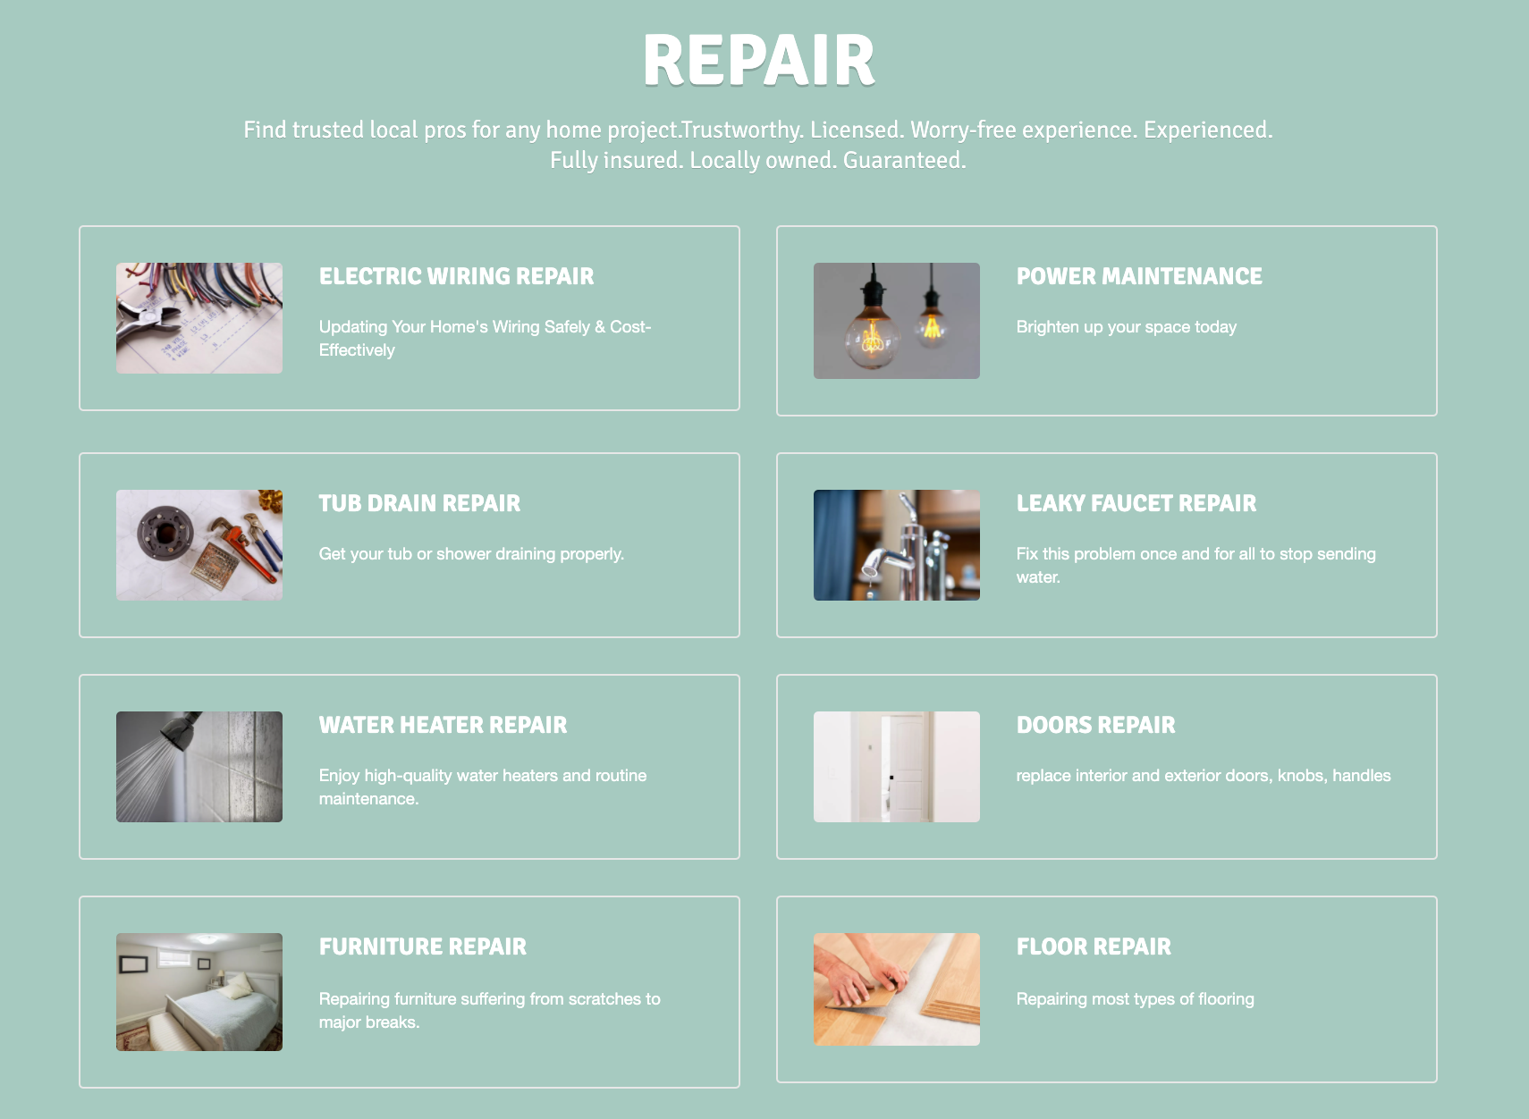
Repair
Main function of this website
all requests will be recorded and tracked
Notes:
Repair是一项最直接的能够提供给顾客的服务，也是主打项目之一，将会有多种细节化的维修方向供给顾客选择，并且所有的请求都会被后台记录跟踪。
Repair is the most direct service that can be provided to customers, and one of the main projects. There will be a variety of detailed repair directions for customers to choose, and all requests will be recorded and tracked by the background.

Slide 7
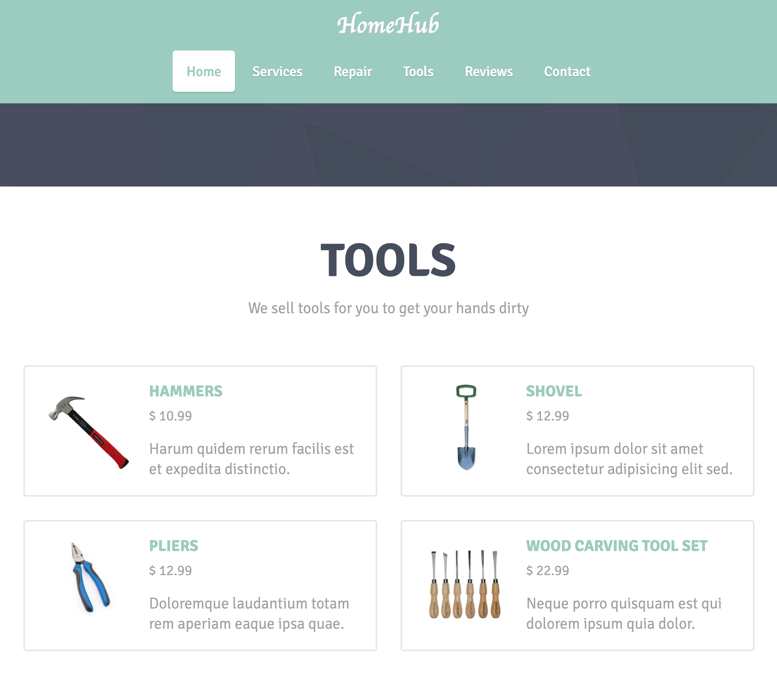
Tools
Sales for earn profit
Transaction in MySQL
Notes:
商品买卖是一种最直接的变现方式，同时还鼓励顾客在有能力的时候自己动手。还有考虑到我们的忠实顾客可能需要一些小工具为自己的物品进行维护。每一笔交易将会储存在MySQL中便于管理。
Trading is one of the most direct ways to earn profit, and it also encourages customers to do it themselves when they have the ability. Also consider that our loyal customers may need some gadgets to maintain their items. Each transaction will be stored in MySQL for easy management.

Slide 8
Thank You

