Slide 1



WC2O24
View in Power BI
Last data refresh:
11/17/2024 10:42:10 AM UTC
Downloaded at:
11/17/2024 10:51:20 AM UTC

Slide 2
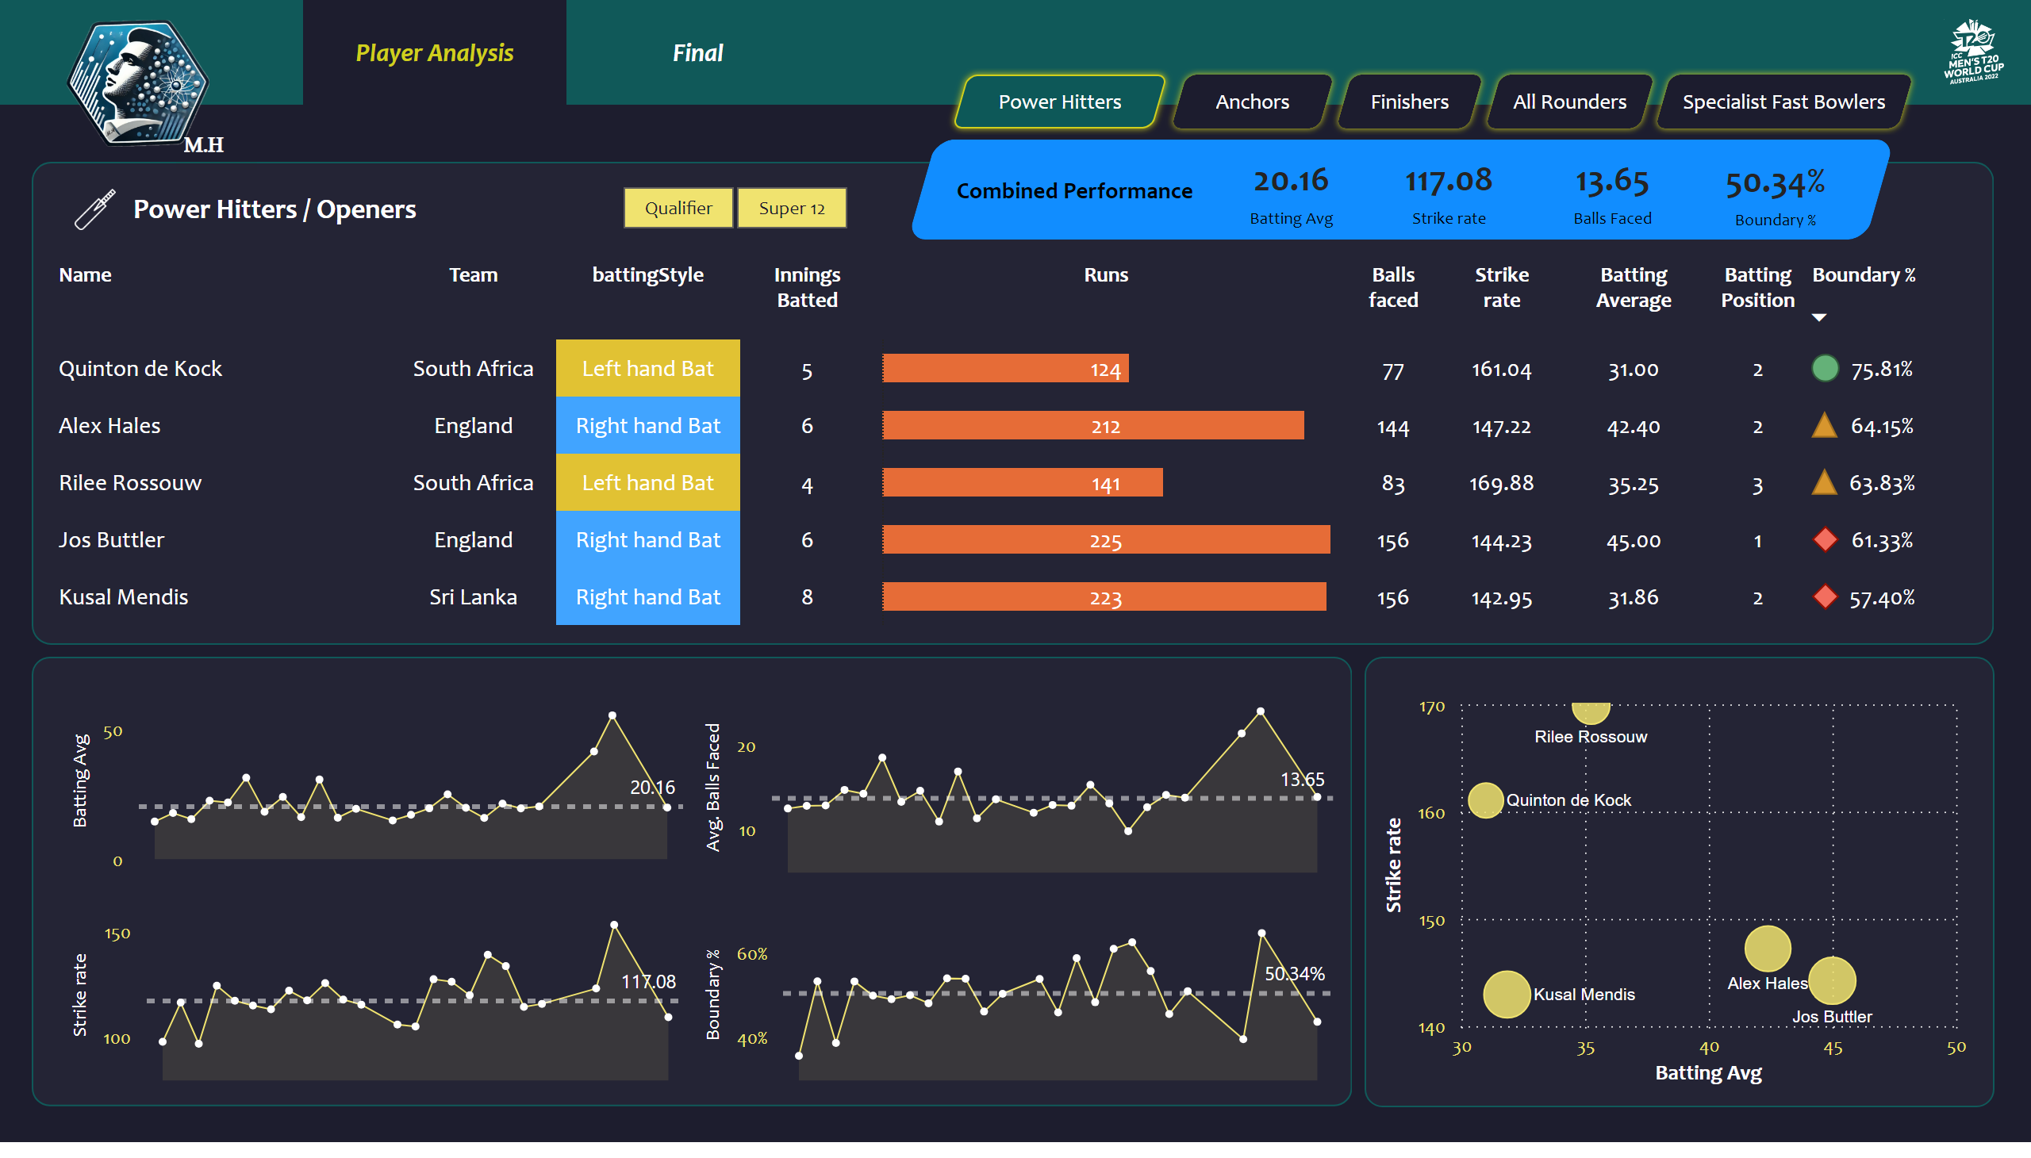
Project - Sportan
Notes:
slicer
No alt text provided
image
No alt text provided
shape
No alt text provided
actionButton
No alt text provided
actionButton
No alt text provided
actionButton
No alt text provided
actionButton
No alt text provided
actionButton
No alt text provided
shape
No alt text provided
shape
No alt text provided
card
No alt text provided
card
No alt text provided
card
No alt text provided
card
No alt text provided
shape
No alt text provided
areaChart
No alt text provided
shape
No alt text provided
areaChart
No alt text provided
areaChart
No alt text provided
areaChart
No alt text provided
shape
No alt text provided
image
No alt text provided
shape
No alt text provided
tableEx
No alt text provided
scatterChart
No alt text provided
Button Player Ana selected
No alt text provided
Button Player Ana selected
No alt text provided
image
No alt text provided
textbox
No alt text provided

Slide 3
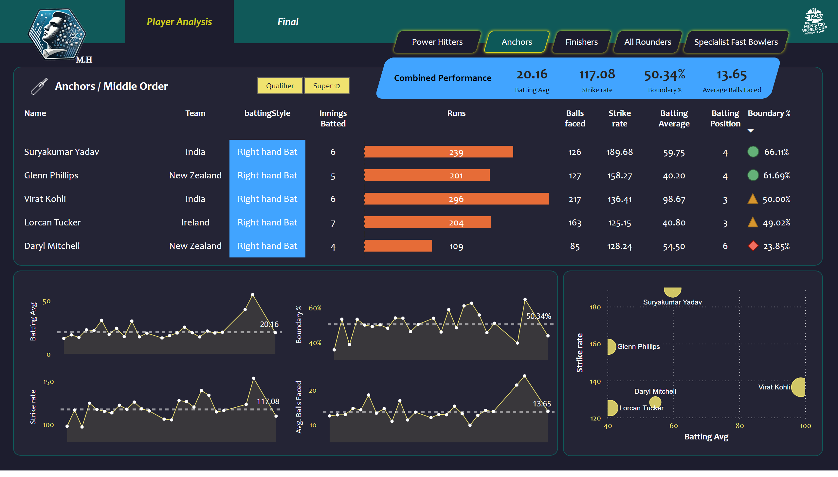
Anchors / Middle Order
Notes:
slicer
No alt text provided
image
No alt text provided
shape
No alt text provided
actionButton
No alt text provided
actionButton
No alt text provided
actionButton
No alt text provided
actionButton
No alt text provided
actionButton
No alt text provided
shape
No alt text provided
shape
No alt text provided
card
No alt text provided
card
No alt text provided
card
No alt text provided
card
No alt text provided
shape
No alt text provided
areaChart
No alt text provided
shape
No alt text provided
areaChart
No alt text provided
areaChart
No alt text provided
areaChart
No alt text provided
shape
No alt text provided
image
No alt text provided
shape
No alt text provided
tableEx
No alt text provided
scatterChart
No alt text provided
Button Player Ana selected
No alt text provided
Button Player Ana selected
No alt text provided
image
No alt text provided
textbox
No alt text provided

Slide 4
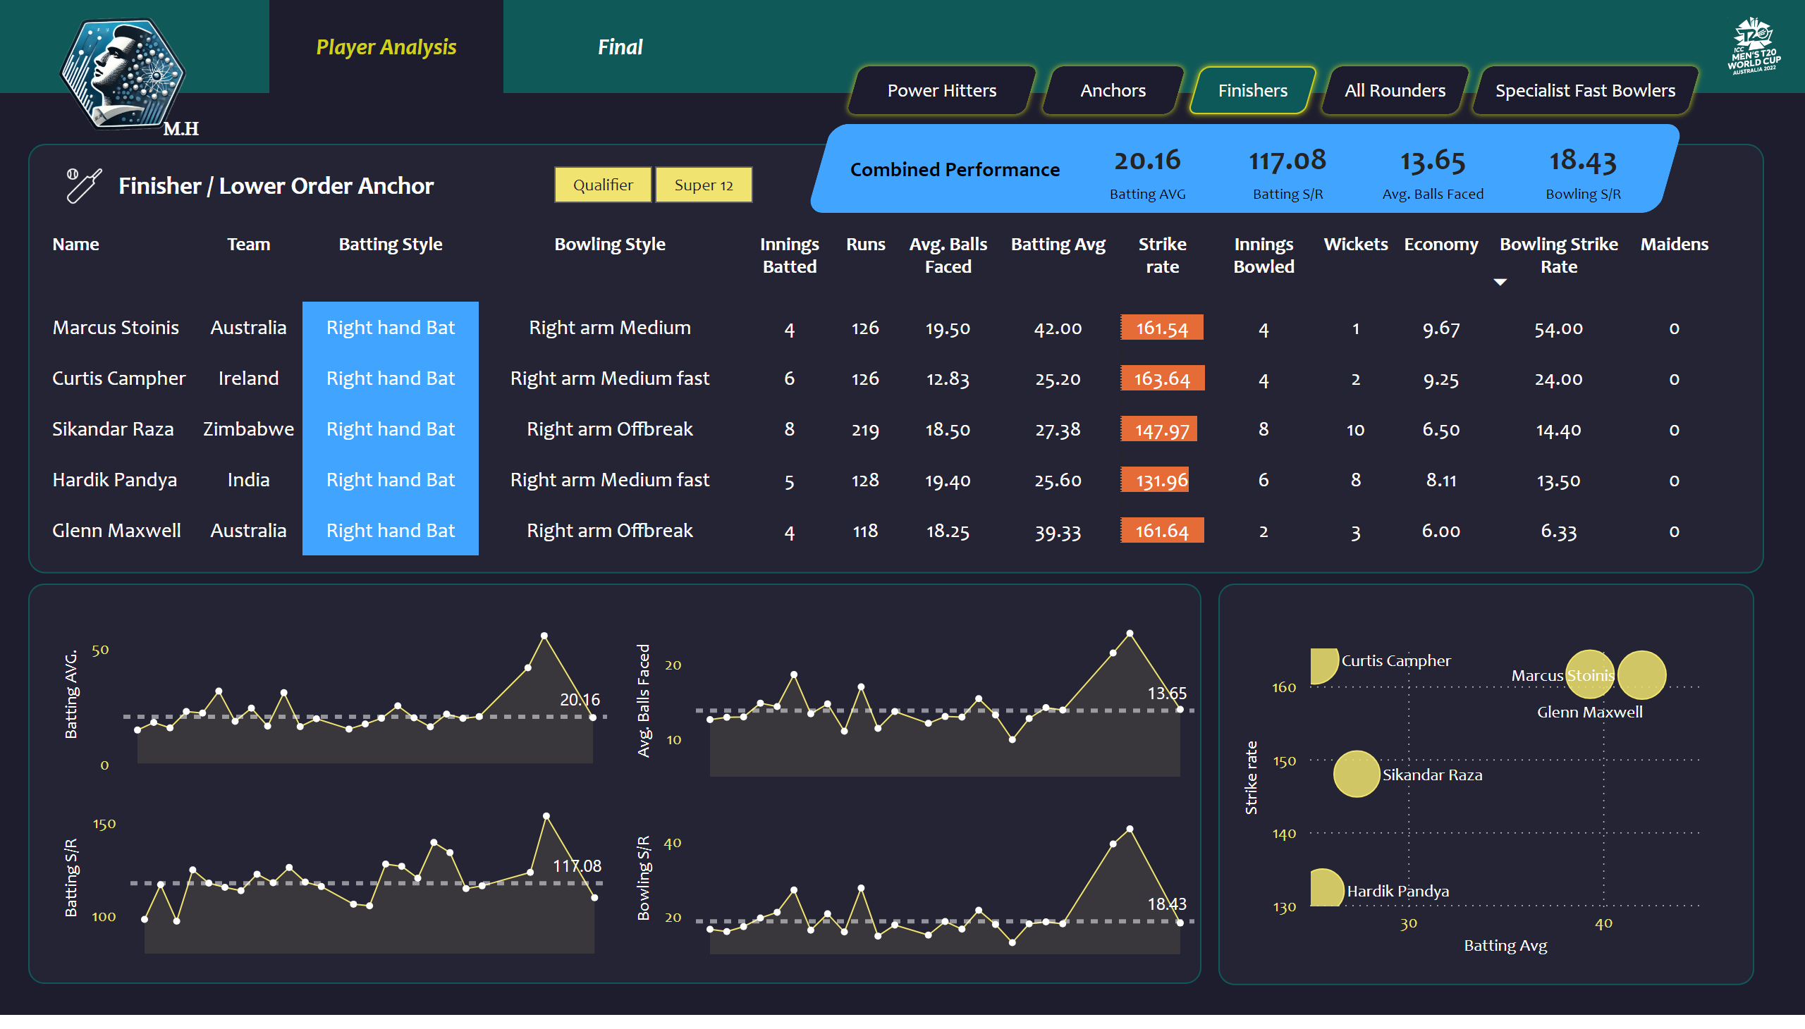
Finisher / Lower Order Anchor
Notes:
tableEx
No alt text provided
slicer
No alt text provided
image
No alt text provided
image
No alt text provided
shape
No alt text provided
shape
No alt text provided
actionButton
No alt text provided
actionButton
No alt text provided
actionButton
No alt text provided
actionButton
No alt text provided
actionButton
No alt text provided
shape
No alt text provided
shape
No alt text provided
card
No alt text provided
card
No alt text provided
card
No alt text provided
card
No alt text provided
shape
No alt text provided
areaChart
No alt text provided
shape
No alt text provided
areaChart
No alt text provided
areaChart
No alt text provided
areaChart
No alt text provided
shape
No alt text provided
scatterChart
No alt text provided
Button Player Ana selected
No alt text provided
Button Player Ana selected
No alt text provided
image
No alt text provided
textbox
No alt text provided

Slide 5
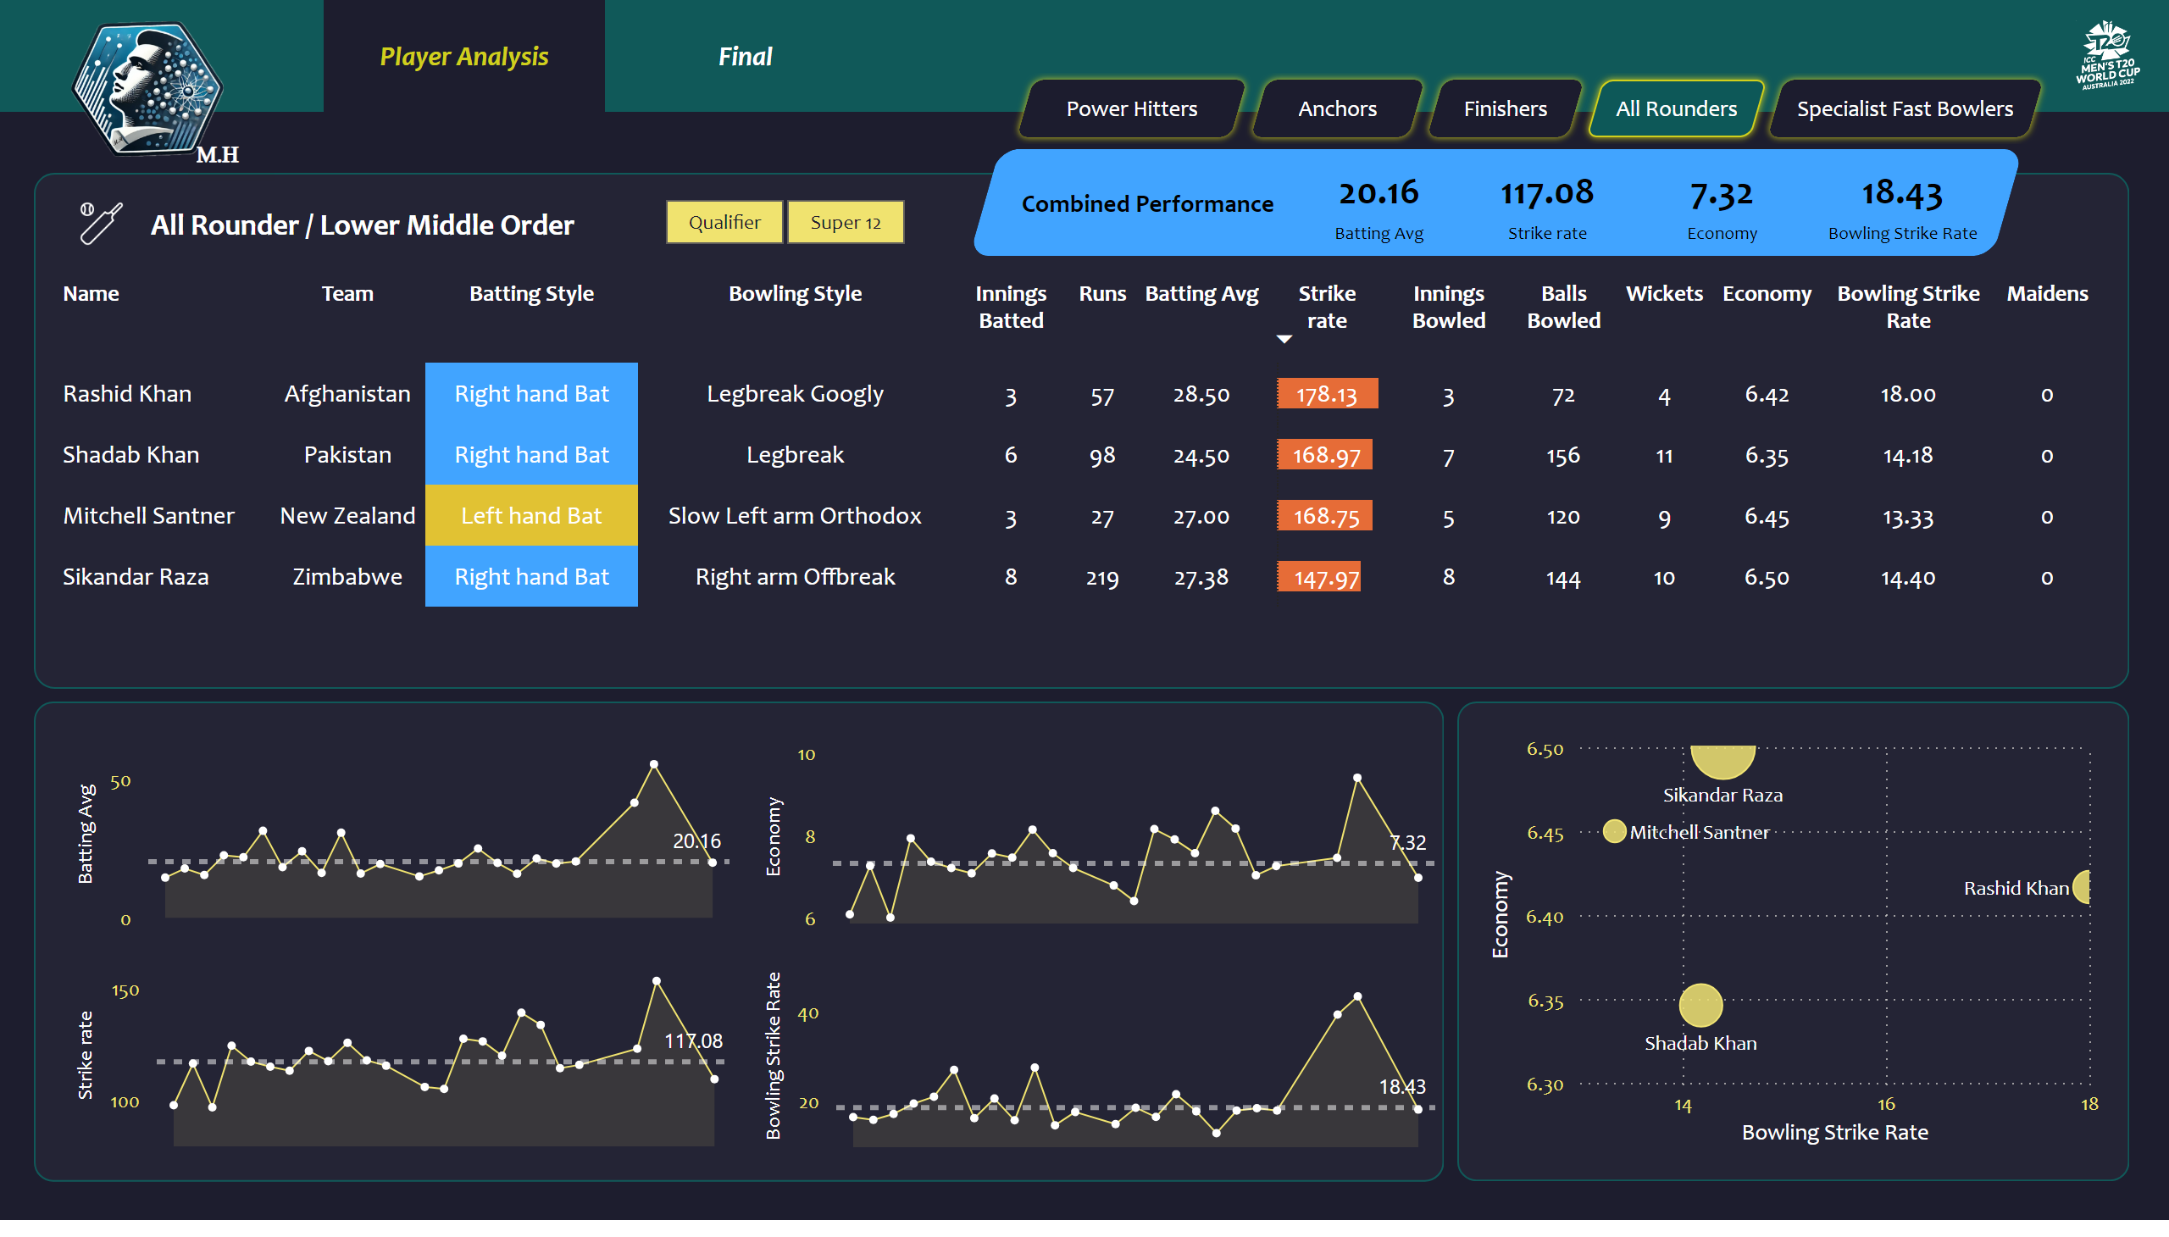
All Rounders / Lower Middle Order
Notes:
tableEx
No alt text provided
slicer
No alt text provided
image
No alt text provided
image
No alt text provided
shape
No alt text provided
shape
No alt text provided
actionButton
No alt text provided
actionButton
No alt text provided
actionButton
No alt text provided
actionButton
No alt text provided
actionButton
No alt text provided
shape
No alt text provided
shape
No alt text provided
card
No alt text provided
card
No alt text provided
card
No alt text provided
card
No alt text provided
shape
No alt text provided
areaChart
No alt text provided
shape
No alt text provided
areaChart
No alt text provided
areaChart
No alt text provided
areaChart
No alt text provided
shape
No alt text provided
scatterChart
No alt text provided
Button Player Ana selected
No alt text provided
Button Player Ana selected
No alt text provided
image
No alt text provided
textbox
No alt text provided

Slide 6
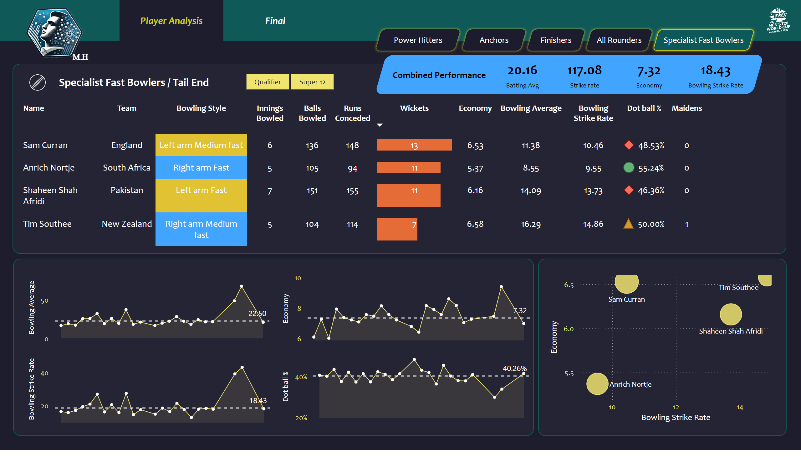
Specialist Fast Bowlers / Tail End
Notes:
tableEx
No alt text provided
slicer
No alt text provided
image
No alt text provided
shape
No alt text provided
Button Anchores
No alt text provided
Button Power Hitters
No alt text provided
Button Finishers
No alt text provided
Button All Rounders
No alt text provided
Button Fast Bowler selected
No alt text provided
shape
No alt text provided
shape
No alt text provided
areaChart
No alt text provided
shape
No alt text provided
areaChart
No alt text provided
areaChart
No alt text provided
areaChart
No alt text provided
shape
No alt text provided
image
No alt text provided
shape
No alt text provided
scatterChart
No alt text provided
Button Player Ana selected
No alt text provided
Button Player Ana selected
No alt text provided
image
No alt text provided
card
No alt text provided
card
No alt text provided
card
No alt text provided
card
No alt text provided
shape
No alt text provided
textbox
No alt text provided

Slide 7
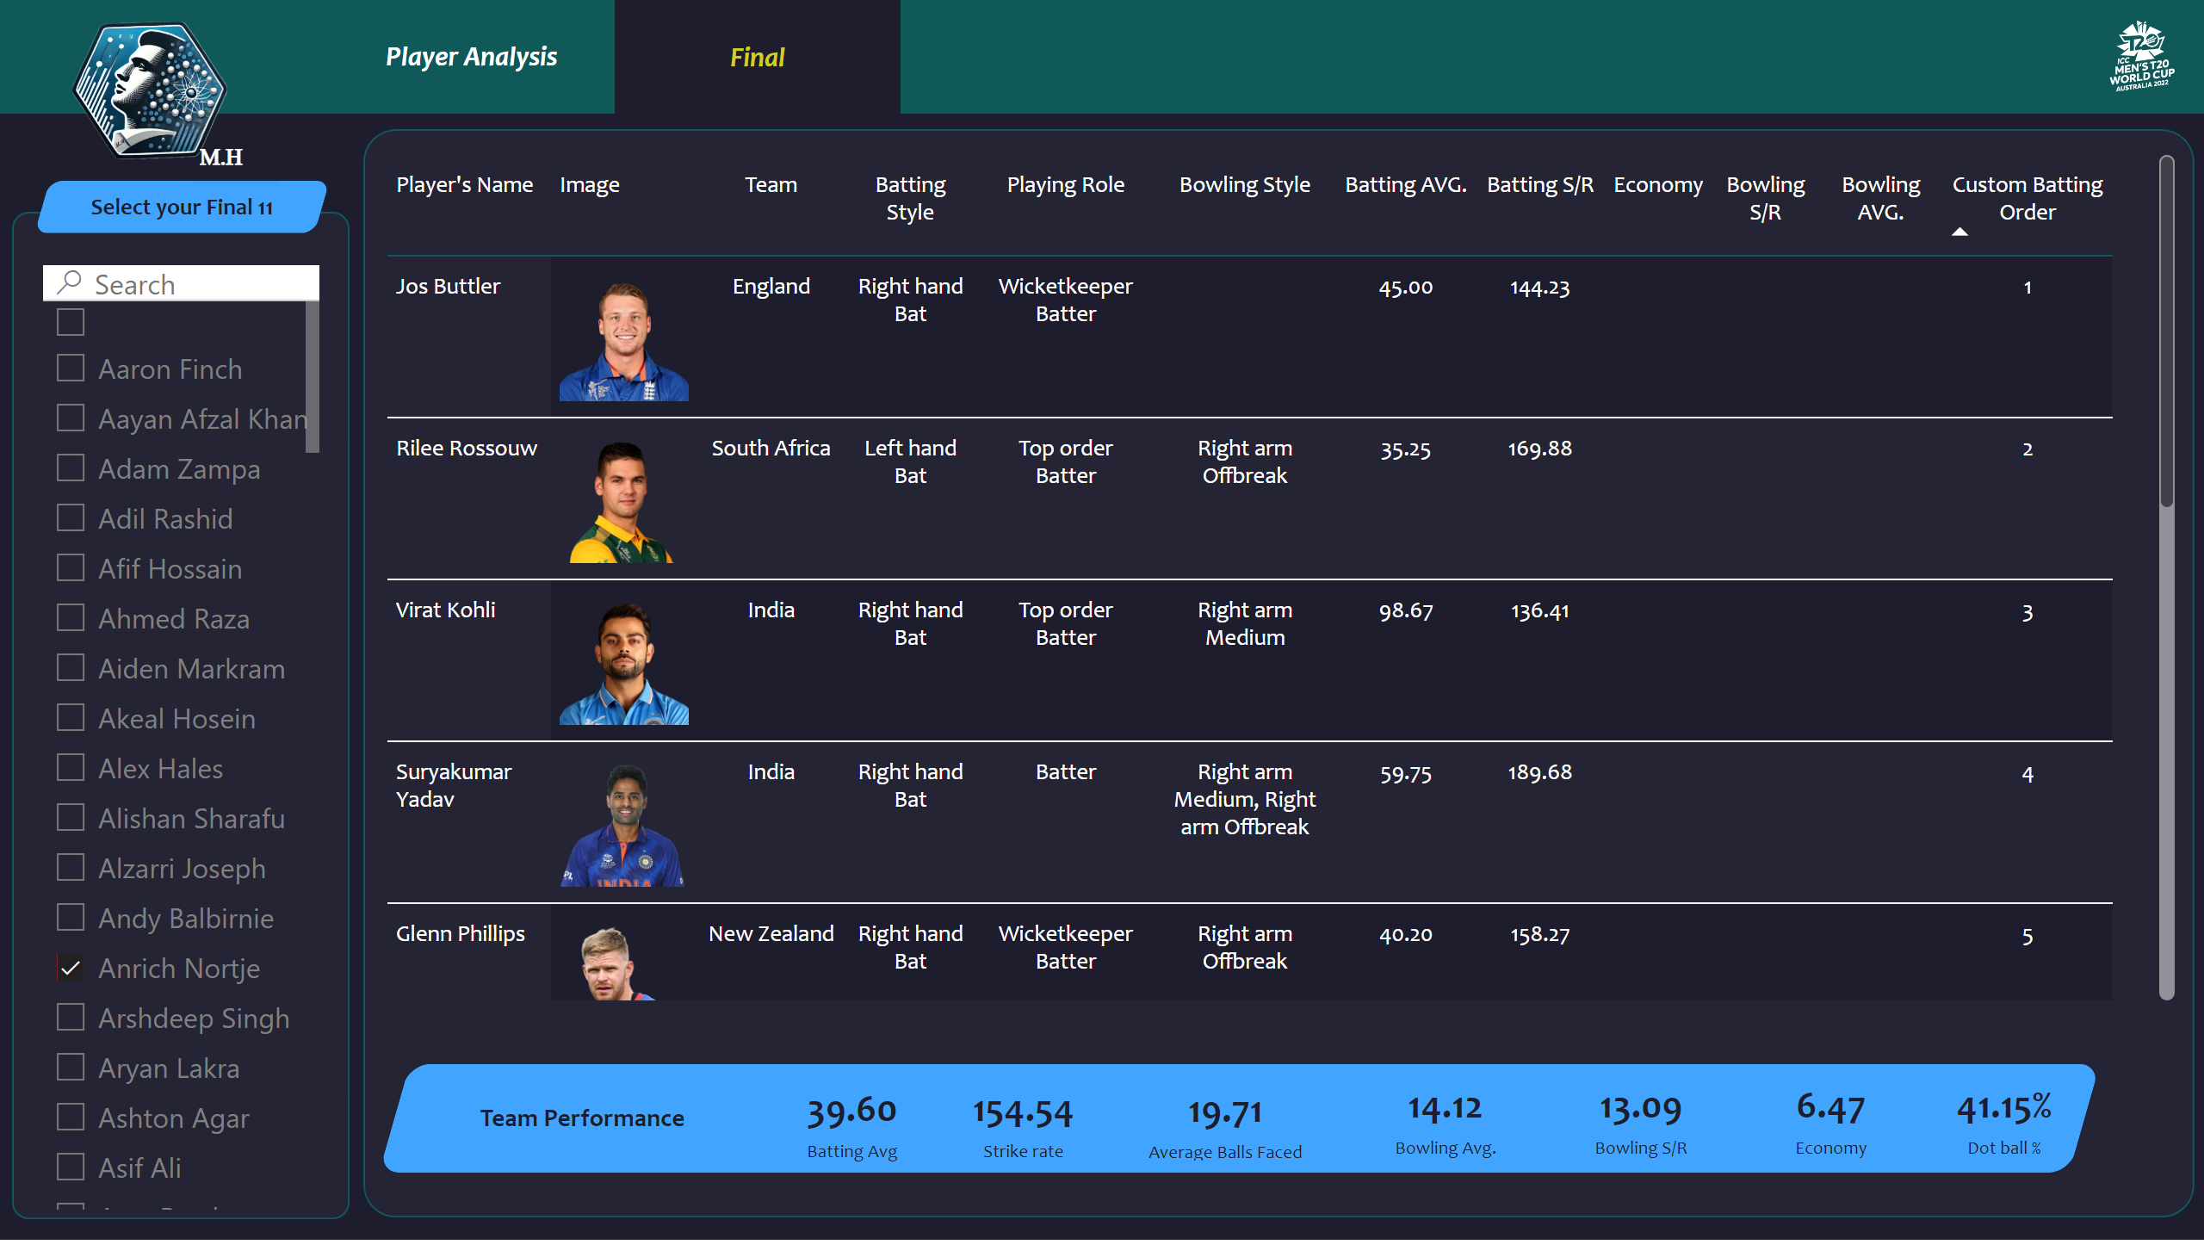
Final
Notes:
image
No alt text provided
shape
No alt text provided
shape
No alt text provided
Button Player Ana selected
No alt text provided
Button Player Ana selected
No alt text provided
slicer
No alt text provided
shape
No alt text provided
shape
No alt text provided
pivotTable
No alt text provided
shape
No alt text provided
card
No alt text provided
card
No alt text provided
card
No alt text provided
card
No alt text provided
card
No alt text provided
card
No alt text provided
card
No alt text provided
shape
No alt text provided
image
No alt text provided
textbox
No alt text provided

Slide 8

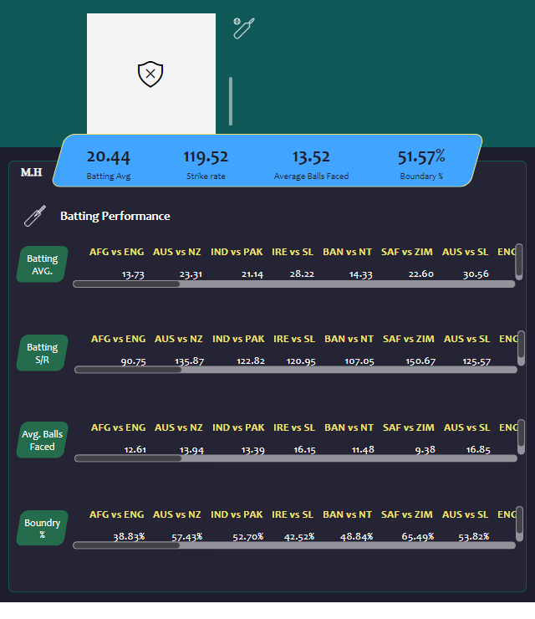



Batters- Player details
Notes:
textbox
No alt text provided
simpleImageEBC4593F96F1425FB3D84C5BF02B5075
No alt text provided
shape
No alt text provided
shape
No alt text provided
shape
No alt text provided
shape
No alt text provided
image
No alt text provided
shape
No alt text provided
card
No alt text provided
card
No alt text provided
card
No alt text provided
card
No alt text provided
shape
No alt text provided
shape
No alt text provided
shape
No alt text provided
shape
No alt text provided
shape
No alt text provided
pivotTable
No alt text provided
shape
No alt text provided
shape
No alt text provided
image
No alt text provided
pivotTable
No alt text provided
pivotTable
No alt text provided
pivotTable
No alt text provided
textbox
No alt text provided

Slide 9
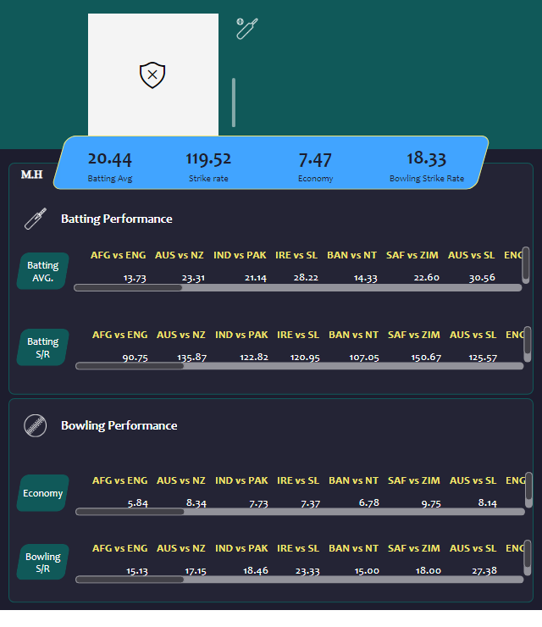
Rounder /Low
Notes:
textbox
No alt text provided
simpleImageEBC4593F96F1425FB3D84C5BF02B5075
No alt text provided
shape
No alt text provided
shape
No alt text provided
shape
No alt text provided
shape
No alt text provided
image
No alt text provided
shape
No alt text provided
card
No alt text provided
card
No alt text provided
card
No alt text provided
card
No alt text provided
shape
No alt text provided
shape
No alt text provided
shape
No alt text provided
shape
No alt text provided
shape
No alt text provided
shape
No alt text provided
shape
No alt text provided
image
No alt text provided
shape
No alt text provided
shape
No alt text provided
image
No alt text provided
pivotTable
No alt text provided
pivotTable
No alt text provided
pivotTable
No alt text provided
pivotTable
No alt text provided
textbox
No alt text provided

Slide 10
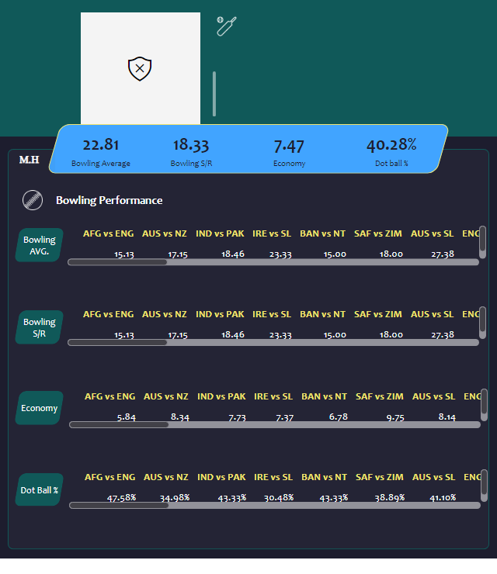
Bowler- Player details
Notes:
textbox
No alt text provided
simpleImageEBC4593F96F1425FB3D84C5BF02B5075
No alt text provided
shape
No alt text provided
shape
No alt text provided
shape
No alt text provided
shape
No alt text provided
image
No alt text provided
shape
No alt text provided
card
No alt text provided
card
No alt text provided
card
No alt text provided
card
No alt text provided
shape
No alt text provided
shape
No alt text provided
shape
No alt text provided
shape
No alt text provided
shape
No alt text provided
pivotTable
No alt text provided
shape
No alt text provided
shape
No alt text provided
image
No alt text provided
pivotTable
No alt text provided
pivotTable
No alt text provided
pivotTable
No alt text provided
textbox
No alt text provided

Slide 11
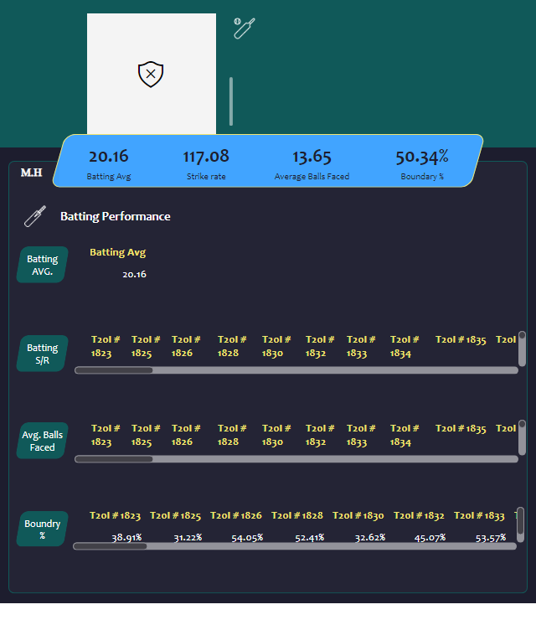
Duplicate of Batters- Player details
Notes:
textbox
No alt text provided
simpleImageEBC4593F96F1425FB3D84C5BF02B5075
No alt text provided
shape
No alt text provided
shape
No alt text provided
shape
No alt text provided
shape
No alt text provided
image
No alt text provided
shape
No alt text provided
card
No alt text provided
card
No alt text provided
card
No alt text provided
card
No alt text provided
shape
No alt text provided
shape
No alt text provided
shape
No alt text provided
shape
No alt text provided
shape
No alt text provided
pivotTable
No alt text provided
shape
No alt text provided
shape
No alt text provided
image
No alt text provided
pivotTable
No alt text provided
pivotTable
No alt text provided
pivotTable
No alt text provided
textbox
No alt text provided

