Slide 1
LibraryAdmin
Book borrowing system
Exam work 2022
Made by: Frantal Attila – Csányi Marianna

Slide 2
Introduction
The LibraryAdmin is a book rental system was made for to model the process of borrowing and returning books.
It records the datas of library members, books and movements with their quantity in the library.
It records all the facts with a timestamp. Displays book renters in a separate table.

Slide 3
Technical datas
The software was made by free licenced programs (JAVA JDK, NetBeans, XAMPP, MariaDB, DIA)
The program can be run on Windows 10, MAC IOS or Linux operating systems with any kind of browsers.
The software was made by JAVA 14.0.2 version.
The database manager is MariaDB 2.7.2.
The program is based on the RUP development method, it is iterative and incremental.
The software is designed in MVC model.
Software license is a trial version for school exam.

Slide 4
Installation and login
You can install the program as a user with administrator privileges. Copy the LibraryAdmin folder to the C: \ drive.
Run Xampp framework to build the database.
Run the C:\LibraryAdmin\dist\LibraryAdmin.exe
Complete the required registration and login.

Slide 5
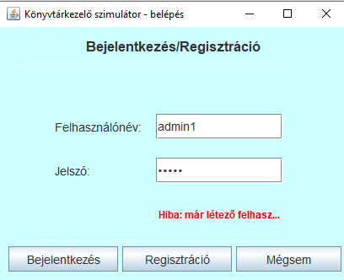
The registration is done by entering your username and password, when the program will notify the successful registration with "System info". There are possibilities for new registration with encrypted passwords. An existing user registration request an error message.

Slide 6
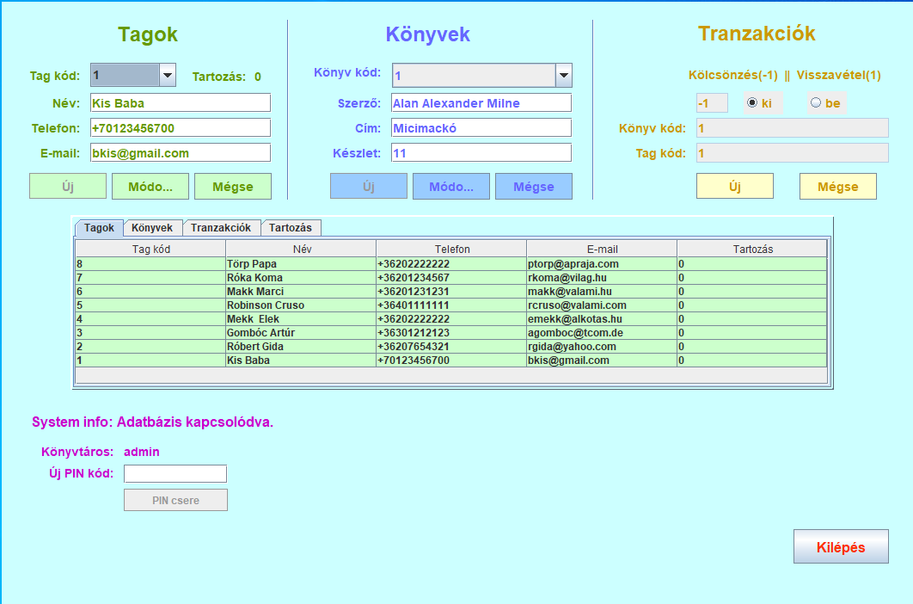
Librarian interface
If the database does not exists, then the program create it with the example datas as you can see.
The user password also can be changed here with „Új PIN kód:” (New PIN code) option.

Slide 7
The „Tagok/Könyvek/Tranzakciók” (Members / Books / Transactions) tabs cannot be edited directly on the table, it is only used to display the datas.
The datas are displayed order by ID descending, so by time descending.

Slide 8
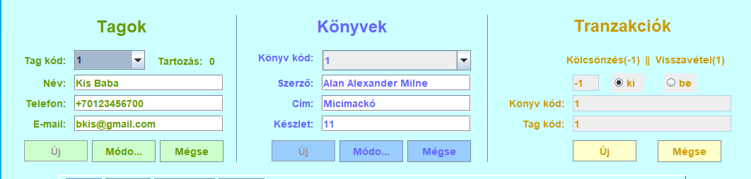
Manage members, books, transactions
Members are registered by name, phone and email address (all fields are required), and the code/id is created automatically.
Books are registered according to author, title, and stock quantity. All fields are required. The code/id of the book is generated automatically too.
Librarians can see all transactions of own perspective. A negative number shows a borrow, a positive number shows a return.
To clear the fields have to use „Mégse„ (cancel) button.
If a book is not available we get this message: „A könyv nincs készleten!" (The book is out of stock!)
When there are datas in „Tagok” (Members) or „Könyvel” (Books) fields „Új” (New) button is inactive to avoid double recording.

Slide 9

Store the transactions
We can check datas on tab „Tranzakciók”.
The „Könyvek„ (books) tab shows the current set of books.
Tab „Tartozás„ (debit) shows the list of borrowing.

Slide 10
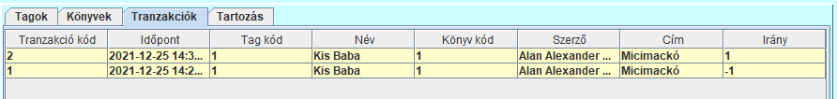
Returning
We can see all returnings on tab „Tranzakciók”.
On tab „Tartozás” datas are changes.
The program can be closed with the „Kilépés" button

Slide 11
User interface - web application
Installation and login
You can install the program as a user with administrator privileges. Copy the LibraryUser folder to C:\xampp\htdocs\php
Run Xampp framework to build the database.
Run the C:\LibraryAdmin\dist\LibraryAdmin.exe
Complete the required registration and login.
Open in a browser this surface: http://localhost/php/LibraryUser/index.php

Slide 12
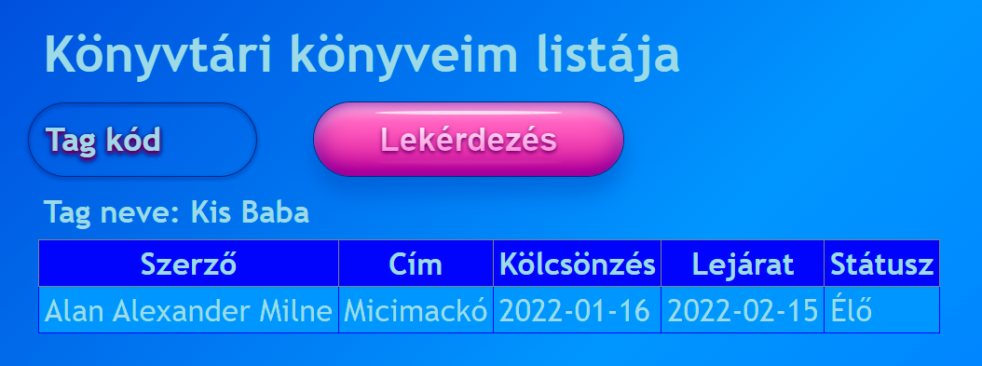
Options of query for members
There are opportunities for registered members to check their book debts and return details via web interface.

