Slide 1
LibraryUSER
Book borrowing system – USER PLATFORM
Exam work 2022
Made by: Csányi Marianna

Slide 2
Introduction
LibraryUser is a web interface for the LibraryAdmin book rental system that provides query capabilities to library members. It can be used by any browsers.
Members, who registered in LibraryAdmin Book Rental Database have the opportunity to remotely query their Library Debt informations and check their loan and return deadline via the LibraryUser web interface.

Slide 3
Technical datas
- The software was made by free licenced programs (Geany, XAMPP, MariaDB, DIA)
- The program can be run on Windows 10, MAC IOS or Linux operating systems with any kind of browsers.
- The software was made by PHP and CSS style description language.
- The database manager is MariaDB 2.7.2.
- Software license is a trial version for school exam.

Slide 4
Hardware and software requirements
A mid-range computer / tablet / mobile phone
4 GB RAM
2 GHz processor
3Gb free storage space
Windows 10 operating system.
Any browser.
MySQL server connection (Xampp framework)
Java environment installed
LibraryAdmin - library registration

Slide 5
Installation and login
- You can install the program as a user with administrator privileges. Copy the LibraryAdmin folder to the C:\xampp\htdocs\php folder.
- Run Xampp framework to build the database.
- Run the C:\LibraryAdmin\dist\LibraryAdmin.exe
- Open in a browser this link below: http://localhost/php/LibraryUser/index.php

Slide 6

After successful login, the program will ask for the membership code.

Slide 7

If you enter a non-existent member code, you will get an error message: „The member does not exists.”

Slide 8
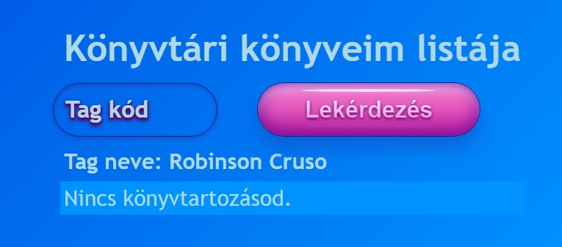
Query options
If the member does not have any debt the program displays a message: „You do not have any book debt!".

Slide 9
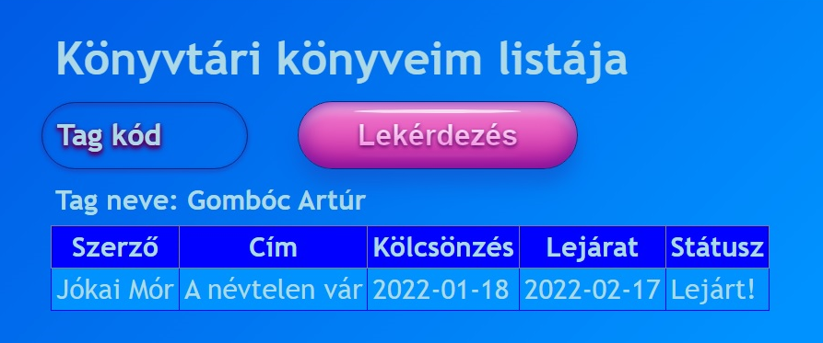
In case of expired rental, the expiration time can be checked.

Slide 10
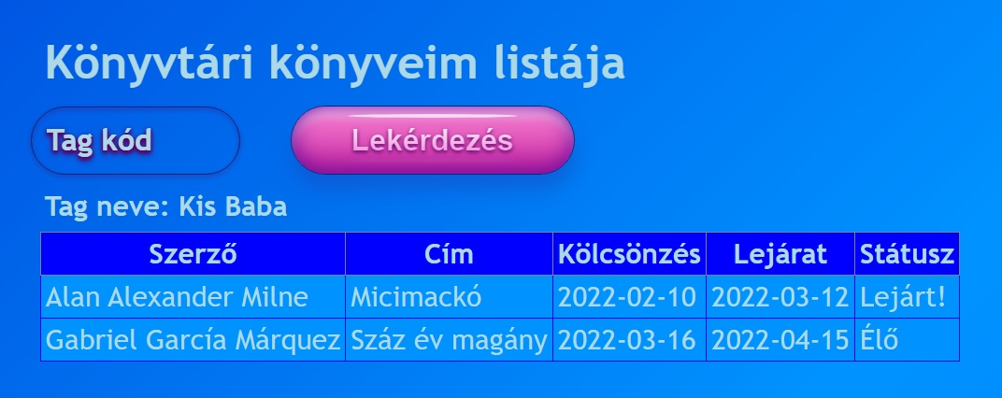
Library members can have both live and overdue debts.
You can exit the program by closing the browser.

Slide 11
Thank you for your attention!
As a development option, I suggest calculating and displaying the fee for overdue debts to the user.

